Slide 1

#WEARECISCO Cisco: Company Overview
The bridge to possible
[fiscalYear]
imimobile Integration PMO
November 22, 2021

Slide 2

Table of Contents
1
Company Overview
6
Cisco’s Commitment: Purpose
2
Cisco’s Strategy
7
Cisco impact programs
3
Cisco’s Commitment: Trust
8
Business Units - Products
4
Cisco’s Commitment: Innovation
9
Supporting Functions
5
Cisco’s Commitment: Choice
10
Links to additional resources

Slide 3


Company Overview
#WEARECISCO
Deck last updated on August 24, 2021

Slide 4

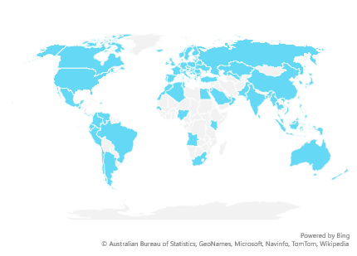
Cisco Global Presence
[totalRevenue]
[fiscalYear] revenue
78,700+
Employees
95
Countries
362
Offices globally
Notes:
Those 78,700 employees are across 362 different offices, driving nearly $50B in revenue.
Source: Cisco Key Facts & Figures
Link (Internal): https://spokesperson.cisco.com/#/content-detail/df16d068-2426-4fcd-b588-e9eac9c90906

Slide 5

FY21 Financials
[investments]
Total cash and investments
[totalRevenue]
Revenue
[productRevenue]
Product revenue
[serviceRevenue]
Services revenue
Notes:
In FY21, $36B of our revenue came from product revenue, and $13.8B came from services. We maintain $24.5B in total cash and investments.
Sources:
https://newsroom.cisco.com/press-release-content?type=webcontent&articleId=2190704
https://investor.cisco.com/financial-information/interactive-financials/default.aspx

