Slide 1
A Seminar on “Snapshot differential algorithm for data analysis using map reduce technique”

Slide 2
Agenda
Introduction
Existing System
Proposed System
Algorithms
Data Flow Diagram
System Architecture
Functional Requirement
Non-Functional Requirement
Advantages
Future Work

Slide 3
1. Introduction
Rapid development in retail stores
Data stored and processed by analytical database system is exploding
Analyst need real time usage information and they also need to dig out useful information
Our system will help in fast and efficient massive log processing and serve as an analysis tool to analyst

Slide 4
2. Existing System
RDBMS system
Cannot cope with problems with massive data
Limits when facing data beyond TB level
Performance of RDBMSs deceases sharply, which makes log data processing based on RDBMSs ineffective
Parallel DBMS
parallel databases meet the “performance property”
Do not score well on the fault tolerance
Can scale upto 10 node only

Slide 5
Proposed System
Analysis tool using Hadoop
Divide and conquer using snapshot differential algorithm
Hadoop is a framework designed for processing big data on large cluster built of commodity hardware
The Hadoop provides both reliability and efficiency
HDFS stores large files across machines in a large cluster

Slide 6
Algorithm
Map reduce
Map reduce break the process into two phases
Map step: Master node takes the input divide it into smaller sub problems and distribute them to worker nodes
Reduce step: Master node collects the answers to all the sub problem and combines them to get the output

Slide 7
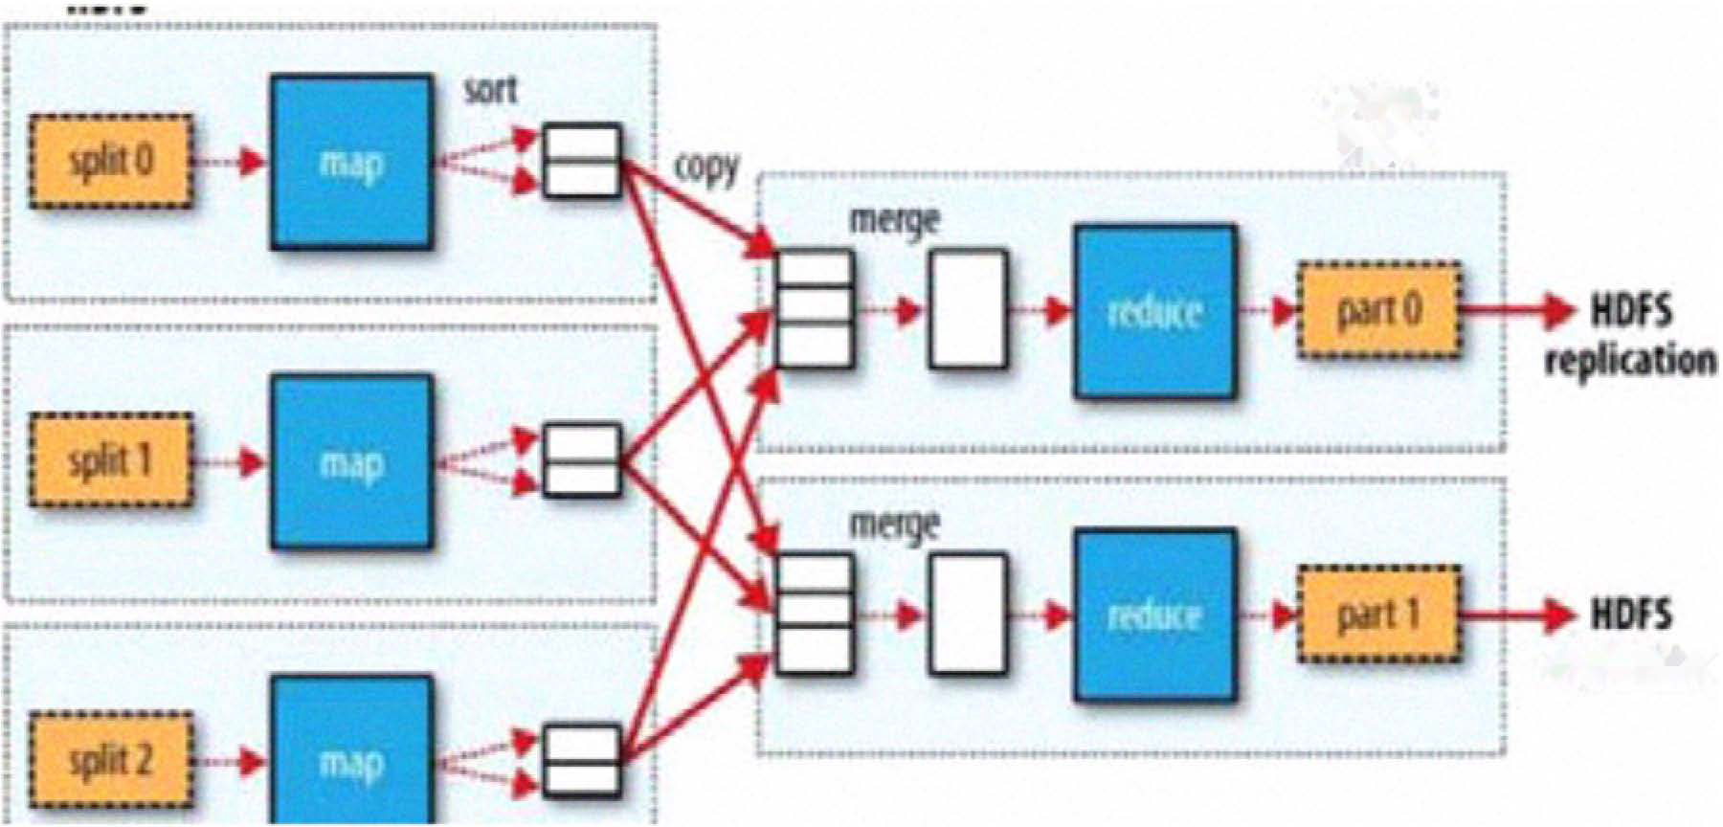
Algorithm
Map Reduce technique

Slide 8
Algorithm (continued)
Snapshot Differential Algorithm
View source snapshot as file containing a set of distinct records.{R1,R2,R3,.........Rn}where Ri denote the record
Ri is of the form <Ki,Bi>where ki is key and Bi is rest of the record representing one or more fields.
For snapshot differential problem we have two snapshot F1 and F2
Compare two snapshot to get delta (F1-F2)U(F2-F1) asoutput Fout i.e. of the form {R1,R2,R3,.........Rn}

Slide 9
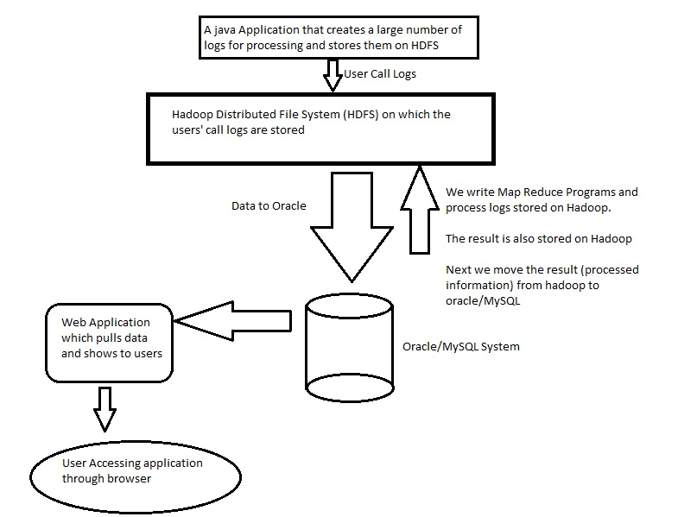
Data flow diagram

Slide 10
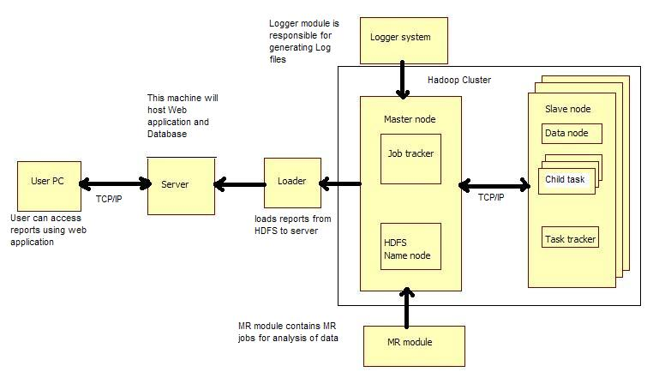
System Architecture

Slide 11
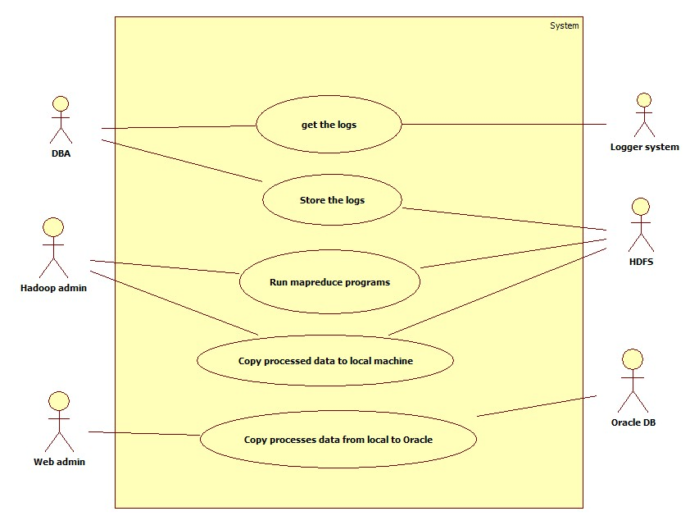
Use case diagram

Slide 12
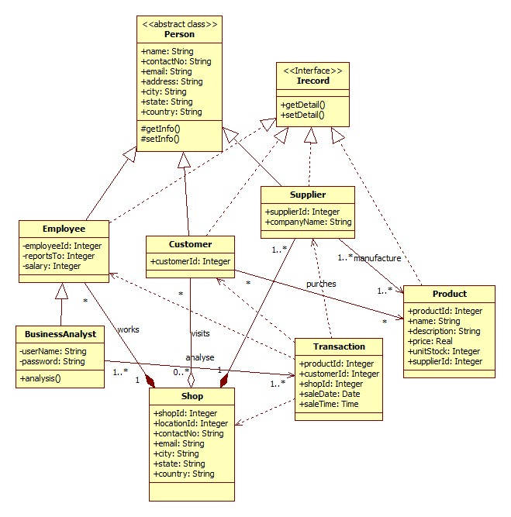
Class Diagram

Slide 13
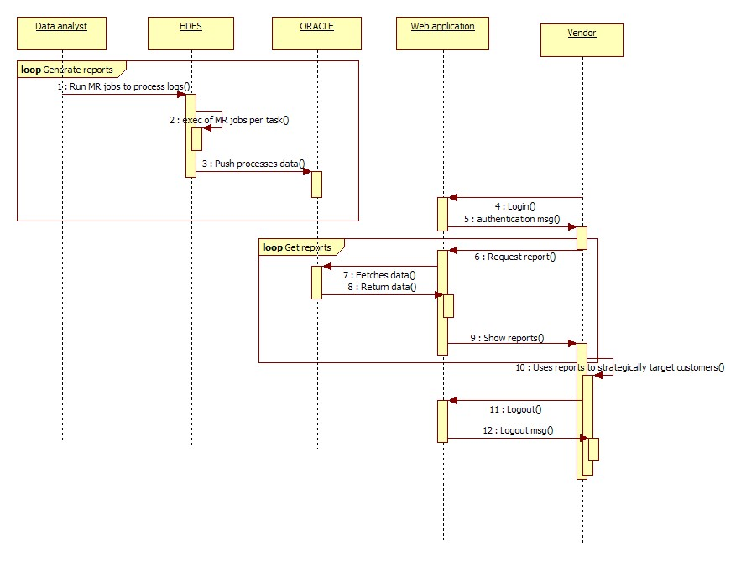
Sequence Diagram

Slide 14
Functional Requirement
Logger Module
To generate logs
MR Module
MR jobs for processing
UI Module
Provide analysis result to end user
Analysis Module
contains sub-modules for different type of analysis

Slide 15
Non-Functional Requirement
Performance
System can produce results faster when connected to more nodes
When work load increases no need to scale up existing system just add new node to system and it will perform as usual.
It may take more time for peak loads at main node.
Every node works independently to improve performance.
The system will be available 100% of the time. Once there is a fatal error, the system will provide understandable feedback to the user
Design Constrain:
Programing language:
Our System works on hadoop framework. We will use java . The system has to be designed JDK 6.0
Database
The system will use HDFS and Oracle for our databases.

Slide 16
System Requirement
Hardware:
Minimum 3 pc(node)
Processor: Intel Pentium and above
Memory: minimum of 1GB RAM
Hard disk of minimum 40 GB
Software:
Name: Apache Hadoop framework
Version Number: Version 0.20.2
Name: SQL- Server
Version Number: Version 7.0.1
Name: Internet Explorer
Version Number: Version 6 onward

Slide 17
Cost estimation
Equipment needs and costs: (Approximate)
At least three Intel machine Pentium III/Pentium IVs with Linux.(min: 1 GB RAM ) : 60,000 /-
LAN wire: 200/-
Hub: 700/-
TOTAL : 60,900 /-

Slide 18
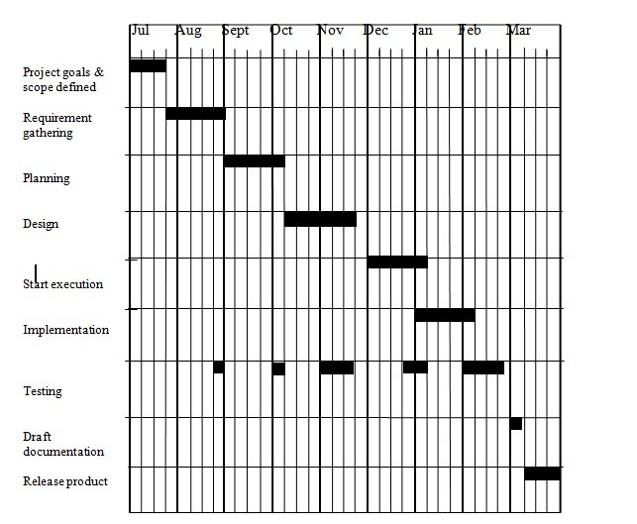
Gantt Chart

Slide 19
Contribution
Domain Analysis
Literature Survey
Mathematical Model
UML Diagram
System Architecture
Project Report

Slide 20
Advantages
Cost effective
Performance
Fault tolerance
Scalability
Helps in decision making
Hadoop is open source framework
Provides applications both reliability and data motion

Slide 21
Future Work
If we want to improve the efficiency, we can compress the snapshot, the output of Mapper and the output of Reducer
In addition, we can expand the scale of the Hadoop cluster and change the parameters of the cluster
The system can be modified to analyze data in different domains

Slide 22
References
[1]. Jing Bi, Zhiliang Zhu, Ruixiong Tian, and Qingbo Wang, 2010 IEEE 3rd International Conference on Cloud Computing (CLOUD), Miami, Florida, pp. 370–377, 2010.
[2]. Wilburt Juan Labio, Hector Garcia-Molina. Efficient Snapshot Differential Algorithms for Data Warehousing.
[3]. Ralf Lammel, Data Programmability Team. Google's MapReduce Programming Model-Revisited[R]. Redmond, WA, USA: Microsoft Corp. 2007.
[4]. Yun Tao Li. Design and Implementation of System Massive Data Processing Based on Hadoop[D]. Harbin: Harbin Institute of Technology, 2009.
[5]. Chuntao Li, Bo Liu. An Improvement on Window Snapshot Differential Algorithm. Computer Applications and Software. Vo1.27, No.4:P.I40- 142. 2010,4.

Slide 23
Thank You..!

