Slide 1
PROJECT REVIEW / JAVA WEB APPLICATION
Personal Finance
Manager
A practical workspace for tracking expenses, planning budgets, and keeping savings goals visible.
JAVA 11+ · SERVLETS + JSP · TOMCAT 9 · MYSQL 8
REVIEW DECK · 02 OCTOBER 2026
PERSONAL FINANCE MANAGER / PROJECT REVIEW
02 OCT 2026 · 01

Slide 2
01 / PRODUCT
Everyday money, in one focused workspace
Three connected jobs keep personal finance activity organized.
01 / EXPENSES
02 / BUDGETS
03 / GOALS
Track spending
Plan with budgets
Save toward goals
Record dated expenses with a category, amount, and optional description. Review or remove entries from your own list.
Set a category limit for a monthly or yearly period, then keep budget totals visible alongside spending.
Give a savings target a name, amount, and deadline so future priorities have a place in the plan.
CAPTURE
PLAN
REVIEW
One account → personal records → a dashboard that points to the next useful action
PERSONAL FINANCE MANAGER / PROJECT REVIEW
02 OCT 2026 · 02

Slide 3
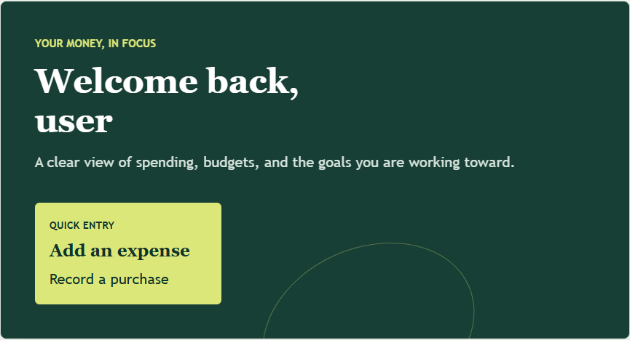
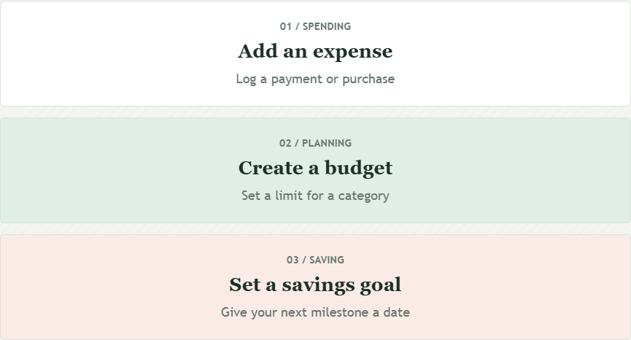
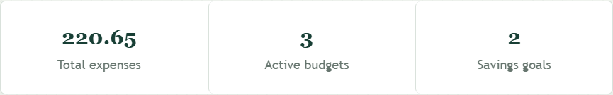
02 / EXPERIENCE
Dashboard, from welcome to next action
A composed view of three genuine dashboard regions from the running app.
QUICK ACTIONS
Visible role
The signed-in account and USER/ADMIN role remain easy to spot.
Linked totals
Expenses, budgets, and goals open their detail lists.
KPI VALUES USE TEMPORARY REVIEW DATA
PERSONAL FINANCE MANAGER / PROJECT REVIEW
02 OCT 2026 · 03

Slide 4
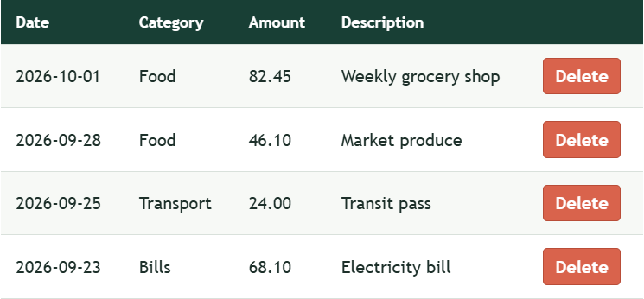
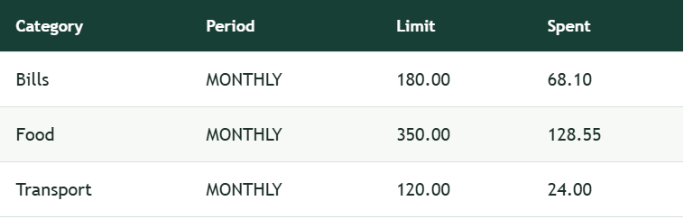
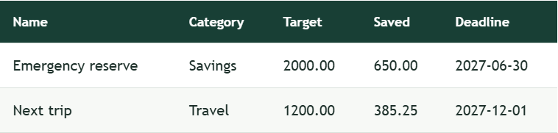
03 / DAILY WORKFLOWS
The detail pages make the records useful
Forms and lists keep entry simple and make saved data easy to review.
Expenses
Budgets
Goals
Date · category · amount · note
Period limits and stored spend
Targets · progress · deadline
The current user sees only their own records; admin reporting is a separate, role-guarded route.
PERSONAL FINANCE MANAGER / PROJECT REVIEW
02 OCT 2026 · 04

Slide 5
04 / ACCESS MODEL
Registration is open; admin creation is not
Role is assigned by the server and checked again on protected routes.
PUBLIC REGISTRATION
USER ACCOUNT
Registration always assigns USER
SHARED LOGIN
USER → DASHBOARD
role-aware redirect
ADMIN → ADMIN AREA
ADMIN-ONLY /admin
USER AREA
Create admin accounts · inspect cross-user records · reject non-admin sessions
Manage personal expenses, budgets, goals, and password
PERSONAL FINANCE MANAGER / PROJECT REVIEW
02 OCT 2026 · 05

Slide 6
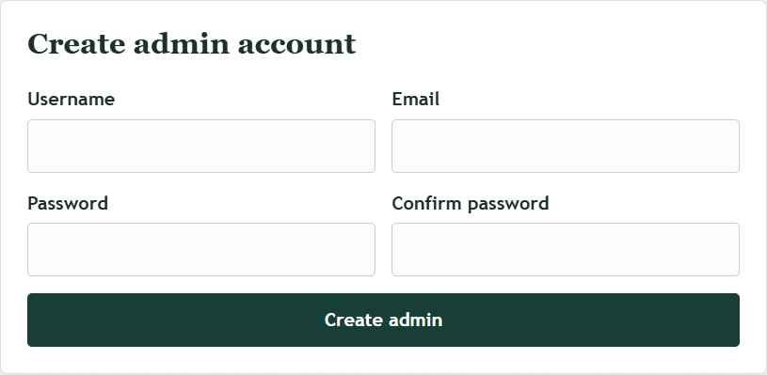
05 / ADMIN AREA
Admin tools are protected, not public
The admin route requires an authenticated ADMIN session before it can show the account form or records.
Create admin accounts
Only an existing administrator can create another admin login.
Review all records
The admin view lists users and cross-user finance records read-only.
Server-side guard
Unauthenticated visitors go to login; non-admin users receive 403.
SCREENSHOT CROPPED TO ACCOUNT-CREATION PANEL; USER EMAILS OMITTED
PERSONAL FINANCE MANAGER / PROJECT REVIEW
02 OCT 2026 · 06

Slide 7
06 / DATA MODEL
One account anchors three record types
Every finance record carries a user_id foreign key; personal queries filter by the signed-in owner.
expense
1 : many
id PK
app_user
user_id FK
id PK
date · category · amount · description
username UNIQUE
email UNIQUE
budget
password_hash
role
1 : many
id PK
created_at
user_id FK
category · period · limit · spent snapshot
goal
1 : many
id PK
MySQL · InnoDB · foreign keys · unique usernames and emails
user_id FK
name · target · saved · deadline
PERSONAL FINANCE MANAGER / PROJECT REVIEW
02 OCT 2026 · 07

Slide 8
07 / ARCHITECTURE
A compact MVC-style Java web stack
The WAR packages application code, JSP views, and runtime dependencies for Tomcat.
BROWSER
TOMCAT 9
SERVICES
REPOSITORIES
MYSQL 8
JSP pages
HTML forms
Servlet routes
Session checks
Auth rules
Business logic
JDBC queries
User-scoped data
app_user
expense · budget · goal
Java 11+ · Maven WAR · javax.servlet 4 · JSP/JSTL · JDBC + HikariCP
Login dispatches by role; controllers forward to JSPs under /views.
PERSONAL FINANCE MANAGER / PROJECT REVIEW
02 OCT 2026 · 08

Slide 9
08 / TRUST & SECURITY
The important boundaries are explicit
Security comes from server-side checks and data-scoped queries—not hidden UI controls.
AUTHORIZATION
CREDENTIALS
Role checks on protected routes
BCrypt password storage
AdminServlet checks the signed-in session role before showing data or creating admins.
PasswordUtil hashes passwords; password change checks the current password and requires 8+ characters.
DATA ISOLATION
OPERATIONS
Owner-scoped operations
Environment-based DB config
Expense lookup, update, and delete repository methods include both record ID and user ID.
FINANCE_DB_URL, FINANCE_DB_USER, and FINANCE_DB_PASSWORD stay outside source code.
DATA NOTE / budget.spent_amount is stored and incremented when an expense is added.
Expense edits/deletes are not reconciled yet, so this value can drift; add recomputation and tests next.
PERSONAL FINANCE MANAGER / PROJECT REVIEW
02 OCT 2026 · 09

Slide 10
09 / RUN LOCALLY
Build the WAR, deploy to Tomcat, open the app
The repository includes setup instructions in README.md and a manual evaluator walkthrough in TESTING.md.
01
02
03
04
Prepare
Create schema
Package
Deploy
Java 11+ · Maven
MySQL 8 · Tomcat 9
Run src/main/resources/db/schema.sql
Set FINANCE_DB_* for Tomcat
mvn clean package
Build target/personal-finance-web.war
Copy WAR to Tomcat webapps
Open /personal-finance-web/
DATABASE SETUP
Schema seeds demo roles for local review.
Change demo passwords before public use; keep real DB secrets in environment variables.
PERSONAL FINANCE MANAGER / PROJECT REVIEW
02 OCT 2026 · 10

Slide 11
10 / REVIEW EVIDENCE
A clear walkthrough; coverage can keep growing
Seven focused unit tests now cover password hashing and authentication behavior.
Create a regular account
BUILD CHECK
Public registration assigns USER; log in and review the dashboard.
PASS
Exercise the core workflows
Add an expense, budget, and goal; verify lists and dashboard counts.
mvn clean package
WAR artifact: target/personal-finance-web.war
Check access boundaries
After logout, request protected routes; try cross-user record IDs.
Build verified for this review deck on 02 Oct 2026.
Next: repository/DB integration tests and data-isolation coverage. The manual walkthrough remains in TESTING.md.
PERSONAL FINANCE MANAGER / PROJECT REVIEW
02 OCT 2026 · 11

Slide 12
11 / PROJECT TEAM
Planned ownership across the team
A proposed division of responsibility; update the slide as each contribution is completed.
SB
Sachin Bhati
AB
Aayush Bagauli
AP
Ayush Pandey
JAVA BACKEND & SECURITY
DATA & INTEGRATION
FRONTEND & UX
Authentication, role guards, password changes, and service behavior.
MySQL schema, JDBC persistence and owner scoping; Tomcat/Maven setup and verification.
JSP/CSS screens, responsive forms and tables, dashboard workflows, and accessibility checks.
STRETCH: reconcile budgets after expense edits/deletes; add regression tests.
Own the end-to-end checklist, setup notes, and review presentation.
Capture and review the primary user and admin flows at desktop and mobile sizes.
PLANNED RESPONSIBILITIES · Confirm task handoffs as work is completed.
PERSONAL FINANCE MANAGER / PROJECT REVIEW
02 OCT 2026 · 12

Slide 13
TAKEAWAY
A small finance app,
with clear next steps.
REVIEW PATH
Register as USER
↓
Log a transaction
↓
Plan a budget or goal
↓
Review as ADMIN
Track everyday records. Keep personal data scoped. Give reviewers a predictable path through the product.
NEXT QUALITY STEP
Expand coverage to repository/database integration tests, then repeat the documented data-isolation checks.
PERSONAL FINANCE MANAGER / PROJECT REVIEW
02 OCT 2026 · 13

