Slide 1


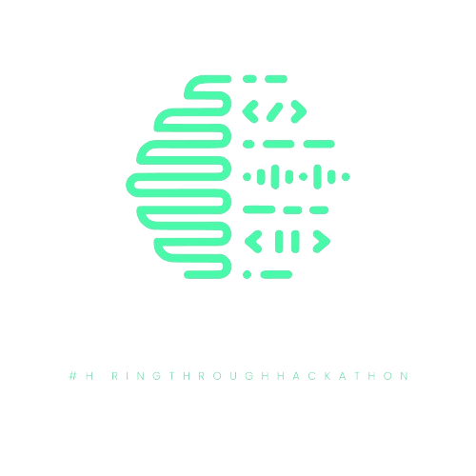
VISHWANIKETAN'S INSTITUTE OF MANAGEMENT ENTREPRENEURSHIP AND ENGINEERING TECHNOLOGY (VIMEET)
(Affiliated to University of Mumbai/Approved by DTE/AICTE/NAAC at A+ Grade in 1st Cycle)
HACK TO CRACK 2.O
CODE . . CONQUER
CREATE

Slide 2

HACK TO CRACK 2.O
1.0
Team Details
Team Name : Bad Apple
Team Leader Name : Prabhat Mukhiya
Team Members : Sachin Bind, Prem Chavan, Manishankar Tripathi
Problem Statement : Blockchain-based platform for issuing, verifying, and sharing academic credentials securely and globally.
PS No: 4.3 [Education Technology – 3]

Slide 3
Hack To Crack
HACK TO CRACK 2.O
Problem Statement Description
A Blockchain-based platform for issuing, verifying, and sharing
academic credentials securely and globally. This platform serves as a unified portal where students can manage their credentials, institutions can issue official documents, and employers or organizations can verify them instantly.
Institutions issue credentials (degrees, transcripts, certificates) on a tamper-proof blockchain ledger.
Students store and access credentials securely through a digital wallet or portal.
Employers and organizations verify credentials instantly without intermediaries, reducing fraud and administrative delays.

Slide 4
HACK TO CRACK 2.O
Idea Details
This platform leverages blockchain technology to issue, verify, and share academic credentials securely and globally. It provides a unified portal where students can manage their credentials, institutions can issue official documents, and organizations can verify them instantly. By eliminating the need for manual verification and reducing the risk of fraud, the system ensures a more efficient, transparent, and accessible credentialing process.
Key Benefits:
Secure & Immutable – Prevents document tampering and forgery.
Decentralized Access – Students can share credentials anytime, anywhere.
Automated Verification – Reduces manual processes and speeds up hiring and admissions.
Global Standardization – Ensures interoperability across institutions and countries.

Slide 5
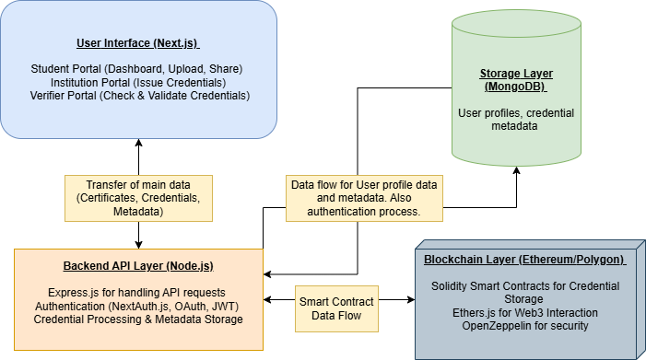
HACK TO CRACK 2.O
Flowchart / Architecture

Slide 6
HACK TO CRACK 2.O
Tech Stack Used
The project will primarily leverage blockchain and Web3 technologies, along with modern web development tools, integrating additional technologies as needed.
Ethereum (Mainnet or Polygon for scalability)
Solidity (for writing contracts)
Web3 Integration: Ethers.js (for connecting frontend to blockchain)
Node.js with Express.js (for handling API requests)
MongoDB (for storing user metadata & credential references)
Next.js (for fast, server-rendered UI)
Tailwind CSS (for modern UI design)

