Slide 1
SONARQUBE

Slide 2
What is SonarQube ?
A platform to manage code quality
Free, open source, LGPL, web based portal
Static code analyser
Supports more than 20 programming languages
Developed by a Swiss company : SonarSource
For Developers
Maintainability
Good programming practices
Bugs
For Tech transfer
Info on software maturity
Better valuation
Preparation for a due diligence (Technical Debt)
Notes:
Note that only the last of the advanced criteria is showing up on the search on field.

Slide 3
Sonar not what !
Performance analysis (memory, CPU)
Conformity to requirements specifications
Expertise on architecture and technological choices.
Notes:
Note that only the last of the advanced criteria is showing up on the search on field.

Slide 4
Requirements
The only prerequisite for running SonarQube is to have Java (Oracle JRE 8 onwards or OpenJDK 8 onwards) installed on your machine.
Hardware Requirements
The SonarQube server requires at least 2GB of RAM to run efficiently and 1GB of free RAM for the OS.
The amount of disk space you need will depend on how much code you analyze with SonarQube
Supported Platforms
Java : Oracle JRE8, OpenJDK8
Database : MySQL, MySQL, Oracle, Postgrel
Web Browsers : Internet Explorer11, Mozilla Firefox, Google Chrome, Safari
Notes:
Note that only the last of the advanced criteria is showing up on the search on field.

Slide 5
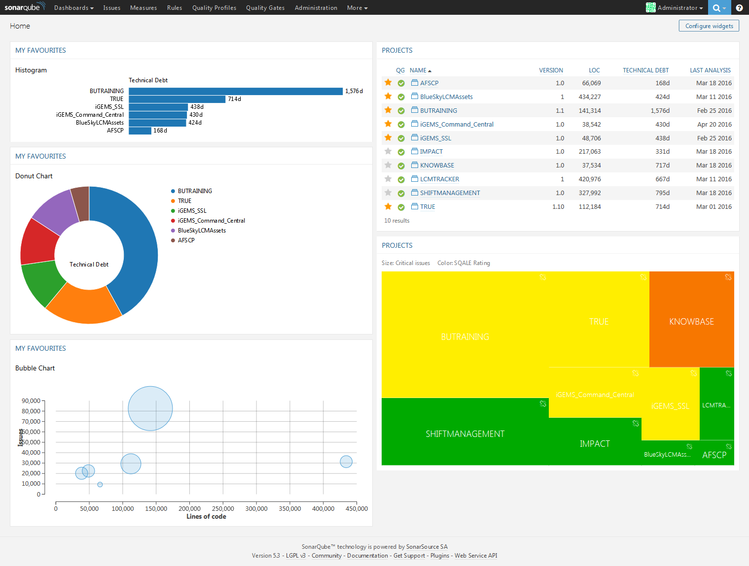
SonarQube GUI

Slide 6
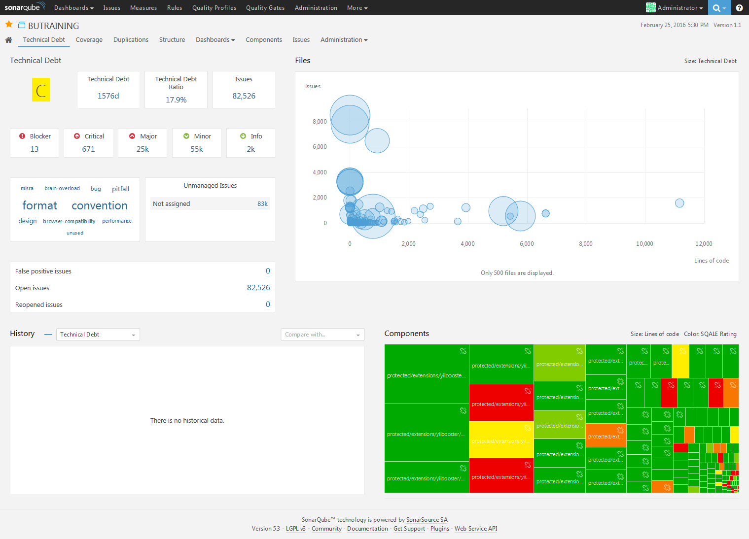
SonarQube Basic Statistics

Slide 7
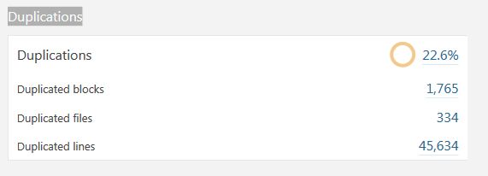
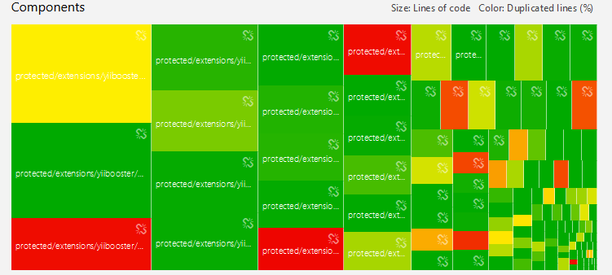
SonarQube -Duplications
Notes:
Note that only the last of the advanced criteria is showing up on the search on field.

Slide 8
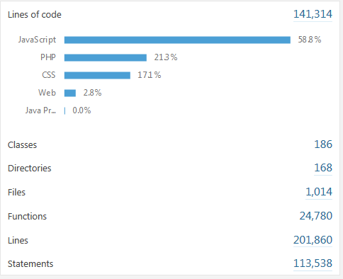
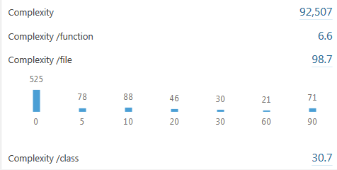

SonarQube- Project Structure
Notes:
Note that only the last of the advanced criteria is showing up on the search on field.

Slide 9
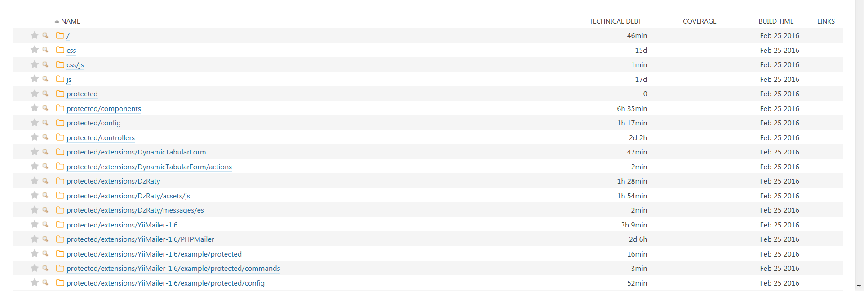
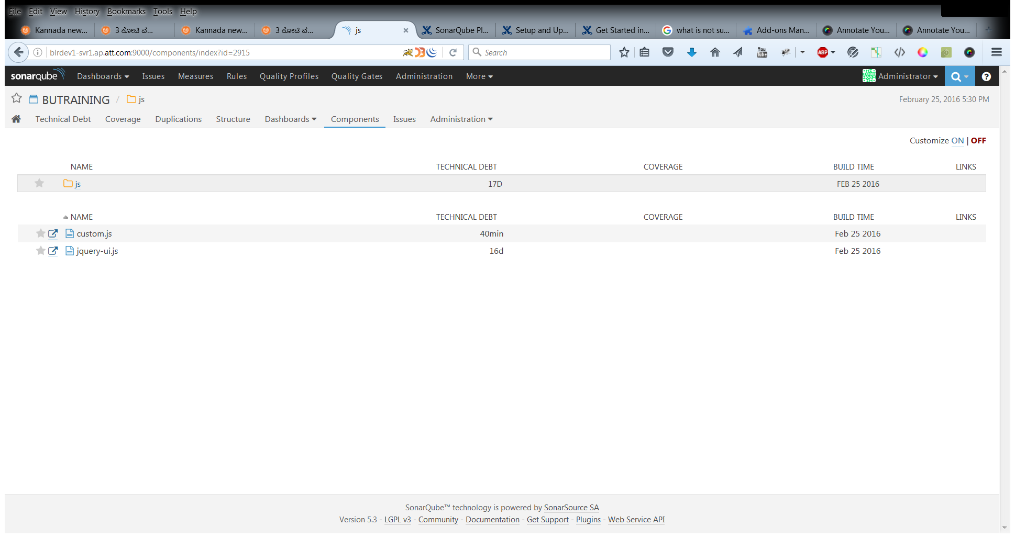
SonarQube- Project Components
Technical debts by directories
Technical debts by files
Notes:
Note that only the last of the advanced criteria is showing up on the search on field.

Slide 10
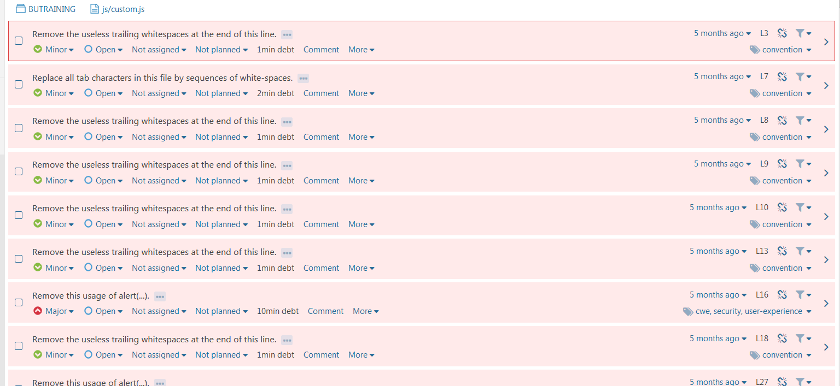
SonarQube- Violations
Notes:
Note that only the last of the advanced criteria is showing up on the search on field.

Slide 11
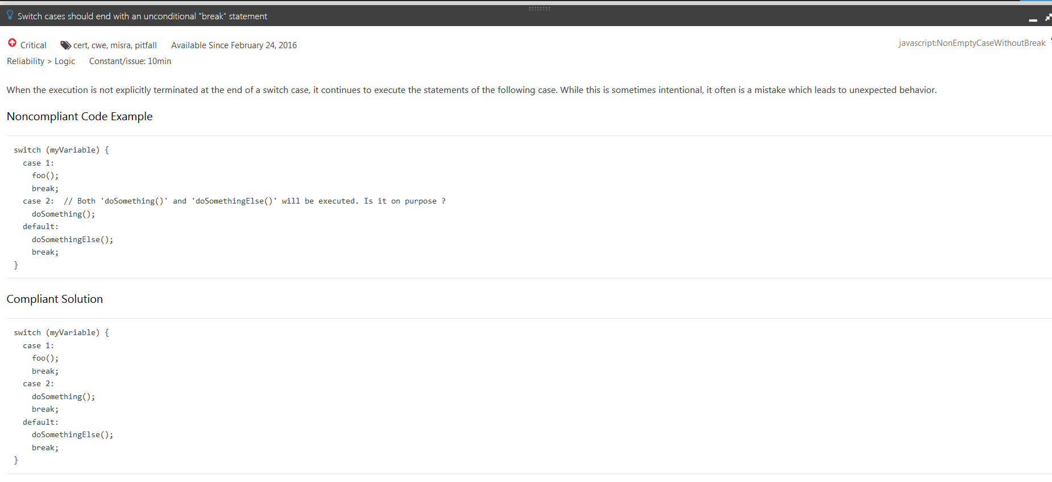
SonarQube
Sample solution
Notes:
Note that only the last of the advanced criteria is showing up on the search on field.

Slide 12
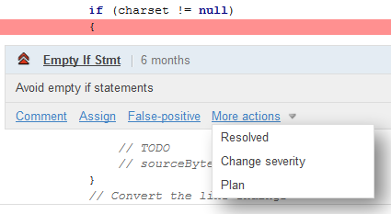
SonarQube Managing Violations
For each violations you can
Comment
Change its severity
Declare it as a false-positive
Assign it to someone
Assign it to some action plan
Notes:
Note that only the last of the advanced criteria is showing up on the search on field.

Slide 13
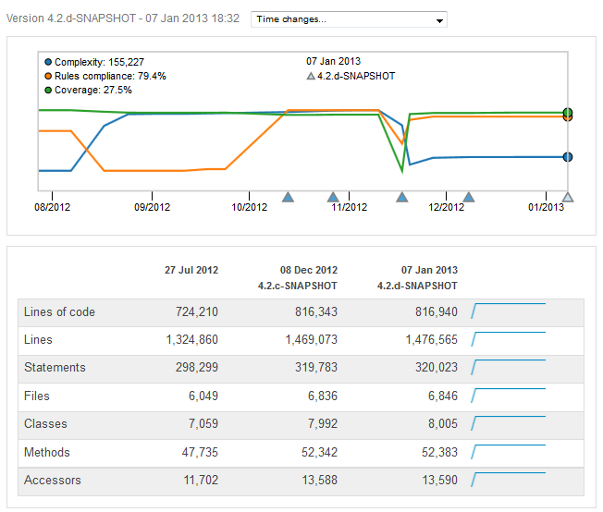
SonarQube Time machine
Notes:
Note that only the last of the advanced criteria is showing up on the search on field.

Slide 14
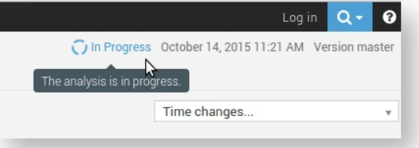
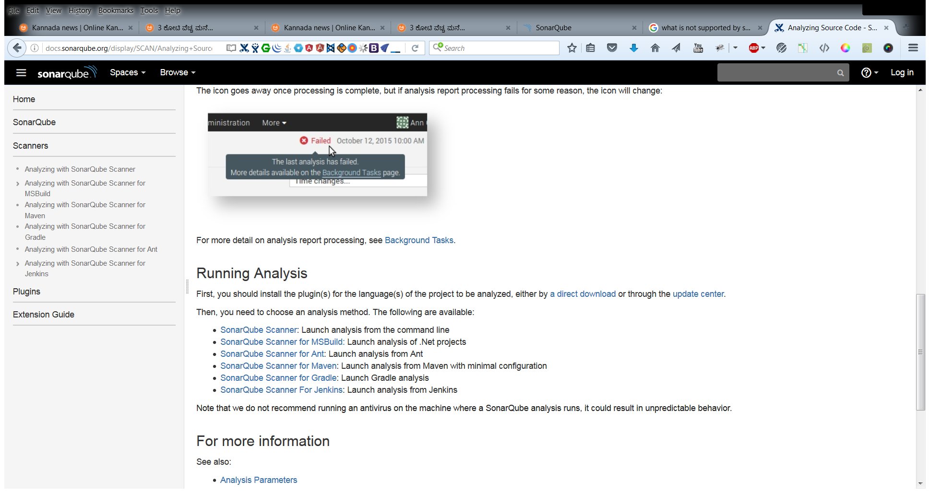
SonarQube Analyzers
During analysis
Post analysis
Running Analysis
SonarQube Scanner: Launch analysis from the command lien
SonarQube Scanner for MS Build: Launch analysis of .NET projects
SonarQube scanner for Ant: Launch analysis from Ant
SonarQube scanner for Maven: Launch analysis from Maven with min configuration
SonarQube scanner for Gradle: Launch Gradle analysis
SonarQube scanner for Jenkins: Launch analysis from Jenkins
Notes:
Note that only the last of the advanced criteria is showing up on the search on field.

Slide 15
Thank You!!

