Slide 1

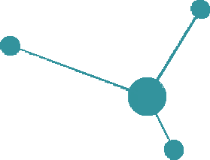
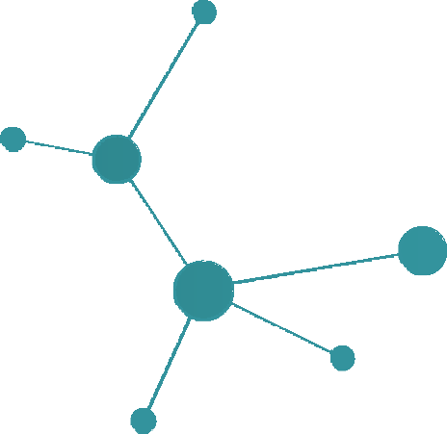


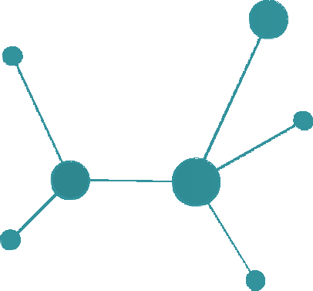



DNA SEQUENCE
CLASSIFICATION

Slide 2

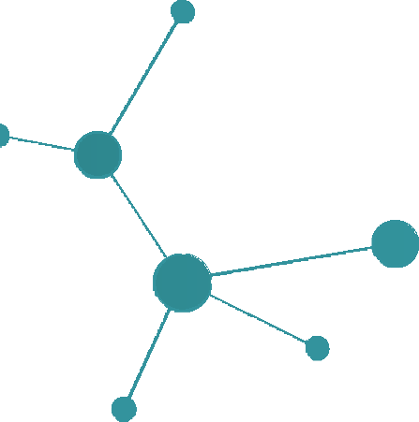

Contents
Introduction
01
02
Basic facts about DNA and the process of DNA Sequencing
Problem
The complexity of problem at hand and the required solution for that problem
Techniques Applied
The different modelling and machine learning techniques deployed to solve the problem at hand
03
Model Selection
Comparison of model results on different metrics and analyzing there comparative level of performance
04
Conclusion
Which machine learning model should be selected for the final deployment in the Industry
05

Slide 3
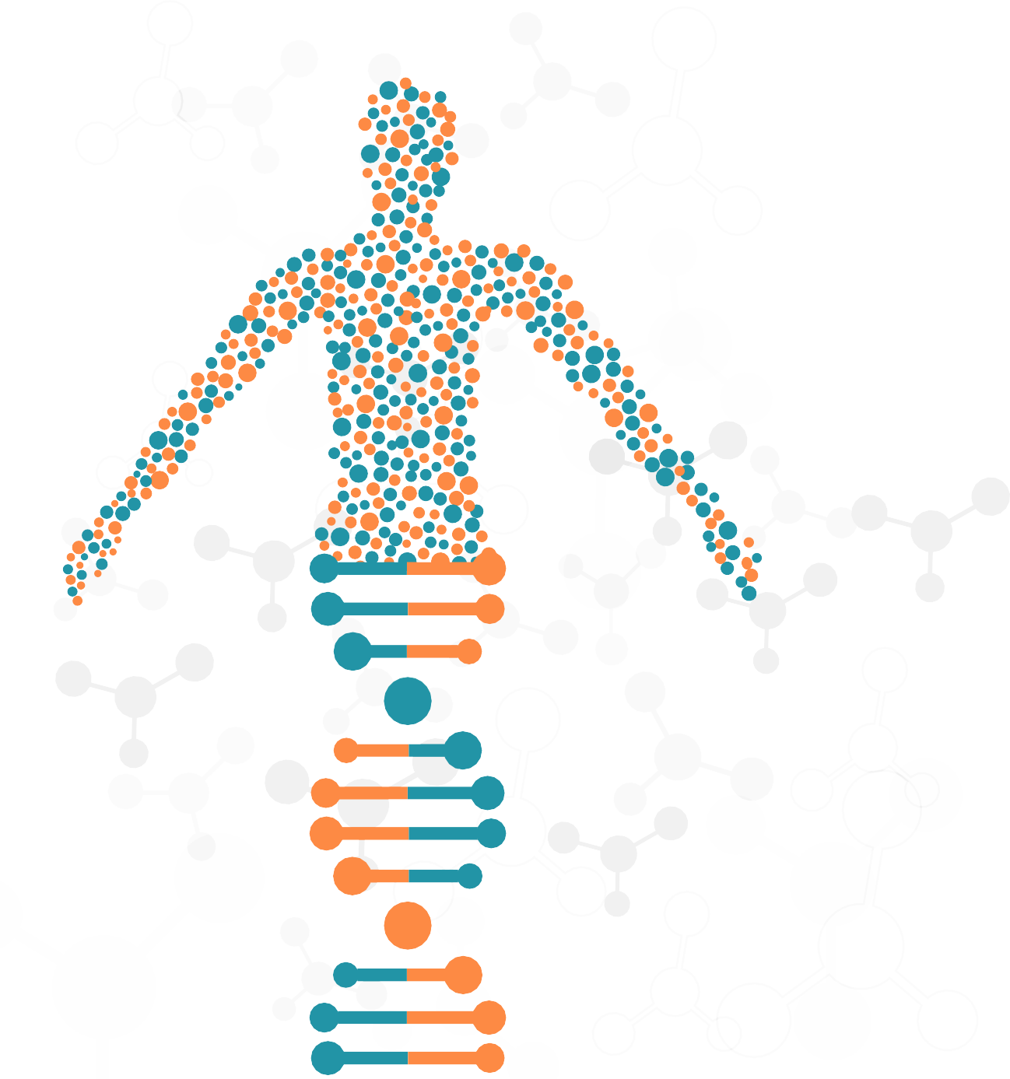
Introduction to DNA
DNA sequencing is the process of determining the sequence of nucleotides (As, Ts, Cs, and Gs) in a piece of DNA.
3Billion
The human genome contains about 3 billion base pairs that spell out the instructions for making and maintaining a human being.
In the DNA double helix, the four chemical bases always bond with the same partner to form "base pairs." Adenine (A) always pairs with thymine (T); cytosine (C) always pairs with guanine (G). This pairing is the basis for the mechanism by which DNA molecules are copied when cells divide, and the pairing also underlies the methods by which most DNA sequencing experiments are done.
How new is DNA Sequencing
Since the completion of the Human Genome Project (1990-2003), technological improvements and automation have increased speed and lowered costs to the point where individual genes can be sequenced routinely, and some labs can sequence well over 100,000 billion bases per year, and an entire genome can be sequenced for just a few thousand dollars.
What do improvements in DNA sequencing mean for human health?
Researchers now are able to compare large stretches of DNA - 1 million bases or more - from different individuals quickly and cheaply. Such comparisons can yield an enormous amount of information about the role of inheritance in susceptibility to disease and in response to environmental influences. In addition, the ability to sequence the genome more rapidly and cost- effectively creates vast potential for diagnostics and therapies.

Slide 4









Problem
UCI DNA Sequence Data:
The UCI dataset consists of this genetic coding, using which, we determine if a person belongs to a promoter class or not.
01
CLASS ‘+’
(is promoter)
CLASS ‘-’
(is not promoter)
02
Classifying DNA Sequences:
DNA sequence classification is the activity of determining whether or not an unlabeled sequence S belongs to an existing class C. The arrangement of these classes is very important as it determines genetic coding.

Slide 5


Abstract
The completion of the human genome project in the last decade has generated a strong demand in computational analysis techniques in order to fully exploit the acquired human genome database. The human genome project generated a perplexing mass of genetic data which necessitates automatic genome annotation. There is a growing interest in the process of gene finding and gene recognition from DNA sequences. In genetics, a promoter is a segment of a DNA that marks the starting point of transcription of a particular gene. Therefore, recognizing promoters is a one step towards gene finding in DNA sequences. Promoters also play a fundamental role in many other vital cellular processes.

Slide 6

Training Methodology
Data-set
The data is a 1990 generated collection of 106 instances
across 58 attributes. All the instances are labelled with binary labels i.e. ‘+’ and ‘-’
Train-test split
The data is split into training and test data for validation of the model later.
The training data size is set to 25% of the original data
Model Selection
To select which model performs best for the given dataset, we train a host of different models, like Logistic Regression, SVM, Naïve Bayes, Neural Networks etc.
Model Training
The models are trained one-by one with the training data.
The model parameters are updated using gradient descent.
Model Performance
Model performances are compared using the metric of Accuracy Score, which tells us the proportion of correct classifications made by the model.

Slide 7












Modelling Techniques Deployed
Logistic Regression
Logistic regression models the probabilities for
01
classification problems with two possible outcomes. It’s an extension of the linear regression model for classification problems.
Random Forest
Random forests is an ensemble learning method for classification, that operates by constructing a multitude of decision trees at training time and outputting the class that is the mode of the classes of the individual trees.
Neural Networks
Artificial neural networks are computing systems inspired by the biological neural networks that "learn" to perform tasks by considering examples, generally without being programmed with task-specific rules.
Naïve Bayes
Naive Bayes classifiers are a collection of algorithms based on Bayes' Theorem where every pair of features being classified is independent of each other.
ACCURACY
ACCURACY
ACCURACY
ACCURACY
ACCURACY
92%
63%
89%
93%
96%
02
03
LR
RF
NN
NB
SVM
04
Support Vector Machines
Support-Vector Machines are supervised learning models that use a set of mathematical functions that are defined as the kernel. The function of kernel is to take data as input and transform it into the required form.
05

Slide 8
Model Selection
 | Training Accuracy | Std. Deviation | Testing Accuracy
K-Nearest Neighbor | 82% | 0.1139 | 78%
Gaussian Process | 87% | 0.0561 | 89%
Random Forest | 62% | 0.1830 | 63%
Decision Tree | 68% | 0.2175 | 74%
Neural Networks | 91% | 0.0968 | 89%
Naïve Bayes | 83% | 0.1375 | 93%
Adda Boost | 87% | 0.1125 | 86%
Support Vector Machine | 85% | 0.1089 | 96%
Highest Testing Accuracy
The Support Vector Machine provides the highest testing accuracy. This means it correctly classified the highest number of samples in the test data
Lowest Std. Deviation
The Gaussian Process gave the smallest amount of Std.
Deviation in it’s test results. This means it has the most consistent accuracy score
Highest Training Accuracy
The Neural Networks offer highest amount of testing accuracy. This mean that the neural network might be better suited for a number of new unseen data.
Hybrid Results
Gaussian process model offers good amount of training accuracy and low std. deviation, coupled with relatively good testing accuracy.

Slide 9



Conclusion
Business Problem
We are able to build machine learning models that can classify any new incoming data about a DNA sequence into the Binary Classes with relatively high accuracy.
Technical Problem
We are able to achieve good performance in different metrics using different models. We can do a critical analysis of these models and compare the performances on different test data.
Which Model to select for Deployment?
Generally it is observed that there exist no such model that offers, train once, fit all capability. Different models perform differently for distinct data-sets. It is up to the end user to decide what he/she desires out of the model. In our case:
If accuracy is of paramount importance, then Support Vector Machines is the choice.
If consistency of results I required, then Gaussian Process should be chosen.
If the end user requires a model that is scalable, then Neural Networks fit the role.
If there is requirement of a model that performs relatively good on all parameters but does not excel in any, then Gaussian process can be used.

Slide 10
Thank You

