Slide 1
Movie Ticket based Restaurant Recommendation System
Sachin Dhande
Application Architect

Slide 2
Introduction
i) The goal for this project is to recommend Restaurant, Bar, Café which are nearby Movie Theater and people who has booked movie ticket in particular Movie Theater. Mostly people who go for movies in Theater eat in Restaurant, Bar, Cafe after movies show. Probability of people eating out after Movie show is very high.
ii) This system will recommend targeted customers (who has booked Movie Show) a Restaurant, Bar, Café nearby to Movie Theater. Recommendation will be before end of movie show so that customer can readily choose from recommended option instead manual looking out for restaurant after show.
iii) Improve business of Restaurant, Bar, Café in nearby location to Movie Theater.

Slide 3
2. Data Sources
i) The customers who have booked online movie ticket using different websites or mobile application like BookMyShow, TicketBooking are readily available in movie theater database.
ii) Those Movie Theater data consists of basic booking information like Name of customer, age of customer, movies name, movies theater address, pin code of Movies Theater, Address of Movie’s Theater, Movie’s show time, Movies category, Ticket ID, No of seats booked.
iii) Foursqure APIs will provide the details about Restaurants, Bars, Café with in radius of 500 meters from Movie Theater’s geographic location (latitude, longitude).

Slide 4
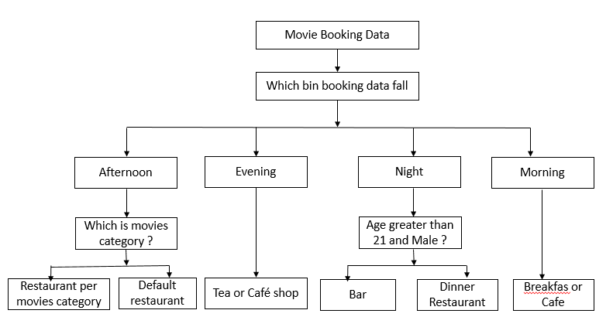
3. Modeling
Most of the key field in the Movies booking data readily available few fields need data binning for model prediction.
Also geographical location data is available from Foursquare APIs which need data filteration. Using Decision Tree Model we can predict the recommendation to customer who has booked movie ticket.

Slide 5
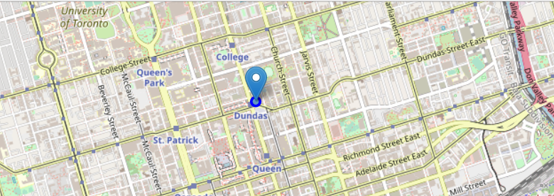
4. Geographical location :
We can also visualize the geographical data for surrounding data using many APIs like Foursqure

Slide 6
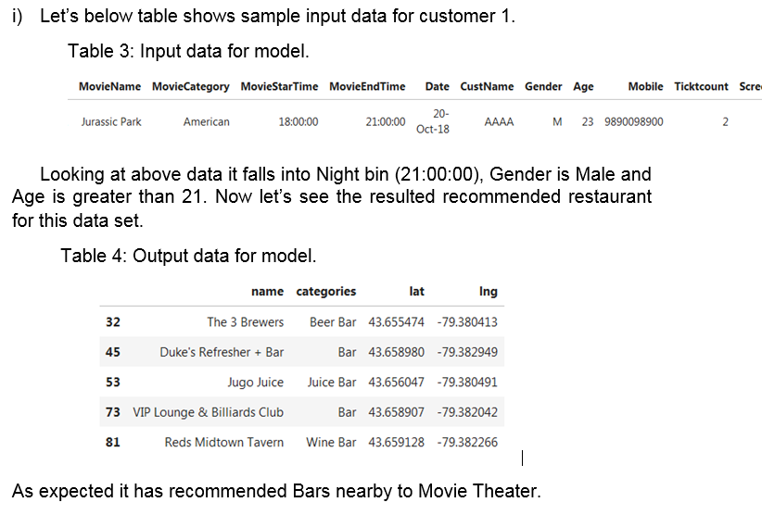
5. Result
In this section we will analyze 2 results we got results from Decision Tree Classification model for two different set of data set

Slide 7
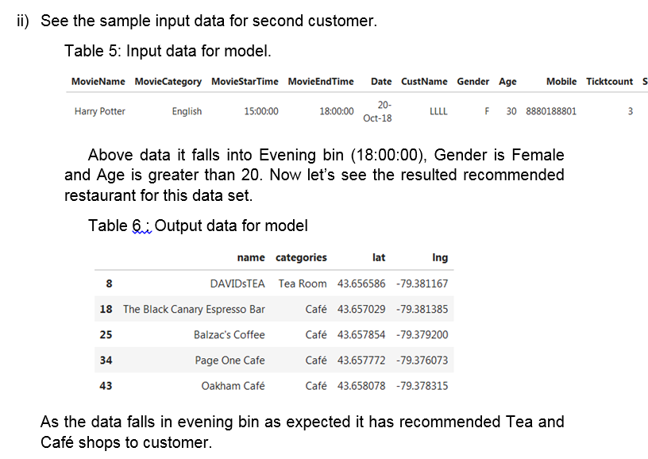

Slide 8
6. Conclusion
From above two samples it seems model is working fine and recommendations are in line with key variables. The recommendation model is predicting the results more accurately as per the key attributes it is going to increase business profit for Restaurant, Bar and Café owner surround the Movies Theater. Customer will be more satisfied by provide recommendation rather than manually searching in geographical area.

