Slide 1
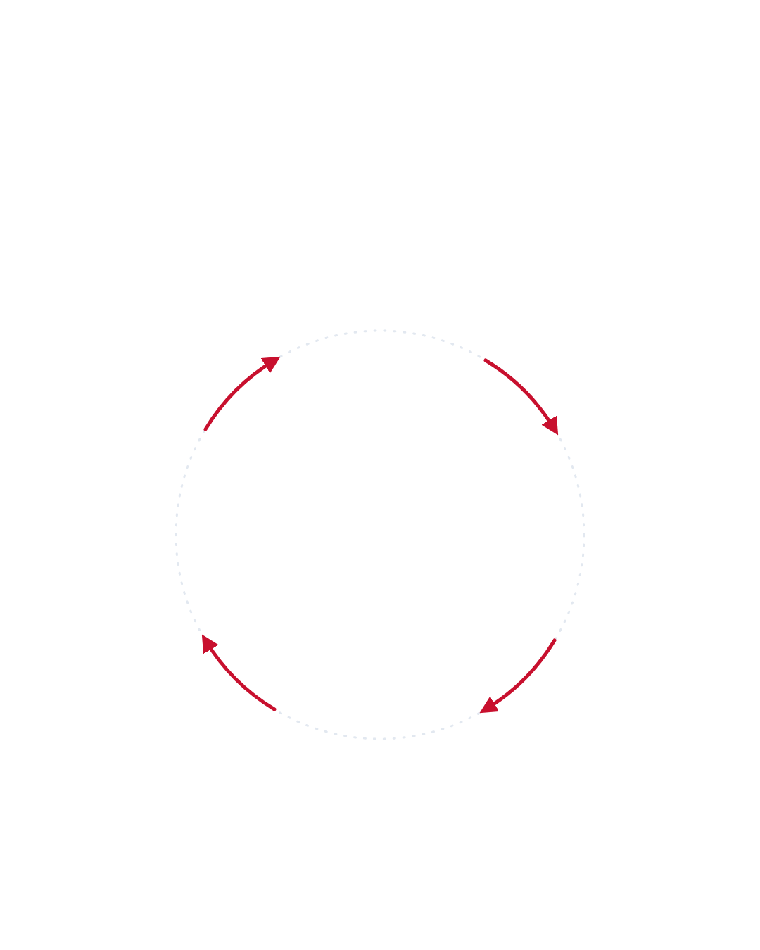
• MEN'S HEALTH GUIDE
The Anxiety Cycle
How worry can make you go soft during sex
1
Worry about performance
"What if it happens again?"
4
BREAK THE CYCLE
Take the pressure off
✓ Slow down
✓ Talk to your partner
✓ Focus on sensation
2
More worry next time
The memory adds pressure
Focus shifts away from arousal
You start monitoring instead of feeling
3
Erection fades
Anxiety gets in the way of arousal
Keeps happening? Speak to a GP or sexual health clinic.
Sources: NHS · Journal of Andrology
vigrxplus.uk.com

