Slide 1

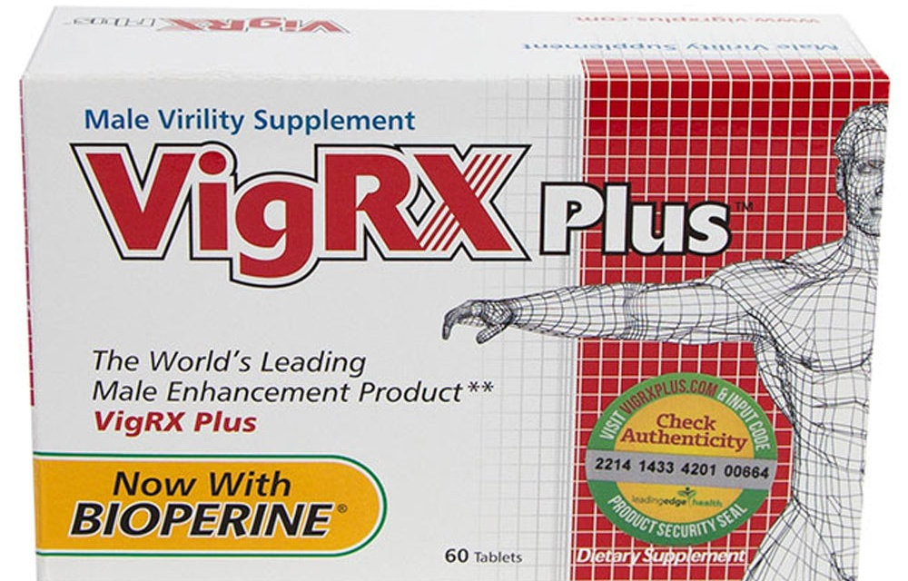
MEN'S HEALTH GUIDE
Why Do I Go Soft
During Sex?
Causes, Fixes and When to See a GP
Common causes
Practical fixes
When to see a GP
vigrxplus.uk.com
Food supplement · not a medicine

