Slide 1
Yes We Care _Find your service provider In your mobile

Slide 2
Title: Yes We Care- Find your service provider In your mobile
Guide:
1.Prof. A.V. kumar (Department of Comp)
2.Amit Khachane(DSC LEAD SRES)
Project by:
1. Sachin Dongare (TE Comp)
https://www.linkedin.com/in/sachindongare1311/
2.Rucha Deshmukh (TE Comp)
https://www.linkedin.com/in/rucha-deshmukh-16752b151/

Slide 3
Outline :
Introduction
Objectives
Technology platform overview
Application snapshot
Future work & conclusion

Slide 4
Introduction
Nowadays Migrations are cause by a variety of factors like Marriage, Employment, Education, Lack of Security or services .Moving to a new city is always exciting. However, with the excitement comes difficulties. Sometimes, essentials such as get the Perfect House, home improvement , education , domestic services , hospital information it very difficult to find such all services in new city
YESWECARE is best solution to find all services at your mobile phone. We are a mobile marketplace for local services. We help users by providing service provider information from there city. YESWECARE will work tirelessly to make a difference in the lives of people by catering to their service needs at their doorsteps.

Slide 5
Objectives of project
To Provide all domestic as well as industrial services in one application
To Promote best service provider all over city
Time saving and
To save time and money by using our services instead of agent

Slide 6
Academic objectives
Learning the mobile application development .
Learn how android application works , and its life cycle.
Design and develop useful android application with compiling user.
Learning android API for data storage ,retrieval , user preferences , file ,data base ,content provider

Slide 7
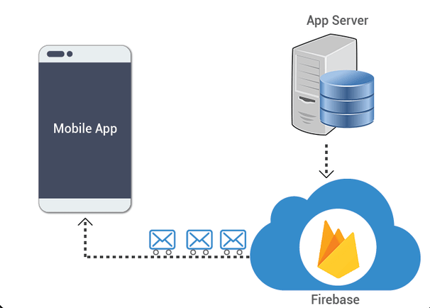
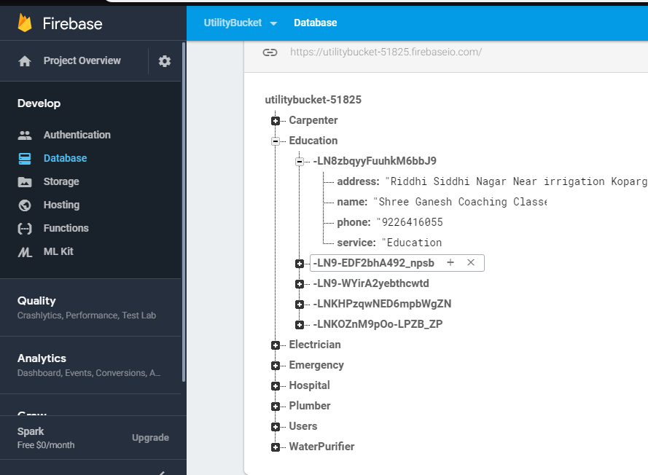
Architecture
Input(registration)
………………………….
>

Slide 8
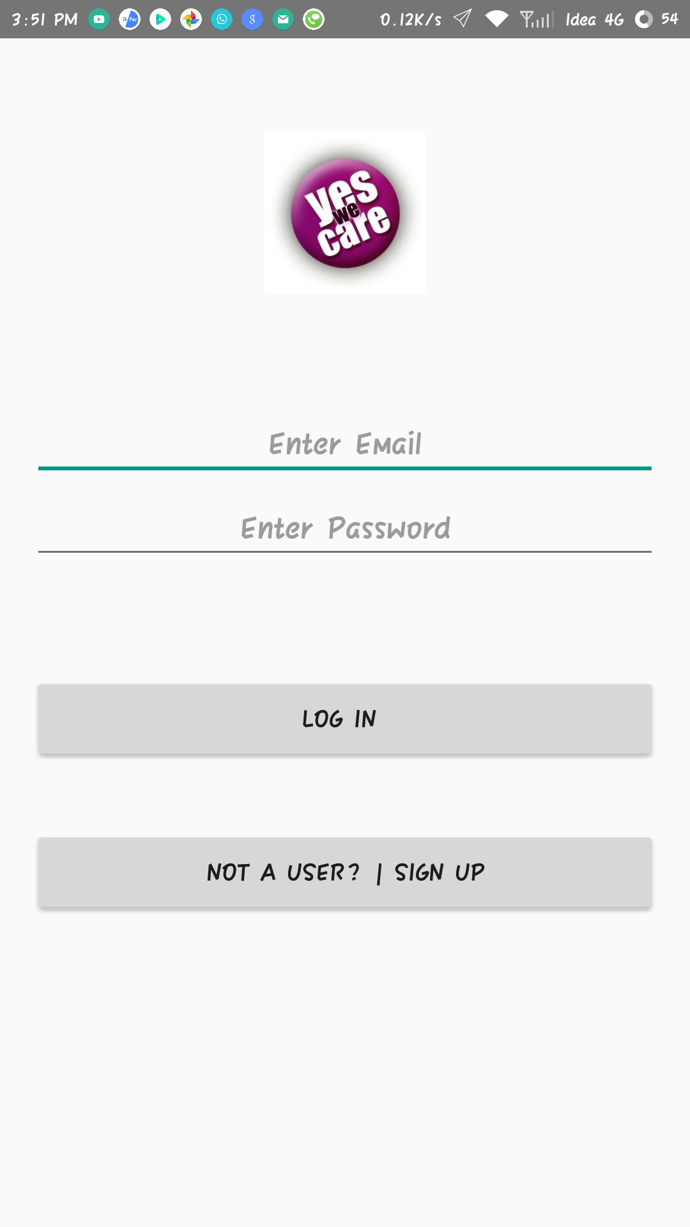
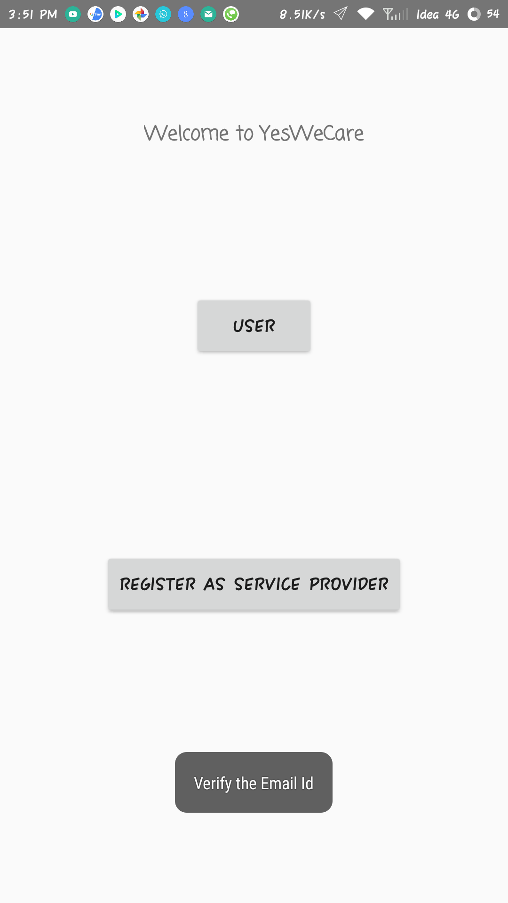
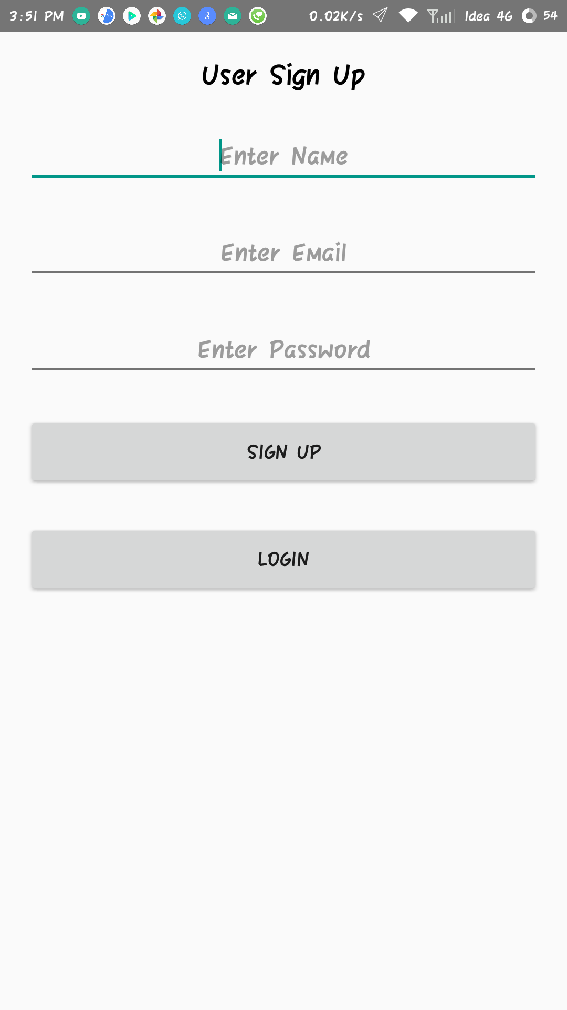
After successful login
For new user

Slide 9
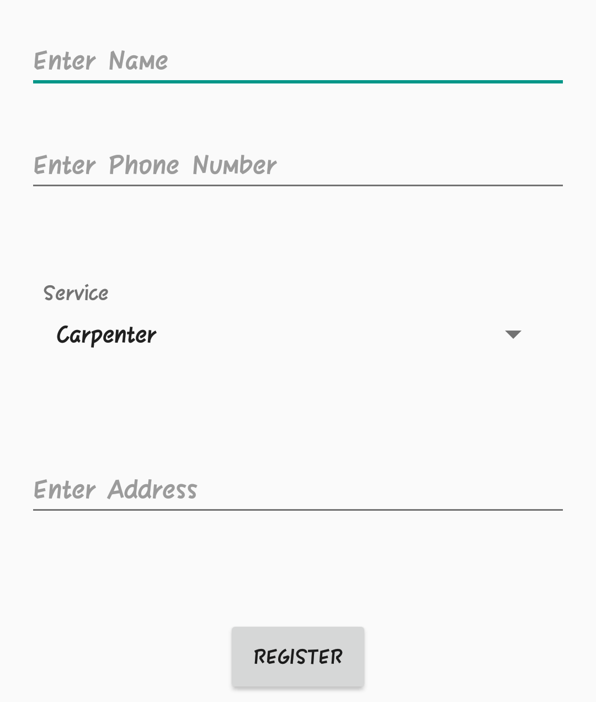
For service Registration

Slide 10
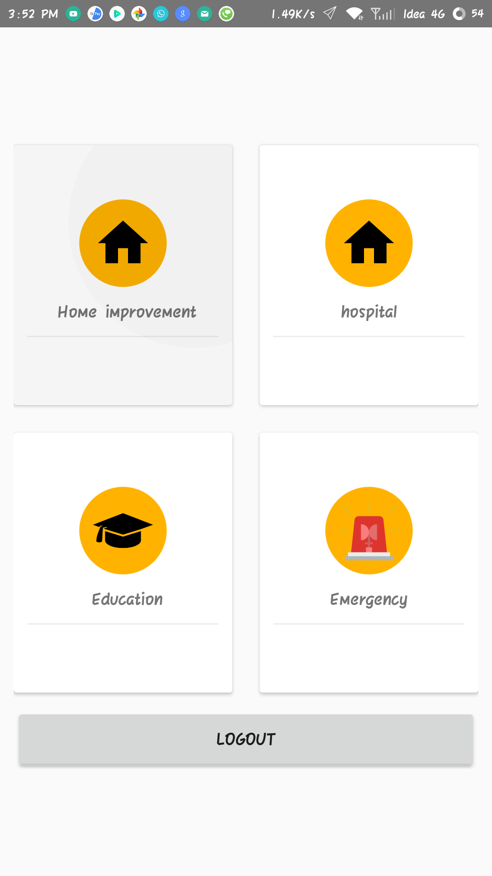
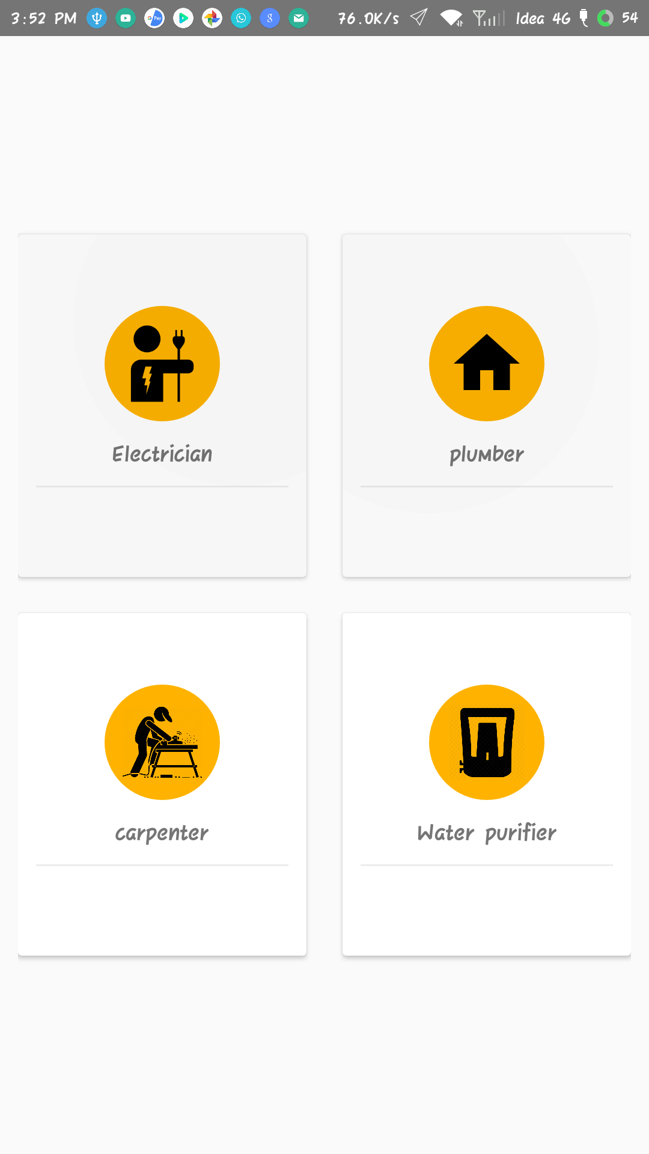
Service provider category

Slide 11
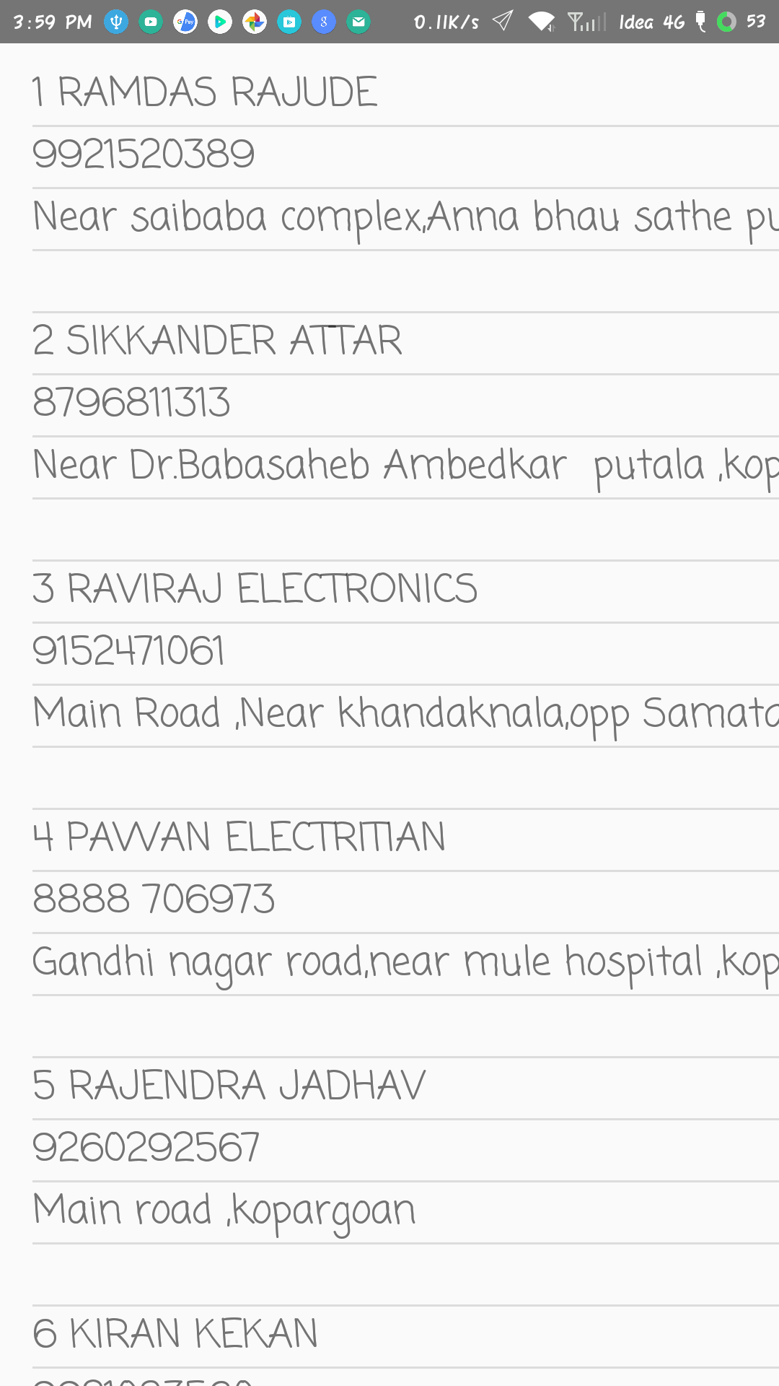
On selecting service

Slide 12
Future Scope:
In future we will add more features to our app. There are various features listed.
By using location API, we can locate nearby service provider.
End to end chat with service provider
Service provider recommendation
Option for searching a service.
Even we are providing search box for user to search a service, which is not recognized, by user in category.
Service provider booking through application

Slide 13
Thank you

