Slide 1
CAPITATION
Owner: Capgemini Java Support Team
IT Owner: Capgemini Java Support Team
Owner From Business: Eunice Turner, Chris Alvarado
Notes:
Welcome to the session on Internet/HTML/DHTML

Slide 2
Table of Contents
What is capitation?
Functional overview of capitation
Monthly Capitation Process
Frequency and timings
Technical details
Recent enhancements

Slide 3
What is capitation?
Capitation - A fixed fee is paid to a dentist in a prepaid network, per member, per month. The capitation payment will vary according to the number of members selecting the provider, the types of benefit plan and the capitation schedule for each plan.

Slide 4
Functional Overview of Capitation
The main functionality of Capitation JAVA interface is to extract the data from the compass database, send it to the mainframe for further processing.
Mainframe batch generates the capitation, monthly rosters & weekly reports.
Capitation Process starts with extraction of member and dependent data from Compass database. All the active and terminated prepaid members are listed in a file called CAPTEST.txt is created by Autosys batch process (Shell script + Compass stored procedure).
On the basis of unique case keys, the data is sorted and populated in a new file called uniquecase.txt.

Slide 5
Functional Overview of Capitation(Contd.)
The active members and its dependent data is extracted from the uniquecase file and is stored in a file called rosters.
Once rosters file is created successfully, it gets copied to the mainframe System through FTP process.
Provider facts data (i.e. Vendor, operating company, network, facility and plan rate) is outbound from the provider facts database to the Mainframe System

Slide 6
Functional Overview of Capitation(Contd.)
After creation of rosters file, the generation of potentially terminated file starts through Autosys batch process.
The comparison between the current month and previous month data is done in order to list out the terminated members and dependents.
If the status of member is on hold for consecutive 3 months then that member is declared as terminated.
If it is terminated for last two months but present month status is active then its status is set to active.

Slide 7
Functional Overview of Capitation(Contd.)
The member term file and dependent term file gets created.
Before merging these two files into one, process checks if a member is terminated, then set all of its dependents as terminated.

Slide 8
Functional Overview of Capitation(Contd.)
Once the final term file is generated, process copies that file over to mainframe system through FTP process.
Cap amount is calculated according to the data from providerFacts on the basis of plan rates.
Business validates the rosters and checks before printing and mailing.
After validation, Checks and Rosters will be sent for printing and mailing.

Slide 9
Monthly Capitation Process
Technical Details:
There are total 3 extracts –
1. Compass Input - ExecuteSchedule_CAPFACT*.TXT - Contains all active member and dependent details
2. Compass Term - CAPFACT_TERMINATED*.TXT - Contains all terminated member and dependent details
3. Compass Convert - cap_xref_*.txt - Contains group and member details.

Slide 10
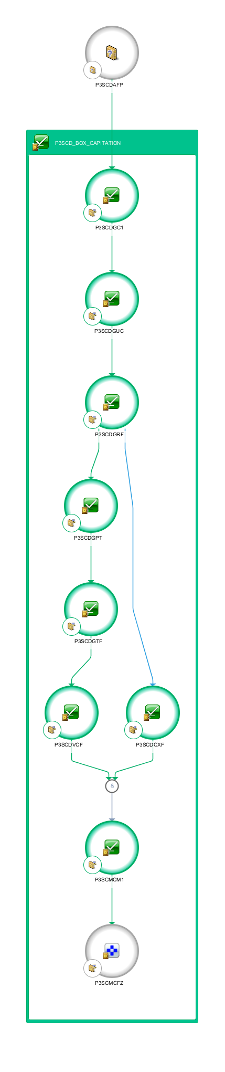
Monthly Capitation - Autosys Batch Job Flow

Slide 11
Monthly Capitation Process(Contd.)
Process Flow:-
1 P3SCDGC1 Generates the CAPTEST.txt file
2 P3SCDGUC Generates the unique case keys file (uniquecase.txt)
3 P3SCDGRF Generates the roster file using the capitation_rewrite.jar.
4 P3SCDGPT Generates the Potentially terminated members & dependents file.
5.P3SCDCXF Generates Cap XREF File
6 P3SCDGTF Generates termination file.
7 P3SCDVCF Validates CapFact1 File.
8.P3SCMCM1 Triggers Monthly Capitation FTP on Mainframe.
9.P3SCMCFZ Capitation Process start on Mainframe

Slide 12
Frequency and timings
Job name | Start time (CST) | Duration
P3SCDGC1 | 00:04:39 AM | 04Hrs 26 min 49 Sec
P3SCDGUC | 04.31:28 AM | 09 Sec
P3SCDGRF | 04.31:37 AM | 44 Min 03Sec
P3SCDCXF | 05:15:40 AM | 0sec
P3SCMCFM | 05:15:40 AM | 0 sec
P3SCDGPT | 05:15:40 AM | 43Min 52Sec
P3SCDGTF | 05:59:32 AM | 7 Min 52Sec
P3SCDVCF | 06:07:24 AM | 2 Sec
P3SCMCFT | 06:07:26 AM | 13 Min 34 Sec
P3SCMCFZ | 06:21:08 AM | 0 sec

Slide 13
Technical Details
Server :
SV67433.sunlifecorp.com - PROD
SV67431.sunlifecorp.com - STAGE
SV67428.sunlifecorp.com - SIT/DEV
Autosys URL:
Prod : https://waaeportal.sunlifecorp.com/wcc/ui/Login.html
Non Prod : https://waaeportal-tst.sunlifecorp.com/wcc/ui/Login.html
Bit Bucket URL: http://bitbucket.us.sunlife/scm/cmpi/capitation_rewrite.git
Log Path: /users/apps/fortis/java/prod_fp3a/applications/Capitation/log
/users/apps/fortis/java/impl_fm3a/applications/Capitation/log
/users/apps/fortis/java/intg_fn3a_sbc/applications/Capitation/log
/users/apps/fortis/java/dev_fd3a/applications/Capitation/log

Slide 14
File Path
Extract File names :
ExecuteSchedule_CAPFACT*.TXT
CAPFACT_TERMINATED*.TXT
cap_xref_*.txt
File Path:
Prod : /users/apps/fortis/prod_fp3a/DBD_Reports/CF
Stage : /users/apps/fortis/impl_fm3a/DBD_Reports/CF
SIT : /users/apps/fortis/intg_fn3a_sbc/DBD_Reports/CF
DEV : /users/apps/fortis/dev_fd3a/DBD_Reports/CF

Slide 15
Thank You

