Slide 1
MS Access
What are we trying to achieve?
Developing a simple database consist of tables, relationships, queries and reports

Slide 2

Today's Goal
Traditional file systems concept vs. Database approach.
What is a database?
Creating a database using MS Access.
  Creating tables.
  Creating forms.
Vindya Wipulaguna IIT

Slide 3

Traditional file systems concept vs. Database approach.
Easy access.
Avoid data duplication.
Can be accessed by many users at the same time.
To provide multiple views.
Secure access.
Vindya Wipulaguna IIT

Slide 4
What is a Database?
Database is a collection of related data organized in one or more tables.
A relational database is a collection of tables, which are related to each other and stored in one place.
Database applications and the functionality examples known to you?
Vindya Wipulaguna IIT

Slide 5
What is a Table?
Is a primary object of a database.
A table is lot like a spreadsheet.
The data is arranged in columns(fields) and rows(records).
Example tables for a sample database?
Vindya Wipulaguna IIT

Slide 6
What is a Record?
Shows information about a single person or an item in a table.
A record may contain several fields.
A record is a collection of fields.
Vindya Wipulaguna IIT

Slide 7
What is a field?
Is a piece of data within a record.
Each field has a identifier(name).
Eg: name, address, phone no, grade, birth date, ect.
Vindya Wipulaguna IIT

Slide 8
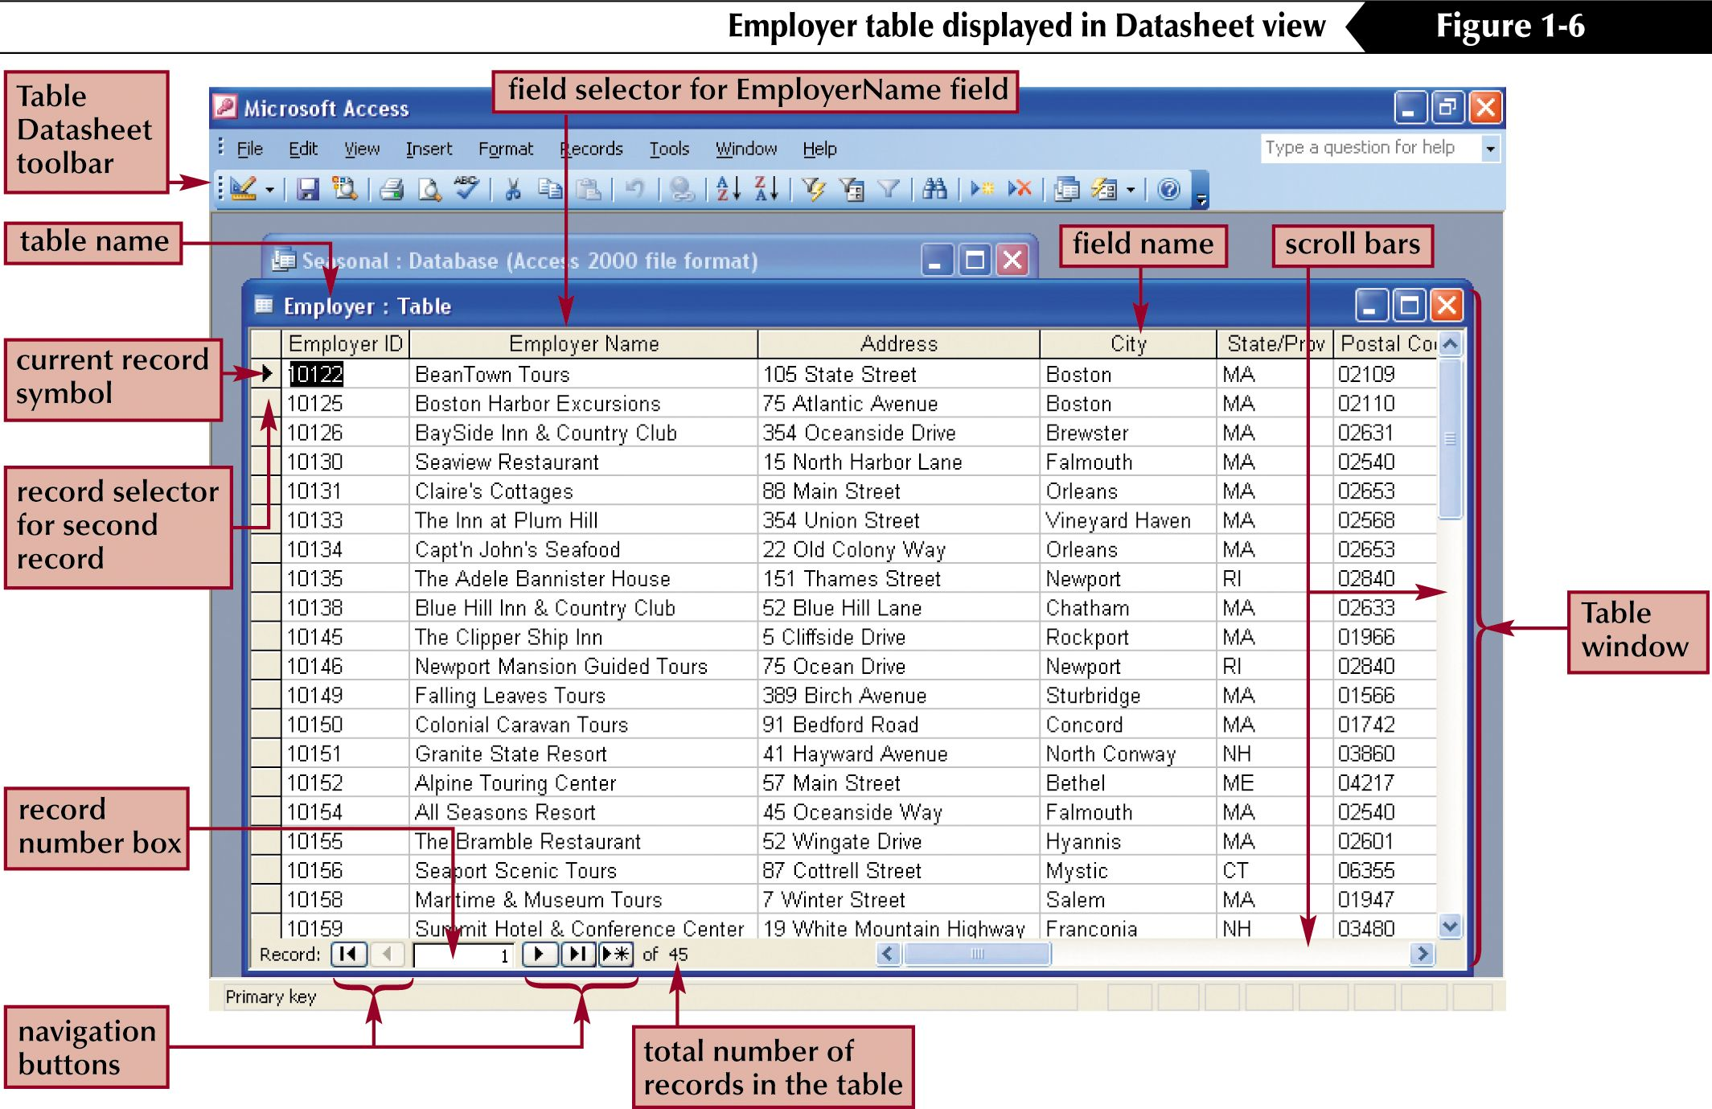
What are the rows and the columns that you can identify ?
Vindya Wipulaguna IIT

Slide 9
Storing Data into Tables
Each database entry is stored as a row, this is called a record.
Each record is a collection of information about one thing.
Each type of detail is kept in its own column: a field.
<table>
Vindya Wipulaguna IIT

Slide 10
END
Vindya Wipulaguna IIT

