Slide 1
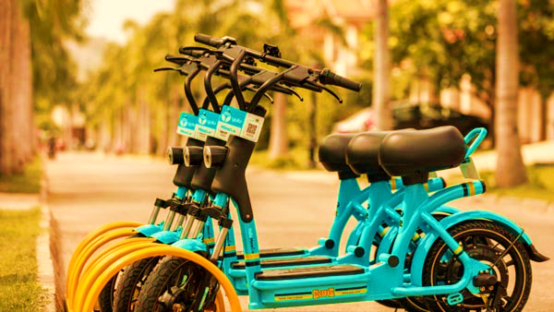
Bike Renting Demand Prediction
Presented by:
Sachin Jadav
Swati Pawar
Shivraj Patil

Slide 2





Sachinkumar Jadav
Aspiring Data Scientist
Education
Skills
Contact
M.Sc. Mathematics(2019-2021) from Sardar Patel University
B.Sc. Mathematics(2016-2019) from Gujarat University
HSC Science(2016), Bits School of Science
SSC(2014) , St. Xavier’s High School
Pune, Maharashtra
Python
Statistics
SQL
+8141240925
Pandas
Excel
sgkjadav@gmail.com
Hobbies
Languages
English
Sketch
Music
Anime
Gaming
Gujarati
Hindi

Slide 3




Swati Pawar
Aspiring Data Scientist
Education
Skills
Contact
Bachelor of Science (Hons.) Agriculture (2022) Dr.BSKKV Dapoli
HSC Science(2018), RKMM Jr College of Science
SSC(2016) ,Tulsai Pachpute Madhyamik Vidyalaya
Pune,India
Python
Statistics
SQL
+91 9322117461
linkedin.com/in/swati-pawar-642b26246
swatibalupawar468@gmail.com
Pandas
Excel
Work Experience
Internship Training
Vrundavan Agro Sales and Services (Oct 2021-Nov2021)
Hobbies
Languages
Learn about Testing , Packaging , Transport of Organic Fertilizers and implemented all basic Agriculture knowledge gain with the a Practical and Industrial viewpoint
English
farming
Music
Travelling
Hindi
Marathi

Slide 4

Shivraj G Patil
Aspiring Data Scientist
Education
Skills
Contact
B.Tech Automobile Engineering (2017-2021) from Symbiosis Skills and Professional University, Pune
HSC Science(2017), Jaihind Jr College of Science
SSC(2015) , Canossa Convent High School
ShivTrupti, Babulwadi Road, Fagane.Tal Dist Dhule
Python
Statistics
SQL
+91-8412840909
Pandas
Excel
shivrajgpatil99@gmail.com
Work Experience
Safety Engineer Tata Motors Passenger Vehicle Ltd, Pune (2021-22)
Hobbies
Languages
Data Analysis of Industrial injuries for further incident prevention
Safety Audits to improve the workplace environment
English
Intern Road Safety (2020-21)
Video
Music
Travelling
Fixed Gear
Marathi
1. Root cause analysis for Road Accidents
Hindi

Slide 5
Problem Statement:
Currently Rental bikes are introduced in many urban cities for the enhancement of mobility comfort. The client is Seoul Bike, which participates in a bike share program in Seoul, South Korea. An accurate prediction of bike count is critical to the success of the Seoul bike share program
It is important to make the rental bike available and accessible to the public at the right time as it lessons the waiting time. Eventually, providing the city with a stable supply of rental bikes becomes a major concern
The final aim of this project is the prediction of bike count required at each hour for the stable supply of rental bikes

Slide 6
Work Flow:
Data Collection
and
Understanding
Data Wrangling & Feature Engineering
02
Conclusions
EDA
Model Selection and Evaluation
Preparation of data for model building.
05

Slide 7
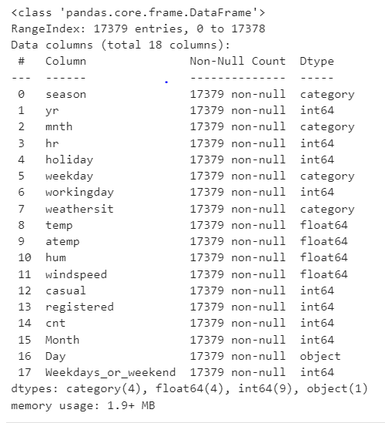
Data Features:
Bike Data is used for Analysis and Model Building
The dataset contains weather information (Temperature, Humidity, Wind speed), the number of bikes rented per hour and date information
In this we had total 8760 observations and 14 features including target variable

Slide 8
Data Wrangling and Feature Engineering:
As we know we had 8760 observations and 14 features.
Categorical Features: Seasons, Holiday, month, weekday and Day
Numerical Columns: Date, Hour, Temperature, Humidity, Wind speed, Rented Bike count
The Dataset has no null values
Zero Duplicate entries found
We changed the data type of Date column from ‘object’ to ‘datetime64[ns]’. This was done for feature engineering
We Created two new columns with the help of Date column ‘Month’ and ‘Day’. Which were further used for EDA. And later we dropped Date column

Slide 9
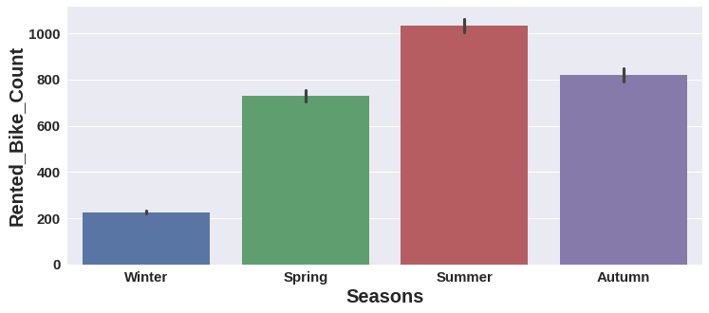
EDA (Exploratory Data Analysis)
-
Summer season had the highest Bike Rent Count

Slide 10
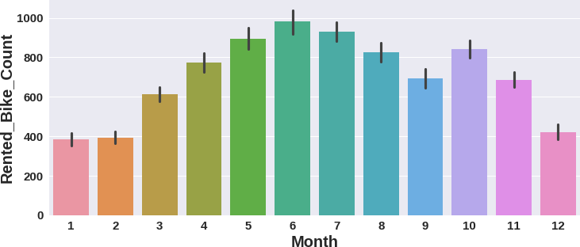
EDA (Exploratory Data Analysis)
Bike Rent Count started since March and it was highest in June.

Slide 11
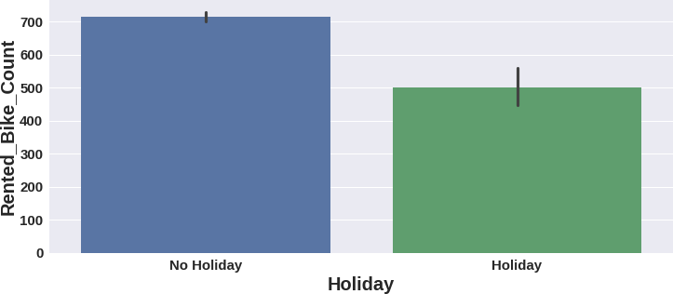
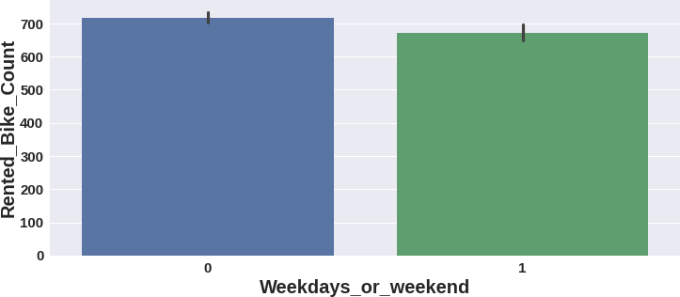
EDA (Exploratory Data Analysis)
High number of bikes were rented on No Holidays.
Which is almost 700 bikes.
More than 700 bikes were rented on weekdays.
On weekdays, almost 650 bikes were rented.

Slide 12
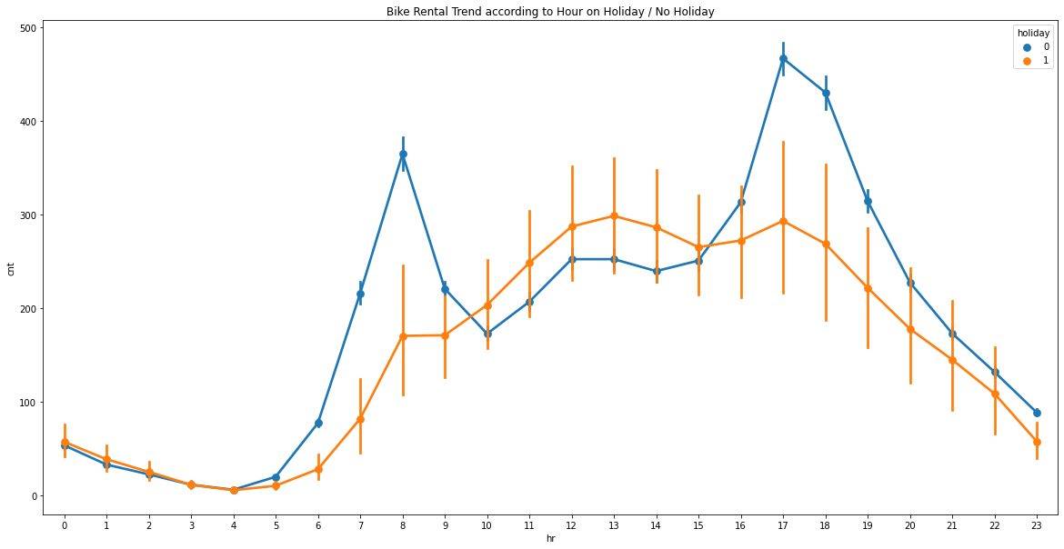
EDA (Exploratory Data Analysis) : Observation
Count
Hour

Slide 13
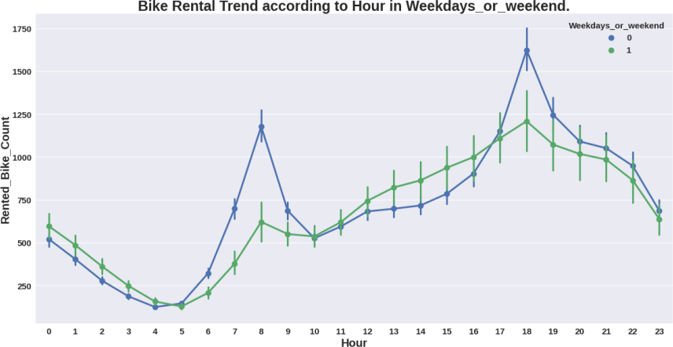
EDA (Exploratory Data Analysis) : Observation

Slide 14
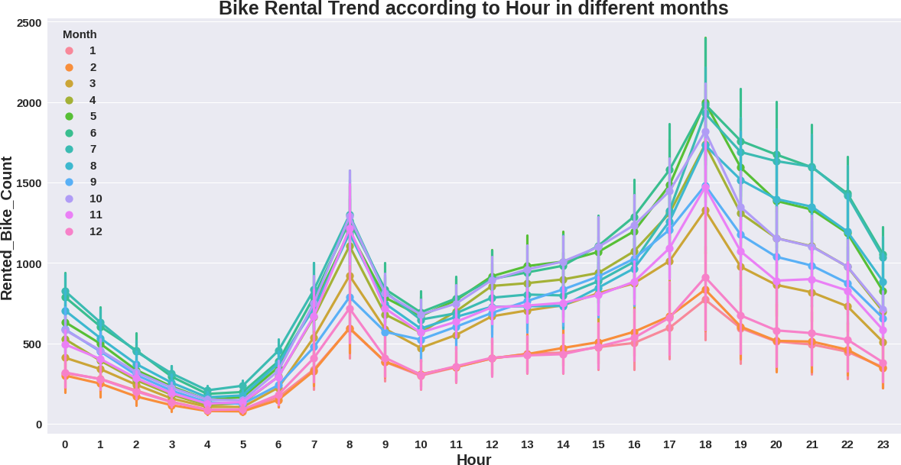
EDA (Exploratory Data Analysis) : Observation

Slide 15
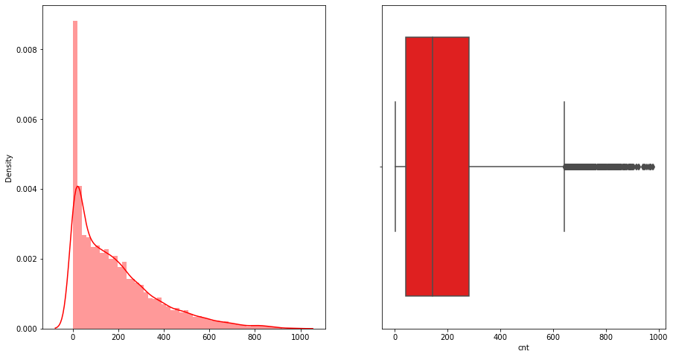
EDA (Exploratory Data Analysis) : Observation
Rental Bike
Rental Bike

Slide 16
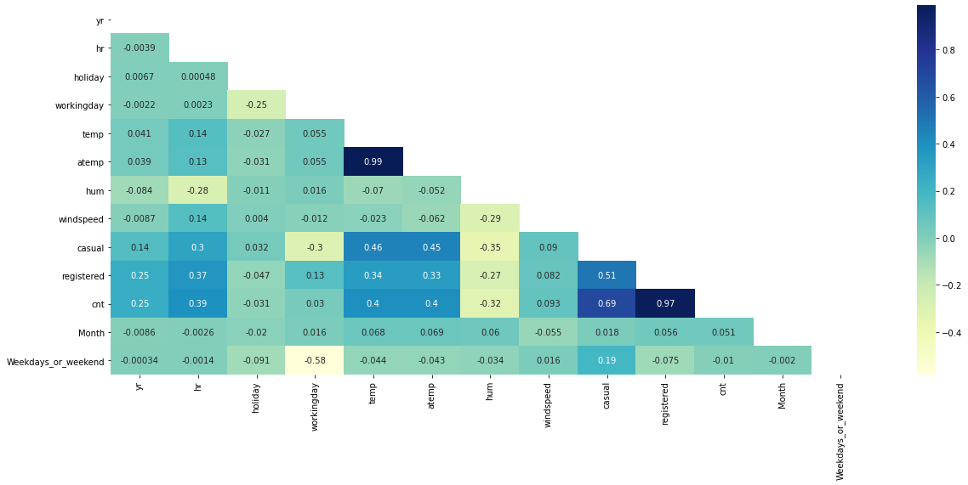
Preparation of Data for Model Building
Next we created dummy variables for categorical Seasons column and did mapping with 0 and 1 for holiday and functioning column.

Slide 17
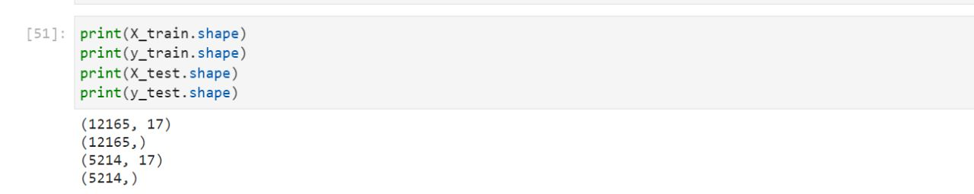
Data Standardization
Data standardization helps improve the quality of your data by transforming and standardizing it

Slide 18
Model Selection and Evaluation
As this is the regression problem we are trying to predict continuous value. For this we used following regression models.
Single and Multiple Linear Regression
Lasso regression (regularized regression)
Ridge Regression(regularized regression)
ElasticNet Regression(regularized regression)
Decision Tree Regression
Random forest Regression
AdaBoostRegressor
Gradient Boosting Regression
Xtreme Gradient Boosting Regression

Slide 19
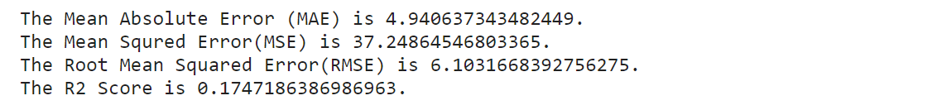
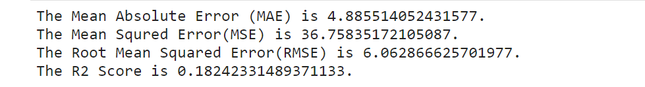
Model Selection and Evaluation
Single Linear Regression:
Train Set:
Test Set:-
Linear regression analysis is used to predict the value of a variable based on the value of another variable.

Slide 20
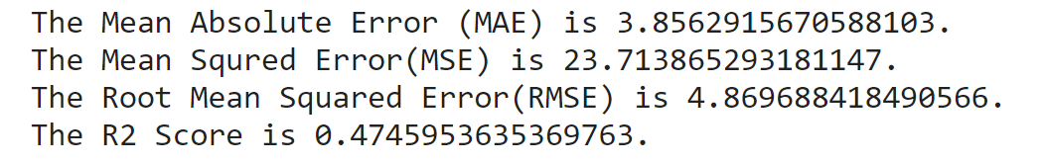
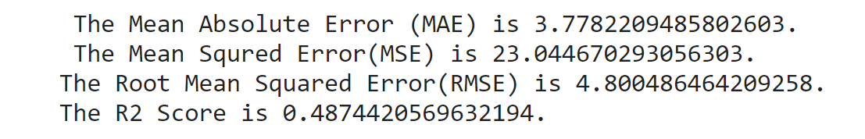
Model Selection and Evaluation
Multiple Linear Regression:
Train Set:
Test Set:-
Linear regression analysis is used to predict the value of a variable based on the value of another variable.

Slide 21
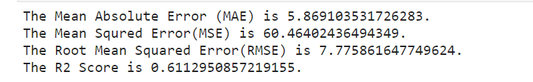
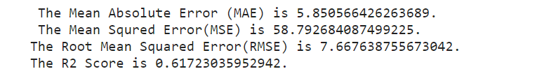
Model Selection and Evaluation
Lasso Regression:
Train Set:
Test Set:-
Lasso regression analysis is used to predict the value of a variable based on the value of another variable.

Slide 22
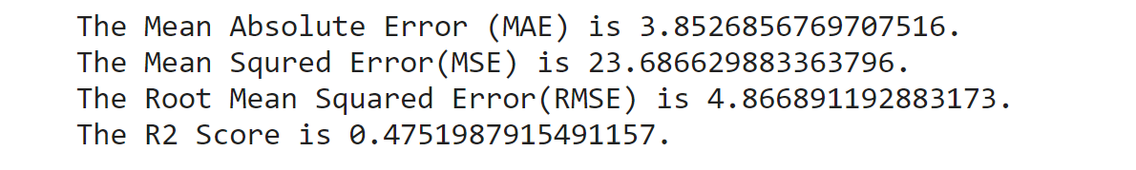
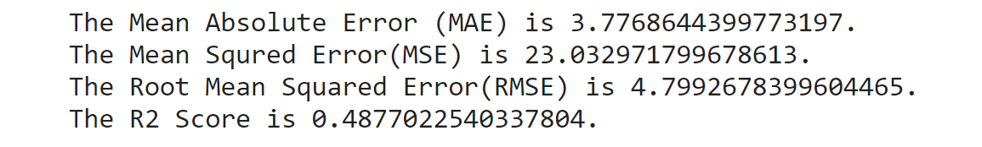
Model Selection and Evaluation
Ridge Regression:
Train Set:
Test Set:-
Ridge regression is a model tuning method that is used to analyse any data that suffers from multicollinearity.

Slide 23
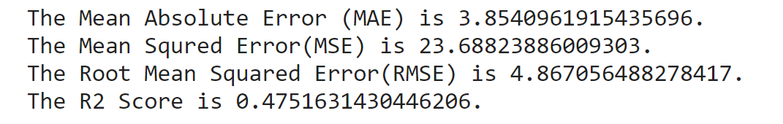
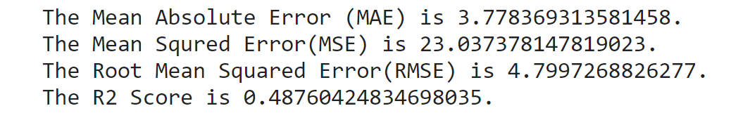
Model Selection and Evaluation
ElasticNet Regression:
Train Set:
Test Set:-
Elastic net linear regression uses the penalties from both the lasso and ridge techniques to regularize regression models.

Slide 24
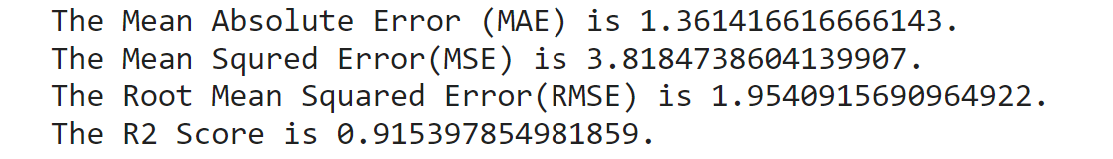
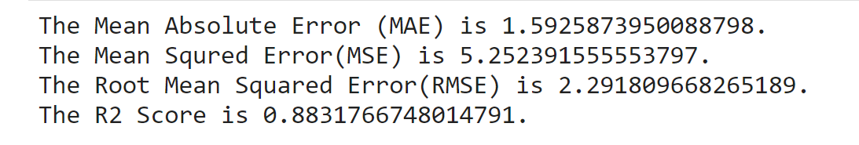
Model Selection and Evaluation
Decision Tree Regression:
Train Set:
Test Set:-
Decision tree regression observes features of an object and trains a model in the structure of a tree to predict data in the future to produce meaningful continuous output.

Slide 25
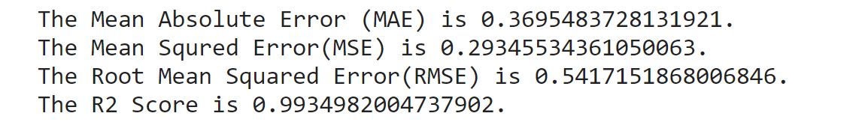
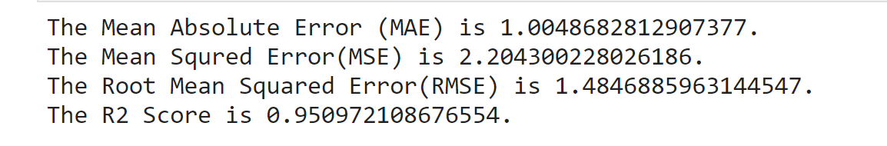
Model Selection and Evaluation
Random Forest Tree Regression:
Train Set:
Test Set:-
Random forest is a type of supervised learning algorithm that uses ensemble methods (bagging) to solve both regression and classification problems.

Slide 26
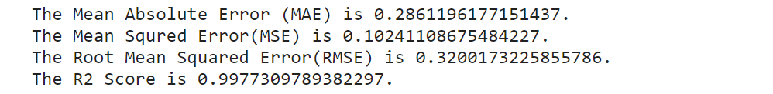
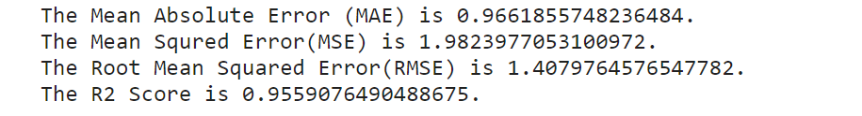
Model Selection and Evaluation
AdaBoostRegressor:
Train Set:
Test Set:-
An AdaBoost regressor is a meta-estimator that begins by fitting a regressor on the original dataset and then fits additional copies of the regressor on the same dataset but where the weights of instances are adjusted according to the error of the current prediction. As such, subsequent regressors focus more on difficult cases.

Slide 27
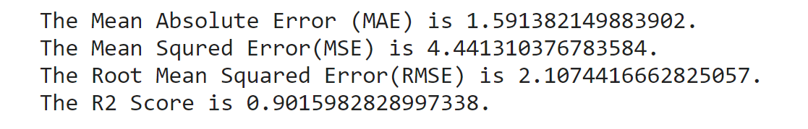
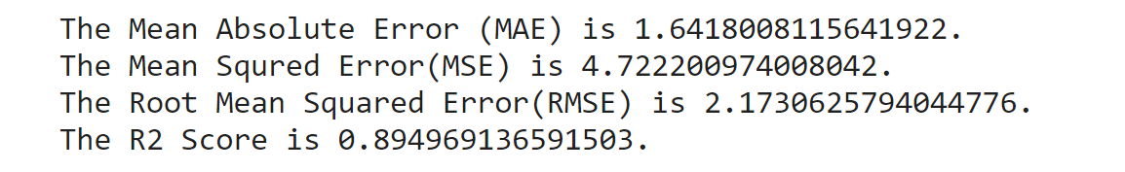
Model Selection and Evaluation
Gradient Boosting Regression:
Train Set:
Test Set:-
Similar to finding the line of best fit in linear regression, the goal of gradient descent is to minimize the cost function, or the error between predicted and actual y.

Slide 28
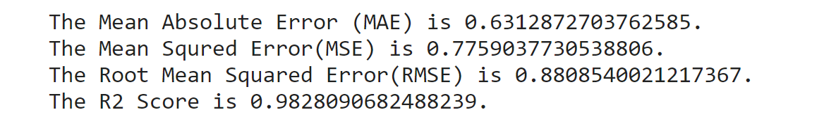
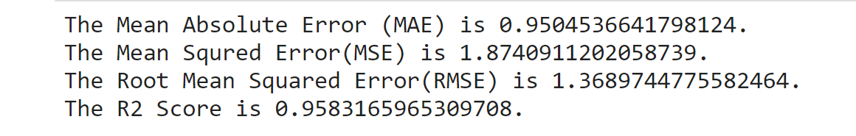
Model Selection and Evaluation
Xtreme-Gradient-Boosting Regression:
Train Set:
Test Set:-
Extreme Gradient Boosting is a tree-based algorithm, which sits under the supervised branch of Machine Learning.

Slide 29
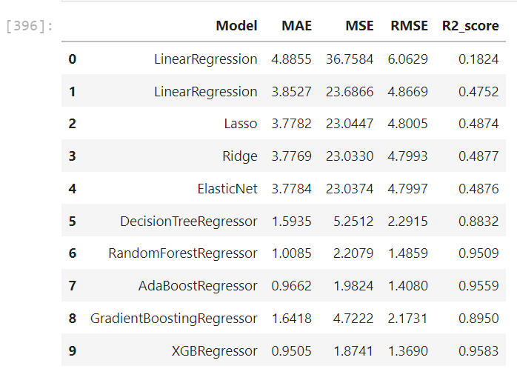
Result:

Slide 30
Conclusion:
As per our analysis Extreme Gradient Boost Algorithm gives highest accuracy as compared to other Algorithm
From this we can predict bike count required at each hour for the stable supply of rental bikes

