Slide 1





Cloud Data Company
C2C Cloud Brain
13641, Main St.
Bellevue, WA 98005, USA.
pm@click2cloud.net | + 1 425 749 7495
V-8, Laxmi Nagar,
Nagpur – 440022
contact@click2cloud.net | +91-712-3207999
F2, Beijing Silver Tower, No.2 East 3rd Ring North Road. Chao yang District., Beijing
contact@click2cloud.net | +010-64126268

Slide 2
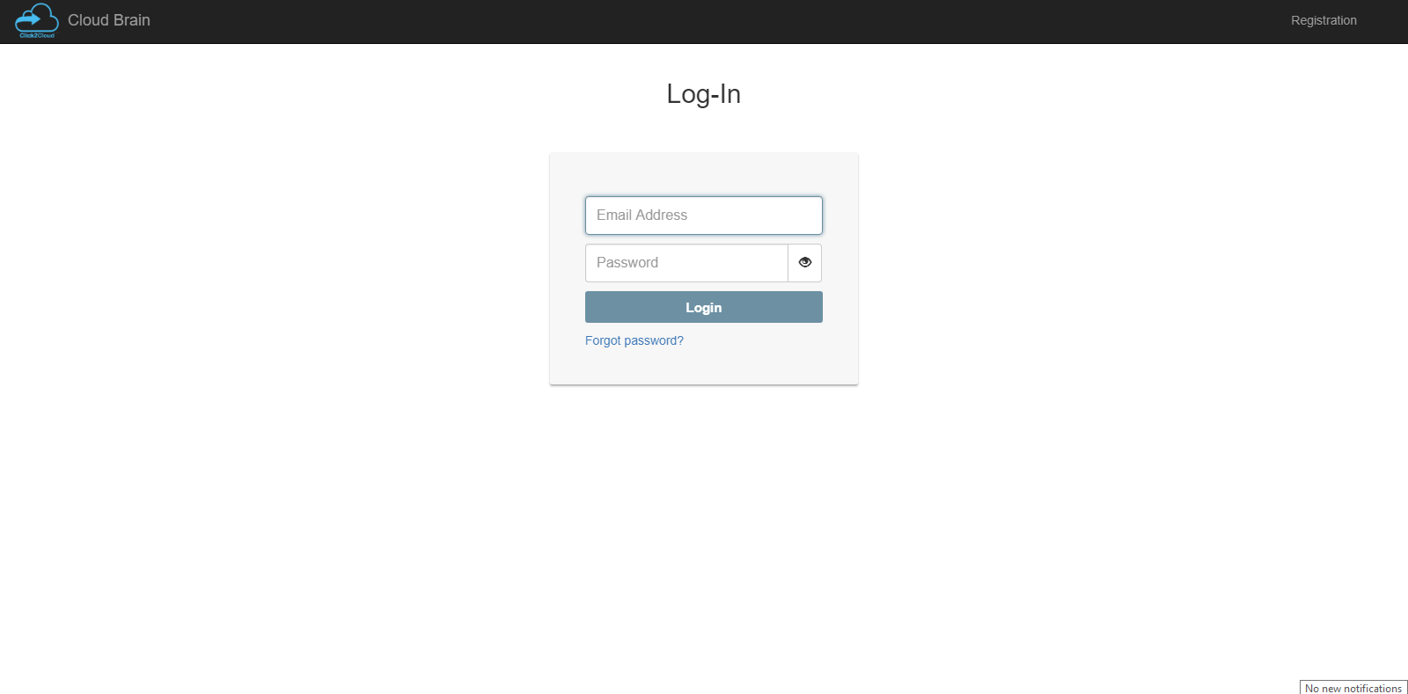
Login

Slide 3
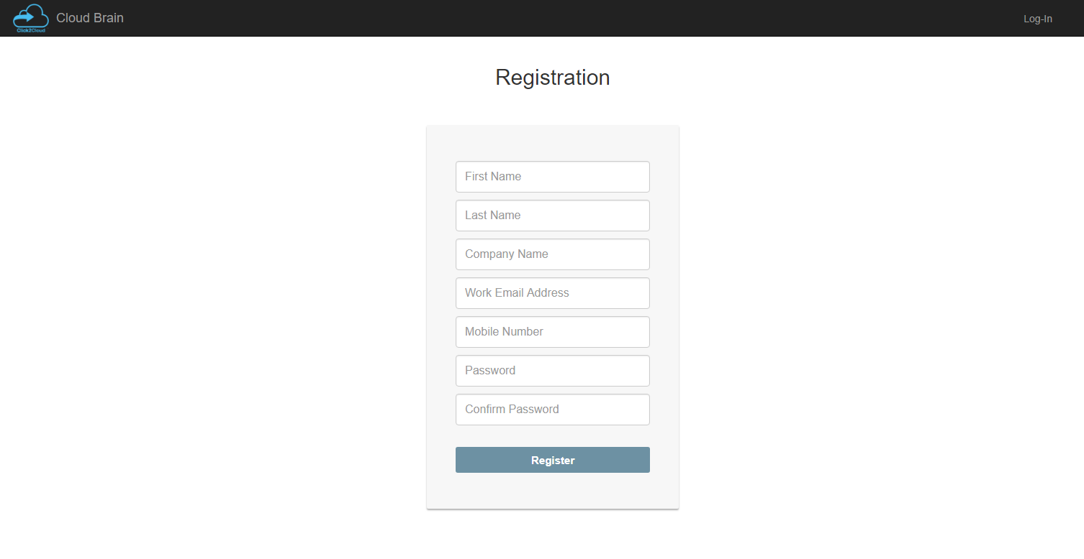
Registration

Slide 4
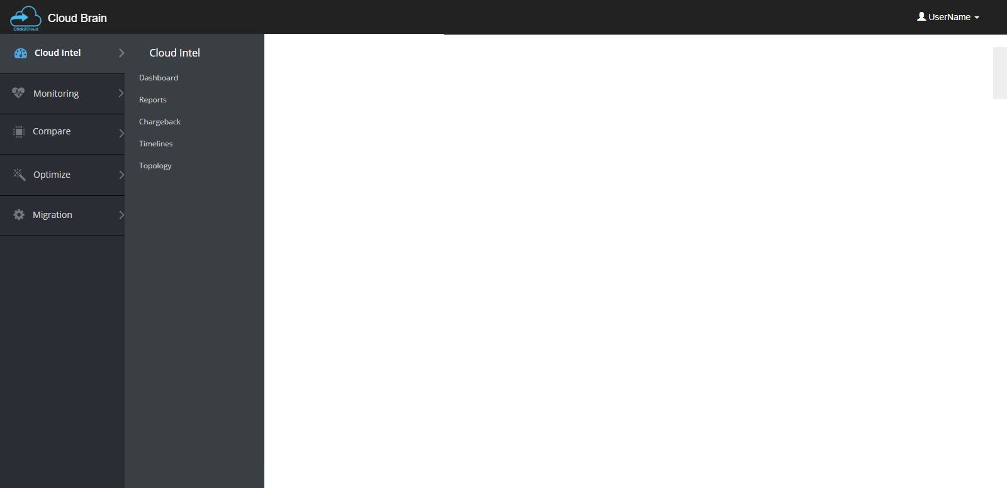
Side Menu (Cloud Intel)

Slide 5
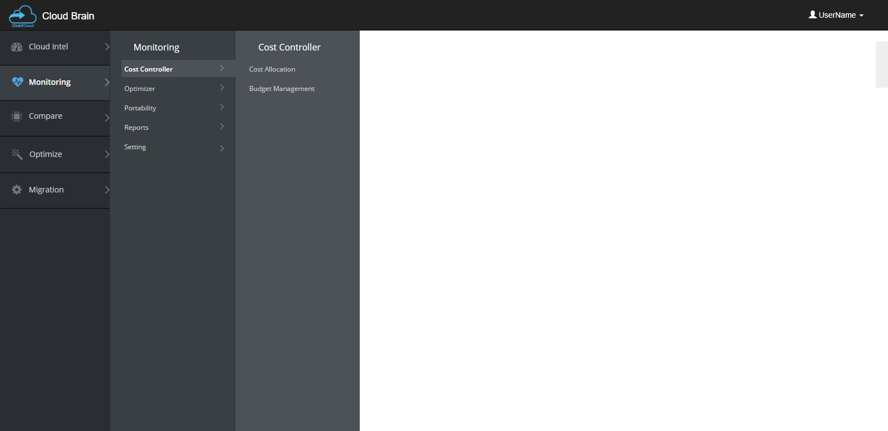
Side Menu (Monitoring – > Cost Controller)

Slide 6

Side Menu (Monitoring – > Optimizer)

Slide 7
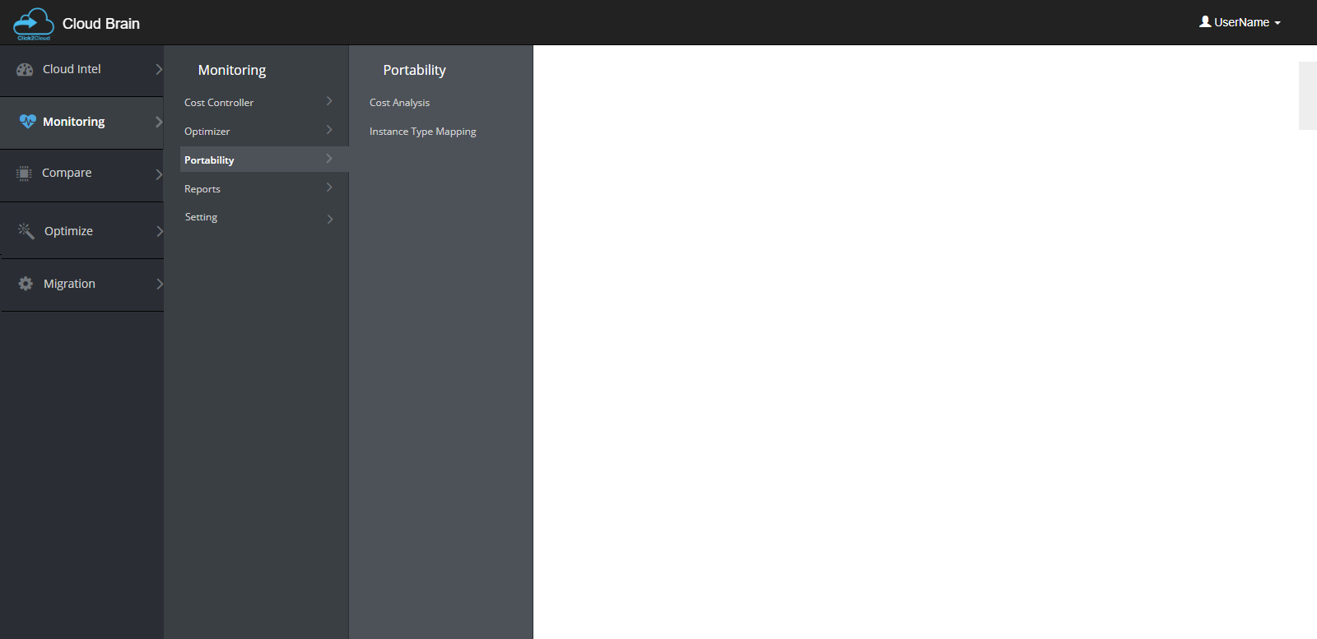
Side Menu (Monitoring – > Portability)

Slide 8
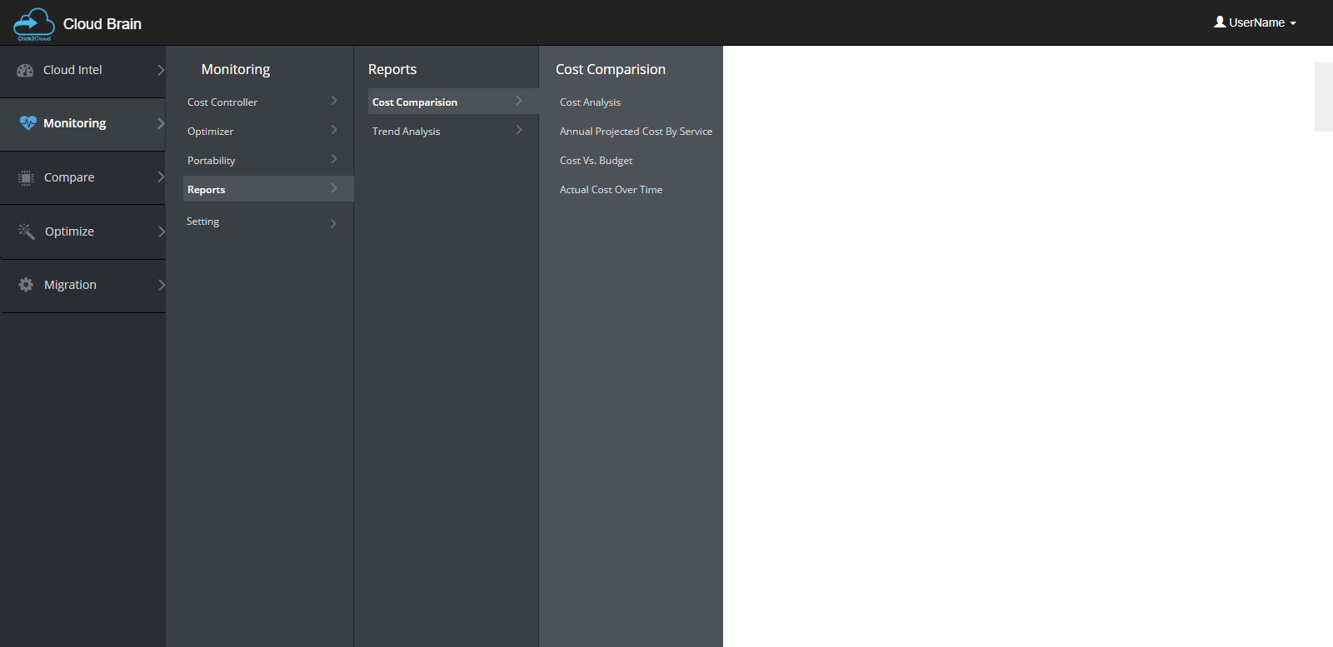
Side Menu (Monitoring – > Reports – > Cost Comparison)

Slide 9
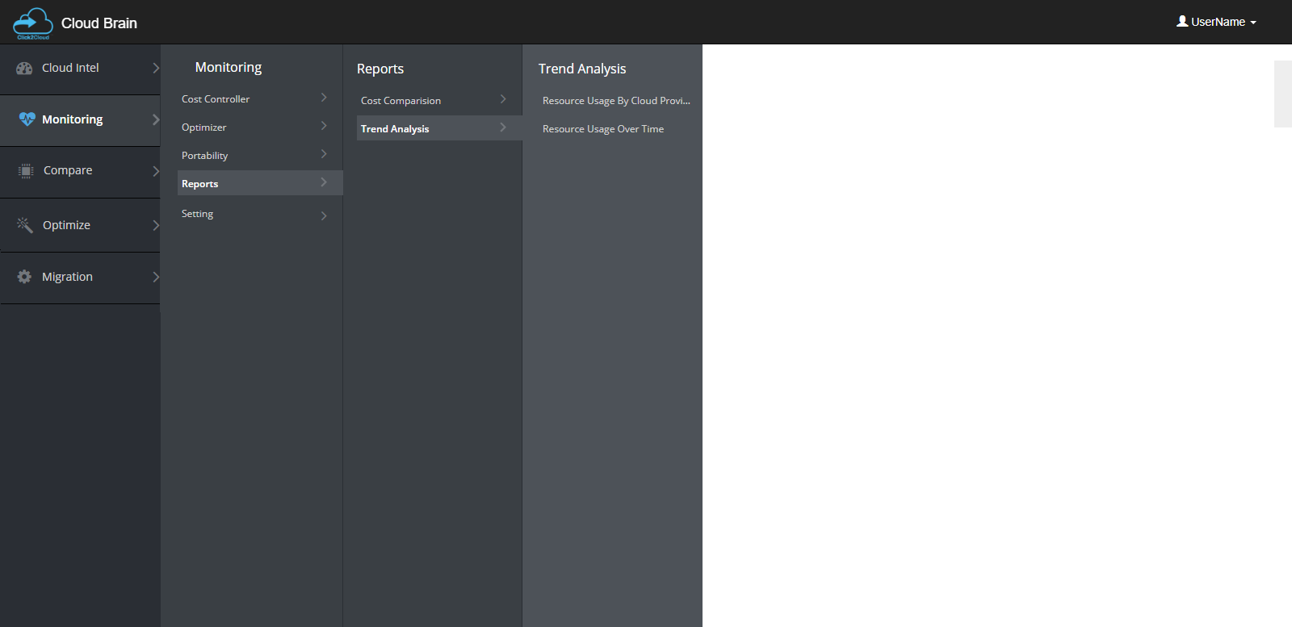
Side Menu (Monitoring – > Reports -> Trend Analysis)

Slide 10
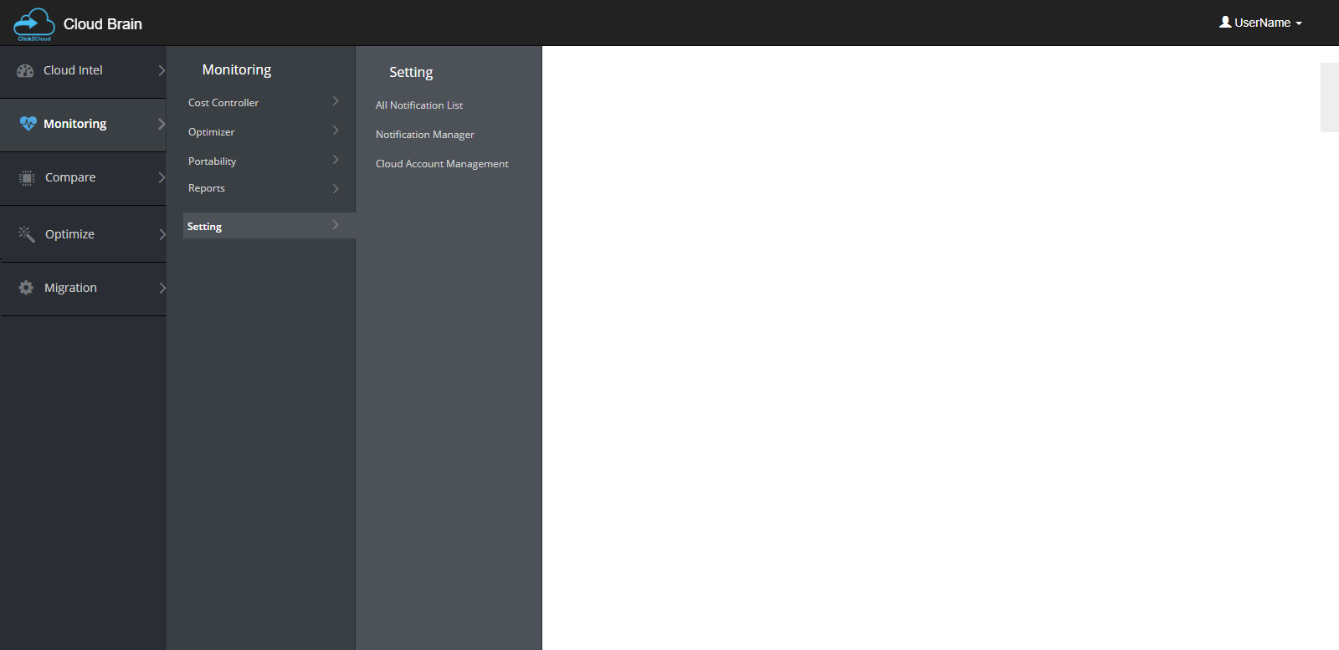
Side Menu (Monitoring – > Setting)

Slide 11
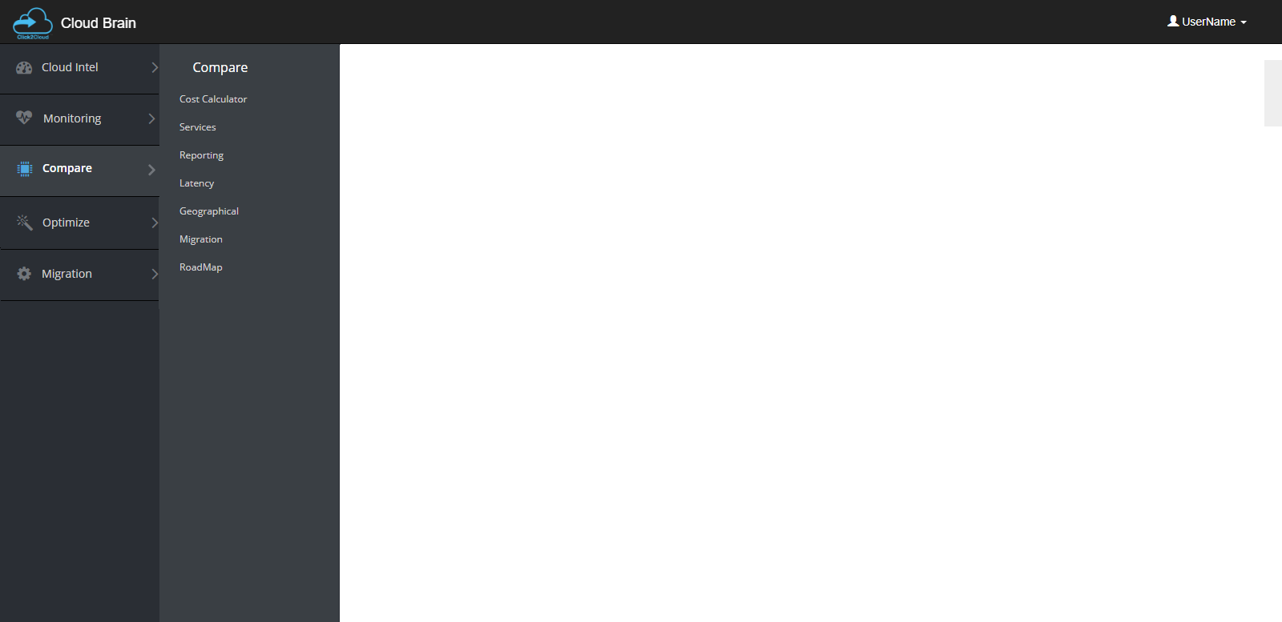
Side Menu (Compare)

Slide 12

Side Menu (Optimize)

Slide 13
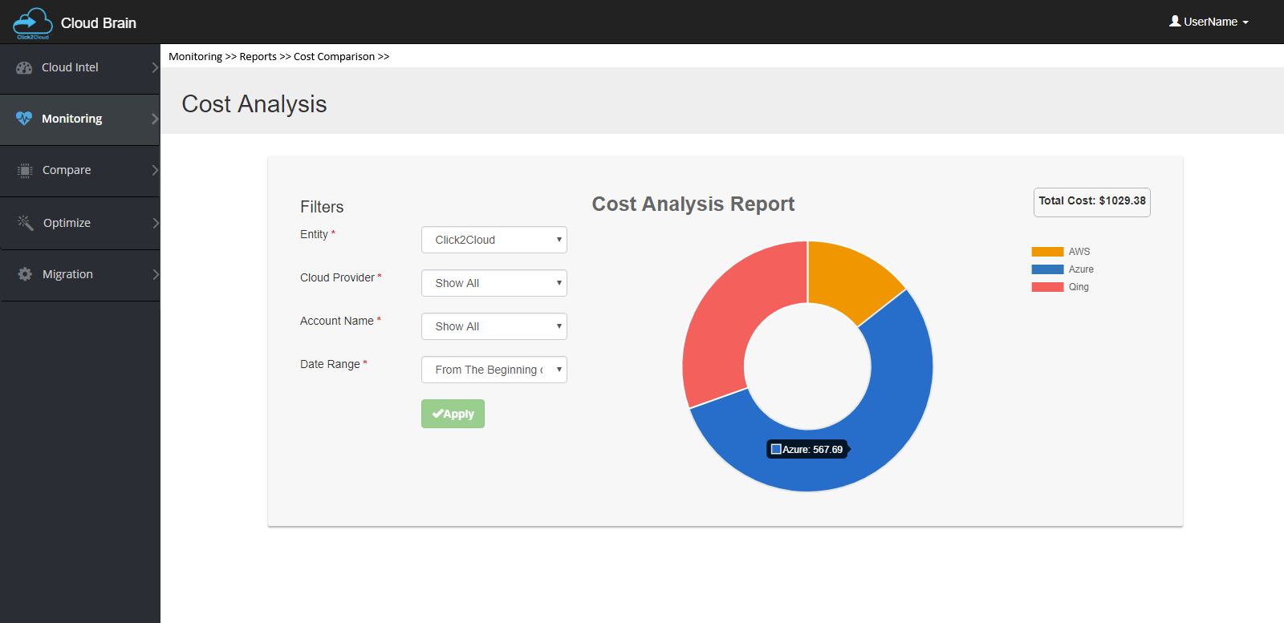
Monitoring – > Reports – > Cost Comparison

Slide 14
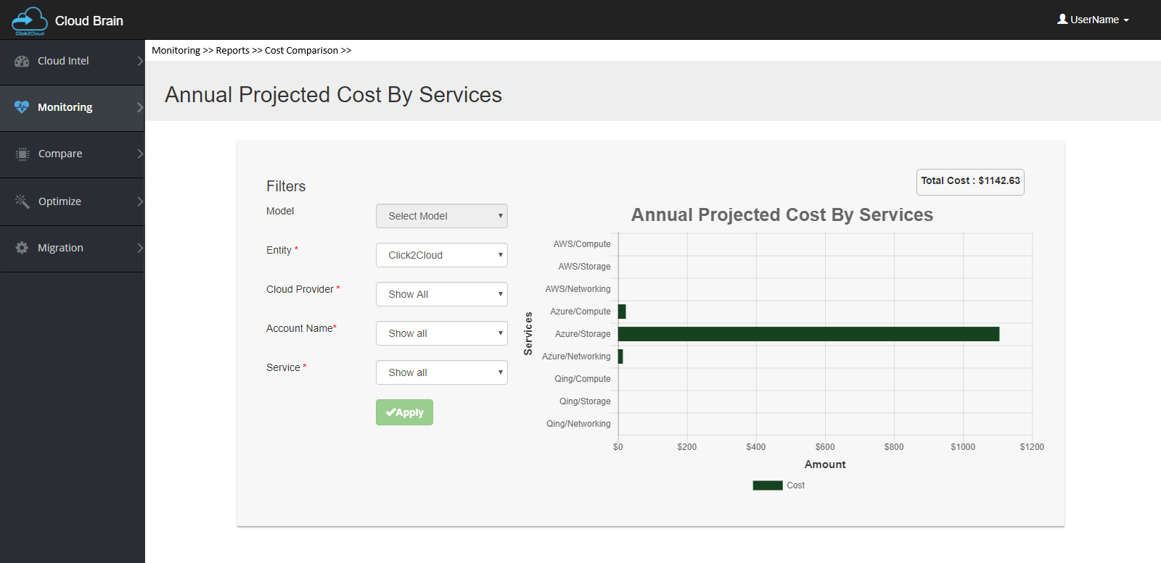
Monitoring – > Reports – > Cost Comparison

Slide 15
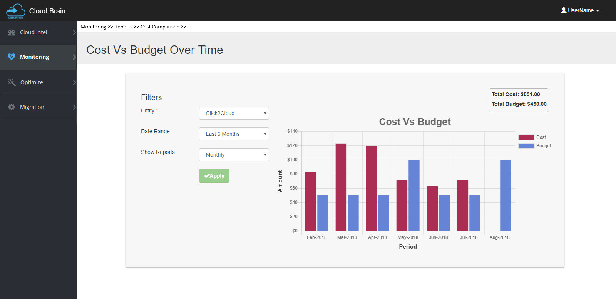
Monitoring – > Reports – > Cost Comparison

Slide 16
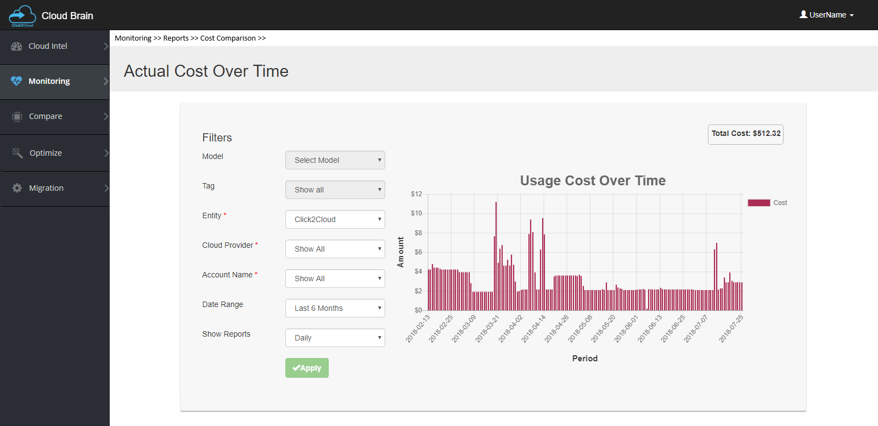
Monitoring – > Reports – > Cost Comparison

Slide 17
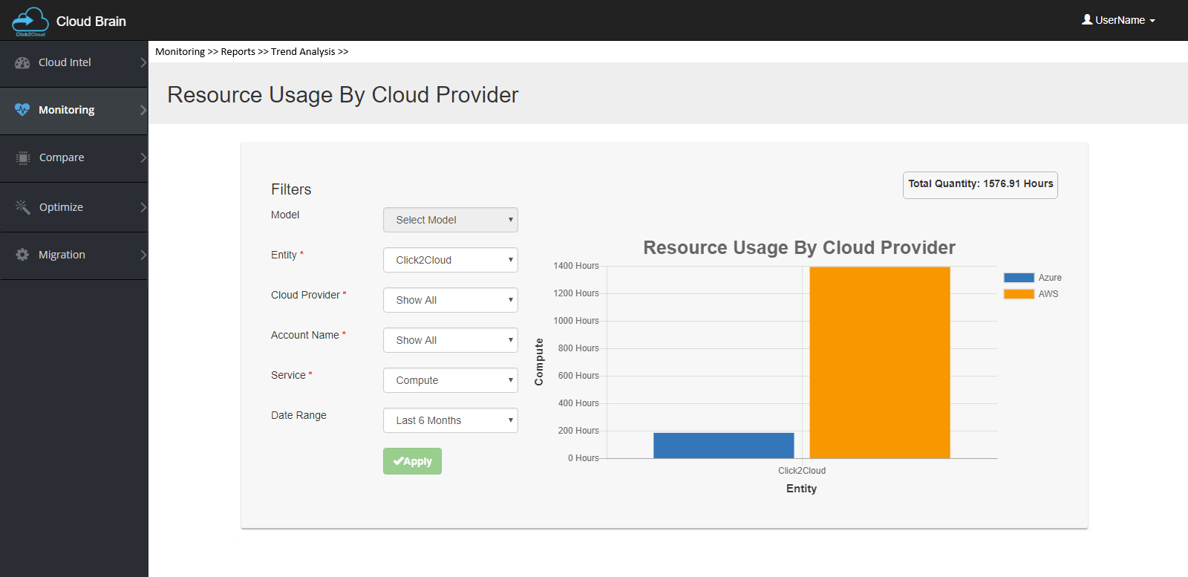
Monitoring – > Reports – > Trend Analysis

Slide 18
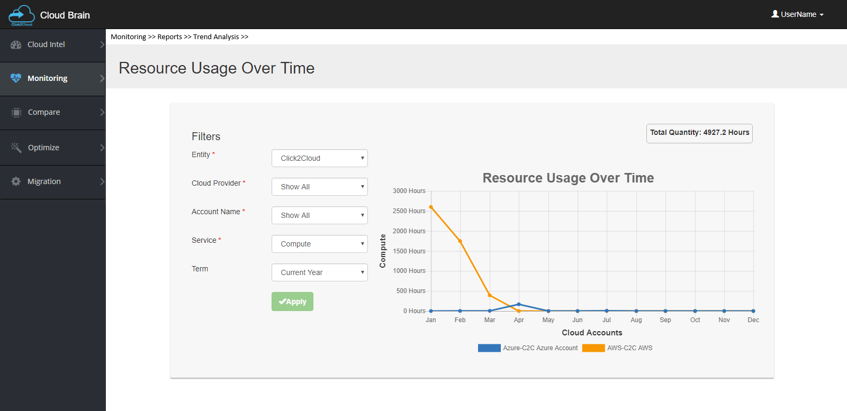
Monitoring – > Reports – > Trend Analysis

Slide 19
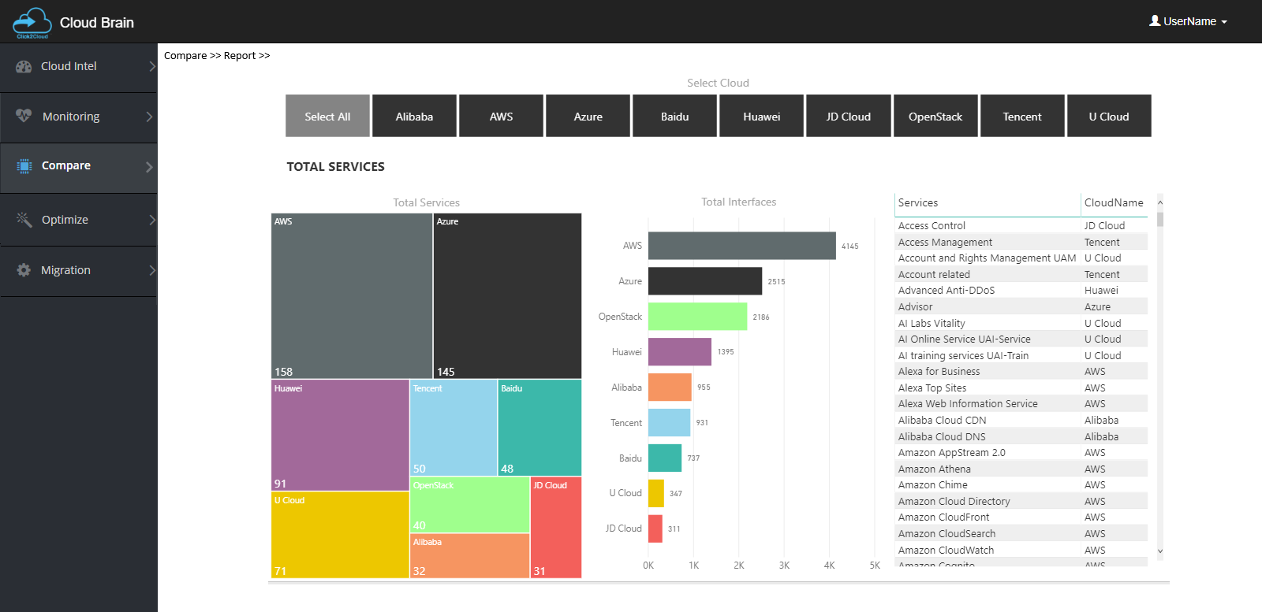
Compare – > Report

Slide 20

Thank you - Looking forward to your queries
At Click2Cloud Inc., we care about your growth. We combine the most suitable technologies with intellect and expertise to help customers meet their swiftly changing needs of global business models and dynamic requirements for sophisticated technology solutions to meet their business requirements.
Click2Cloud Headquarters
Click2Cloud India Office
Click2Cloud China Office
2549 152nd NE Ave, Redmond 98052, WA USA
Phone: +1-425-748-9666
Email: contact@click2cloud.net
Website: www.click2cloud.com
IT Park Nagpur– 440022
contact@click2cloud.net |
Phone: +91-712-3207999
Email: contact@click2cloud.net
Website: www.click2cloud.com
F2, Beijing Silver Tower, No.2 East 3rd Ring North Road. Chao yang District., Beijing
Ph: 130 23185971 / 131 62780929
Email: contact@click2yun.com
Website: www.click2yun.com
Cloud Migration Technology Company
Click2Cloud Inc.
contact@click2cloud.net | +1 425 748 9666
Notes:
Presentation for Graph + Details

