Slide 1





Click2Cloud Cloud Brain
13641, Main St.
Bellevue, WA 98005, USA.
pm@click2cloud.net | + 1 425 749 7495
V-8, Laxmi Nagar,
Nagpur – 440022
contact@click2cloud.net | +91-712-3207999
F2, Beijing Silver Tower, No.2 East 3rd Ring North Road. Chao yang District., Beijing
contact@click2cloud.net | +010-64126268

Slide 2
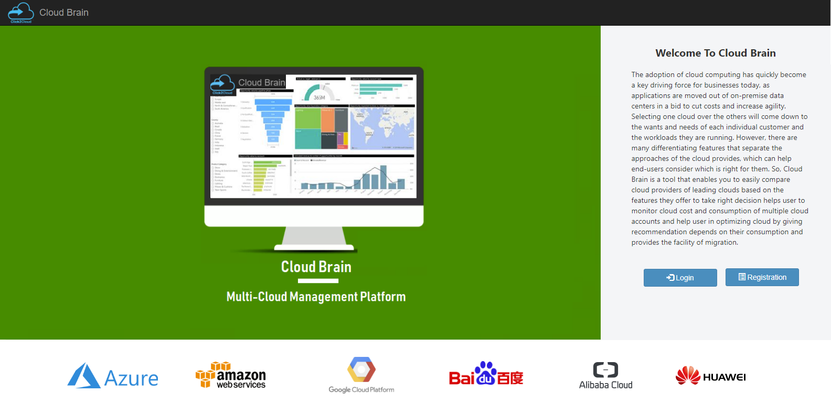
Cloud Brain

Slide 3
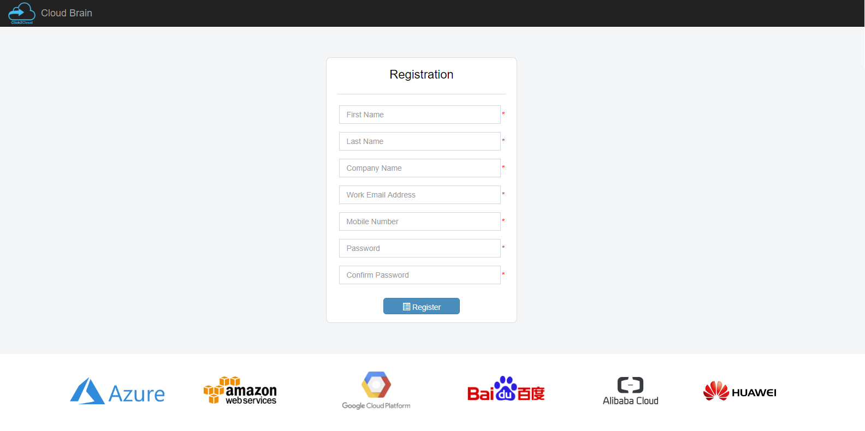
Registration

Slide 4
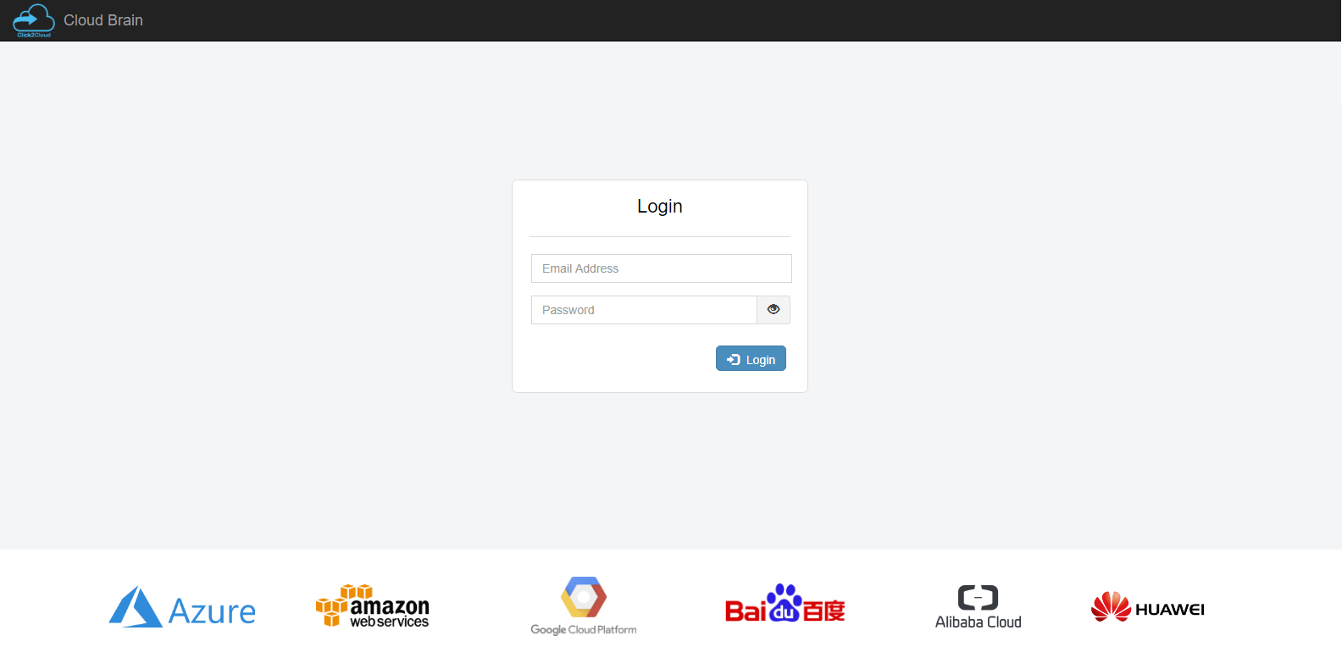
Login

Slide 5
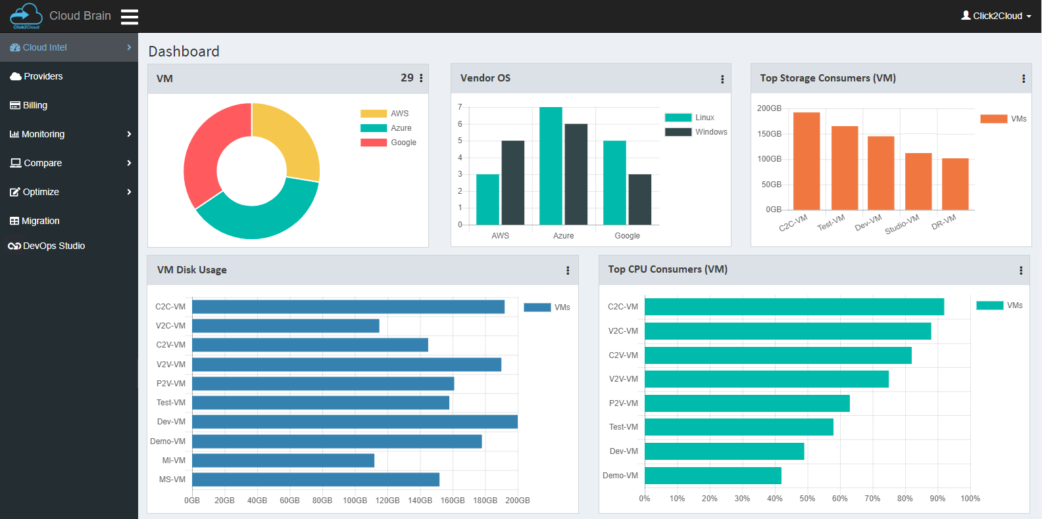
Dashboard (Cloud Intel)

Slide 6
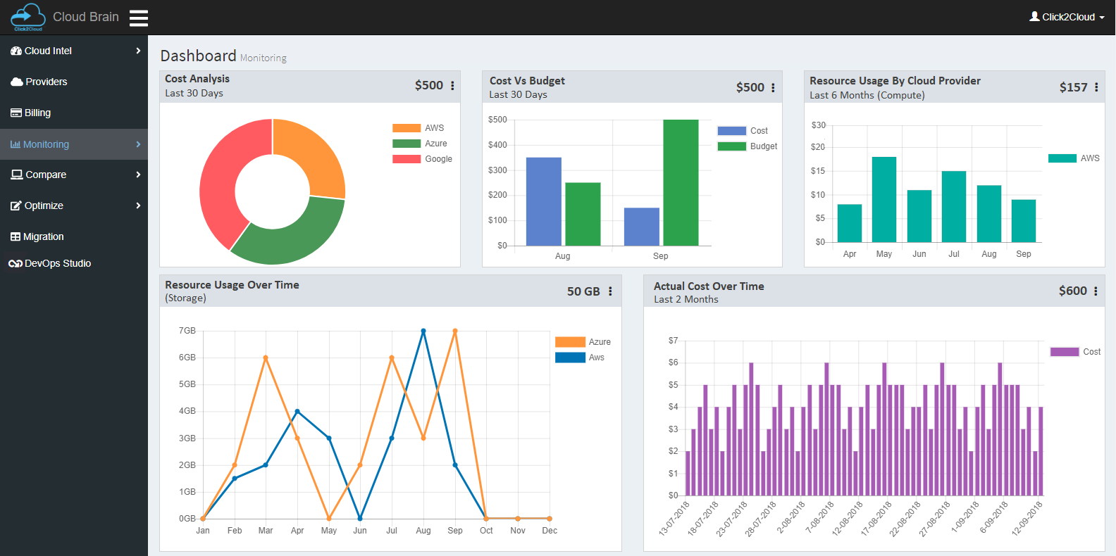
Dashboard (Monitoring)

Slide 7
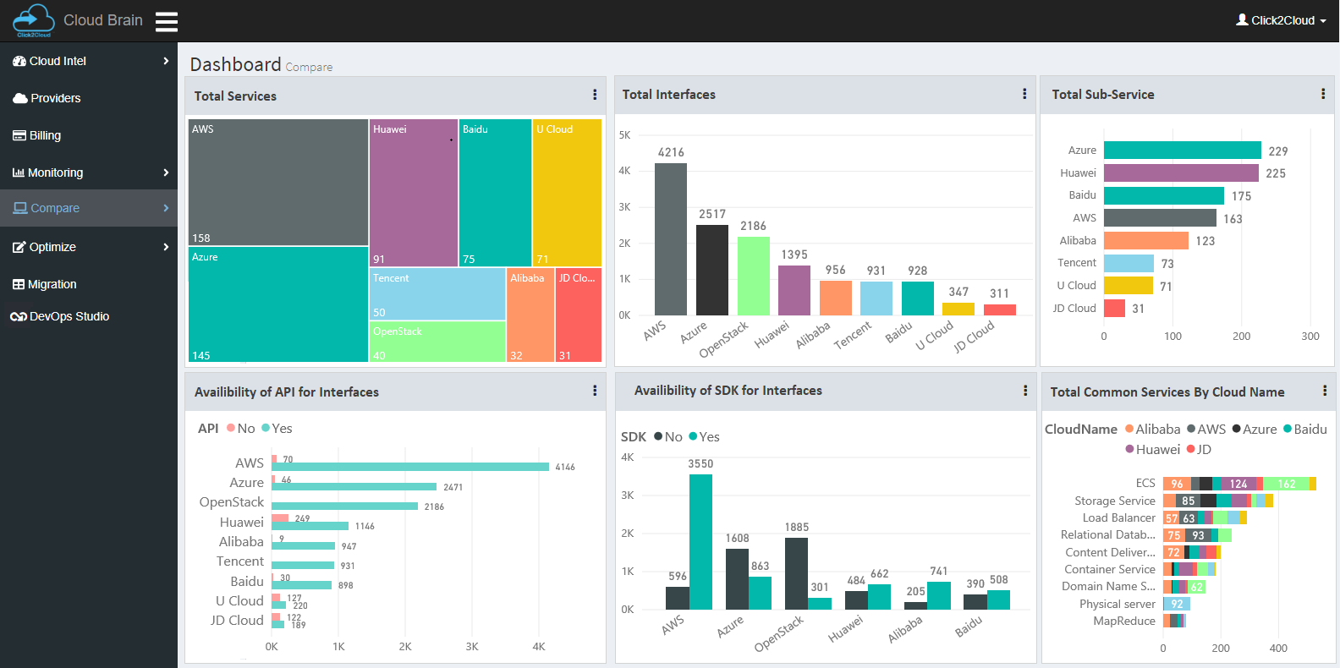
Dashboard (Compare)

Slide 8
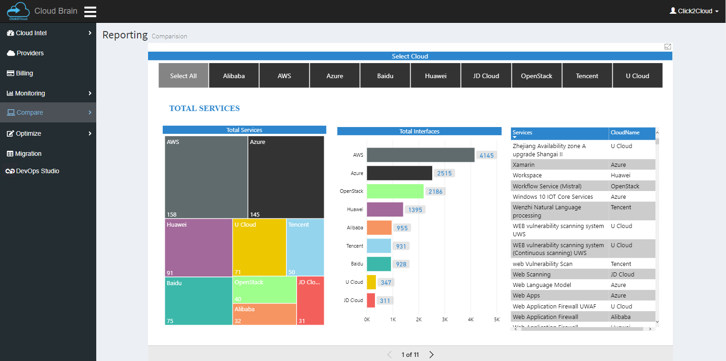
Reporting (Compare)

Slide 9
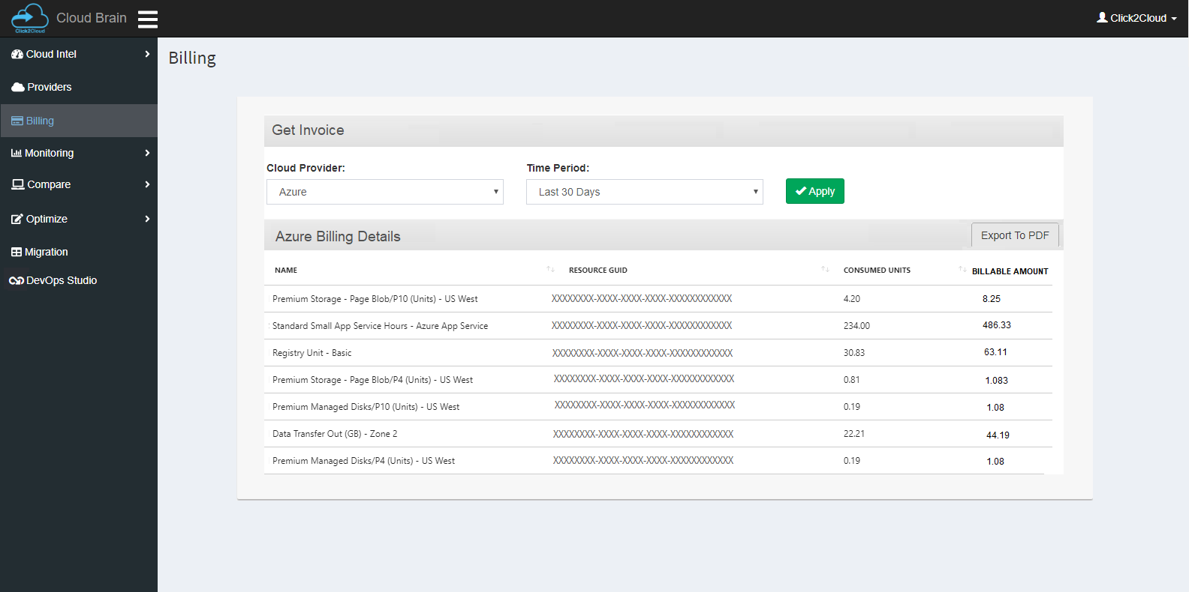
Billing

Slide 10
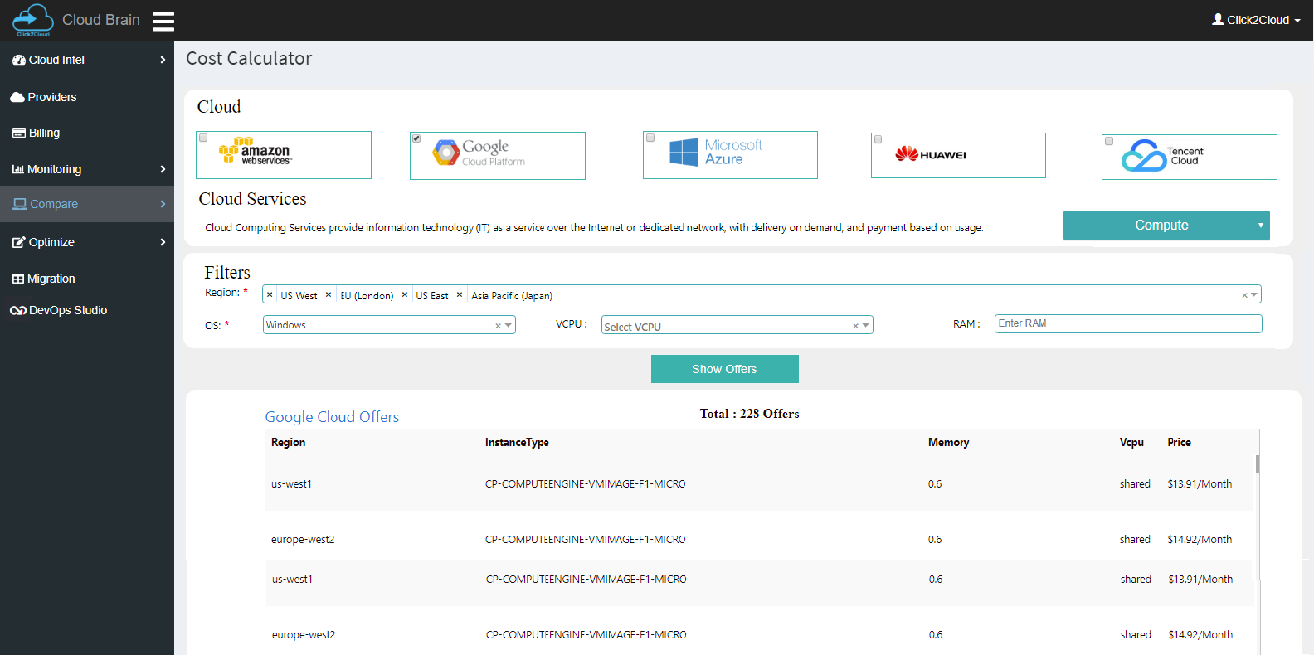
Cost Calculator (Compare)

Slide 11
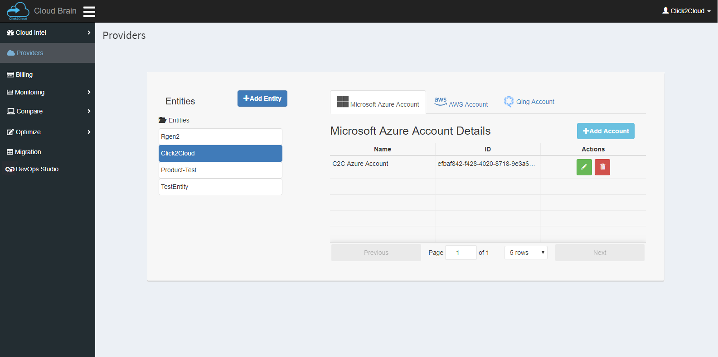
Providers

Slide 12
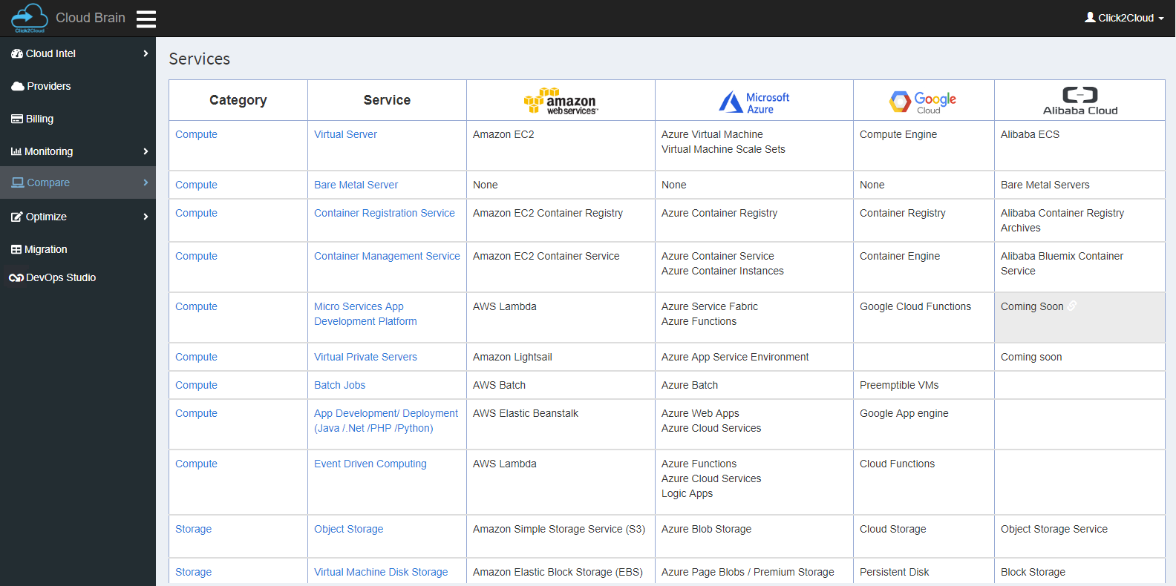
Services (Compare)

Slide 13
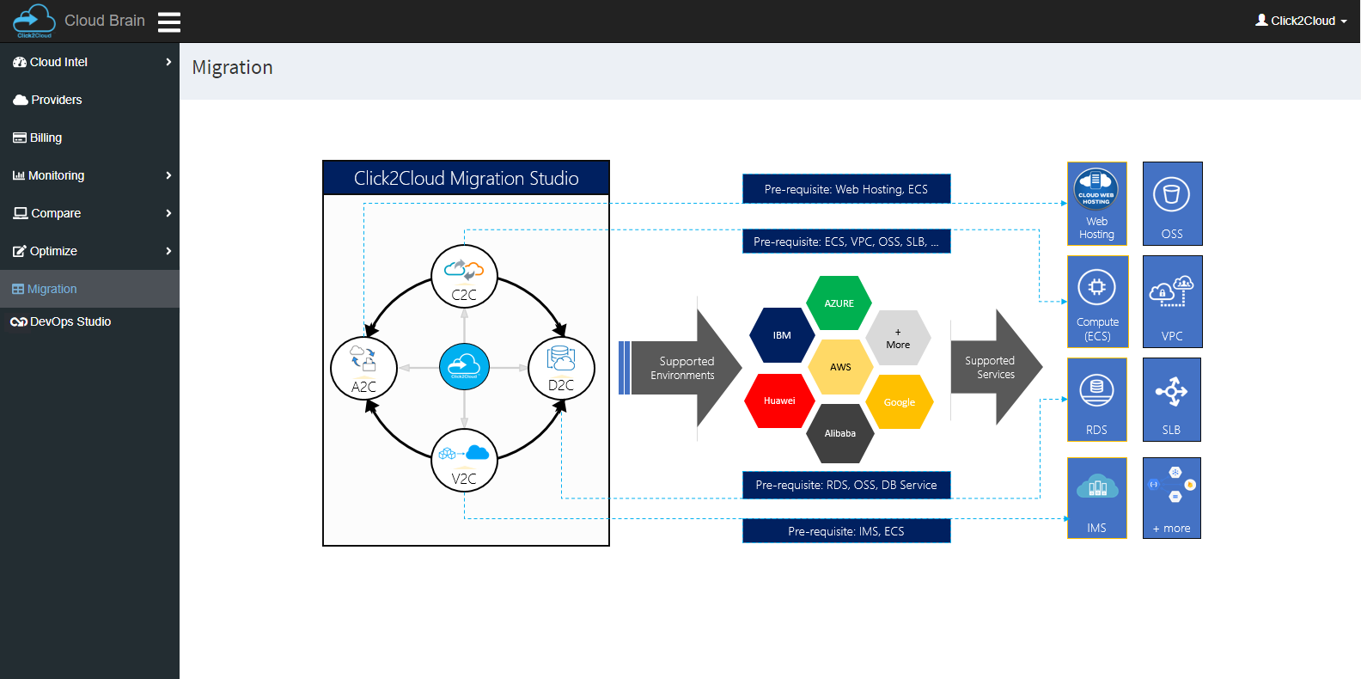
Migration

Slide 14
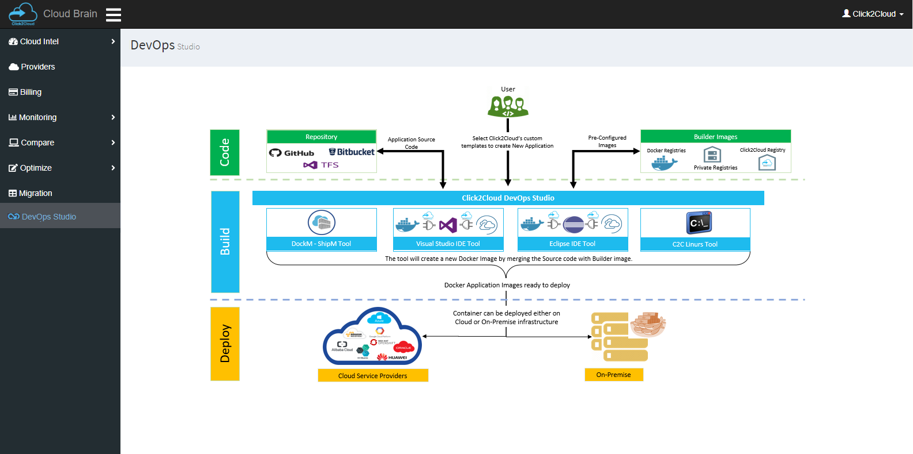
DevOps Studio

Slide 15
Thank you - Looking forward to hear your queries
At Click2Cloud Inc., we care about your growth. We combine the most suitable technologies with intellect and expertise to help customers meet their swiftly changing needs of global business models and dynamic requirements for sophisticated technology solutions to meet their business requirements.
Click2Cloud Headquarters
Click2Cloud India Office
Click2Cloud China Office
2549 152nd NE Ave, Redmond 98052, WA USA
Phone: +1-425-748-9666
Email: contact@click2cloud.net
Website: www.click2cloud.net
3, STPI, Building,
Parsodi IT Park, Nagpur - 440022
Phone: +91-712-224-8747 /
+1 425 749 7495
Email: contact@click2cloud.net
Website: www.click2cloud.net
F2, Beijing Silver Tower, No.2 East 3rd Ring North Road. Chao yang District., Beijing
Ph: 130 23185971 / 131 62780929
Email: contact@click2yun.com
Website: www.click2yun.com
Notes:
Presentation for Graph + Details

