Slide 1




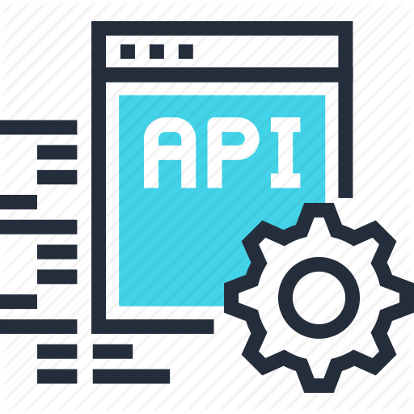
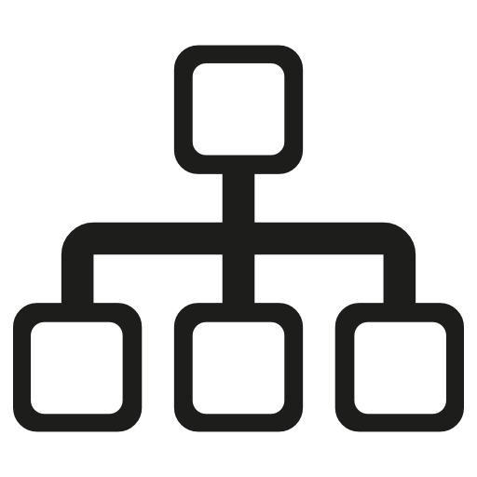
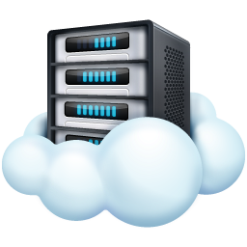
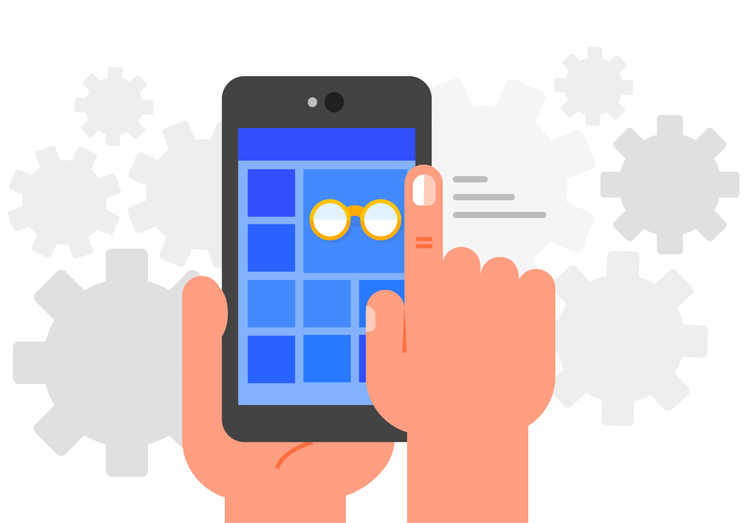



Application Stack
Custom Gophercloud
VPC Service Client
APIs
VPC Subnet
VPC Route
VPC Peering Connection
API Request
Web Server
VPC Subnet
Web Apps
Consume
USE
Cloud API
VPC Peering Connection
CLI Apps
Provider Client
SDK
Response
VPC Route
API Request Management
API Response
+ others.….
Credentials Interface
Regions and Endpoints Management
Languages Targeted
GO
OTC Cloud

Slide 2

Terraform
terraform-provider-opentelekomcloud
API Request
myservice.tf
Data Sources
Consume
otc_vpc_subnet
VPC Subnet
Resources
otc_vpc_subnet_ids
Custom Gophercloud
otc_vpc_route
VPC Subnet
otc_vpc_route_ids
Cloud API
VPC Peering Connection
Apply
otc_vpc_peering_connection
Response
VPC Route
Resources
VPC Route
VPC Peering Connection
otc_vpc_subnet
otc_vpc_route
API Response
CIDR Block
otc_vpc_peering_connection
otc_vpc_peering_connection_accepter
GO
OTC Cloud

