Slide 1

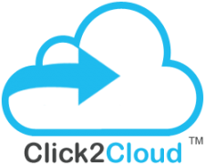
Discussion Sheet
November 16, 2018
Baidu | Click2Cloud

Slide 2


Partnership of Click2Cloud and Baidu
Step1: Baidu will introduce to customer or will share customer use cases. Also, source and destination cloud access.
Step2: As MSP Click2Cloud will migrate workload on Baidu Cloud.
Step3: Click2Cloud will also provide post-migration support.
Baidu Customers
Baidu ⇔ Click2Cloud
①Support each other
End Users

Slide 3
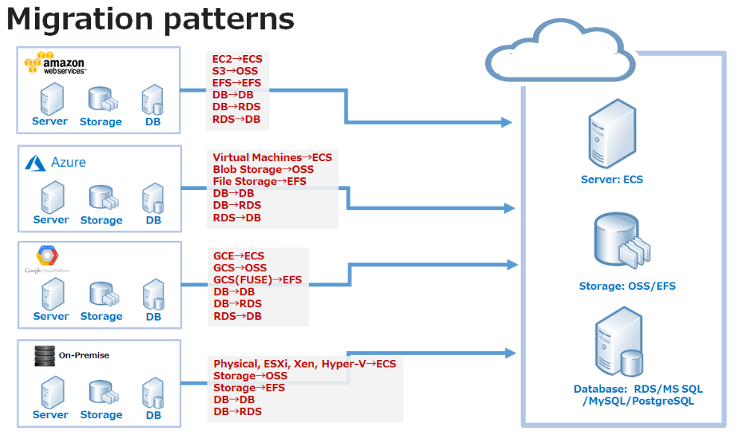
Our Migration POC Plan

Slide 4

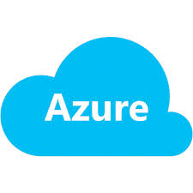






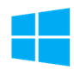
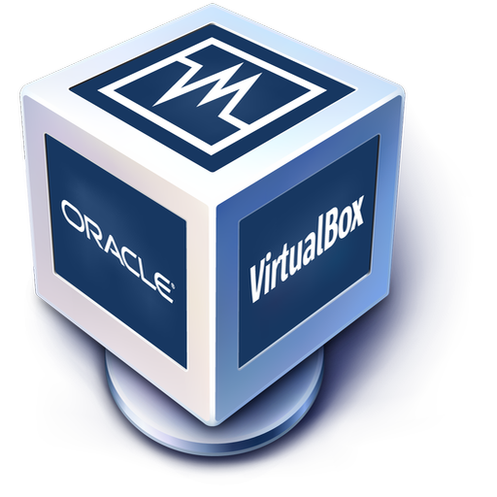
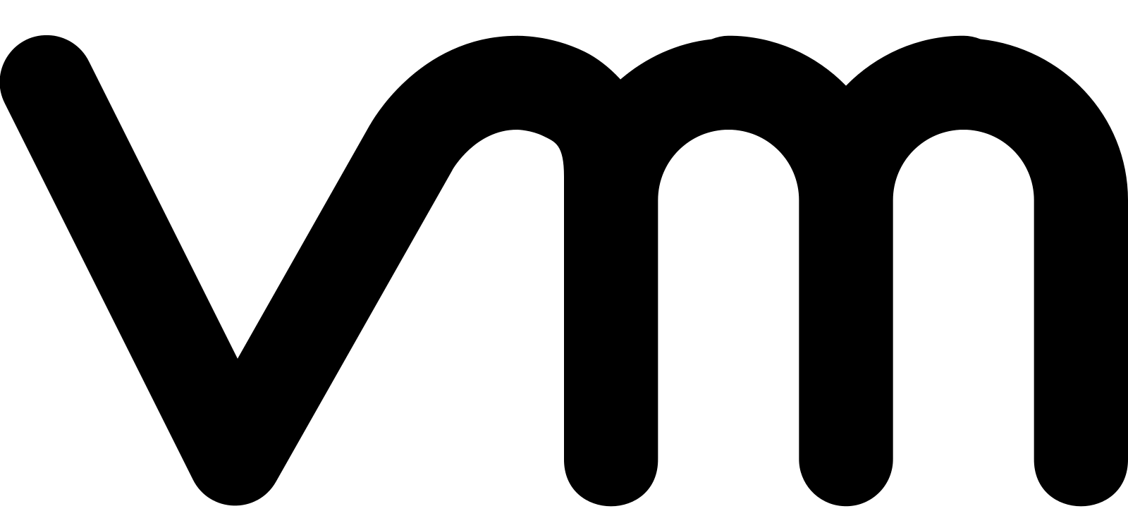



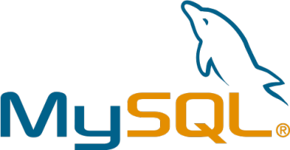

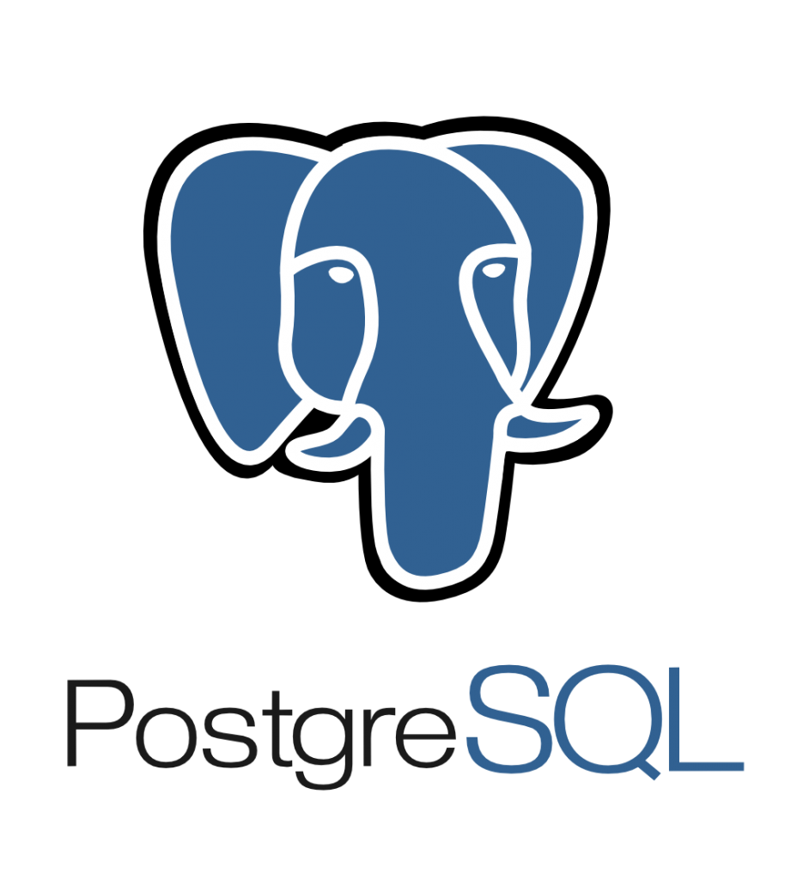
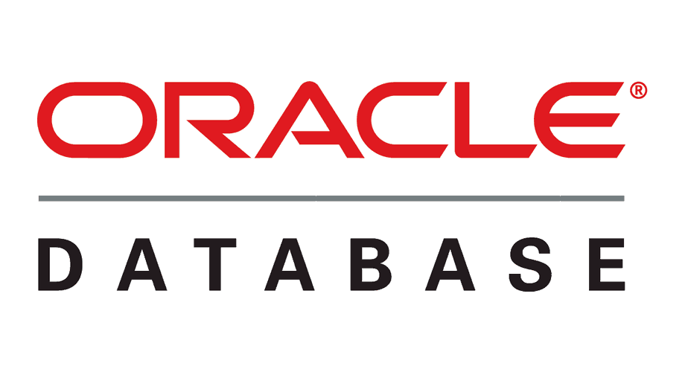
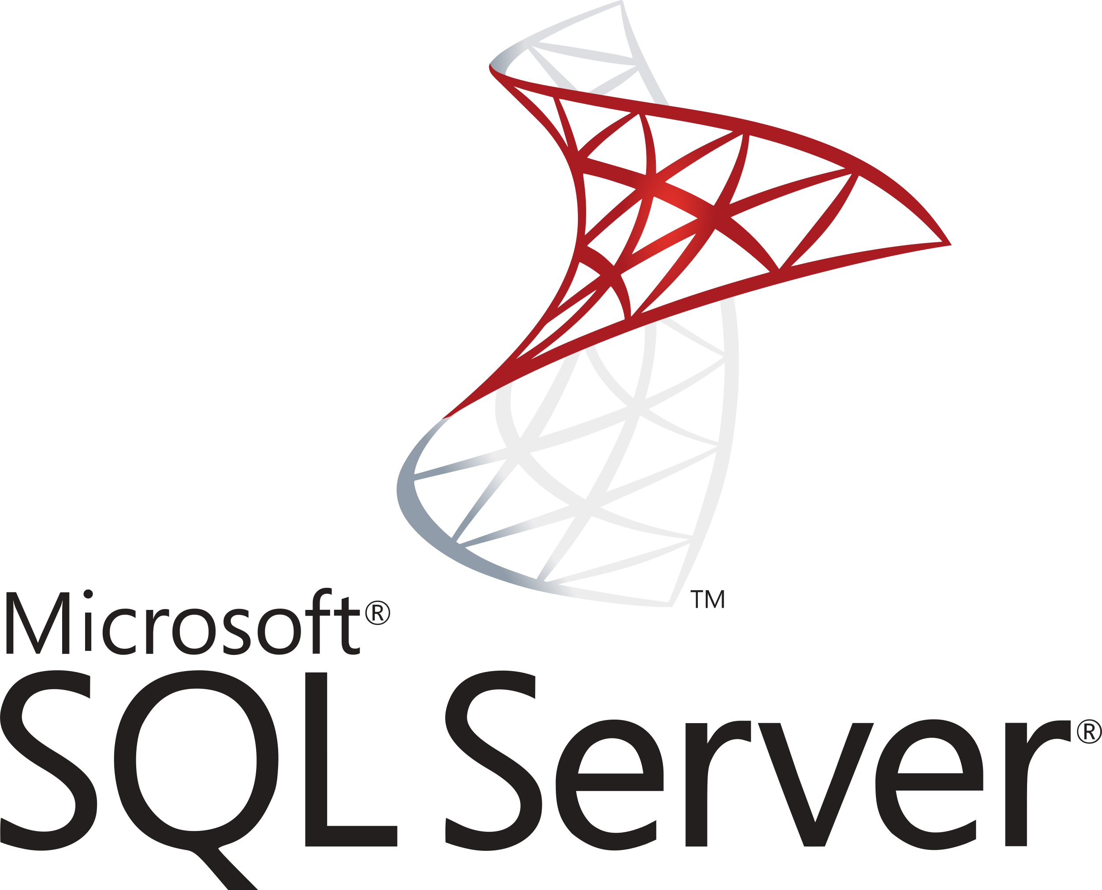



Possible Scenario & Blockage on Baidu Cloud
Migration Patterns
Cloud to Cloud
For Cloud to Cloud and Virtual to Cloud Scenarios, Baidu does not support IMS and BOS Internal Communication; If it gets fixed, we are willing to perform migration in there scenarios as well.
Virtual to Cloud
BOS
Image Service
BCC
Database to Cloud
Baidu does not have RDS support for MongoDB and Oracle.
RDS Service
Storage to Cloud
AWS S3
Azure Blob
Google Storage
Alibaba OSS
Baidu Object Storage

Slide 5




Cloud to Cloud – Migration Architecture
Top Cloud Providers
Destination Cloud
AWS
Azure
Google
User’s Workstation
BCC Instances
1
3
Config file
C2C Migration
Tool
2
Huawei Cloud SDK
Cloud SDK
BOS
Image Service
BCC
Click2Cloud Automation
Alibaba
Huawei
Clouds
Click2Cloud will assist to build
1
2
3
C2C Migration Tool; to help end users to migrate the images/VMs/BCC instances
Click2Cloud Automation Tools; to perform advance level tasks like instances provisioning
Cloud SDK for different programing languages such as Python, Ruby, Go, .NET, Java etc.

Slide 6
Virtual to Cloud – Migration Architecture
Any Virtualization Software
Destination Cloud
Hyper-V
VBox
VMWare
User’s Workstation
BCC Instances
1
3
Config file
C2C Migration
Tool
2
Huawei Cloud SDK
Cloud SDK
BOS
Image Service
BCC
Click2Cloud Automation
On-Premise
Local VHD
Xen
Any Infrastructure Location
Click2Cloud will assist to build
1
2
3
C2C Migration Tool; to help end users to migrate the images/VMs/BCC instances
Click2Cloud Automation Tools; to perform advance level tasks like instances provisioning
Cloud SDK for different programing languages such as Python, Ruby, Go, .NET, Java etc.

Slide 7
Database to Cloud – Migration Architecture
Database Environment
Destination Cloud
MySQL
MSSQL
PostgreSQL
User’s Workstation
1
3
Config file
RDS Instances
C2C Migration
Tool
2
Huawei Cloud SDK
Cloud SDK
RDS Service
Click2Cloud Automation
MongoDB
Oracle DB
Click2Cloud will assist to build
1
2
3
C2C Migration Tool; to help end users to migrate the databases from source cloud RDS to destination cloud RDS
Click2Cloud Automation Tools; to perform advance level tasks
Cloud SDK for different programing languages such as Python, Ruby, Go, .NET, Java etc.

Slide 8
Storage to Cloud – Migration Architecture
Cloud Storage Services
Destination Cloud
AWS S3
Azure Blob
Google Storage
User’s Workstation
Storage Buckets
1
3
Config file
C2C Migration
Tool
2
Huawei Cloud SDK
Cloud SDK
Baidu Object Storage
Click2Cloud Automation
Alibaba OSS
Huawei OBS
Storage’s
Click2Cloud will assist to build
1
2
3
C2C Migration Tool; to help end users to migrate the storage data from source cloud to destination cloud
Click2Cloud Automation Tools; to perform advance level tasks
Cloud SDK for different programing languages such as Python, Ruby, Go, .NET, Java etc.

Slide 9
Migration Matrix Report

