Slide 1


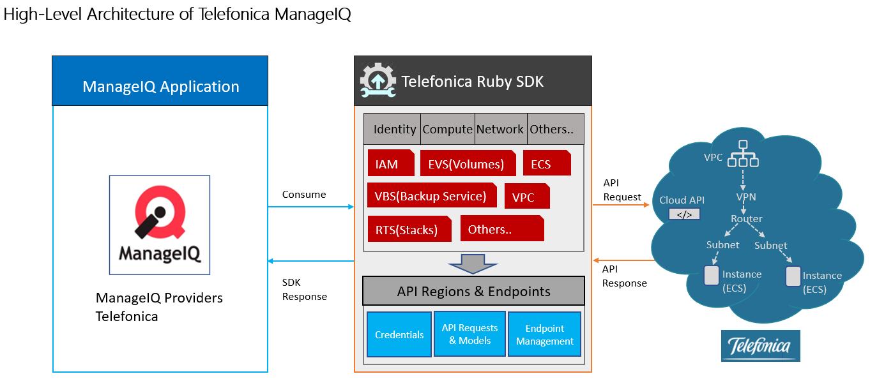










Open-source cloud management platform
Supported platforms
Business Scenarios:
Intelligent Workload Management
Power on only during business hours, ManageIQ automate
Auto-Tagging virtual machines based on file contents
Features:
Self-Service, allowing IT staff to present a catalog to users from which they can select automated services.
Compliance enforcement, allowing an IT department to enforce certain compliance policies.
Optimization, allowing IT staff to optimize the resource utilization of an environment, for example using right sizing and capacity planning.
Project Goal:
Project Status:
Roadmap:
Development of ManageIQ Provider for Telefonica Cloud
Development of Ruby SDK for Telefonica Cloud APIs
Integration of ManageIQ Telefonica provider for available services
Specification documentation and analysis in progress
Development of Ruby SDK for Telefonica Cloud APIs is in progress
Development of ManageIQ provider for Telefonica Cloud APIs is in progress
1
Phase-I
ManageIQ Provider for Services ECS, EVS, IAM, VPC
2
Phase-II
ManageIQ Provider for Services VBS, ELB, RTS, IMS
3
Phase-III
ManageIQ Features with suggestions and enhancements

