Slide 1

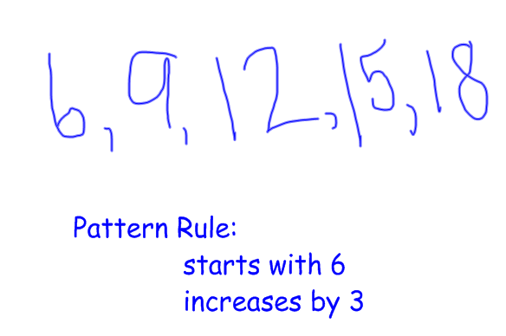


Do you know ?
Pattern
is an excellent way to memorize things
Don't believe me..Try yourself

Slide 2
Can you remember this number ?
31025003
Little Difficult..Huh!! Need help ?

Slide 3
Wow!! Patterns are magical :)
Was it 30 May 2013 written backwards ?
2013-05-30
Now, I can remember it forever

Slide 4
MemoizR (It's cool)
- Let's see how you create a pattern to memorize things.
- You have to arrange your pictures in the correct order
in which they are being taken.
- You can select difficulty level from top header bar.
- Pictures will be shuffled randomly once finished capturing.
- Place your mouse over an image to see the bigger view.
- Click image to select it.
Press Start Game button to begin

