Slide 1
DATA ANALYTICS PROJECT
SLA & TAT
Performance Analysis
Operational ticket reporting | September 2026
Tools: Excel • Power Query • Power BI
Portfolio case study | Data preparation, KPI reporting and recommendations

Slide 2
Project objective & workflow
A reporting solution designed to monitor ticket turnaround and SLA performance.
Business objective
Reporting workflow
Clean ticket data, calculate turnaround time (TAT) and SLA compliance, monitor breaches and open tickets, compare teams, and communicate findings to management.
01
Raw ticket data
02
Power Query cleaning
03
SLA & TAT calculations
Skills demonstrated
04
Excel reporting model
Data cleaning • KPI calculations • SLA/TAT analysis • Visualisation • Interactive filtering • Management reporting
05
Power BI dashboard & insights
02

Slide 3
Headline performance
September 2026 | Support Operations | 35 tickets in the reporting dataset.
TOTAL TICKETS
AVERAGE TAT
SLA COMPLIANCE
SLA BREACH RATE
35
27.5 hrs
82.35%
17.14%
Ticket status distribution
Initial reading
Within SLA
28 tickets
80.0%
Six tickets breached SLA; this represents 17.14% of all tickets.
SLA breached
6 tickets
17.14%
One ticket remains open and should be monitored to closure.
Open
1 ticket
2.86%
Note: The dashboard reports SLA compliance separately from breach rate; retain the project's existing calculation definitions when explaining the metrics.
03

Slide 4
Team comparison: the key finding
Technical has materially lower SLA compliance despite similar average turnaround time.
SLA compliance by team
Average TAT
Support
94.44%
Support
28 hrs
Technical
68.75%
Technical
27 hrs
Management insight
Technical accounts for 5 of the 6 SLA breaches. Since average TAT is similar (27 vs 28 hours), investigate SLA adherence, ticket priority, assignment and escalation handling rather than assuming turnaround time alone explains the gap.
04

Slide 5
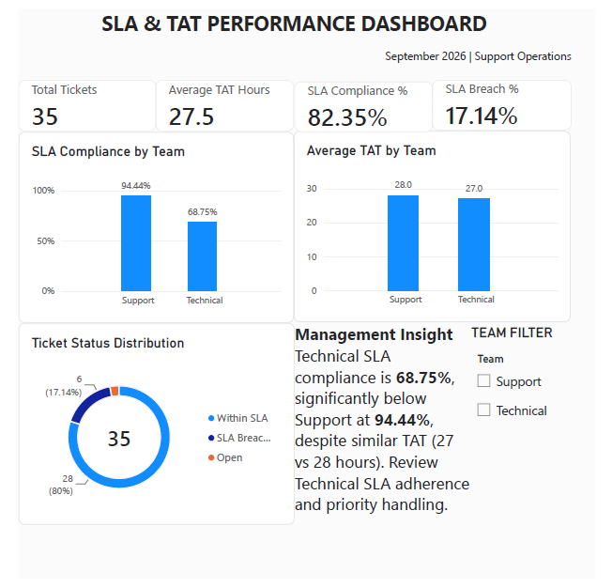
Power BI dashboard
Interactive operational overview with headline KPIs, team-level comparisons, status distribution and a team filter.
Built in Power BI; the submitted project files also include the PBIX workbook and dashboard PDF.
05

Slide 6
Recommendations & next steps
Convert the observed performance gap into a focused review plan.
01
Review Technical breaches
Audit the five Technical SLA breaches by priority, assignment, escalation and breach reason.
02
Check ticket-level patterns
Compare ticket type, age, priority and handling steps to identify recurring drivers.
03
Monitor open ticket
Track the one open ticket to closure and verify whether it approaches an SLA limit.
04
Improve the reporting loop
Review the dashboard with stakeholders and update filters or KPIs based on feedback.
05
Validate before publishing
Reconcile ticket counts, status categories and SLA calculation rules before each refresh.
Conclusion: The dashboard does not just summarize tickets—it highlights where SLA performance needs investigation and gives management a starting point for action.
06

Slide 7
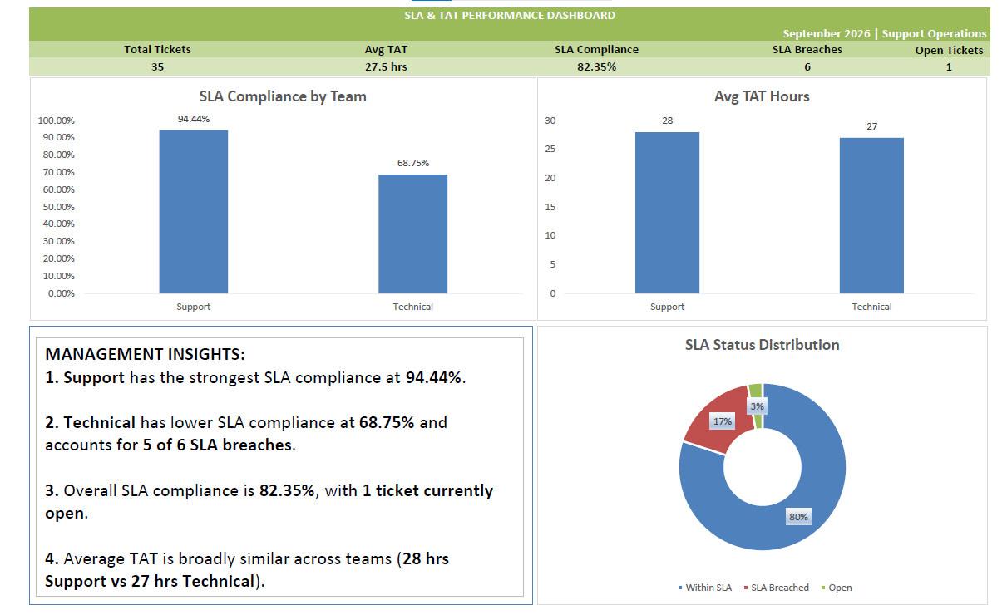
Supporting evidence: Excel dashboard
The same operational story is also presented in Excel, supporting the role's Excel and Power BI requirements.
Project evidence: Excel workbook • Power BI PBIX • dashboard exports • project README/workflow notes
07

