Slide 1

TIME SERIES Anomalies Detection for big data
By Sachin jangoni
Satish goli
ADEO2
Notes:
20mn presentation + 10 mn QA
Bunthet start by introducing himself and ask Sachin to introduce him self (what topic of the internship, when we start the internship and when it will end )

Slide 2
Content
Introduction
Challenges in TS
Global plan, progress and results
Demo
Conclusion
Context of the thesis
Notes:
Bunthet
Perspective (The next steps )
Different experience (What we have learned so far )
(What we have learned so far )
Our remark on their limitation in term of detecting anomalies
What problem that we are trying to solve
Share our global Plan of the internship that we have been designed
Share, tell, describe, show, explain, report

Slide 3
Context of the thesis
Objective of the Thesis
Anomalies Detection in time series data:
This project aims to detect anomalous behaviors in real time to ensure the stability of the flight data by using Unsupervised machine learning approach.
Notes:
Give a concrete example

Slide 4
Introduction

Slide 5
Context of the thesis
Introduction :
In today’s world, anomaly detection can viably help in getting the misrepresentation, finding strange activity in huge and complex time series Big Data sets..
Actually, we have different methods to detect the anomalies in the dataset. But it is based on the labelled data or un labelled data.

Slide 6
Data labels
Supervised Anomaly Detection
Labels available for both normal data and anomalies
Similar to rare class mining
Semi-supervised Anomaly Detection
Labels available only for normal data
Unsupervised Anomaly Detection
No labels assumed
Based on the assumption that anomalies are very rare compared to normal data

Slide 7
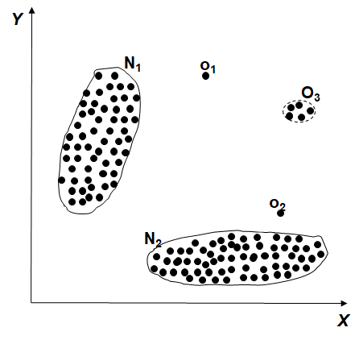
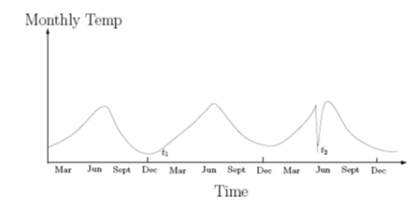
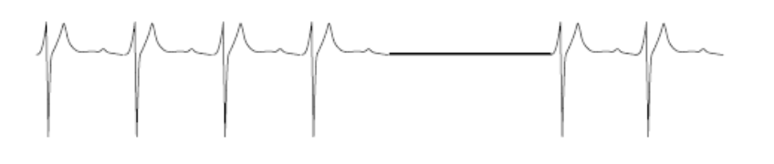
Type of anomaly
Point Anomalies
Contextual Anomalies
Collective Anomalies

Slide 8
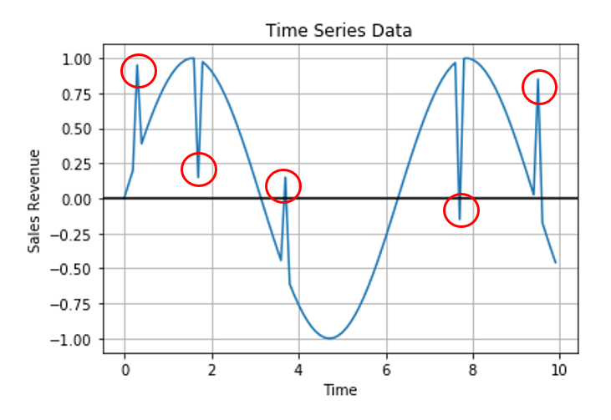
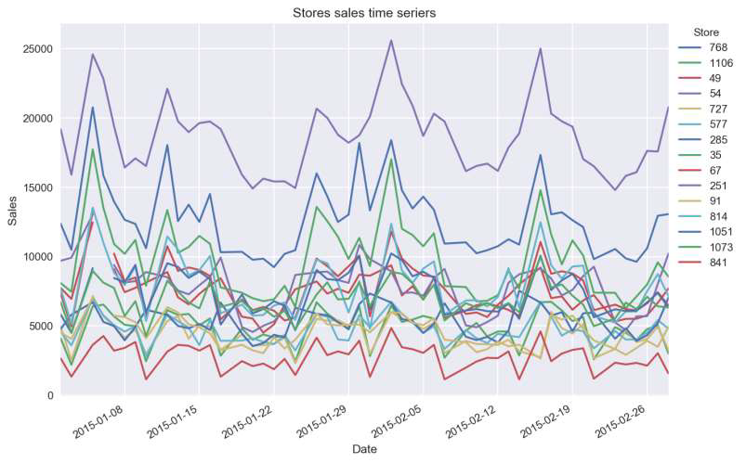
Time series
Effects:
Seasonality
Trend
Auto regression
External factors
Influence
In time series data, an anomaly or outlier can be termed as a data point which is not following the common collective trend or seasonal or cyclic pattern of the entire data and is significantly distinct from rest of the data.

Slide 9


Real World Anomalies
Credit Card Fraud
Cyber Intrusions
Healthcare Informatics / Medical diagnostics
Industrial Damage Detection
Image Processing / Video surveillance
Novel Topic Detection in Text Mining

Slide 10
Challenges

Slide 11
Key challenges
Defining a representative normal region is challenging
The boundary between normal and outlying behavior is often not precise
The data is very huge
Validation part is quite challenging
Malicious adversaries
Data might contain noise
Normal behavior keeps evolving

Slide 12
Challenges
Challenge of unsupervised ML
How many outliers are there in the data?
Method is unsupervised
Validation will be quite challenging (just like for clustering)
Finding needle in a haystack
Working assumptions
There are considerably more "normal" observation than "abnormal" observation(outliers/anomalies) in the data

Slide 13
Project Presentation, Methodology, & Results

Slide 14
Global Plan, Progress and Achievements
Global Plan
Understand the process of the current approaches
Understand the meaning and nature of the some essential coloumns with help from integrators
Data collection and visualization
Machine Learning (ML) Anomalies Detection
Data pre-processing
ML modelling
Train and test ML models
Models benchmarking
Work on greater number of coloumns
Unsupervised ML based Anomalies detection approaches
Define types anomalies
Implement unsupervised ML approaches
Apply the algorithm on the data
Test the result
Notes:
Five significant metrics:
Nb occurrence:
FE queuing (could be linked to RTO):
RTO:
Core:
Error level:
From what we read from the internet, the first 5 type of metrics should be considered because
They keep track of the traffic of the client service and all the processing operations of those service happened from the beginning to the end, from the frontend until the backend levels.
Keep track of the system resource, CPU usage, amount of ram, functional error, user experience
They give essential statistic of the health of the software and user experience
Interaction of the customer activities

Slide 15
Global Plan, Progress and Achievement
Achievements
Data collection and visualization
Data collection :
The dataset which I collected is fully unlabelled data.So, I implemented the unsupervised algorithms to detect the anomalies in the data.
The airline delays and cancellation dataset consists of 10 files from 2009 to 2018 with 28 columns of timeseries insights. Which is available in the kaggle.
I choose the columns of ARR_DELAY.
CRS elapsed time , Actual Elapsed time.
These columns give the data of the flight’s delays and differences between the computer reservation time and actual flight delay time.
Notes:
We use Promethes server as the source of data collection. By experience and availability of the metrics in Prometheus server, we decide to consider only 5 essential metrics for our anomalies detection analysis. We collect the historical values of these metrics and put them as columns in a data frame.
These 5 metrics are:
be_errors_per_trx: Number of backend errors per transaction.
be_total_rto: Total number of backend RTO(Response Time out).
be_tps_per_service: Number of backend occurence by each service.
(We collect the be_tps for each service. The name of the metric is in the format: be_tps_per_service:: "service_name")
fe_current_queue_per_be: Number of front end queueing by each backend.
(We collect the fe_current_queue for each backend. The name of the metric is in the format: fe_current_queue_per_be::"backend_name")
fe_tps_per_msg: Number of front end occurence by each message.
Fallenback rru records is the result of an anomalies.
We also want to collect the core (number of core file when core dump is generated)

Slide 16
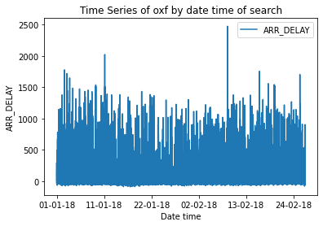
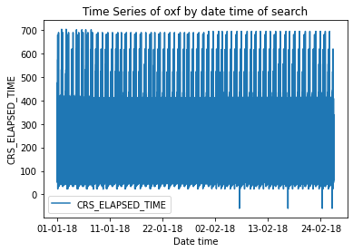
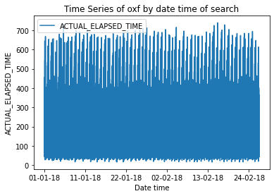
Global Plan, Progress and Achievement
Achievements
Data collection and visualization
Data visualization:
Tool: python
Why data visualization?
Give a quick sky-view of the coloumns in real time in a single dashboard
by comparing the graphs in dashboard and the graph constructed on the extracted metrics
Notes:
Create
Why data dashboarding?
What is Grafana?
Grafana is a multi-platform open source analytics and interactive visualization web application.
It provides charts, graphs, and alerts for the web when connected to supported data sources.
What is Prometheus?
Prometheus is open source computer monitoring and alerting software.
It logs real-time metrics to a time series database based on entry point content exposed using the HTTP protocol.

Slide 17
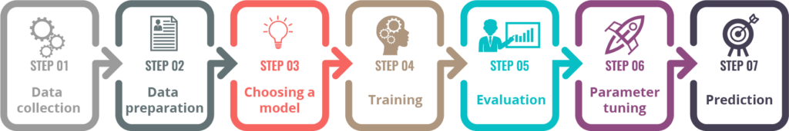
Global Plan, Progress and Achievement
Achievements
ML Anomalies Detection
Data pre-processing: Transform raw data to adapt with ML anomalies detection algorithms.
ML Modeling: Choose any ML-anomalies-detection models that are promising candidates to detect our specifically defined anomalies.
Linear models
Proximity based models
ML training : Train the models with the training data.
7 steps in Machine Learning

Slide 18
Global Plan, Progress and Achievement
Achievements:
Defining the problem: Anomalies detection
Anomaly detection is the process of identifying unexpected events or items in datasets, which differ from the normal data points.
Point anomalies
Contextual anomalies
Collective anomalie
Methods and results
Anomaly visualization, accuracy, f1 score are the important metrics to be considered while evaluating performance of anomaly detection algorithms.
Data preprocessing
Filling missing values by interpolation method

Slide 19
Global Plan, Progress and Achievement
Achievements:
Unsupervised ML based approaches
K-means
PCA analysis to reduce dimensionality
Isolation forest
One-class SVM
Elliptic envelop
LOF

Slide 20
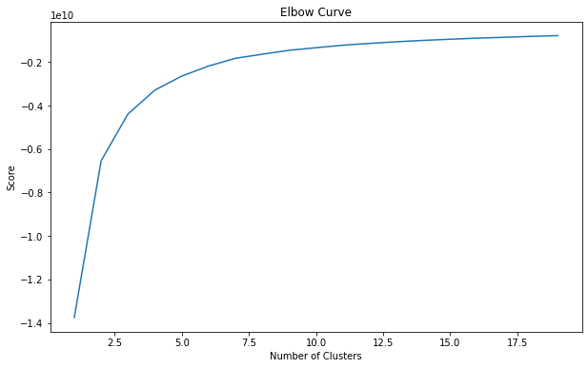
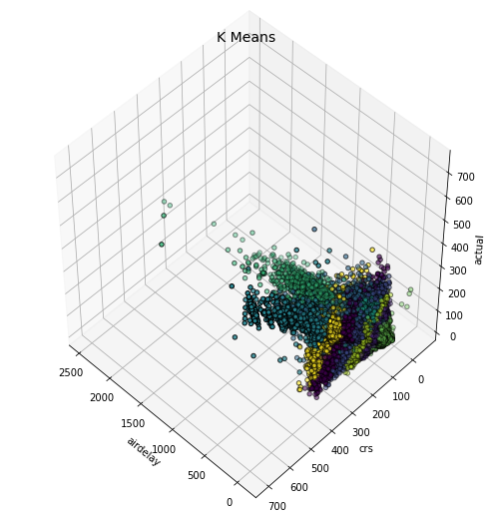
UN-SUPERVISED ML
Kmeans:
It divides the data into some group of clusters the data fall beyond the clusters we consider that data points as anomalies.
Elbow curve :
It is used to select how many number of cluster’s we need to consider.

Slide 21
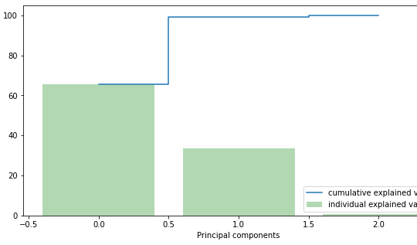
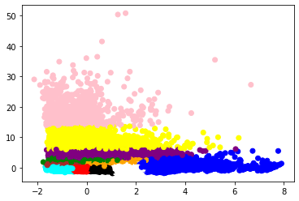
PCA
Principal component analysis:
Pca its basically used for dimensionality reduction or feature selection.
The main feature of pca is it will compresses maximum amount of data into two features

Slide 22
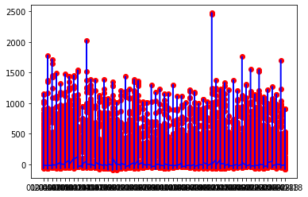
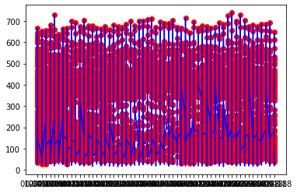
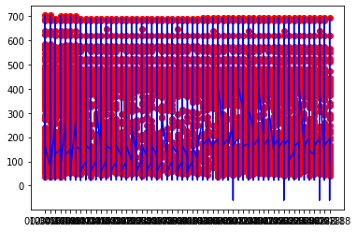
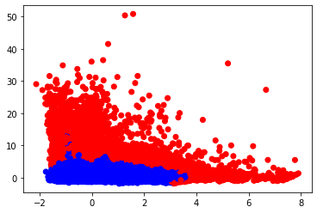
ISOLATION FOREST
The Isolation Forest algorithm isolates observations by randomly selecting a feature and then randomly selecting a split value between the maximum and minimum values of the selected feature
We can not only detect anomalies faster but we also require less memory compared to other algorithms
Isolation forest is very fast and it detects anomalies from large datasets

Slide 23
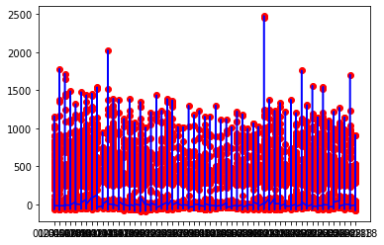
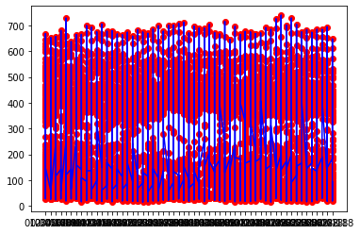
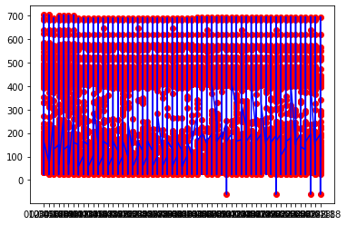
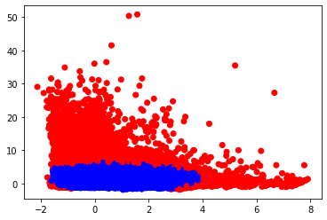
ONE-CLASSSVM
One class svm is trained only on the normal data, in our case the negative examples.
It learns the boundaries of these points and is therefore able to classify any points that lie outside the boundary as anomalies.
Parameters: nu for proportion of outliers. and gamma to determine the smoothing of counter lines.
It gives good results but it is time consuming and it will take lot of time to run the code

Slide 24
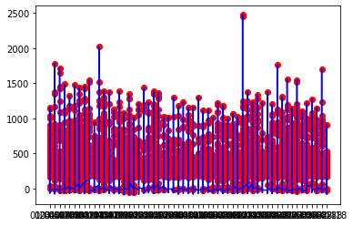
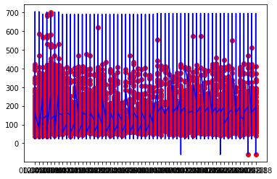
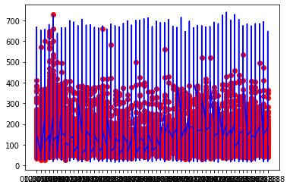
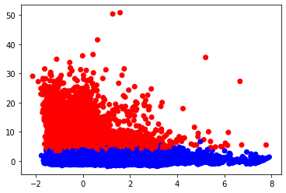
Elliptic Envelop
It will detect outliers based on gaussian distribution
It is basically dependent on contamination level as the name suggests it forms a elliptic circle.
if the data had an ordinary distribution it envelops the majority of the anomalies.

Slide 25
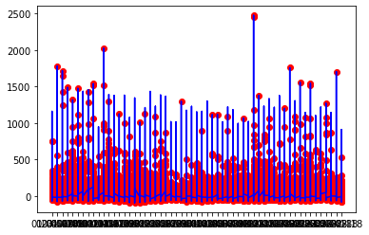
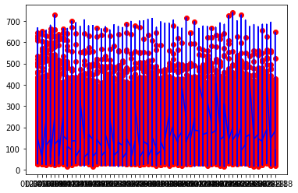
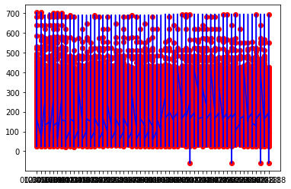
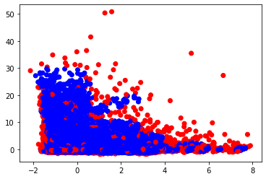
LOCAL OUTLIER FACTOR
Lof is density based approach which mainly depends on nearest neighbours
It scores each point by computing the ratio of the average densities of the points
Local outlier factor calculates an anomaly score by using the local density of each sample point with respect to the points in its encompassing neighbourhood
Lof value of less than 1 is the indicator that the observation is not an outlier while a value greater than 1 indicates a outlier.

Slide 26
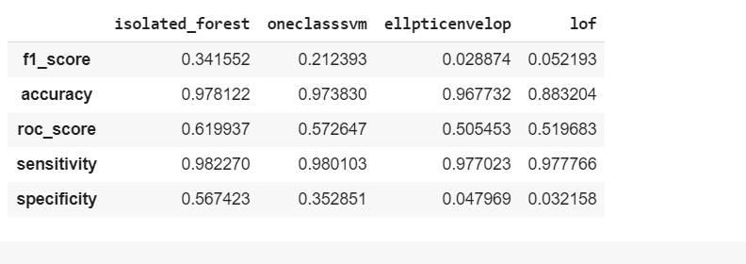
VALIDATION PART
Basically the data which have done analysis is unlabeled data so what I have done for evaluating one model based on accuracy or whatever it is I calculated anomaly manually by using inter quantile method.

Slide 27
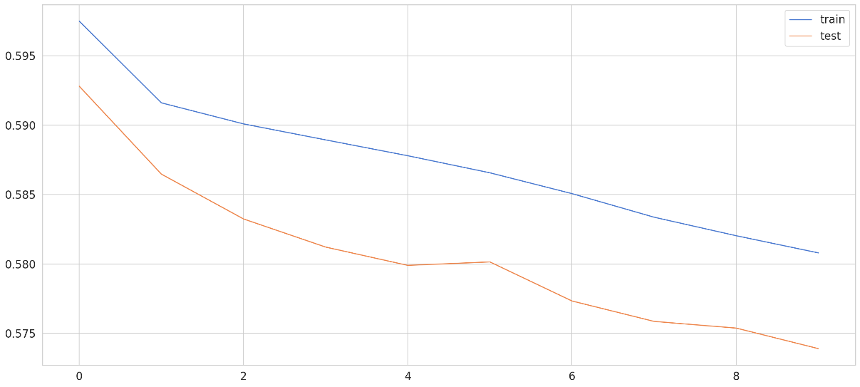
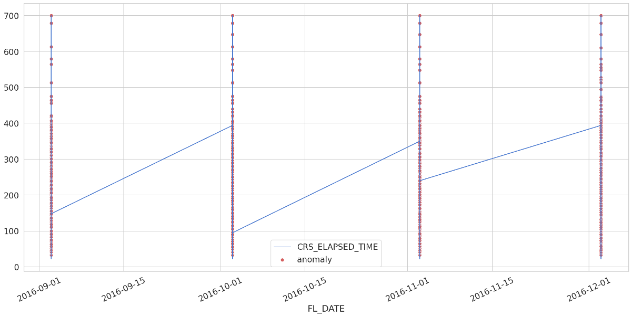
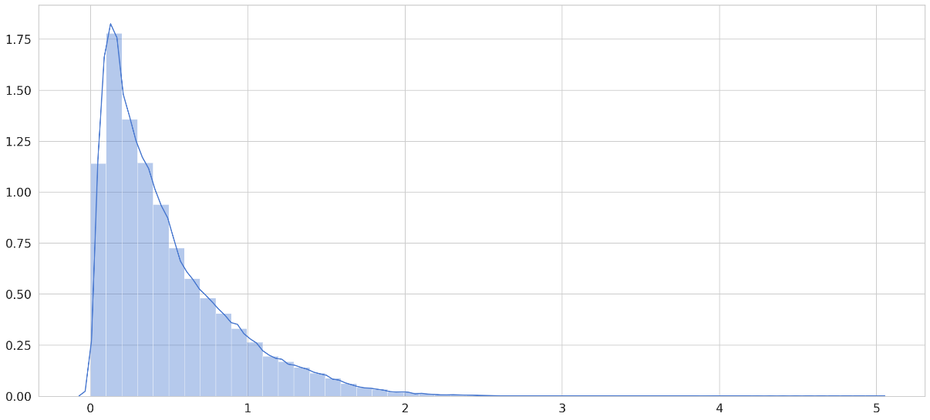
LSTM Autoencoders:
Autoencoders Neural Networks
try to learn data representation of its input. So the input of the Autoencoder is the same as the output? Not quite. Usually, we want to learn an efficient encoding that uses fewer parameters/memory.
The encoding should allow for output similar to the original input. In a sense, we’re forcing the model to learn the most important features of the data using as few parameters as possible.

Slide 28
Demo

Slide 29
Conclusion
One Class SVM and isolation forests were performed the best among all the algorithms and were able to find anomalies in delayed time
K means the quickest yet it is less effective in distinguishing the inconsistencies. But When the dataset is huge, the groups just recognize the extraordinary anomalies.
The elliptic envelope is fast and has a good accuracy score.
Lof is good to detect the outliers, lof had a better performance
Labels are essential to be successful in this project
LSTM Auto-Encoders is built using Keras and Tensor Flow. LSTM Auto-Encoders is a model that can find anomalies in the delayed time, we can try to tune the model and the threshold to get even better results.
Notes:
Bunthet
Resume about what left to do, the next plan, what should the next intern do (remind also when the internship will end)

Slide 30
Thank you
Questions?

