Slide 1
JMeter

Slide 2
About JMeter
Jmeter is open source testing software.
Jmeter is designed to cover various categories of tests:
Load Testing
Functional Testing
Performance Testing
Regression Testing
And more

Slide 3
What And How A Test Plan Works
What is a Test Plan?
A Test plan can be viewed as a container for running test. It defines what to test and how to go about it.
Elements Of Test Plan:
Thread Groups
Logic Controller
Sample Generating Controllers
Listeners
Timers
Assertions
Configuration Elements

Slide 4
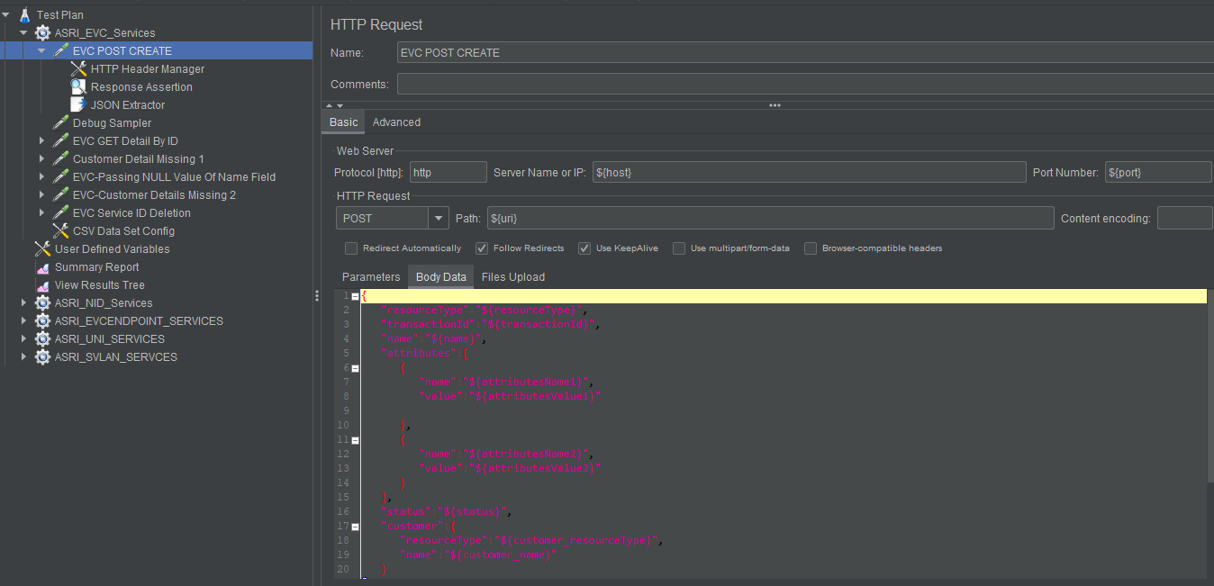
Sample Test Case

Slide 5
Thank You

