Slide 1
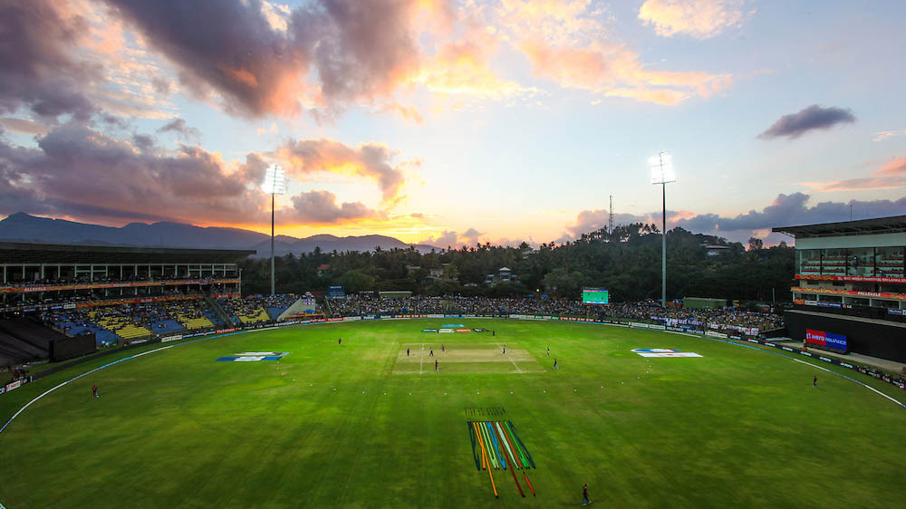
CRICKET WORLD CUP 23 ANALYSIS
BY SACHIN KUMAR

Slide 2
TARGETS
Runs to score
To score at least 280 runs on an average if played in first innings
Runs to defend
Should be able to defend 240 runs on an average

Slide 3
Openers - 2
Parameters | Description | Criteria
Batting Average | Average runs scored in an innings | >45
Strike rate | No. Of runs scored for 100 balls | >95
Innings Batted | Total innings batted | >4
Conversion rate | Converting the small score into a big score | >20
Batting Position | Order in which the batsman should play | <4

Slide 4
Middle Order - 3
Parameters | Description | Criteria
Batting average | Average runs scored in an innings | >50
Strike Rate | No. Of runs scored per 100 balls | >85
Innings Batted | Total innings Batted | >4
Avg. balls faced | Average balls faced by the batter in an innings | >50
Batting position | Order in which the batter plays | >2
Conversion rate | Converting the small score into a big score | >20

Slide 5
Finisher - 1
Parameters | Description | Criteria
Batting average | Average runs scored in an innings | >35
Strike rate | No. Of runs scored per 100 balls | >100
Innings batted | Total innings Batted | >4
Avg. Balls Faced | Average balls faced by the batter in an innings | 35
Batting position | Order in which the batter plays | >4
Innings Bowled | Total innings bowled by the bowler | >2

Slide 6
Lower order bowling allrounder - 2
Parameter | Description | Criteria
Batting average | Average runs scored in an innings | >25
Strike rate | No. Of runs scored per 100 balls | >120
Innings batted | Total innings Batted | >4
Batting position | Order in which the batter plays | >4
Innings Bowled | Total innings bowled by the bowler | >3
Bowling economy | Average runs allowed per over | <5
Bowling strike rate | Average no. Of balls required to take a wicket | <30

Slide 7
Fast Bowlers - 3
Parameters | Description | Criteria
Innings Bowled | Total innings Bowled | >5
Bowling Economy | Average runs allowed per over | <5
Bowling Strike Rate | Avg. No. Of balls required to take wicket | <25
Bowling Style | Bowling style of the bowler | Fast
Bowling Average | No. Of runs allowed per wicket | <25
Dot Balls % | % of dot balls bowled | >55

