Slide 1

End-to-End Handwritten Signature Verification System
SafeSign

Slide 2
Team & Mentor Details
Name | Roll Number
Sumanta Rakshit | 2251079
Sayandeep Biswas | 2251061
Aaditya Kumar Choudhary | 2251078
Sachin Kumar | 2251074
Guided By: Prof. Anurina Tarafdar, Department of CSE

Slide 3
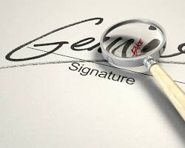

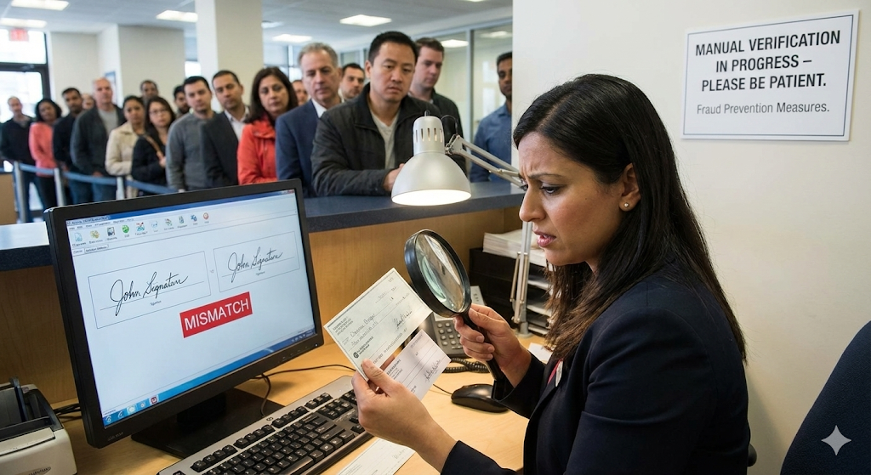
Problem Statement
The Issue: Financial institutions (banks) rely heavily on signatures for cheque clearance and document authorization.
The Challenge: Manual Verification
Human Fatigue
Bank tellers verify hundreds of cheques daily.
Tiredness leads to natural errors and oversight.
Skilled Forgeries
Forgers practice to make the fake signature look perfect.
To the naked eye, these are indistinguishable from the real one.
The Need: An automated, high-precision system to verify authenticity in real-time.

Slide 4

Objectives & Scope
Primary Objective:
Scope:
End Goal: Integration with a web application for real-world deployment.
Automated Verification: To develop an end-to-end automated system for verifying the authenticity of handwritten signatures (specifically for high-stakes documents like bank cheques)
Similarity Learning Approach: To implement Siamese Neural Networks (SNNs) for enabling the model to learn similarity rather than just classification.
Focus on offline (static image) signature verification.
Target high stakes documents (e.g. bank cheques)

Slide 5
Existing Works
Traditional Handcrafted Features + SVM
SigNet: Siamese Convolutional Neural Network
Hybrid Vision Transformer (ViT-Based Verification)
Combines CNNs with Vision Transformers for richer global–local feature learning, but suffers from high computational cost and reduced accuracy on diverse scripts.
.
Uses manually crafted features (edge, texture, shape) classified via SVM.
Limitations: Manual feature design limits scalability, performs poorly across diverse datasets, weaker against skilled forgeries.
Learns signature similarity using a Siamese CNN with writer-independent verification.
Limitations: Requires large datasets; uses only static images (no dynamic pen-based cues); limited testing on noisy real-world signatures.

Slide 6
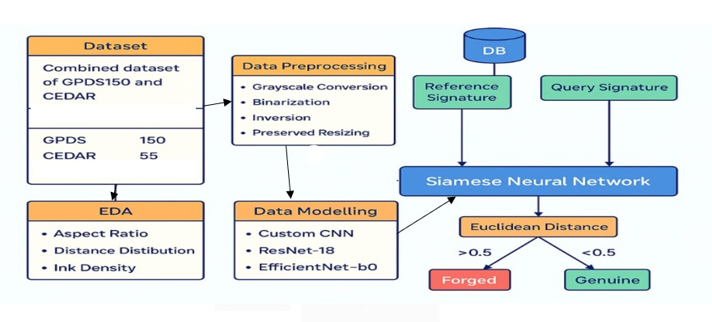
Our Workflow

Slide 7
Our Methodology
Verification-Based Approach: Uses similarity scoring rather than user classification, enabling a writer-independent system that works for new users without retraining.
Siamese Twin Network: Uses two identical CNN branches to extract comparable feature embeddings from a pair of signature images.
Euclidean Distance + Triplet Loss: Learns discrimination by minimizing distance between anchor–genuine pairs and maximizing distance from forgeries using Triplet Loss.
Novelty
End-to-End System: Complete real-world signature verification pipeline, not just a research model
Multi-Script Support: Trained on diverse datasets including BHSig260 (Bengali & Hindi).
Writer-Independent & Cross-Dataset: Verifies new users and uses combined dataset.

Slide 8
Dataset Description
We are using combine dataset of GPDS150 and CEDAR.
Dataset | No. of Users | Samples per user
GPDS150 | 150 | 16 genuine, 16 forged
CEDAR | 55 | 24 genuine, 24 forged
Total images: 7440
We have also trained model on each dataset (GPDS150 and CEDAR) separately. We currently have more datasets like BHSig250 - Bengali and Hindi, we will use them for training later.

Slide 9
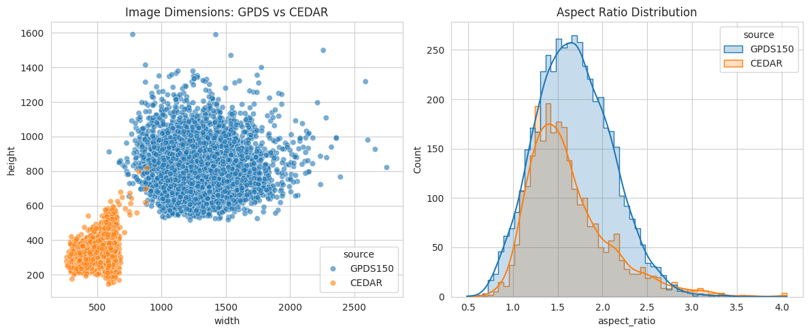
Exploratory Data Analysis (EDA)
What we analysed::
Resolution/Aspect Ratio: To determine optimal resizing strategies.

Slide 10
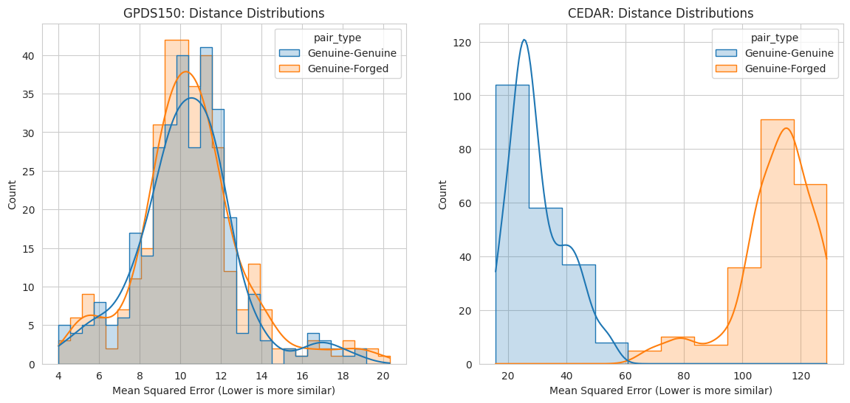
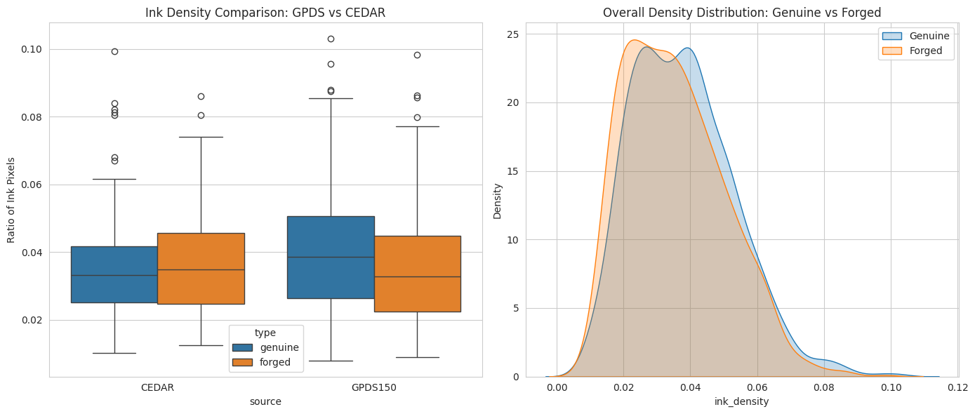
Distance Distribution: Calculated baseline distances between raw pixel pairs to confirm feasibility.
Ink Density: Genuine signatures often have fluid ink flow; forgeries show "hesitation" or uneven density.

Slide 11
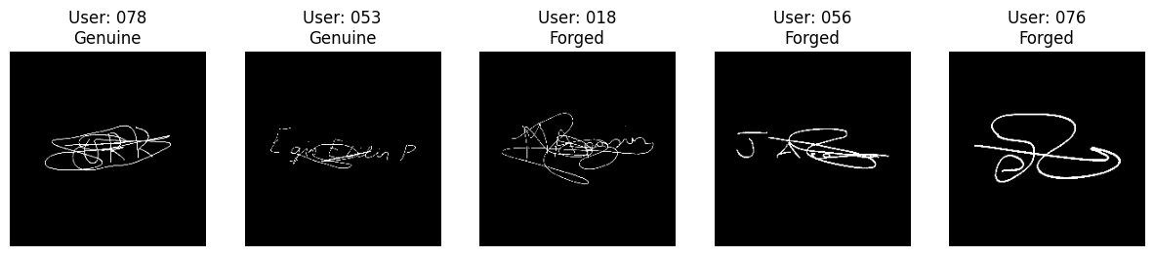






Data Preprocessing Pipeline
Grayscale Conversion: Removing color to focus purely on stroke patterns.
Binarization (Otsu’s Thresholding): Separating ink from the paper background
Inversion: Converting ink to White (255) and background to Black (0) for sparse matrix efficiency.
Resizing: Preserving aspect ratio with padding to uniform size (224 x 224).

Slide 12
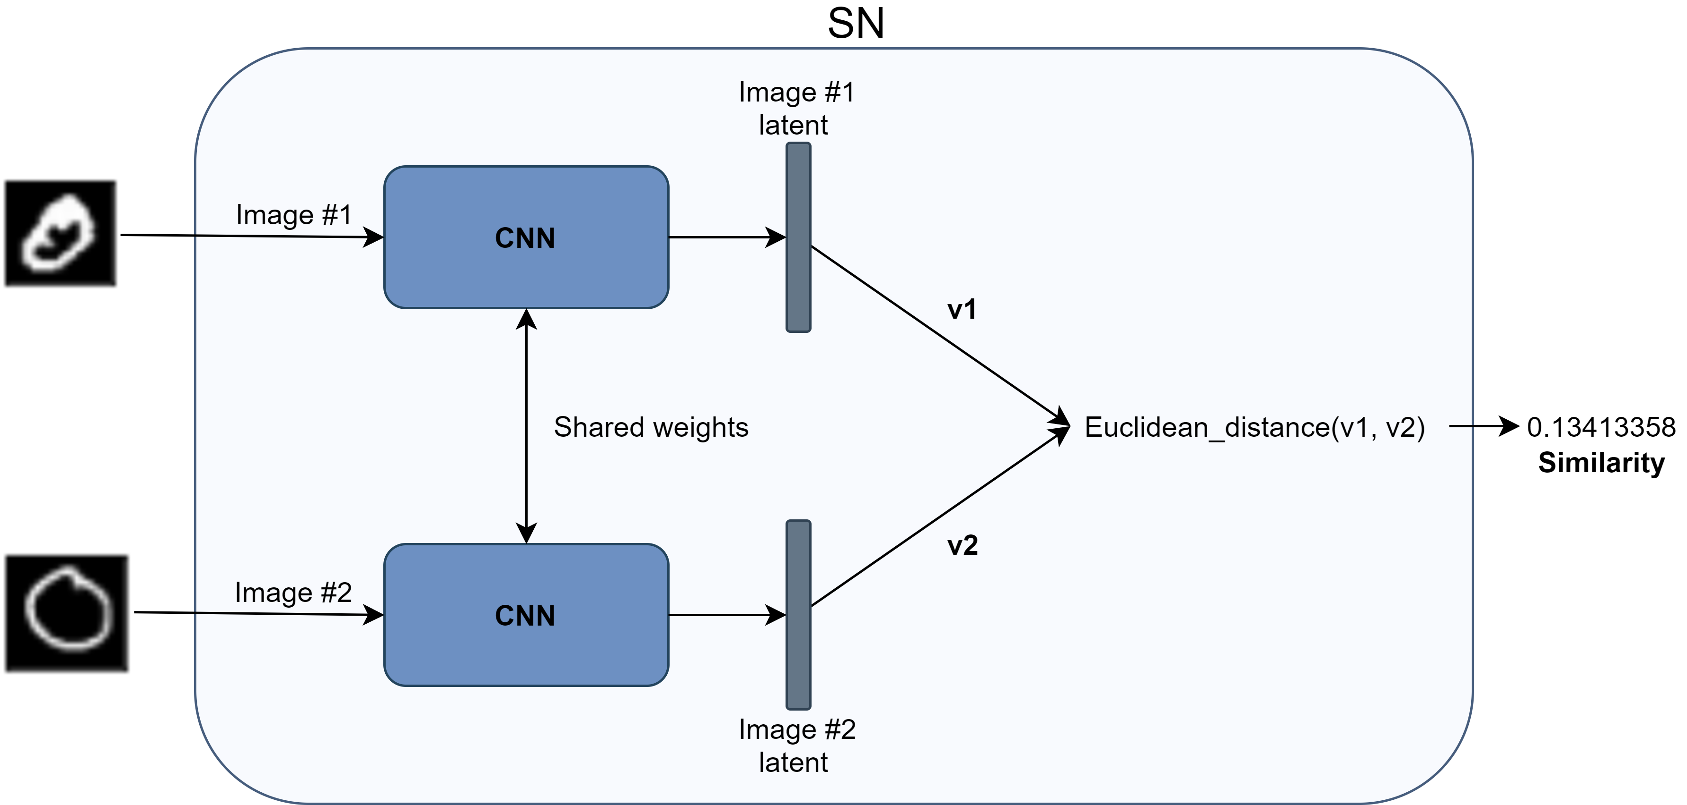
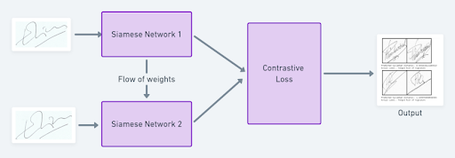

Architecture – Siamese Neural Networks
Twin Architecture: Two identical CNNs with shared weights process signature pairs simultaneously.
Feature Extraction: Backbone models convert images into compact 128-dimensional feature embeddings.
Similarity Metric: System calculates Euclidean Distance between embeddings to measure similarity.
Euclidean Decision: If Distance < Threshold - Genuine and If Distance > Threshold - Forged.
Loss Functions:
Contrastive loss function : reduce distance between genuine pairs and increase distance for forged pairs.
Triplet Loss function: forgery trio to ensure the genuine is closer to the anchor than the forgery by a set margin.

Slide 13

Models (Base CNNs)
Custom CNN
Lightweight Design: Built from scratch with fewer parameters to minimize computational load.
Fast Inference: Optimized for low-resource hardware by focusing on primary stroke shapes rather than deep features.
ResNet-18
Deep Feature Extraction: Pre-trained on imagenet dataset, more robust, has 18 layers.
Forgery Detection: Learns complex, hierarchical textures to detect the subtle "jitters" found in skilled forgeries.
EfficientNet-B0
Compound Scaling: Intelligently balances depth, width and resolution for maximum efficiency.
High Precision: Achieves the best accuracy-to-parameter ratio, capturing fine-grained ink details at low cost.

Slide 14
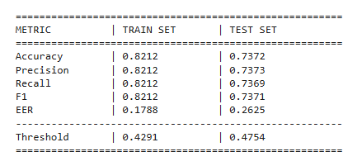
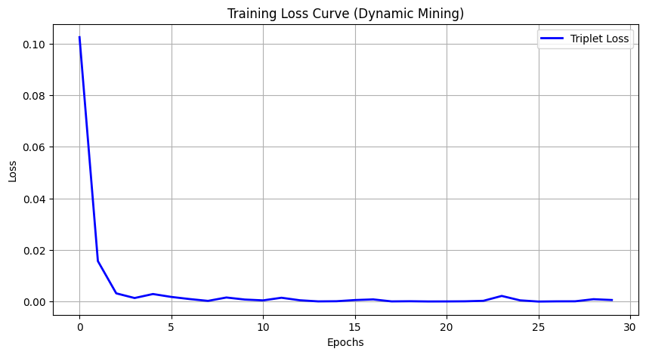
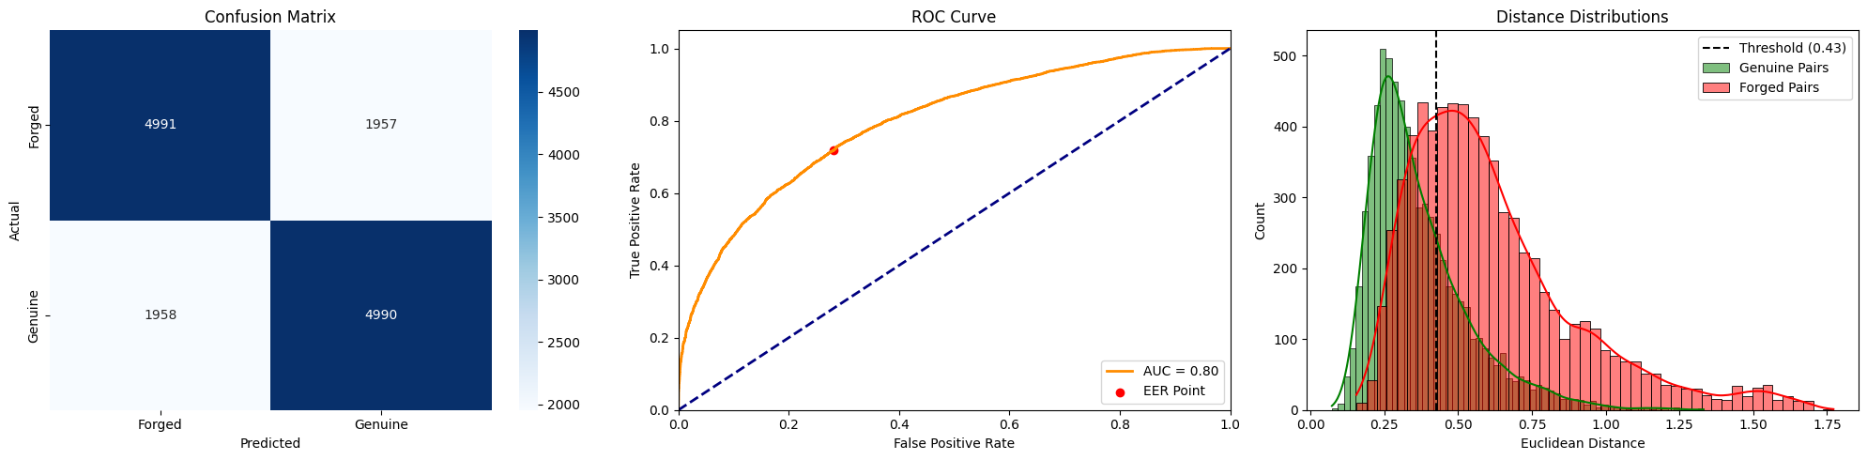
Results
1. Resnet18:

Slide 15
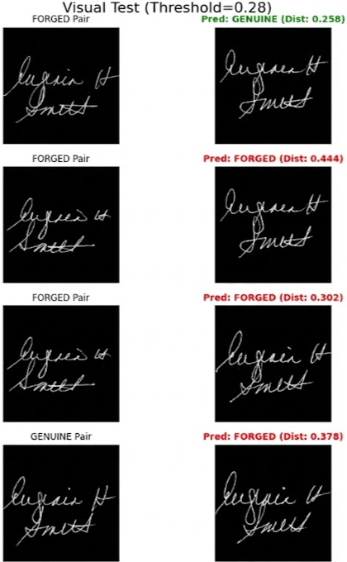
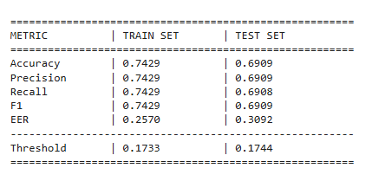

Results
2. EfficientNet-B0:
3. Custom CNN:
We initially built the model on each datasets, accuracy was coming out to be great but on combined dataset due to high variance accuracy is comparatively low.

Slide 16
Challenges & Limitations
High Intra-Class Variability: Genuine signatures naturally vary due to mood or fatigue, makinghard for the model to define a "standard" baseline.
The "Skilled Forgery" Paradox: Skilled forgeries are visually identical to genuine ones; the model must detect microscopic "hesitations" rather than shape differences.
Loss of Dynamic Data: As an offline system, we lack critical biometric features like pen pressure, stroke velocity, and writing order.
Background Noise: Real-world cheques often contain watermarks, stamps, and lines that can interfere with standard binarization techniques.
Unstable Signatures: The model's "One-Shot" accuracy decreases for users who signature style changes drastically day-to-day.

Slide 17
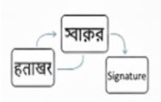

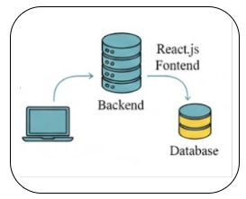
Future Scope & Roadmap
Improving Accuracy and Generalization
Test different model settings to get better accuracy.
Use better training methods to reduce mistakes.
End-to-End System Integration and Deployment
Connect the model to a working web app for real users.
Make the system fast, secure, and easy to use.
Dataset Expansion and Linguistic Diversity
Add more signature datasets for better training.
Include Bengali and Hindi signatures to support more languages.
Challenges and limitations of the project
Challenges and limitations of the project

Slide 18

Conclusion
Enhancing your presentation

Slide 19
References
[1] Dey, S., Dutta, A., Toledo, J. I., Ghosh, S. K., Lladós, J., & Pal, U. (2017). SigNet: Convolutional Siamese Network for Writer Independent Offline Signature Verification. arXiv preprint arXiv:1707.02131. https://arxiv.org/pdf/1707.02131
[2] Zhang, H., Guo, J., Li, K., Zhang, Y., & Zhao, Y. (2024). Offline Signature Verification Based on Feature Disentangling Aided Variational Autoencoder. arXiv preprint arXiv:2409.19754. https://arxiv.org/pdf/2409.19754
[3] de Moura, K. G., Cruz, R. M. O., & Sabourin, R. (2024). Offline Handwritten Signature Verification Using a Stream-Based Approach. arXiv preprint arXiv:2411.06510. https://arxiv.org/abs/2411.06510
[4] Hafemann, L. G., Sabourin, R., & Oliveira, L. S. (2017). Learning features for offline handwritten signature verification using deep convolutional neural networks. Pattern Recognition, 70, 163-176. https://arxiv.org/abs/1705.05787
[5] Yuan, H. J., Zhang, H., & Yin, F. (2025). Online Handwritten Signature Verification Based on Temporal-Spatial Graph Attention Transformer. arXiv preprint arXiv:2510.19321. https://arxiv.org/abs/2510.19321
[6] Piccinini, G., Guarnera, L., & Battiato, S. (2025). SignForensics: A Robust Framework for Forensic Offline Signature Verification With Enhanced Detection, Noise Removal, and Multi-Stage Authentication. IEEE Access, 13, 172456-172470. https://ieeexplore.ieee.org/document/10820123

Slide 20
References
[7] Parracho, M. R. (2025). Signature Forgery Detection: Improving Cross-Dataset Generalization. arXiv preprint arXiv:2510.17724. https://arxiv.org/pdf/2510.17724
[8] Kadam, J., Phadtare, G., Pawar, A., & Maniyar, K. G. (2025). Offline Signature Verification USING Siamese Neural Network. Journal of Information Systems Engineering and Management, 10(26s), 431-439. https://www.researchgate.net/publication/390475418_Offline_Signature_Verification_USING_Siamese_Neural_Network
[9] Kumar, D. S. S. (2023). Offline Signature Verification based on Ensemble of Features using Support Vector Machine. International Journal of Computer Applications, 184(45), 24-29. https://www.ijcaonline.org/archives/volume184/number45/kumar-2023-ijca-922547.pdf
[10] Chetry, B. P., & Kar, B. (2025). Offline Signature Verification Using Pre-Trained Deep Convolution Neural Network: SqueezeNet. SSRG International Journal of Electronics and Communication Engineering, 12(7), 315-326. https://www.internationaljournalssrg.org/IJECE/2025/Volume12-Issue7/IJECE-V12I7P125.pdf
[11] Ishfaq, M., et al. (2024). Enhancing Security: Infused Hybrid Vision Transformer for Signature Verification. International Conference on Computing and Networking Technologies (ICCCNT). IEEE. https://ieeexplore.ieee.org/document/10654737
[12] Ozyurt, F., Majidpour, J., Rashid, T. A., & Koc, C. (2024). Offline Handwriting Signature Verification: A Transfer Learning and Feature Selection Approach. arXiv preprint arXiv:2401.09467. https://arxiv.org/abs/2401.09467

Slide 21

Thank you
Brita Tamm
502-555-0152
brita@firstupconsultants.com
www.firstupconsultants.com

