Slide 1
US accidents severity prediction Algorithm
Sachin Karve
Shivani Jain
Ruchir Agarwal

Slide 2
Introduction
We have tried analyzing the various factors that impacts road accidents in the US.
Also, explored a few modeling techniques to predict the severity of the accident.
The data collected is from February 2016 to December 2020

Slide 3
Inspiration
Road accidents are leading cause of death in healthy Americans
Through our analysis, we want to points out hotspots, month, day and other factors where the count and severity of accident have spiked
We also aim to analyze the severity of accidents and how are other features are related to it
Our main goal is to predict the severity of accidents and avoid creating situations that can lead to accidents in future

Slide 4
DataSet
The dataset has been collected by Sobhan Moosavi, a Scientist at Lyft and is available on Kaggle. The data is collected in real time using multiple APIs that broadcast traffic data captured by a number of entities.
Our dataset consist of 47 columns, which consist of:
Severity of accident
Several environmental factors like temperature, Humidity, wind speed, snow, rain
Several infrastructure data points like stop signal, traffic light, junction, round abouts
It has approximately 3 million records

Slide 5
Data Visualization

Slide 6
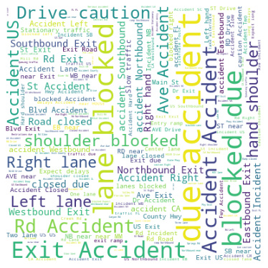
Most Common Tags associated with accidents
Mapped to ‘Description’ field
Represents the natural language description of the accident
Notes:
Used WordCloud, STOPWORDS.
The more prominent the tag -> higher is the tag frequency.

Slide 7
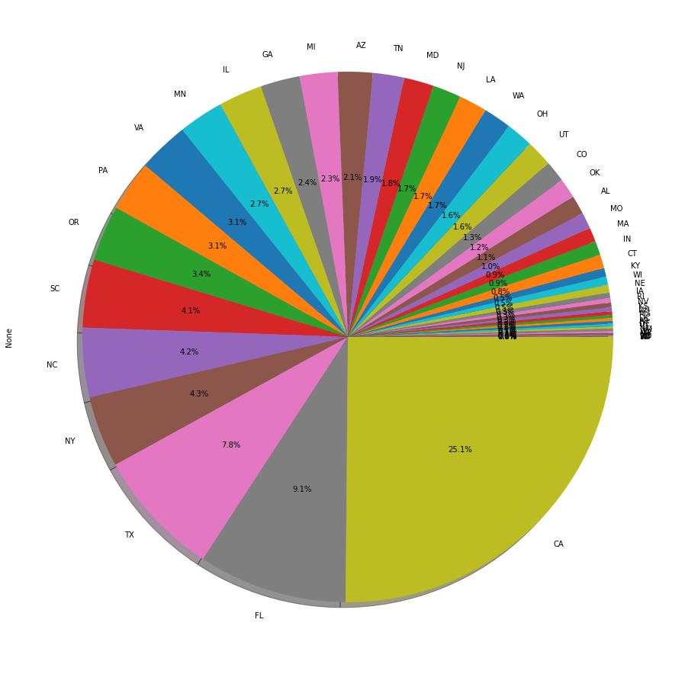
Accidents distribution by States
California has the highest accident %, followed by Florida & Texas
The top three states combined contributes to ~40% of the total accidents in US
Notes:
CA has highest #accidents.
Every 4th accident happens in CA
Top three states accounts to 40% of the total.
The overlapped labels belong to the states with least accident% (Though, the labels and % shares of some states is overlapped, it does not impact visualization as these states have the least % of accidents. So, it’s harmless to even ignore them)

Slide 8
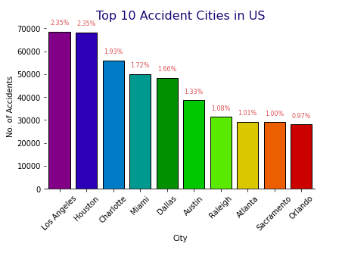
Top Accidents-prone Cities
Across the US, LA observes the most #accidents, followed by Houston and Charlotte
Notes:
This is in conjunction with previous visualization.
LA (from CA) and Houston (from TX) are top US cities for #accidents.

Slide 9
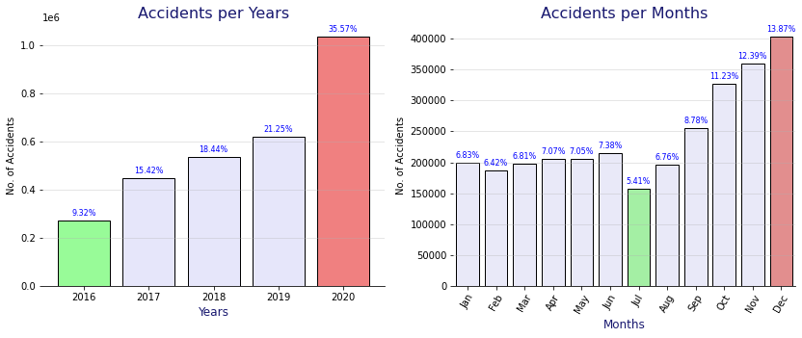
Accidents per Year & Month
The number of accidents have increased by ~2.5 times from 2016 to 2020
December witnesses most accidents probably because it is the holiday month
Notes:
Left image:
Accidents increasing constantly from 2016 to 2020 by ~2.5 times.
Right image:
First half of the year, observes constant #accidents
Second half observes a constant increase in #accidents.
Could be because of excessive travelling due to Christmas and New Year holidays.

Slide 10
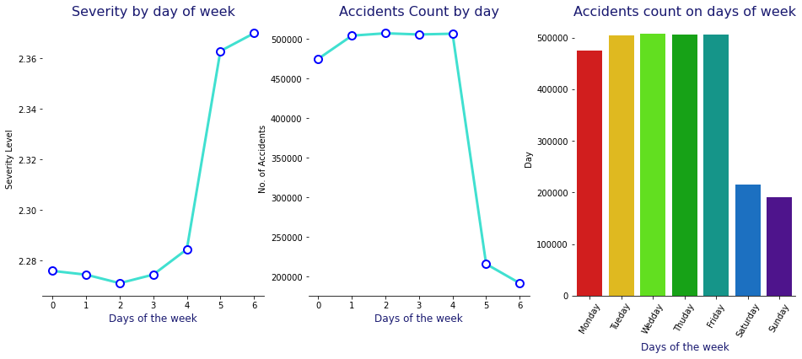
Accidents Severity & Count by Day
0 - 6 represent Monday to Sunday on the x axis
We observe that most accidents occur during weekdays as people travel for work, though severity of accident is most during the weekend
Notes:
The severity of the accidents increases over the weekend as people travel away from the city where the vehicle speed can be high, in contrary to what’s the case in cities where because of traffic, the speed cannot be much high,

Slide 11
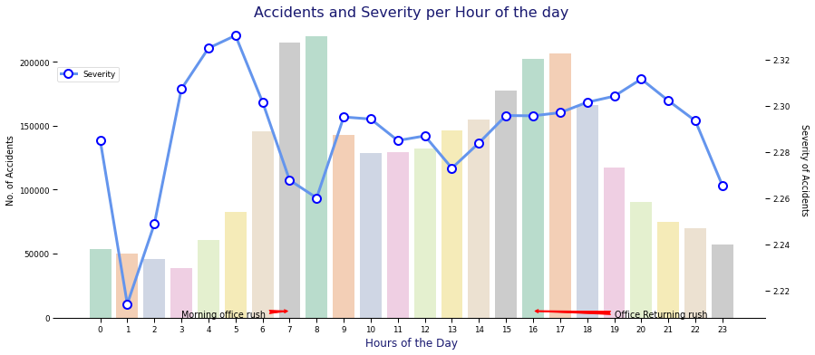
Accidents & Severity per Hour
While the two peak ranges in #accidents occur during office rush hours, the severity peaks do not follow the same trend

Slide 12
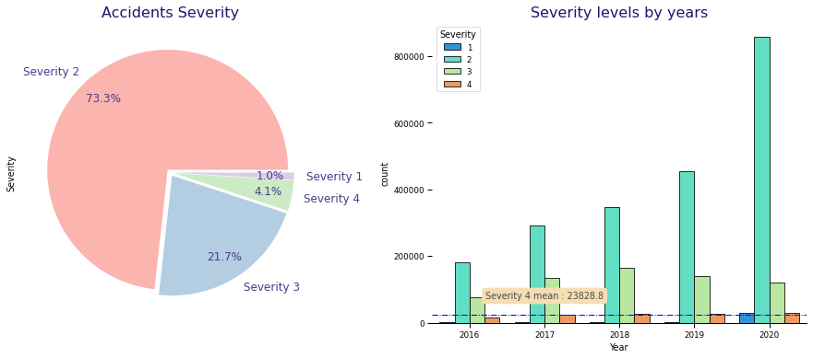
Severity percentage and its distribution

Slide 13
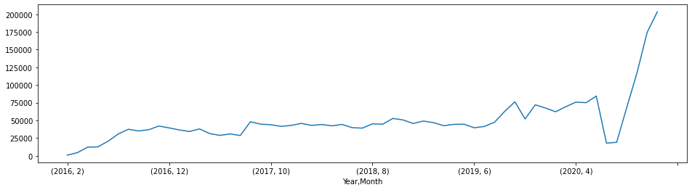
Number of the accidents over the Years
In the second half of 2020, the #accidents increased by more than 200%

Slide 14
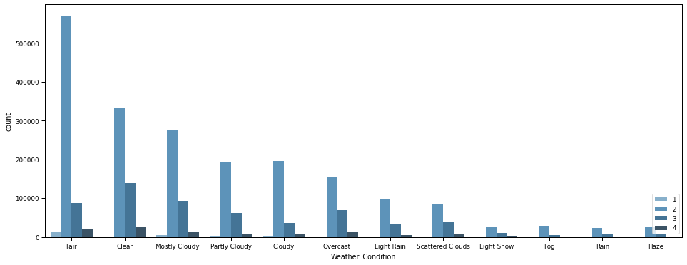
Number of accidents across weather conditions
Fair weather witness maximum accident majorly of severity 2
Most of the accidents are of severity 2

Slide 15
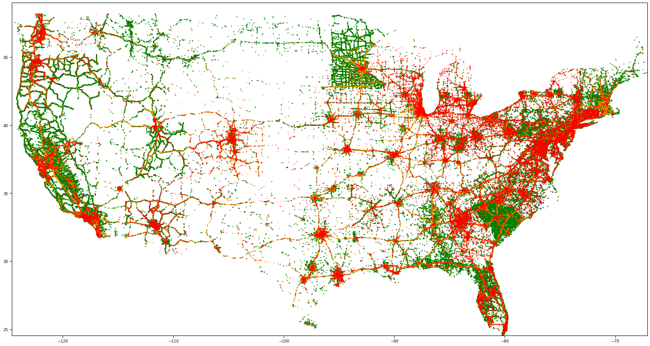

Accident Severity variation within US

Slide 16
Data Cleaning

Slide 17
Feature reduction
Null value columns: End_Lat, End_Lng, Number, Wind_Chill(F), Precipitation(in)
Columns discarded: ID, Description, Street, City, Zip code, Country, Civil_Twilight, Nautical_Twilight , Astronomical_Twilight

Slide 18
Columns altered
Extracted the following columns: extracted year, month and day from Start_Time, End_Time, Weather_Timestamp columns to analyze the data
The following columns are label encoded: Side, County, State, Timezone, Weather_Condition
The following column values were converted to binary: Sunrise_Sunset, stop, junction, Bump, roundabout, traffic calming

Slide 19
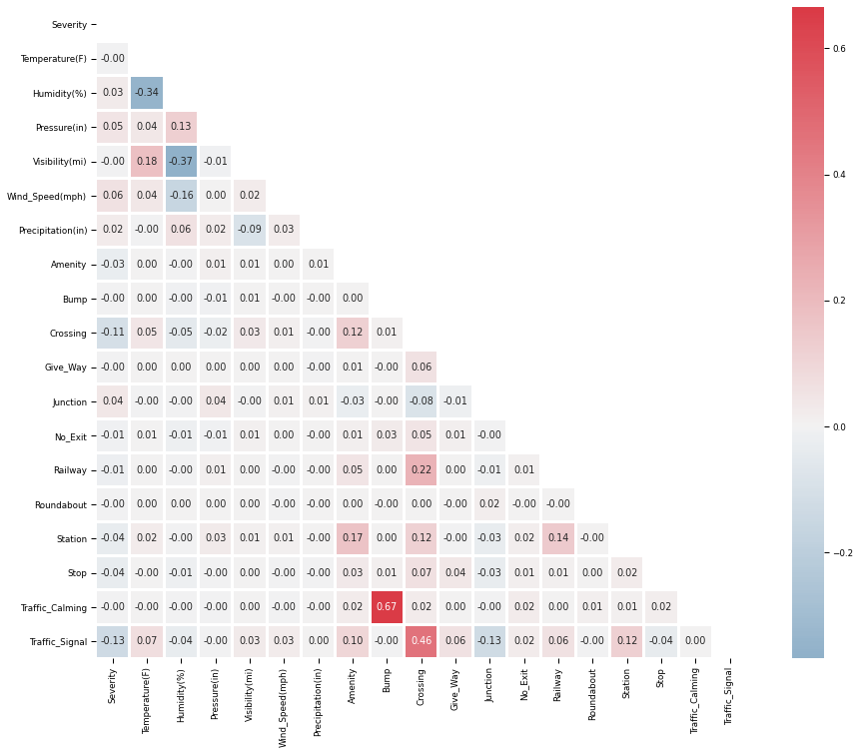
Feature Selection - Correlation Matrix
Notes:
We observe that traffic signal and crossing are nearly correlated with severity

Slide 20
Data Models
Decision Tree
Was fast to compute
Generated ~82% accuracy
Neural Network
To improve model accuracy, we set epochs to 20 while keeping the batch size 32
Low epochs can underfit the model while a very high epoch can overfit it
With above configuration, model generated ~79% accuracy
SVM
Took the highest time amongst all.
Provided ~70% accuracy.
Notes:
Decision Tree
Supervised learning.
Basically, a collection of if-else statements.
----------
NN
Unsupervised learning.
Has multiple layers, hence often called multi-layer perceptron.
For optimization, as NN uses Gradient descent which is iterative, we have set epochs to 20 and gave a batch size of 32.
As keeping low epochs, can underfit the model and setting a very high epoch can overfit the model.
Epoch defines the #times the ENTIRE dataset passes back and forth through the NN.
Batch Size defines the total number of training samples to pick from the training dataset to predict the gradient error.
------------
SVM
Supervised Learning
Most time consuming, amongst the three.
Finds decision boundary to separate the data.

Slide 21
Summary
With 3M records, it seems that Decision Tree model fits best to predict severity
But, we also want to highlight a potential bias that could have penetrated into the model
In the dataset considered, Severity is measured as impact on traffic i.e the time taken to resume the normal traffic flow
US population chart shows that the population is more across east and west coast and less in the central region
Given a situation of accident in Los angeles and Boulder considering equal number of lanes, traffic would resume faster in Boulder than in LA due to population

Slide 22
Thank you

