Slide 1



Course Project 1: Subfamily classification of glycoside hydrolase family
Siva Shanmugam (Postdoc)
Xinpeng Zhang (PhD student)
Yi Xing (Master student)
Md. Numan Islam (PhD student)
Department of Food Science and Technology
10/23/2025
PI: Dr. Yanbin Yin

Slide 2
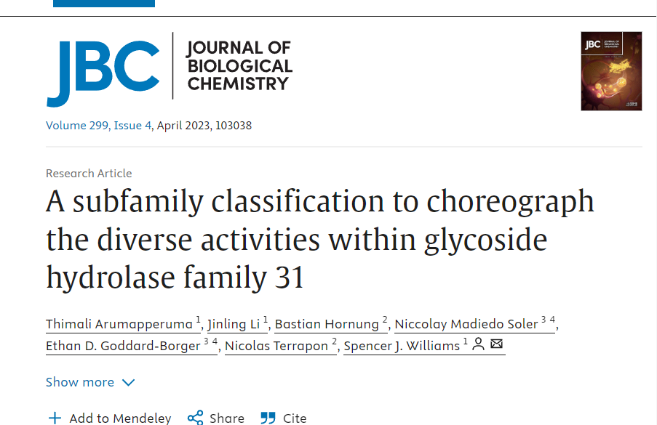
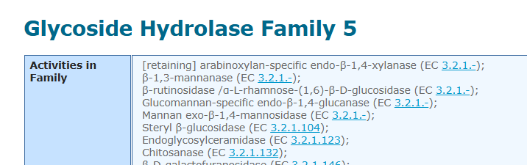
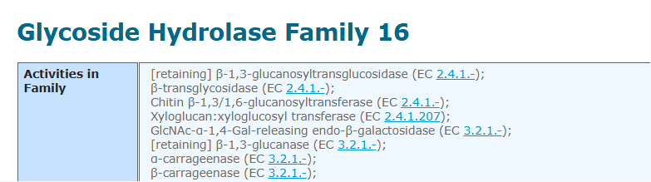
Introduction
Goal: Classify the CAZy family into subfamilies, analyze and visualize them using Bioinformatics tools and methods.
In this project, we will do CAZyme subfamily classification following the paper:
DOI: https://doi.org/10.1016/j.jbc.2023.103038
We will use GH31 as an example to show all analyses
Students will form two groups to work together on GH5 (group 1) or GH16 (group 2)

Slide 3
Outline
1. Workflow
2. Data preparation
3. Domain annotation
4. Domain extraction
5. Sequence similarity networks (SSNpipe)
6. Cytoscape Visualization
7. Phylogenentic Analysis
8. Other analysis

Slide 4
Workflow

Slide 5





Workflow1. Subfamily Classification: Data Preparation, Annotation, and Domain Extraction
GH31 protein sequences
(batch_protein_sequences.fasta)
Data download
E- Value < 1e-15
coverage >0.35
Domain annotation
filtered file containing high-confidence matches
(gh31_hmmscan.out.dm.ps.stringent)
Domain extraction
extracted GH31 domain sequences
(random_selected_extracted_domains_02.faa)
filter_modules_20sep2025.py
random subset (20% )
subfamily classification

Slide 6
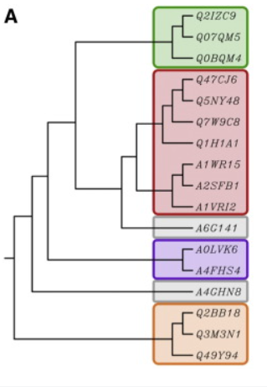
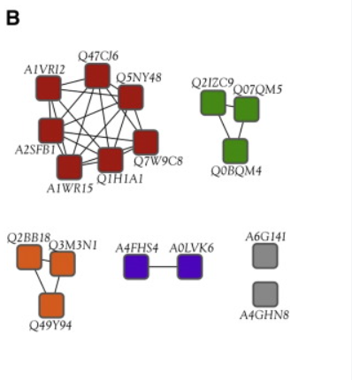
Classification Method Introduction:
Method | Phylogenetic Trees | Sequence Similarity Networks (SSNs)
Purpose | Shows evolutionary relationships between sequences | Visualizes sequence similarity within protein families
Visualization | Complex, hierarchical structure; can be hard to interpret for large datasets | Nodes (proteins) connected by edges based on similarity; easy overview
Alignment | multiple sequence alignment (MSA) | pairwise sequence similarity
Scalability | Computationally intensive; challenging for large datasets | Computationally efficient; scales well with dataset size
Best For | Detailed evolutionary insights | Quick functional clustering and relationship overview
Scalability Challenge: As the CAZy database expands, it will be increasingly difficult to generate accurate subfamily phylogenies for most families.
https://doi.org/10.1074/jbc.RA119.010619
https://doi.org/10.1016/j.bbapap.2015.04.015

Slide 7
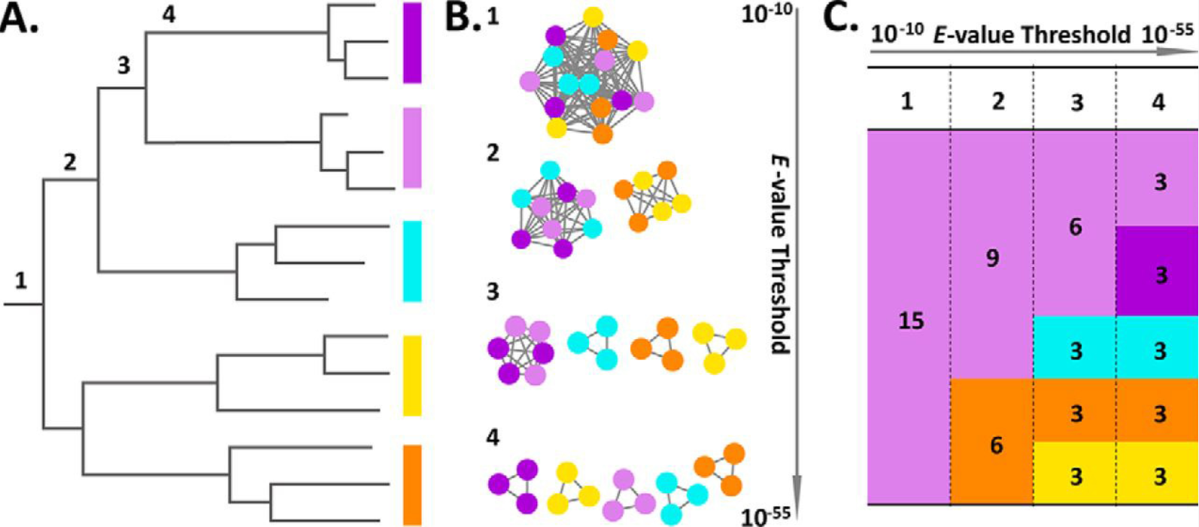
Classification Method Introduction:
15 sequences to be classified into subfamilies illustrates the relationships between distinct representation and analysis
Number 1–4 indicate four hypothetical subfamily classifications
A. Evolutionary tree: Subfamily delineation consists of drawing a vertical line (below numbers 1–4) and making a family for each outcoming branch.
B. SSN connection graph: SSNs with sequences represented as nodes (circles) and all pairwise sequence relationships (alignments) above a defined E-value threshold indicated with edges (lines).
At increased thresholds (numbers 1–4), the connected components break up into an increasing number of subcomponents, representing putative subfamily delineations.
C. SSN tabular summary: Each column (numbers 1–4 for each E-value threshold, separated by a vertical dashed line) depicts a distinct subfamilization and displays the number of clusters/subfamilies as colored boxes and the number of members/sequences in each cluster/subfamily.
https://doi.org/10.1074/jbc.RA119.010619

Slide 8



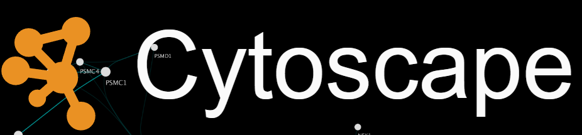

Workflow2. Subfamily Classification Using SSNs and Phylogenetic Analysis
Subfamily Classification
Sequence Similarity Networks (SSNs) Creation
Phylogenetic Analysis
Perform pairwise alignments
Multiple Sequence Alignment
Apply E-value filtering
Phylogenetic Tree Construction
Visualize networks
Tree Visualization

Slide 9
Part I Data preparation

Slide 10
1.1 - Create Project Folders and Clone Git Repository
Log in your swan OnDemand and download all data to the work folder.
For each part, we recommend to create a folder and named with “part_1”, “part_2” ...
*Remember to do that and we won’t show it again in the next slides.
*NEVER forget which folder you are in and which you should be.
cd /work/fdst396/your_name
mkdir course_project_1
cd course_project_1
git clone https://github.com/numanislam/course-project-1-Subfamily-classification-of-glycoside-hydrolase-family
mkdir part_1
cd part_1

Slide 11
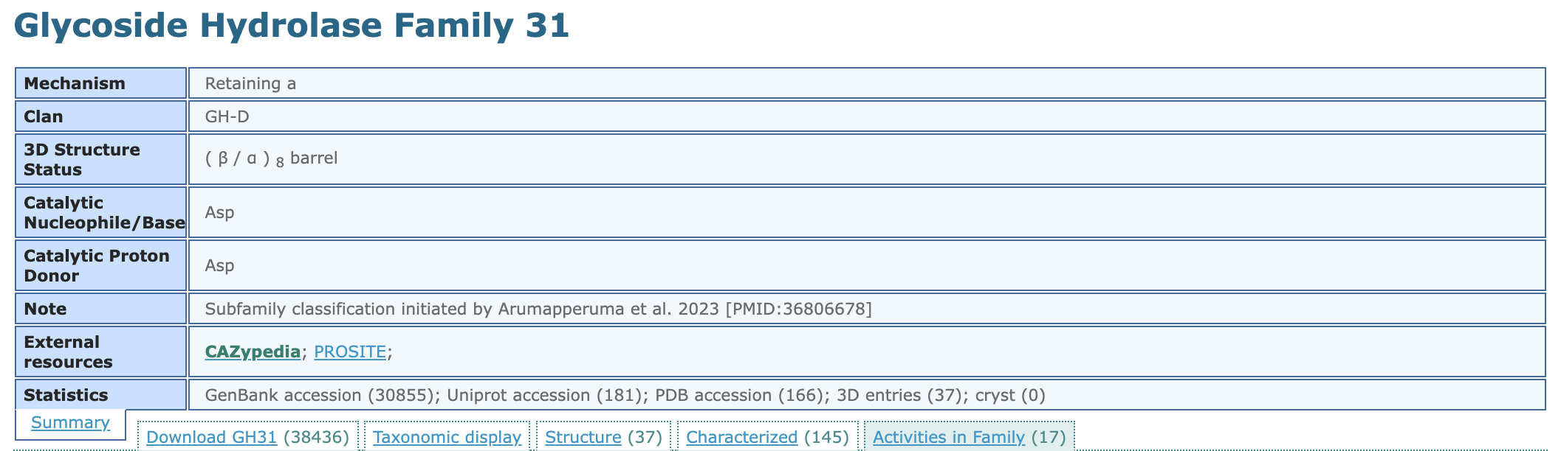
1.2 - Download and Process GH31 Family GenBank IDs
Go to the CAZy website http://www.cazy.org/
Select GH classes on CAZy database http://www.cazy.org/Glycoside-Hydrolases.html
Choose GH31 (change into your family) http://www.cazy.org/GH31.html
Find the txt file containing IDs

Slide 12
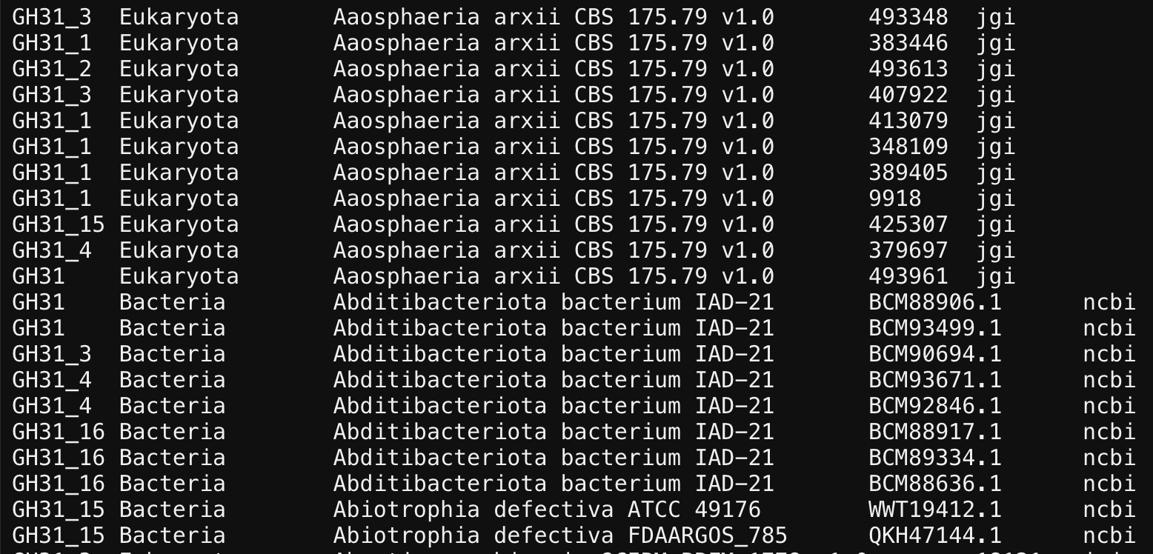
1.2 - Download and Process GH31 Family GenBank IDs
Copy the link and use the wget to download it on swan
wget https://www.cazy.org/IMG/cazy_data/GH31.txt
Columns in GH31.txt 1. Subfamily
2. Taxonomy: Domain
3. Organism: Species/Strain
4. Protein ID
5. Database

Slide 13
1.2 - Download and Process GH31 Family GenBank IDs
Use GH31.txt to get a list of genbank ids of GH31 family
less GH31.txt | grep -w ncbi | cut -f 4 > list_ids.txt
Remove the redundant IDs
cat list_ids.txt | sort | uniq > uniq_list_ids.txt
You will get 30850 unique ids in GH31
wc -l uniq_list_ids.txt

Slide 14
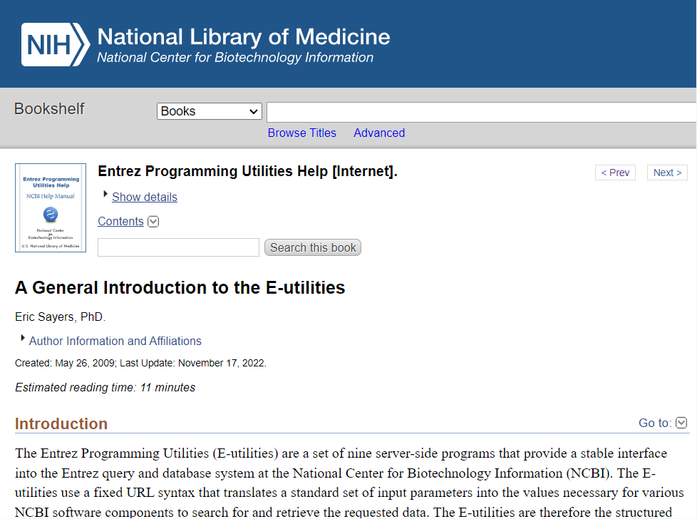
1.3 - Automating NCBI Data Retrieval with E-utilities and API Keys
The Entrez Programming Utilities (E-utilities) are server-side tools for automating queries and retrieving data from NCBI
NCBI has provided API keys that offer enhanced levels of supported access to the E-utilities
https://www.ncbi.nlm.nih.gov/books/NBK25497/
https://www.ncbi.nlm.nih.gov/books/NBK179288/

Slide 15
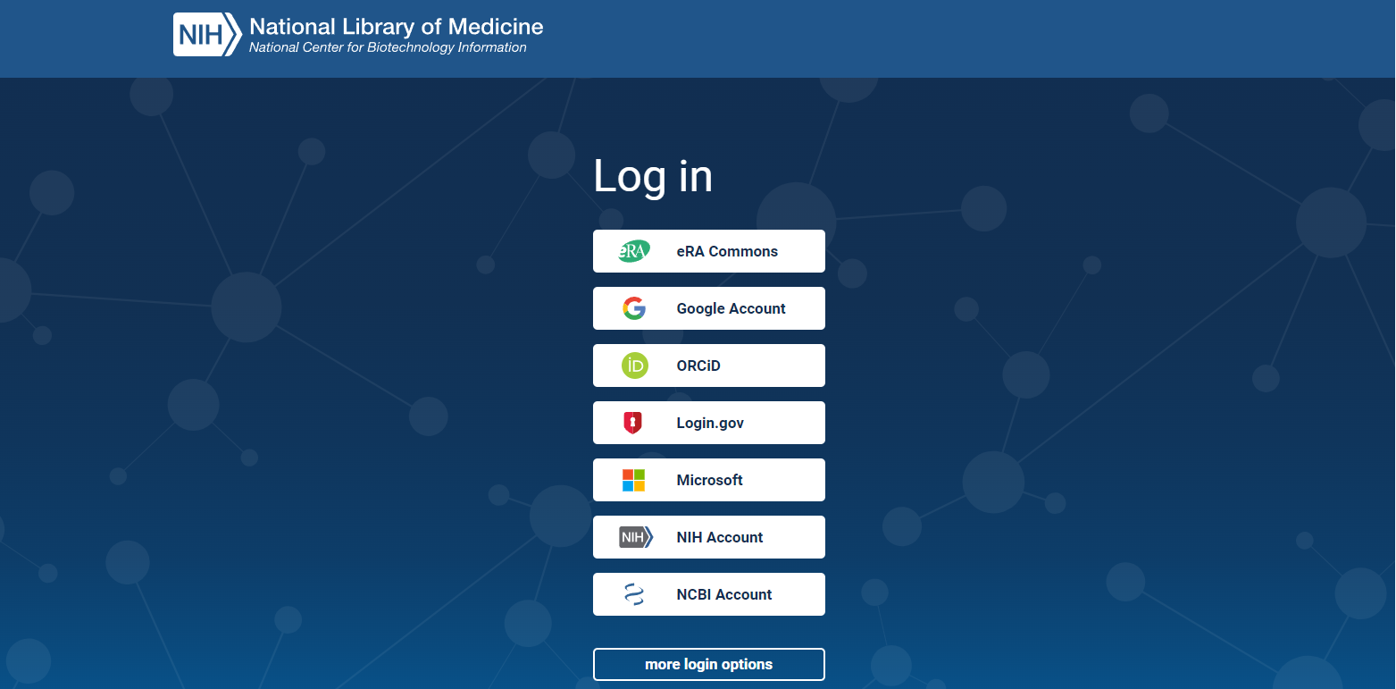
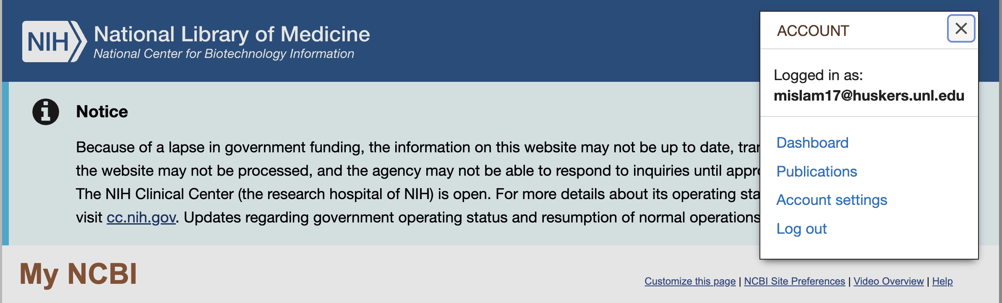
1.3 - Automating NCBI Data Retrieval with E-utilities and API Keys
Creating an NCBI Account (Recommended to Use Your UNL Account) https://account.ncbi.nlm.nih.gov/
Then go to the “Account settings”

Slide 16
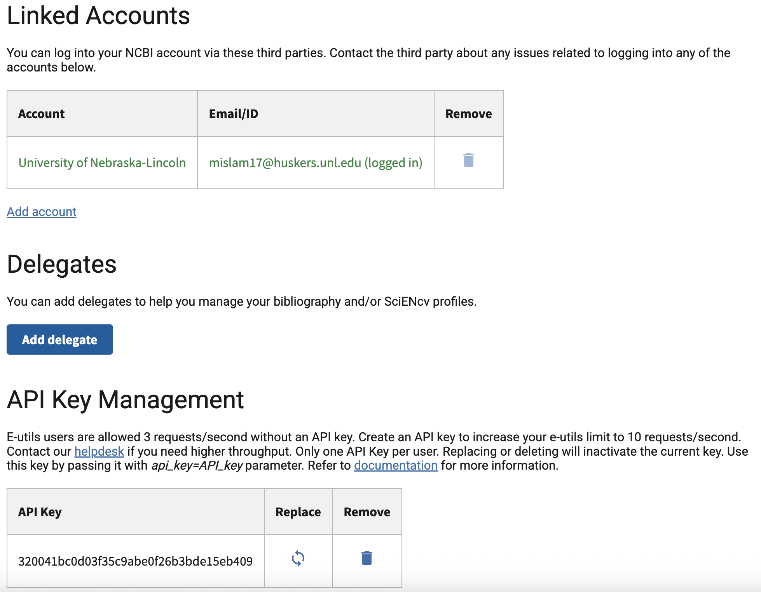
1.3 - Automating NCBI Data Retrieval with E-utilities and API Keys
Find your API key in the end.

Slide 17
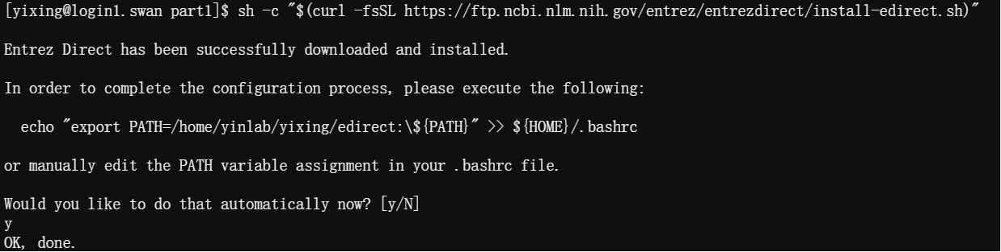
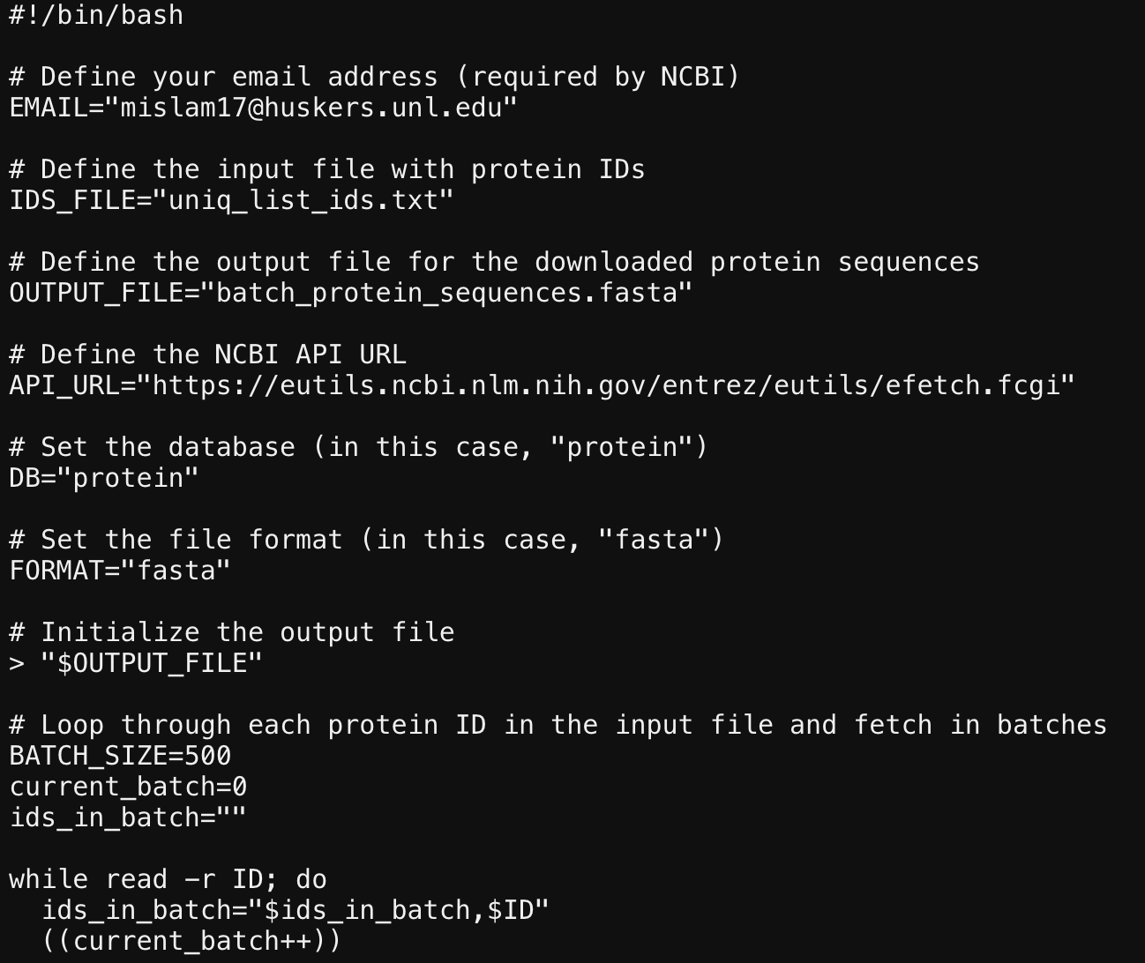
Run the following command:
(Type y and click enter when it asks you to do it)
And use this command to set your NCBI API key
Revise to change email address
The uniq_list_ids.txt file will be processed for this sh script
sh -c "$(curl -fsSL https://ftp.ncbi.nlm.nih.gov/entrez/entrezdirect/install-edirect.sh)"
export NCBI_API_KEY=your_API_KEY
cp ../course-project-1-Subfamily-classification-of-glycoside-hydrolase-family/batch_download_protein_seqeunces.sh .
nano batch_download_protein_seqeunces.sh

Slide 18
After that
bash batch_download_protein_seqeunces.sh
It takes ~40 mins to downloading data.
29982 ids were found and downloaded.
Finally, you get a file called “batch_protein_sequences.fasta”.
“batch_protein_sequences.fasta”: protein sequences downloaded from NCBI using GenBank IDs extracted from the GH31.txt file on the CAZy website

Slide 19
Part II Domain annotation
Create your part_2 folder
mkdir part_2

Slide 20
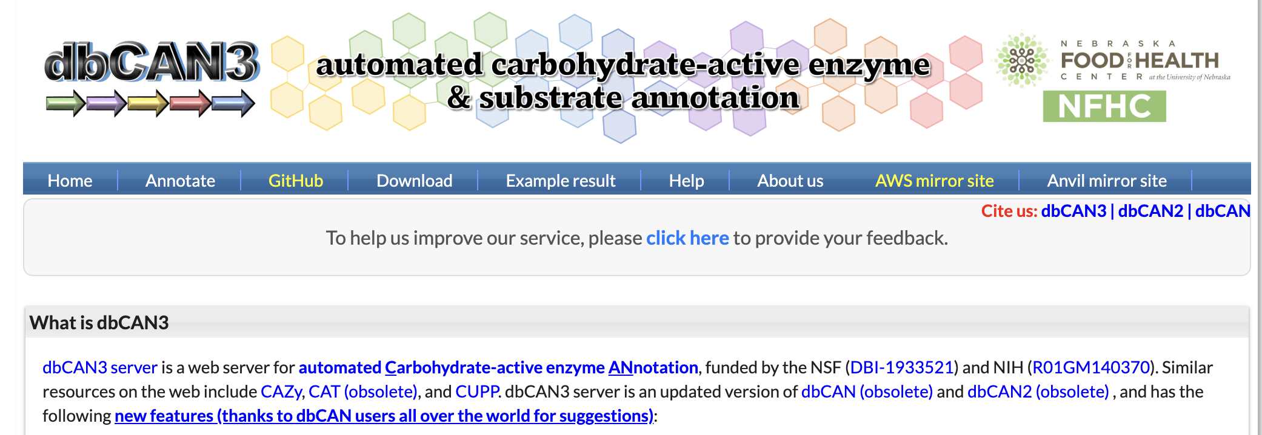
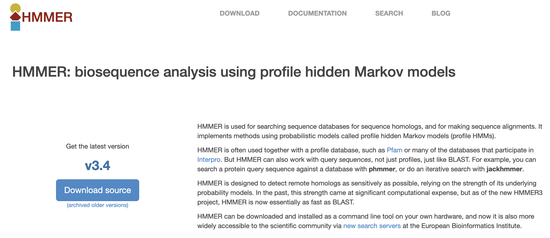
2.1 - Domain Annotation of Protein Sequences Using HMMER and dbCAN
HMMER is used for searching sequence databases for sequence homologs, and for making sequence alignments. HMMER is often used together with a profile database, such as Pfam.
dbCAN: a database for CAZyme family-specific signature domains.
https://bcb.unl.edu/dbCAN2/

Slide 21
2.1 - Domain Annotation of Protein Sequences Using HMMER and dbCAN
Steps to Run dbCAN CAZyme Annotation
Go to the website:
Use wget to download “dbCAN-fam-HMMs.txt.v14” and “hmmscan-parser.sh”
Use module load to activate hmmer on swan.
https://bcb.unl.edu/dbCAN2/download/Databases/dbCAN-old@UGA/readme.txt
https://bcb.unl.edu/dbCAN2/download/Databases/dbCAN-old@UGA/
wget https://bcb.unl.edu/dbCAN2/download/Databases/dbCAN-old@UGA/dbCAN-fam-HMMs.txt.v14
wget https://bcb.unl.edu/dbCAN2/download/Databases/dbCAN-old@UGA/hmmscan-parser.sh
ml hmmer/3.3
hmmbuild -h
#To check if it works or not.

Slide 22
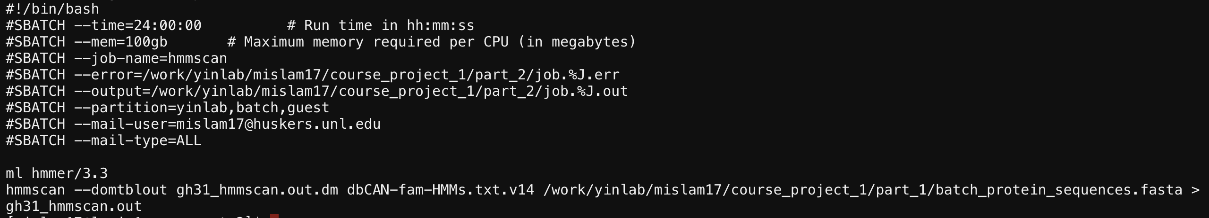
Then prepares the HMM database for faster searches:
hmmpress dbCAN-fam-HMMs.txt.v14
cp ../course-project-1-Subfamily-classification-of-glycoside-hydrolase-family/hmmscan_run.slurm .
nano hmmscan_run.slurm
It takes ~4.5 hrs
Edit it using your own info.
Try smaller mem if the waiting time is too long.
Set error and output with the same path (in your part2 folder).
Add email to remind you when it start/stop.
Remember where you have your GH31 protein sequence files.

Slide 23
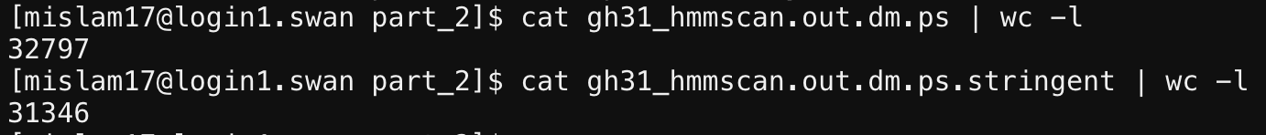
Run the following commands to submit the job
sbatch hmmscan_run.slurm
Run the following commands to make the result readable:
sh hmmscan-parser.sh gh31_hmmscan.out.dm > gh31_hmmscan.out.dm.ps
And extract the final modules by filtering with E- Value <1e-15 and coverage cut off >0.35
cat gh31_hmmscan.out.dm.ps | awk '$5<1e-15&&$10>0.35' > gh31_hmmscan.out.dm.ps.stringent

Slide 24
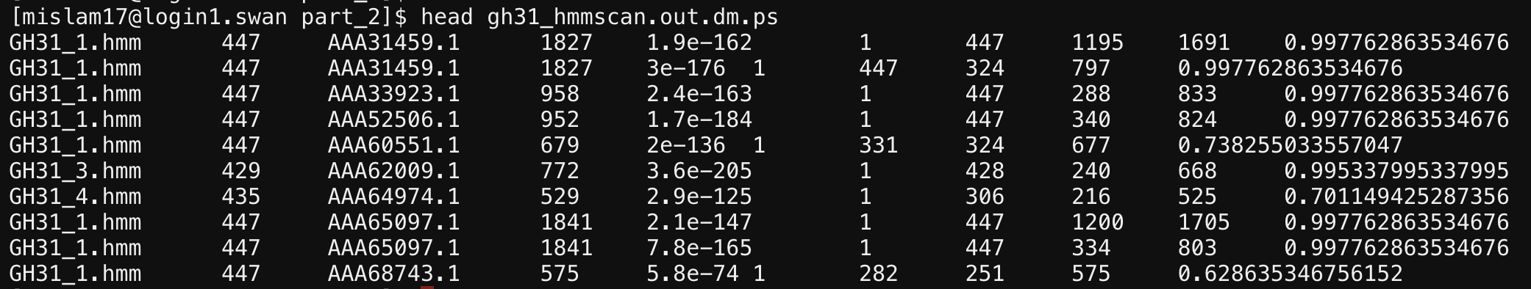
Columns in yourfile.out.dm.ps:
1. Family HMM 2. HMM length 3. Query ID 4. Query length 5. E-value: the similarity between the query sequence and the HMM family
( Lower E-values mean higher similarity and more significant matches) 6. HMM start 7. HMM end 8. Query start 9. Query end
10. Coverage: the proportion of the HMM model that aligns with the query sequence, indicating
how much of the model is covered by the match

Slide 25
Part III Domain extraction
Create your part_3 folder
mkdir part_3

Slide 26
3.1 - Extracting GH31 Domains Using Python and SeqKit
First activate the biopython.
ml biopython/py311/1.81
cp ../course-project-1-Subfamily-classification-of-glycoside-hydrolase-family/filter_modules_20sep2025.py .
cp ../part_1/batch_protein_sequences.fasta .
cp ../part_2/gh31_hmmscan.out.dm.ps.stringent .

Slide 27
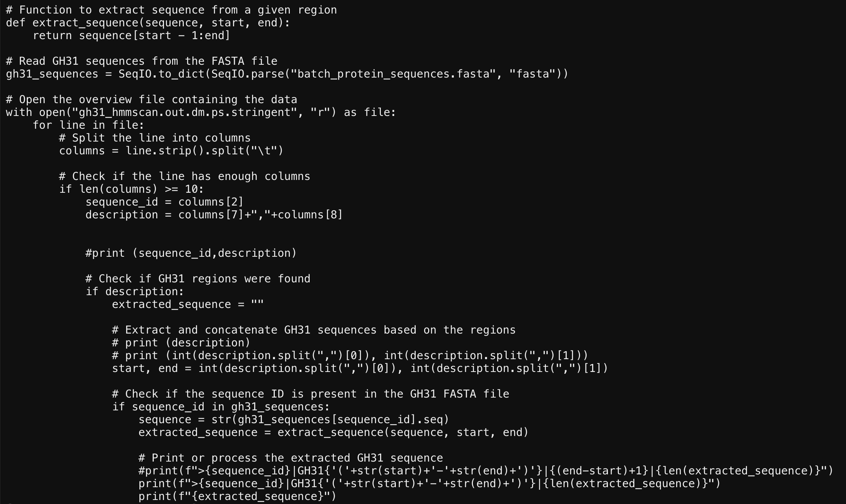
3.1 - Extracting GH31 Domains Using Python and SeqKit
nano filter_modules_20sep2025.py
Change the the family name in filter_modules_20sep2025.py
python filter_modules_20sep2025.py > extracted_domains.faa
ml seqkit
seqkit sample -p 0.2 extracted_domains.faa -o random_selected_extracted_domains_02.faa

Slide 28
Part IV Sequence similarity networks (SSNpipe)
Create your part_4 folder
mkdir part_4
https://github.com/MiguelMSandin/SSNetworks

Slide 29
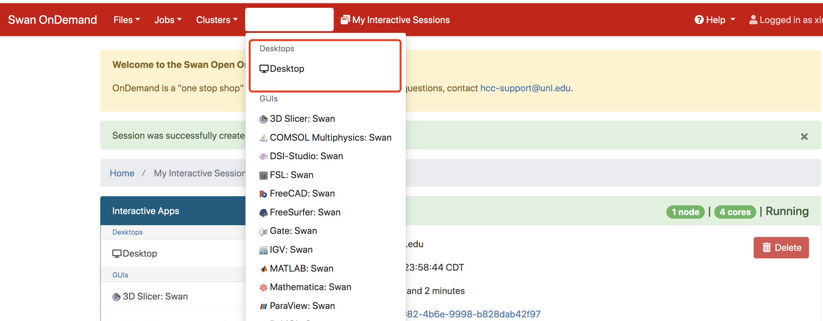
4.1 - Setup and Execution of SSNpipe
Create the part_4 folder and use wget to download :
wget https://github.com/ahvdk/SSNpipe/releases/download/v.1.0-beta/ssnpipe_unix.tar.gz
tar -xvf ssnpipe_unix.tar.gz
Go to ondemand and click the “Interactive Apps”.
Set as the next slide.

Slide 30
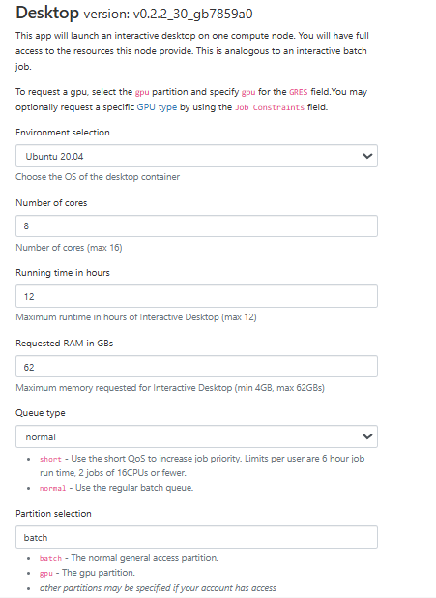
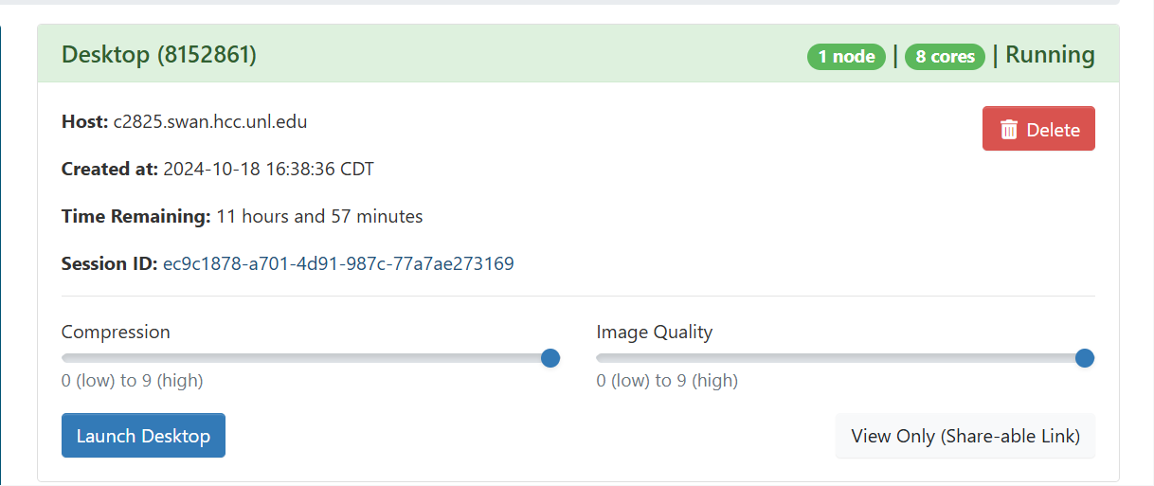


Slide 31
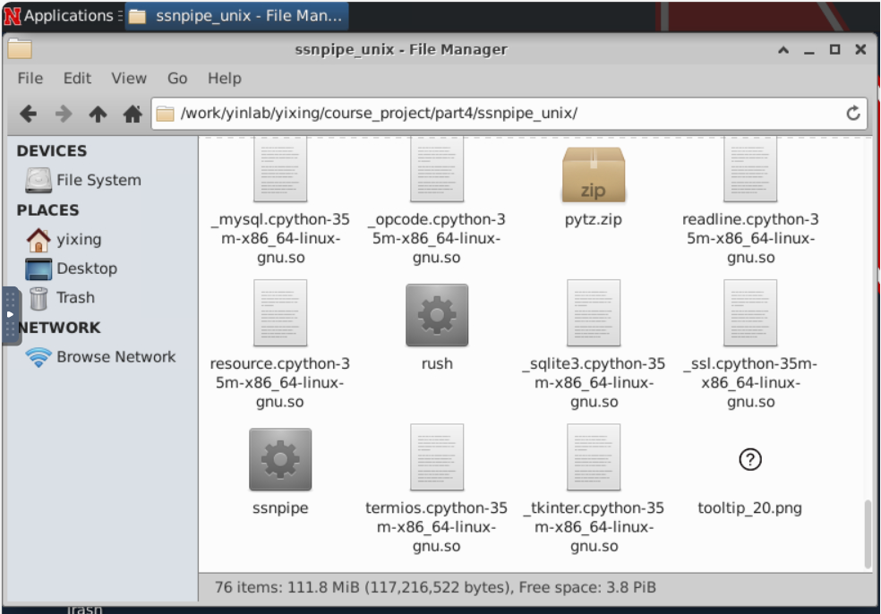
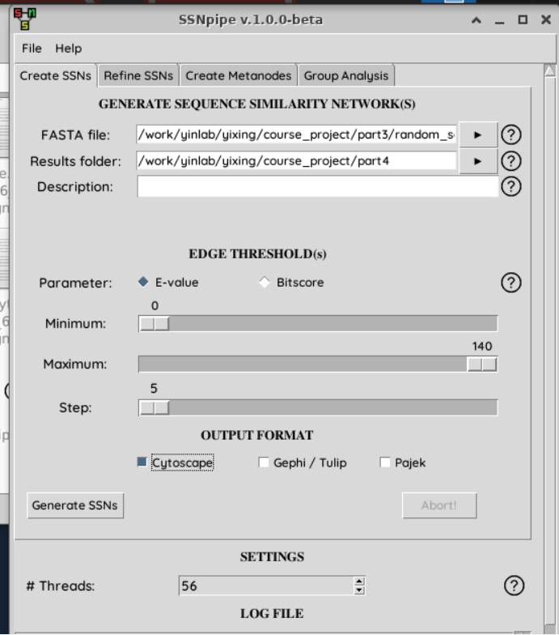
4.2 - Setup and Execution of SSNpipe - Create SSNs
Click the file manager and change the path into part_4 (Don’t use copy paste here).
Move to the ssnpipe folder.
Click the SSNpipe (GUI tool).
The FASTA file will use the random_selected_extracted_domains_02.faa, and choose part_4 folder as the results folder.
E-value: Minimum: 0 Maximum: 140 Steps: 5
Click on Cytoscape and Generate SSNs, the program will run for a few hours depending on the database size and computational power.
It takes about ~40 mins

Slide 32
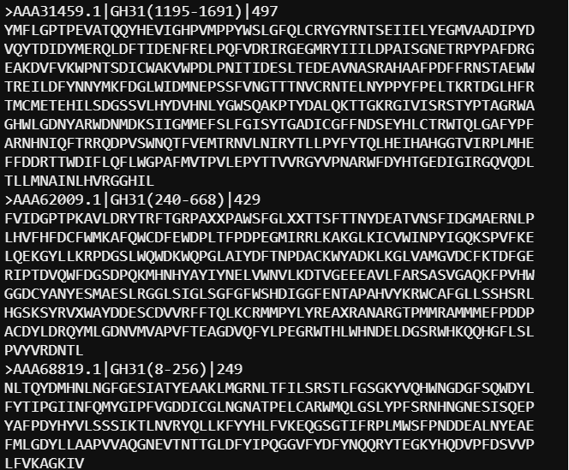
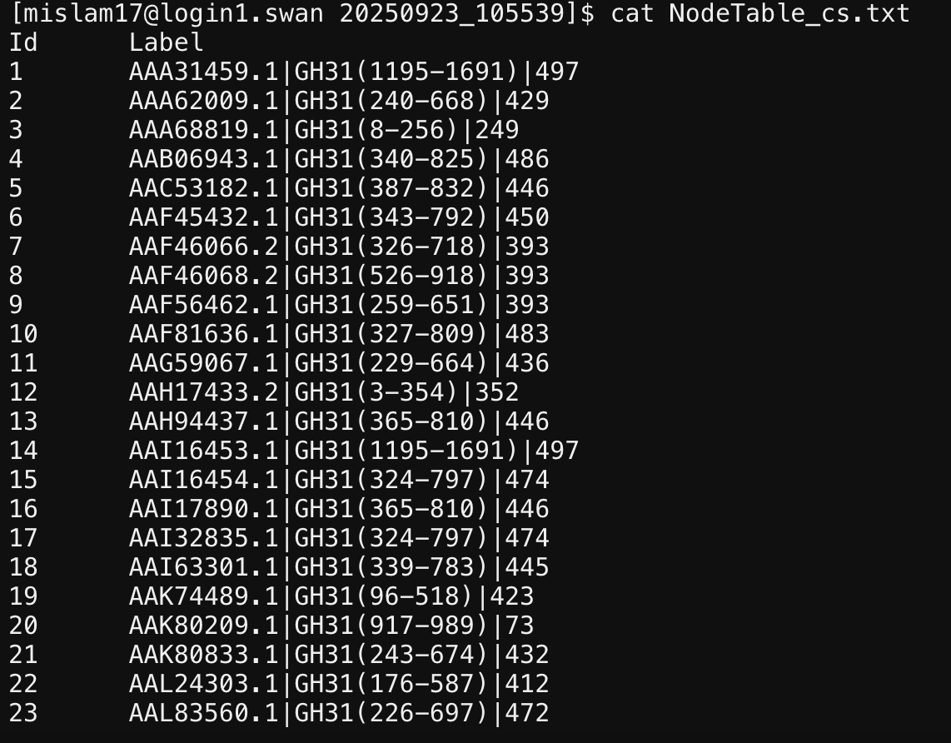
4.2 - Setup and Execution of SSNpipe - Create SSNs
Input: random_selected_extracted_domains_02.faa
Output:
1. NodeTable_cs.txt
sequence id|start end |extracted sequence length
Node ID sequence id|start end |extracted sequence length

Slide 33
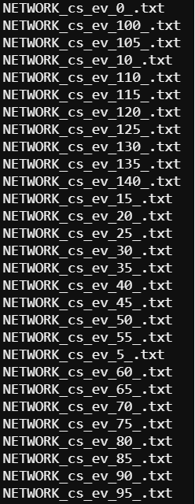
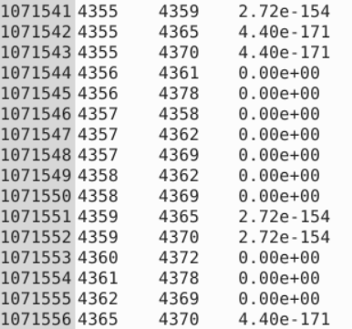
4.2 - Setup and Execution of SSNpipe - Create SSNs
Output:
2. NETWORK_cs_ev_XX_.txt
Node ID
E-value
Lower E-values indicate more significant matches, with values close to zero suggesting a highly relevant match.
E-value of 1e-140 (or 10^-140) is extremely low, meaning the likelihood that this match occurred by chance is almost negligible. This suggests a very high similarity between the query sequence and the target, making the alignment result statistically significant.

Slide 34
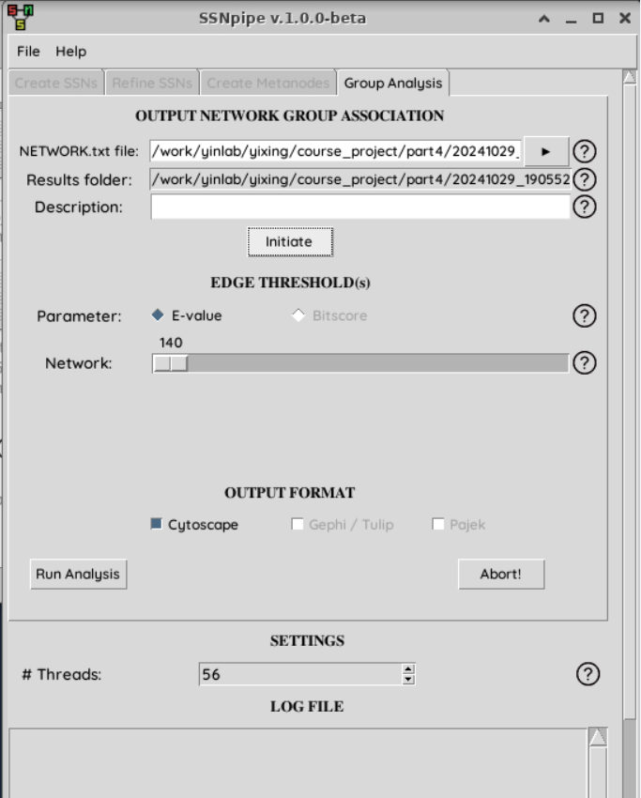
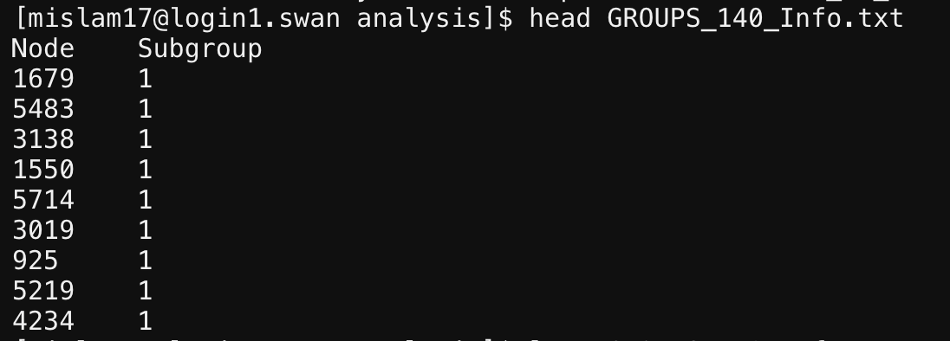
4.3 - Setup and Execution of SSNpipe - Group Analysis
Generate Group Analysis files from the 4th tab.
The NETWORK_cs_ev_XX_.txt will be the input
Click on Initiate and Run Analysis, the program will run for a few hours depending on the database size and computational power.
Output:
1. GROUPS_XXX_info.txt

Slide 35
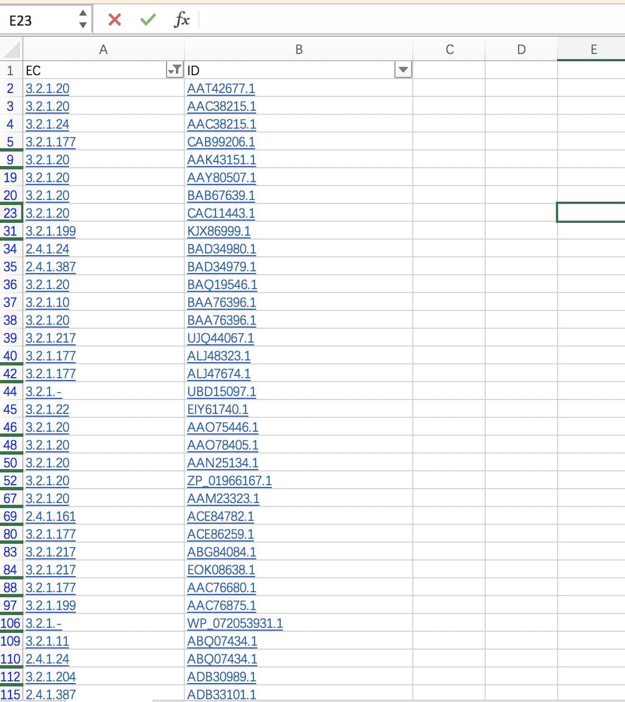
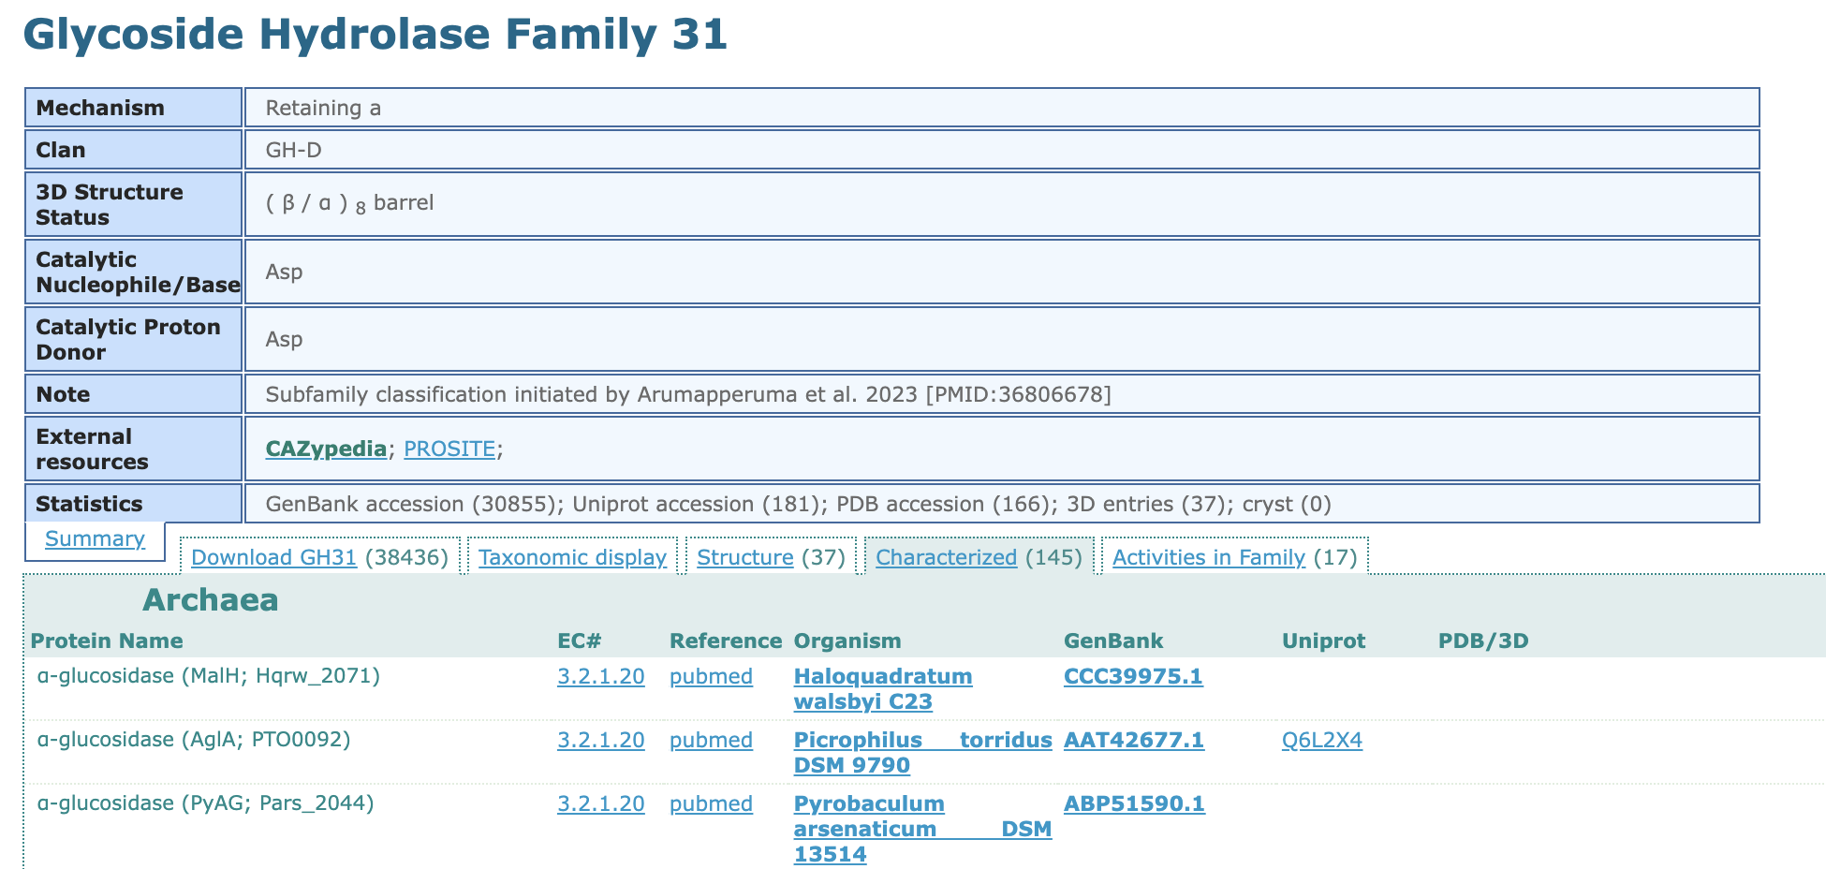
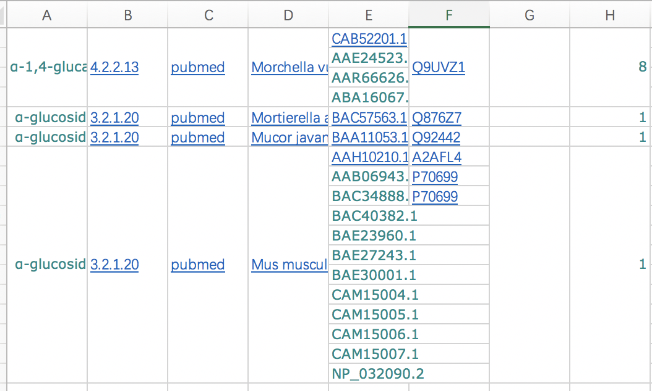
4.4 - Gathering Characterized Genbank IDs and EC Numbers from CAZy
Go to the CAZy family page to get all characterized IDs.
Tabular column page will be shown.
Copy the Characterized IDs, EC numbers from the page and paste them in Excel and select only the IDs which only have hyperlinks (Characterized by CAZy) and make a list.
Copy those in the excel and revise it then use nano to make a txt file and save it:
*There are some Genbank ID with multiple ECs, don’t forget to check, and keep all.

Slide 36
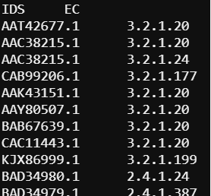
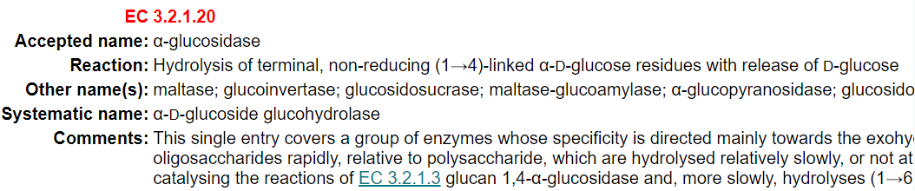
4.4 - Gathering Characterized Genbank IDs and EC Numbers from CAZy
Finally get this result: Name is “Characterized_ids_22sep2025.txt” (name could be changed but you also need to fix the program later).
The first row is IDS/EC
Enzyme Commission (EC) Number Classification
EC number is a classification system based on the chemical reactions that these proteins catalyze. It was developed by the International Union of Biochemistry and Molecular Biology (IUBMB)
First Number: The type of reaction or enzyme class. Ex: EC 3: Hydrolases
Second and third numbers: Enzyme subclass and sub-subclass
Fourth Number: Enzyme identification

Slide 37
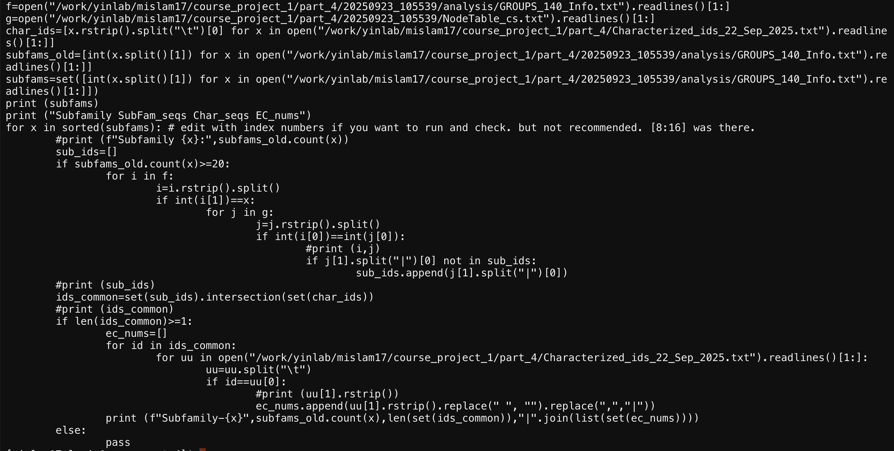
4.4 - EC-Number Mapping for Subfamily Classification
You will use NodeTable_cs.txt, GROUPS_XXX_info.txt, Characterized_ids_22sep2025.txt
cp ../course-project-1-Subfamily-classification-of-glycoside-hydrolase-family/analysis_mapped_20sep2025.py .
nano analysis_mapped_20sep2025.py
python analysis_mapped_20sep2025.py
You need revise those names (from SSNpipe).

Slide 38
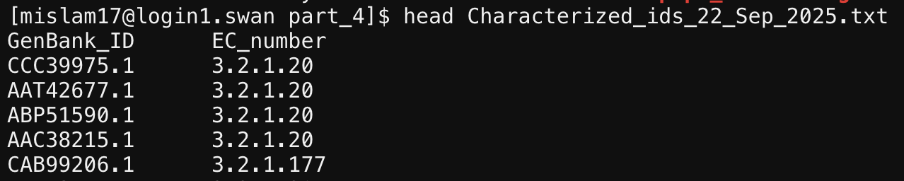
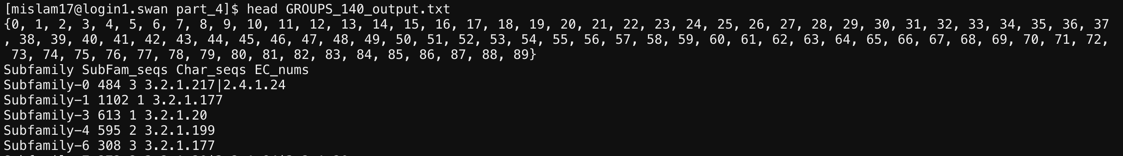
4.4 - EC-Number Mapping for Subfamily Classification
You will use NodeTable_cs.txt, GROUPS_XXX_info.txt, Characterized_ids_22sep2025.txt
cp ../course-project-1-Subfamily-classification-of-glycoside-hydrolase-family/analysis_mapped_20sep2025.py .
nano analysis_mapped_20sep2025.py
python analysis_mapped_20sep2025.py

Slide 39
Part V Cytoscape Visualization
Create your part_5 folder
mkdir part_5

Slide 40

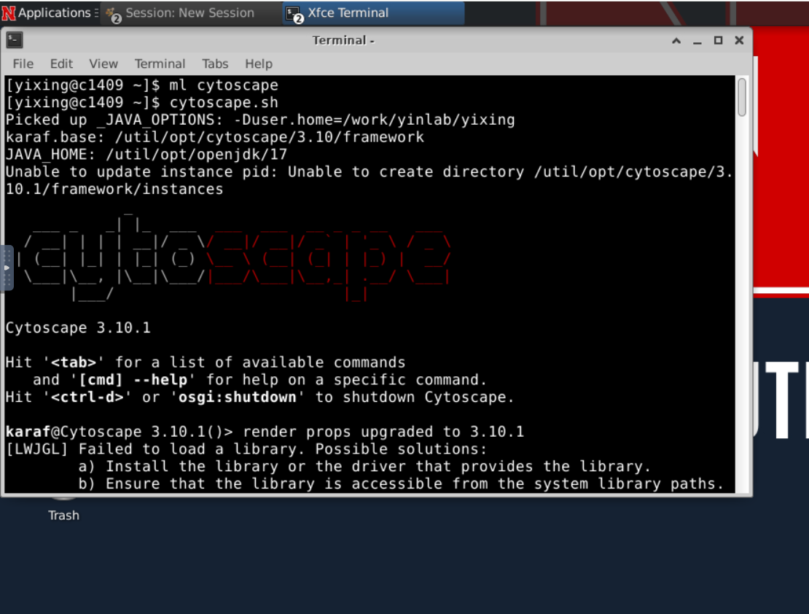
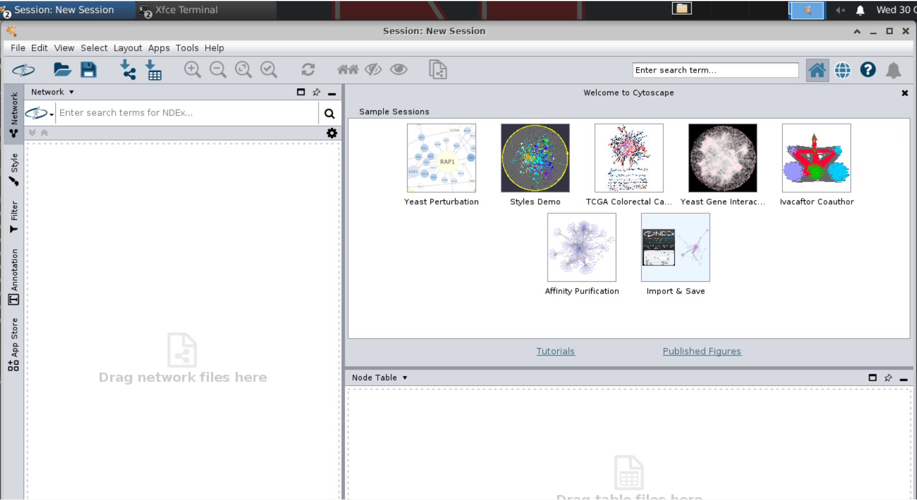
5.1 - Loading and Organizing Network in Cytoscape
Using the desktop and click the terminal on the left of “Applications”
Type:
ml cytoscape/3.10
cytoscape.sh

Slide 41
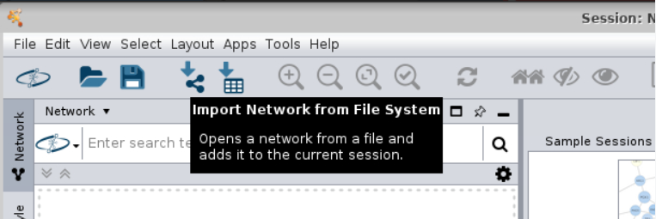

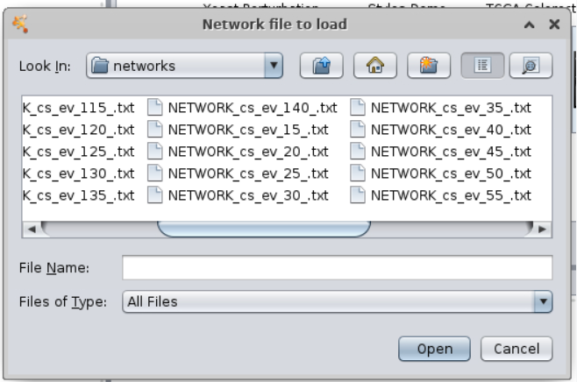
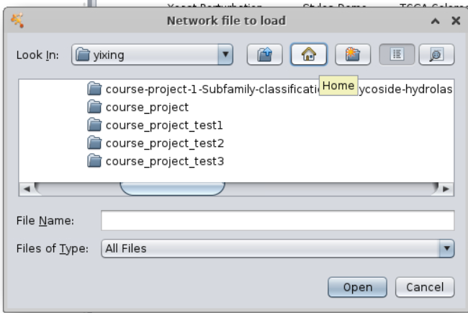

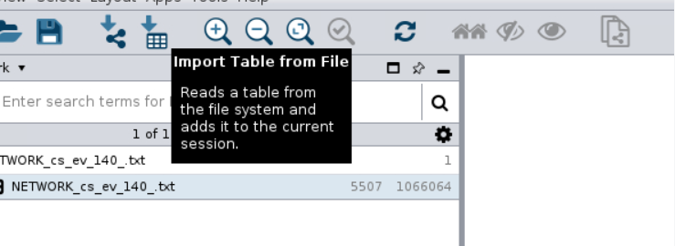
5.1 - Loading and Organizing Network in Cytoscape
Loading input files: NETWORK_cs_ev_XX_.txt, GROUPS_XXX_info.txt, NodeTable_cs.txt
*find your network file and click open
Click the to import NETWORK_cs_ev_XX_.txt
Click the to import GROUPS_XXX_info.txt, NodeTable_cs.txt

Slide 42
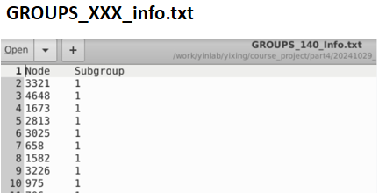
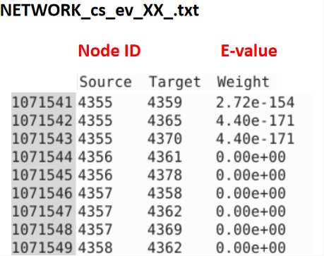
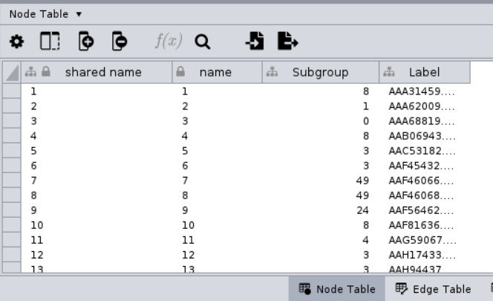
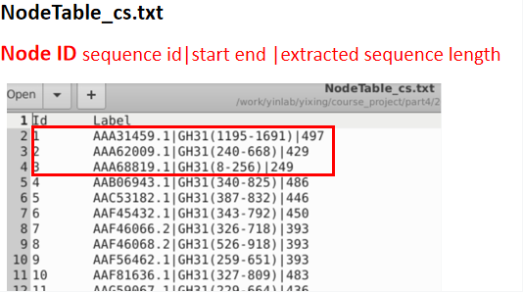
5.1 - Loading and Organizing Network in Cytoscape
NodeTable will generate in Cytoscape

Slide 43


5.1 - Loading and Organizing Network in Cytoscape
Use a yFiles Organic layout from the layout panel. (Install if not available)
Check different nodes (proteins) and subfamilies (clusters), how they are aligned, etc.
Modified colors based on the connected nodes and subfamilies.
Click style icon and modify the fill color.

Slide 44



Export the network to an Image or PDF
Searching the Characterized IDs in a network
Use the top right search box in the Cytoscape to find out the characterized to mark them differently.
Search format: name:YL*
Example search: name:BBM21771.1*
Export the network to an Image or PDF
Here, we have selected the query "BBM21771" This query has 1 node and 25 edges. All are highlighted here, which can be colored seperatly using the Style on the left panel.

Slide 45
Part VI Phylogenetic Analysis
Create your part_6 folder
mkdir part_6

Slide 46


6.1 - Random Sampling for Phylogenetic Analysis
Purpose: Evaluate how well the SSN clusters (subfamilies) match phylogenetic classification.
Use a python program to select random 30 sequences from each subfamily
cp ../course-project-1-Subfamily-classification-of-glycoside-hydrolase-family/phylo_process_random_20sep2025.py .
nano phylo_process_random_20sep2025.py
python phylo_process_random_20sep2025.py > phylo_input_fasttree_100.fasta
Check what are needed for the python program and change the files pathway random_selected_extracted_domains_02.faa analysis/GROUPS_XXX_Info.txt Characterized_ids_22sep2025.txt

Slide 47

6.2 - MAFFT Job Submission Script for Phylogenetic Analysis
cp ../course-project-1-Subfamily-classification-of-glycoside-hydrolase-family/mafft.sh .
nano mafft.sh
sbatch mafft.sh

Slide 48

6.3 - Constructing Phylogenetic Tree Using FastTree
HCC module load FASTTREE
ml fasttree/2.1
fasttree -wag -boot 100 -out tree_e-100.nwk phylo_mafft_align_1e-100.fasta
Output: tree_e-100.nwk in newick format file

Slide 49




6.4 - Phylogenetic Tree Visualization on iTOL
“tree_e-100.nwk” can be visualized using the iTOL available online. https://itol.embl.de/
Download the nwk file to your laptop and upload to itol

Slide 50

6.4 - Phylogenetic Tree Visualization on iTOL
Explore the options over the webserver and save the image for the best SSN Evalue.

Slide 51

6.5 - Using Color Ranges in iTOL for Visualizing SSN Subfamily Clustering
Create color definition files to highlight those nodes(protein) with subfamily.
In ITOL, there are multiple functions to revise the tree. https://itol.embl.de/help.cgi#functions
We will use “COLOR RANGE” function to label subfamilies in the tree. https://itol.embl.de/help/colors_styles_template.txt

Slide 52
6.5 - Using Color Ranges in iTOL for Visualizing SSN Subfamily Clustering
Purpose: to create the Color DATASET file to annotate the Subfamily from SSN
cp ../course-project-1-Subfamily-classification-of-glycoside-hydrolase-family/ itol_color_strip.py .
cp ../course-project-1-Subfamily-classification-of-glycoside-hydrolase-family/ ec.itol_color.py .
Your required file:
Characterized_ids_22_Sep_2025.txt
GROUPS_140_Info.txt
NodeTable_cs.txt
You need to copy those file from your previous work folder
grep ">" phylo_mafft_align_1e-100.fasta | cut -f1 -d'(' | sed 's/>//' > list
python itol_color_strip.py GROUPS_100_Info.txt NodeTable_cs.txt output.txt --id_file list
cat Characterized_ids_22sep2025.txt | awk -v FS='\t' -v OFS='\t' '{print$1"|GH31",$2}' > ec.id.txt
python ec.itol_color.py --input ec.id.txt --output itol_ec_color.txt

Slide 53



6.5 - Using Color Ranges in iTOL for Visualizing SSN Subfamily Clustering
Download those (two outputs) on your laptop and import it into iTOL
itol_ec_color.txt
output.txt

Slide 54



6.5 - Using Color Ranges in iTOL for Visualizing SSN Subfamily Clustering
Follow the steps to get legends.
We have two ring: subfam and EC number.

Slide 55

You could export the result as SVG/PNG file.
NOTICE:
If you don’t have a subscription account, the annotations would not be saved. Please export the result when you finish.
Sign up an account to keep the result (without annotations).

Slide 56
Part VII Other analysis
Create your part7 folder

Slide 57
Interpretation and analysis of the subfamilies based on the Phylogeny and subfamilies from the selected E-value.
Interpretation steps and protocol:
Explain each subfamily in terms of EC number, taxonomical diversity, enzyme activity and structures.
Select any one characterized ID and their EC numbers from each subfamily from the results (Output of “analysis_mapped_20sep2025.py”).
If PDB ID (Protein Data Bank, https://www.rcsb.org/) is available, take the structure, or else model them using “Swiss-model” or AlphaFold2.
Identify the common catalytic domain between each subfamily.
Use PyMol to load and visualize the structures. (Available in HCC interactive apps).

Slide 58


How to use Alaphfold to search protein structure: 1. If know the protein ID/name: https://alphafold.ebi.ac.uk/ Directly search it.
2. If it cannot be found, could try use sequence: Use FASTA tool to search: https://www.ebi.ac.uk/Tools/sss/fasta/

Slide 59

3. Try google colab: https://colab.research.google.com/github/sokrypton/ColabFold/blob/main/AlphaFold2.ipynb

Slide 60
Any Questions?
🕸️
🕸️
👻
🕸️

