Slide 1

H1B Visa Recommender System
Guide: Prof Debabrata Swain
Anay Dombe (16)
Ashitosh Ashture(8)
Sachin Khutan(49)
Kush Chakroborty(41)

Slide 2
What is an H1B Visa?
Non-Immigrant Work Visa
Allows US employers to employ foreign workers
Duration of stay is 3 terms
Decision is based on the lottery process (USCIS) after approved by LCA
Those with US Master’s exemption, have two chances to be selected in the lottery

Slide 3
Problem Statement
Predicting whether he/she is eligible to file an H1B Visa based on certain parameters and recommend areas of improvisation to increase the probability of approval

Slide 4
Existing Solution
Used K-means Clustering and Decision Trees (only prediction)
Provided prediction accuracies for only a small subset of job types( considered only main features)
Provided insights on distribution of our data

Slide 5
Dataset
Source : Kaggle (Roughly 1 million entries)
Features | Description
Case_Status | Certified/Denied
SOC_Name | Job Occupational Code
Job_Title | Title of the job
Full_Time_Position | Full Time/Part Time
Prevailing_Wage | Salary
Year | Year of application
Lat/Lon | Latitude/Longitude of Work Location

Slide 6
Data Pre-processing and Cleaning
Removing NAN values
Removing Outliers (Graphical Method)
Balancing the dataset (equalize the certified and denied count)
One hot encoding
Normalization

Slide 7
Experiments using models
Logistic Regression
Random Forest Classifier
Gaussian NB
Neural Networks

Slide 8
Training and Testing with the models
Algorithm | Accuracy
Logistic Regression | 93%
Random Forest Classifier | 94.30%
Gaussian NB | 87.50%
Neural Networks | 96.06%

Slide 9
Recommendations for Denied Case Status
Using Cosine Similarity
Using Associations Rule Mining

Slide 10
How to generate recommendations using Cosine Similarity ?
Pick the most ‘n’ similar users to the input user by calculating the cosine distance
Map each of the ‘n’ similar users with the input user
Suggest Recommendations after mapping the features

Slide 11
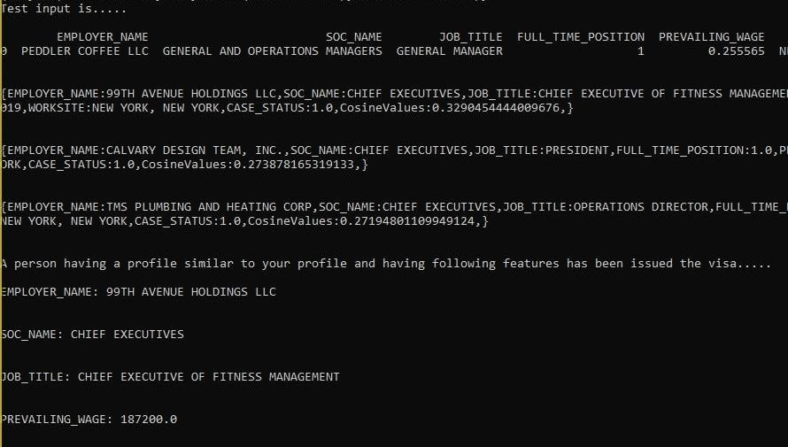
Sample Recommendations by our model using Cosine Similarity

Slide 12
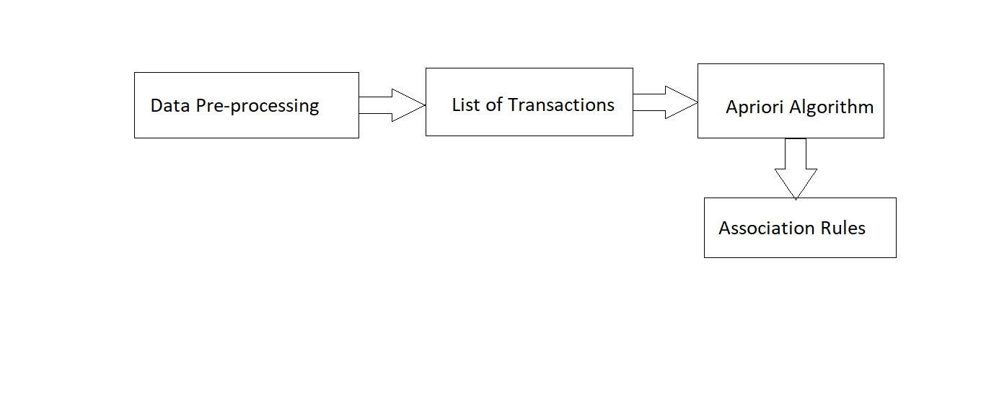
How to generate recommendations using Associations Rule Mining?

Slide 13
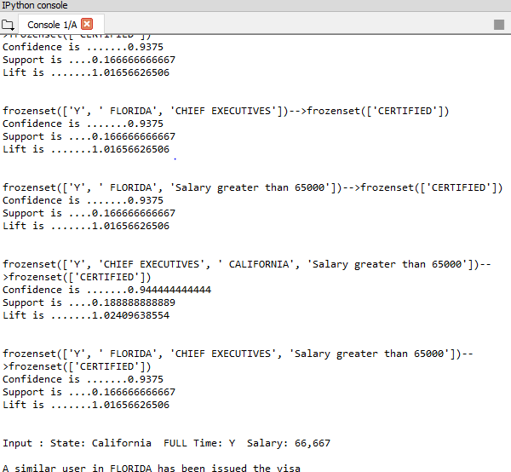
Sample Recommendations using ARM

Slide 14
Conclusions
Logistic Regression Model gives the best accuracy, which will be used for prediction
Since Associations Rule Mining is quite heavy in terms of memory, we decided to use cosine similarity to generate recommendations.

Slide 15
Future Work
Testing of different approaches towards recommendation system.
Evaluating the recommendation system.

Slide 16
Thank You

