Slide 1

PREDICTION OF MACHINE LEARNING USING H1B VISA PREDICTION
The H-1B is a visa in the United States under the Immigration and Nationality act, section 101(a)(15)(H) which allows U.S. employers to employ foreign workers in specialty occupations.

Slide 2

PURPOSE
Work on machine learning and data analytics.
Refine our python coding skills.
Mathematical thinking.
Provide a mathematically holistic prediction of a candidates American dream.

Slide 3
Tools and Libraries Used
Spyder
Anaconda
Pandas
Sklearn
Matplotlib

Slide 4
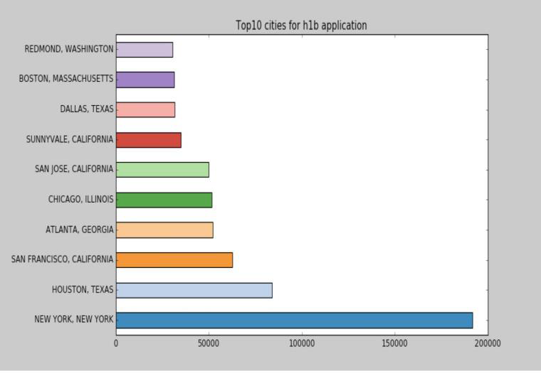
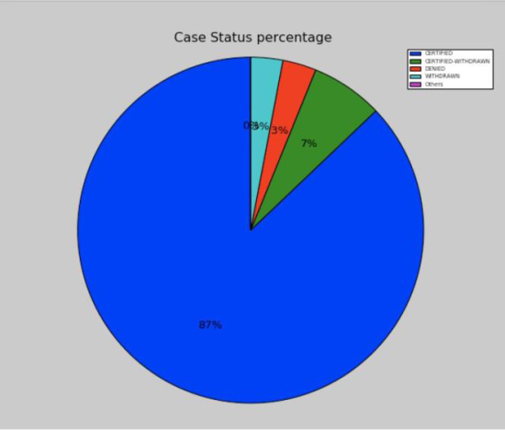
DATASET
We downloaded a dataset about H1-B visa petitions from Kaggle [1]. It consists of more than 3 million data points. The data labels are divided into 4 classes: (1) Certified (2) Denied (3) Withdrawn (4) Certified Withdrawn
ANALYSIS OF THE DATASET
1.ANALYSIS OF CASE STATUS
2.ANALYSIS OF WORKSITE
The panel shows that the majority (87%) of the visa application is certified, followed by 7% Certified-Withdrawn. It is noticed that there are 3% visa application is denied.
From the figure, maximum applications were received from New York (about 190,000 cases) followed by Houston and San Francisco.

Slide 5
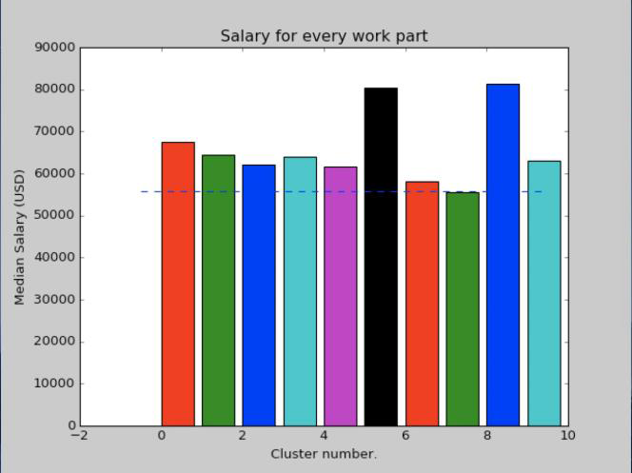
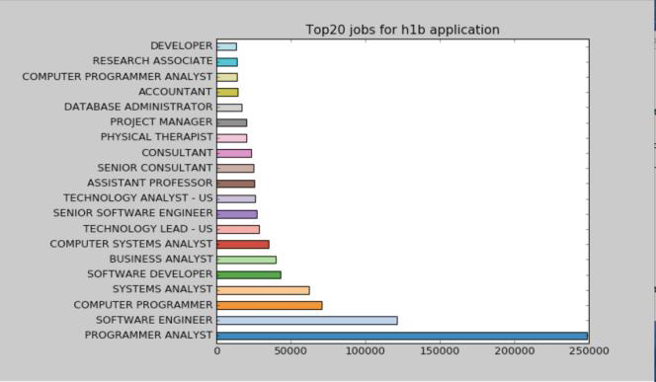
3.ANALYSIS OF AVERAGE SALARY FOR TOP 10 CITIES
4.ANALYSIS OF THE JOB TITLE
Houston holds the record of highest median salary. The next and most similar high salary is found in San Jose in California. About 80,000 USD is the median salary of all the applications.
Maximum number of applications included Programmer Analyst as the job title. Its number was around 250000.It was followed by Software Engineer, Computer Programmer and Systems Analyst.

Slide 6
Results And Accuracy
Logistic Regression | Random Forest Classifier
0.87 | 0.75

Slide 7
Machine Learning
Allows software application to learn from data & become more accurate in predicting results
Use of algorithms to discover knowledge from large dataset
finding patterns in data based on behaviour of data
Machine learns from the experience and starts taking decisions

Slide 8
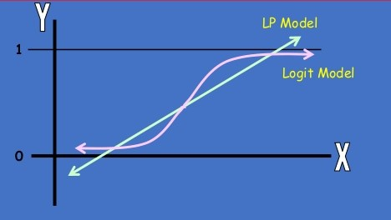
Logistic Regression
To predict result based on two or more predicting variables
Resultant outcome in binary format (Y/N)

Slide 9
Thanks

