Slide 1
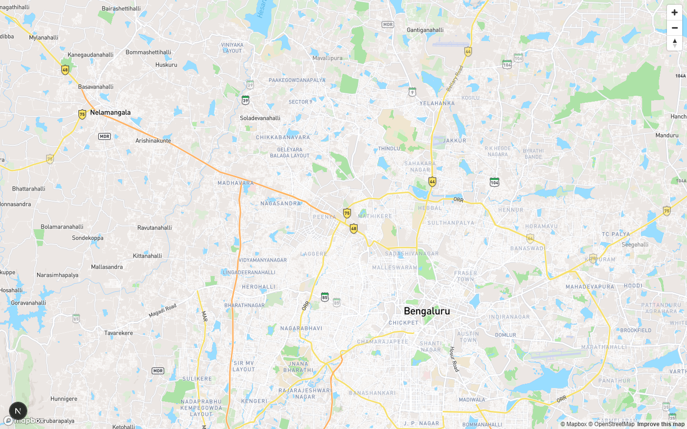
THE CORE PROBLEM
01
The Inflow Paradox
You cannot clear a crash if traffic keeps entering the conflict link at urban approach speeds.
Failure 01
Inflow keeps feeding the shockwave
Manual response clears the obstacle while the queue continues to grow upstream.
Failure 02
Over-deployment burns capacity
Heavy logistics can chase minor incidents while major choke points fail.
HIGH-STAKES LOCAL CASCADE
PROJECT PRAVAH / Deterministic urban response simulation

Slide 2
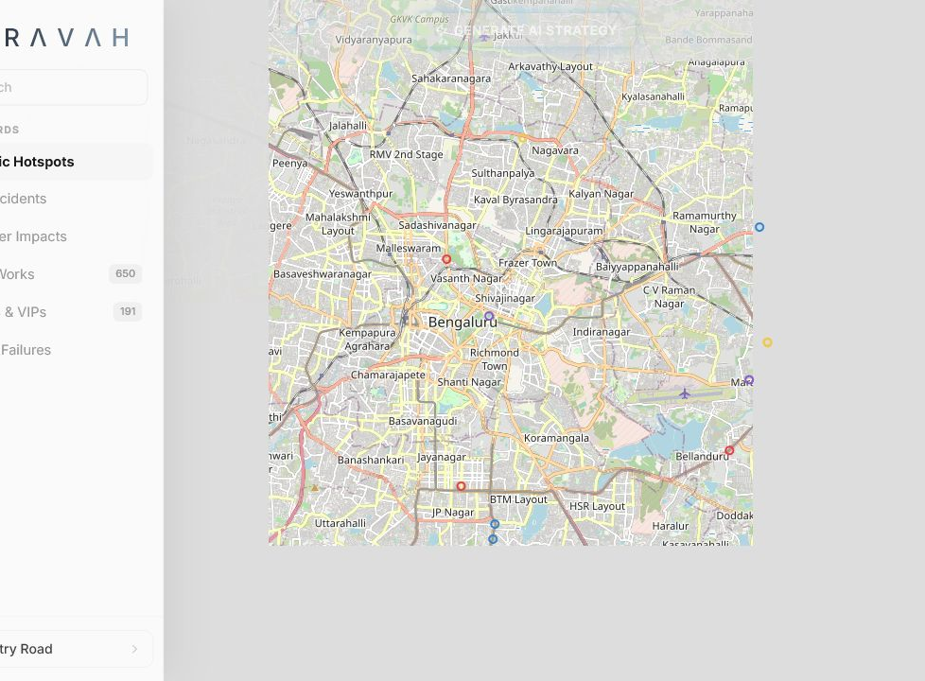

THE PROPOSED SOLUTION
02
Project PRAVAH
A Hybrid Network & Heuristic Decision Support System for tactical containment, resource math, and operator-reviewed mitigation.
SIMULATION-ONLY / HUMAN APPROVAL REQUIRED
Physics
Bounded ghost queues, residual capacity, shockwave velocity.
Behavior
Zonal matrix: dense grid, tech park, arterial response.
Logistics
Officers, barricades, upstream node, route override.
We don't just put dots on a map. We calculate physics, behavior, and logistics to restore flow.
PROJECT PRAVAH / Deterministic urban response simulation

Slide 3
THE MASTER WORKFLOW
03
From incident signal to containment decision
MONEY SLIDE
The core engine stays deterministic and auditable; Phase 2 adds live telemetry and automated handshakes only after governance validation.
01
02
03
04
05
Ingestion
Physics Engine
Arbitration & Routing
Mitigation
Learning
Zonal Behavioral Matrix mapping
Bounded Ghost Queue + resource math
Priority Matrix + OSRM drive-time check
ATCS upstream gating + UI dispatch
Objective Delta-T feedback loop
Phase 2 Roadmap
Edge-node CV + live CCTV telemetry
Automated ATCS handshake / ONDC API
PROJECT PRAVAH / Deterministic urban response simulation

Slide 4
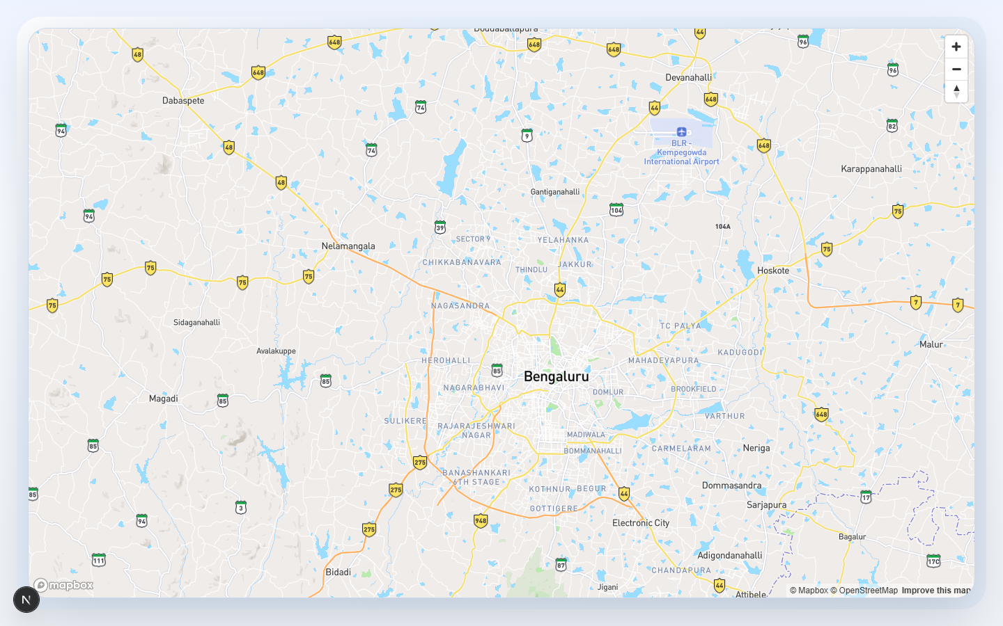
WORKING EXPLANATION / PART 1
04
Physics & routing: bounded, topological, reproducible
Zonal profile + resource request
{
"road": { "class": "ARTERIAL", "lanes": 6,
"zonal_behavior": "DENSE_GRID",
"capacity_per_lane_vph": 1750 },
"kinematic_state": {
"q_ghost_pcu": 3600,
"q_excess_pcu": 420,
"shockwave_speed_kmh": -8.7
},
"deployment": {
"officers_required": 8,
"barricades_required": 14,
"requires_human_approval": true
}
}
Haversine shortcut
OSRM actual drive-time route
Implementation note: MVP uses a 600 PCU/lane simulation storage cap; IRC:64 calibration is a governance-calibration step, not claimed live sensor truth.
Override trigger
Jurisdiction rule
Priority > 0.65
Fastest QRT
PROJECT PRAVAH / Deterministic urban response simulation

Slide 5
WORKING EXPLANATION / PART 2
05
Mitigation & UI: operator-in-the-loop containment
PRAVAH recommends upstream metering and dispatch resources; it does not directly seize police, signal, or navigation controls.
COMMAND
Upstream Signal Gating
Live Incidents
Offset recalibration meters inflow to the residual capacity of the blocked link; operator approval remains mandatory.
Ghost Queue
Weather Impacts
Civic Works
Preemption Protocol
QRT Dispatch
Additive priority score orders simultaneous crashes by severity, inflow, and lane-loss ratio before routing QRTs.
Volatility Warning
Signal Gating
Confidence degraded when historical variance is high.
Meter release to residual capacity; preserve green wave.
Operator sees: barricades, officers, closure pattern, upstream node, and approval gate.
PROJECT PRAVAH / Deterministic urban response simulation

Slide 6
FEASIBILITY, IMPACT & SCALE
06
Day-one feasible. City-wide scalable.
MVP runs on existing ASTraM history and deterministic simulation. Live sensors, PostGIS, ATCS automation, and ride-hailing geofences are extensions.
ASTraM records validated
Rejected rows
Simulation model
Day 1 deployment avoids expensive live sensors.
8,173
0
2.0.0
PRAVAH vs. baseline SOP
Feasibility
Existing cleaned ASTraM CSV, reproducible seed, operator-reviewed API payloads.
Impact
Faster containment, less transverse spillback, objective Delta-T feedback.
Future Scale
PostGIS city graph + ride-hailing geofence synchronization for stadium-scale events.
PROJECT PRAVAH / Deterministic urban response simulation

