Slide 1
Apache Kafka
Sachin Kolhe

Slide 2
Outline for today
Why Kafka
Kafka Terminologies
Demo

Slide 3
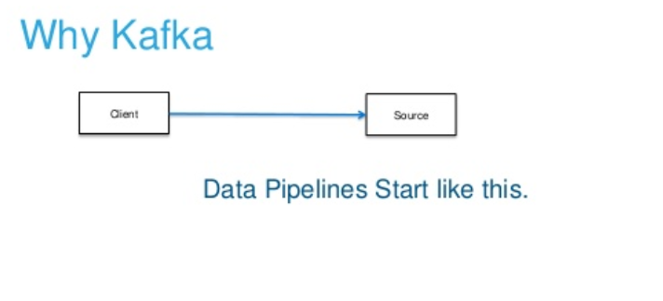

Slide 4
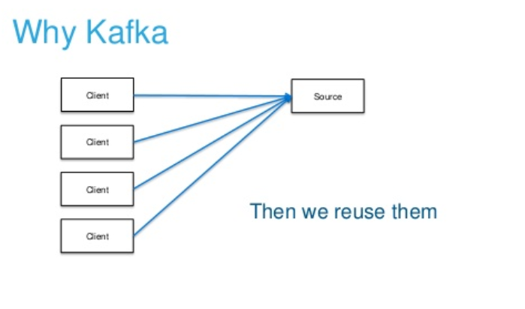

Slide 5
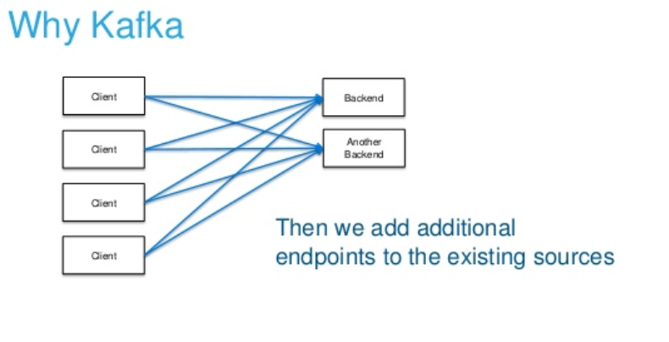

Slide 6
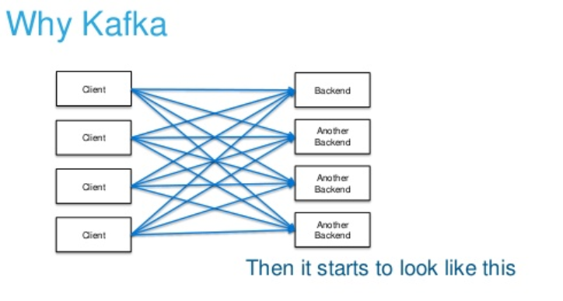

Slide 7
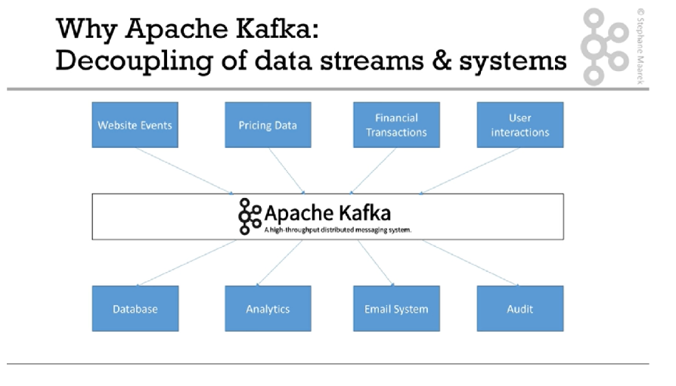

Slide 8
What is Kafka?
kafka is a distributed straming platfom that is used publish and subscribe to stream of records.
Apache Kafka is a fast, scalable, fault-tolerant messaging system which enables communication between producers and consumers using message-based topics.
Moreover, this technology takes place of conventional message brokers like JMS, AMQP with the ability to give higher throughput, reliability, and replication.

Slide 9
History of Apache Kafka
Apache Kafka was originally developed by LinkedIn, and later it was donated to the Apache Software Foundation.
Currently, it is maintained by Confluent under Apache Software Foundation.

Slide 10
Benefits
High Throughput
Low latency
High concurrency
Fault tolerance
Durability
Distributed
Scalability
Resilient Architecture

Slide 11
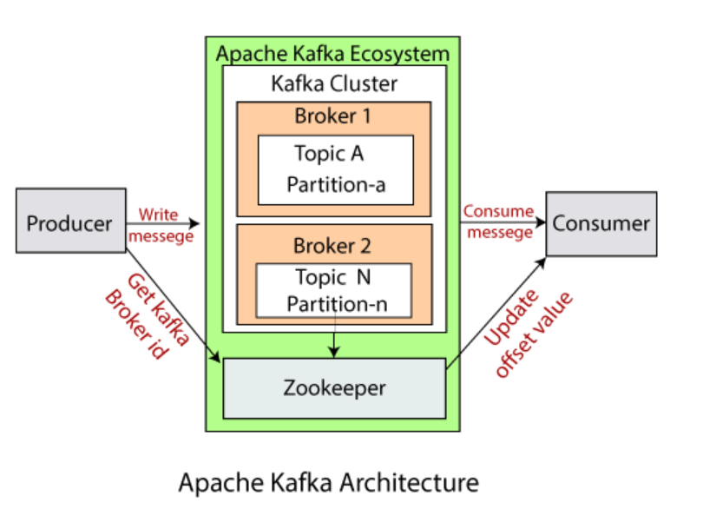
Kafka Architecture

Slide 12
Kafka Broker or Server or Node
Kafka Broker receives messages from producers and stores them on desk keyed by unique offset.
It allows consumers to fetch messages by topic, partitions and offset.
Can handle TB of messages. It can handle hundread of thousands of read and writes per second.
Kafka brokers can create a kafka cluster by sharing information between each other directly or indirectly using Zookeeper
To maintain load balnce kafka cluster typically consists of multiple brokers.
however, these are stateless, hence for maintaining cluster state they use zookeeper.

Slide 13
Kafka Topics
the topic is a logical channel to which producer publish message and from which the consumer recevies the message.
topic defines the stream of a particular type / classification of data.

Slide 14
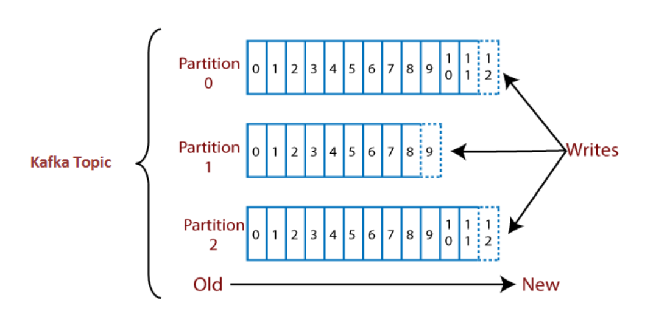
Topic Partitions

Slide 15
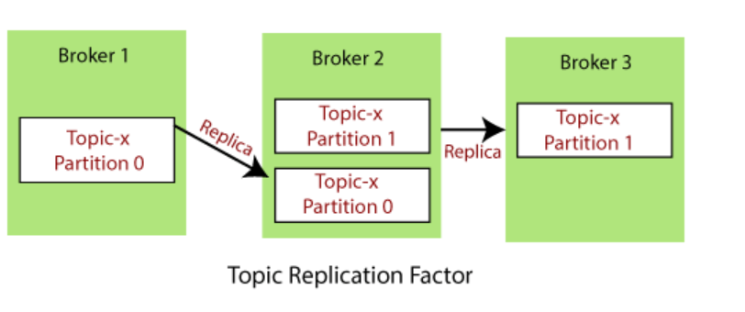
Topic Replication Factor

Slide 16
Kafka Producers
Producers write data to topics (which is made of partitions).
Producers automatically know to which broker and partition to write to.
In case of broker failure, producer will automatically recover.
Producers can choose to receive acknowledgement of data writes.
acks=0: Producer won't wait for acknowledgement.(Possible data loss)
acks=1: Producer will wait for leader to acknowledge.(Limited data loss)
acks=all: Leader + replicas acknowledgement.(No data loss)
Producers can choose to send key with message.
If key=null, data is sent to round robin.
If a key is sent, then all messages for that key will always go to same partition.

Slide 17
Kafka Consumers
Consumers read data from topic(identified by name).
Data is read in order within each partition.
by using partition offset the kafka consumer maintains that how many messages have been consumed because kafka brokers are stateless.

Slide 18
Consumer Group
A consumer group is a group of multiple consumers which visions to an application basically.
Each consumer present in a group reads data directly from the exclusive partitions.
In case, the number of consumers are more than the number of partitions, some of the consumers will be in an inactive state.
Somehow, if we lose any active consumer within the group then the inactive one can take-over and will come in an active state to read the data.

Slide 19
Consumer Offsets
Apache Kafka provides a convenient feature to store an offset value for a consumer group.
It stores an offset value to know at which partition, the consumer group is reading the data. As soon as a consumer in a group reads data, Kafka automatically commits the offsets, or it can be programmed.
These offsets are committed live in a topic known as __consumer_offsets.

Slide 20
Delivery Semantics
The choice of commitment depends on the consumer, i.e., when the consumer wishes to commit the offsets.
In Kafka, there are following three delivery semantics used:
At most once
At least once
Exactly once

Slide 21
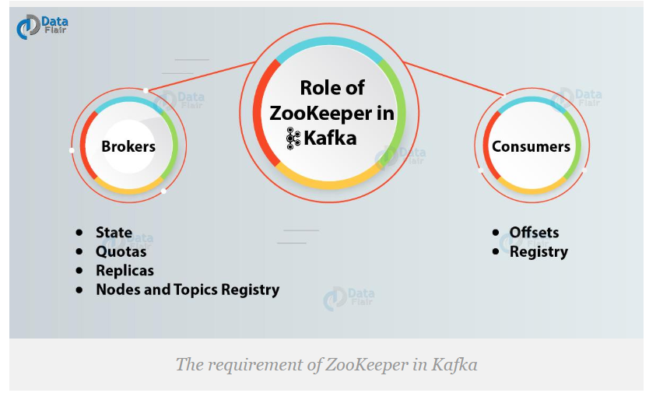
Kafka Zookeeper

Slide 22
Installation of apache kafka
https://kafka.apache.org/downloads
Unzip and put it in some folder
Place the path in Environment Variable

Slide 23
Starting Apache Kafka
Start a zookeeper
zookeeper-server-start.bat config\zookeeper.properties
Start a broker/server
kafka-server-start.bat config\server.properties

Slide 24
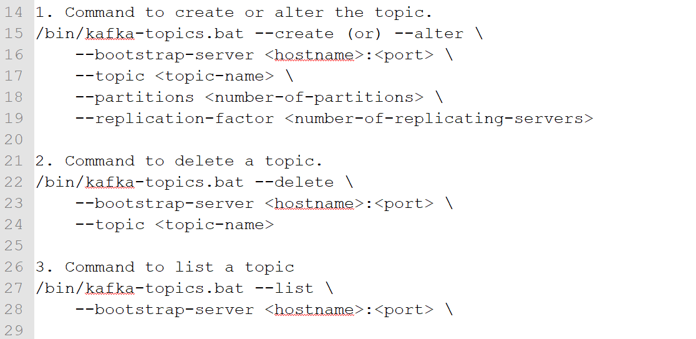
Topic : Create/Delete/Alter

Slide 25
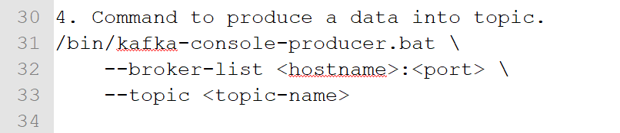
Producer
Command line
Java Code

Slide 26
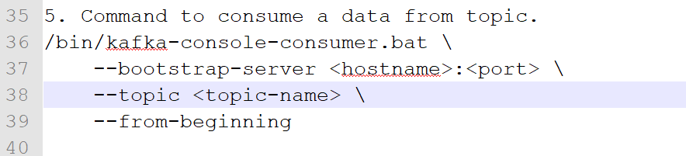
Consumer
Command line
Java Code

Slide 27
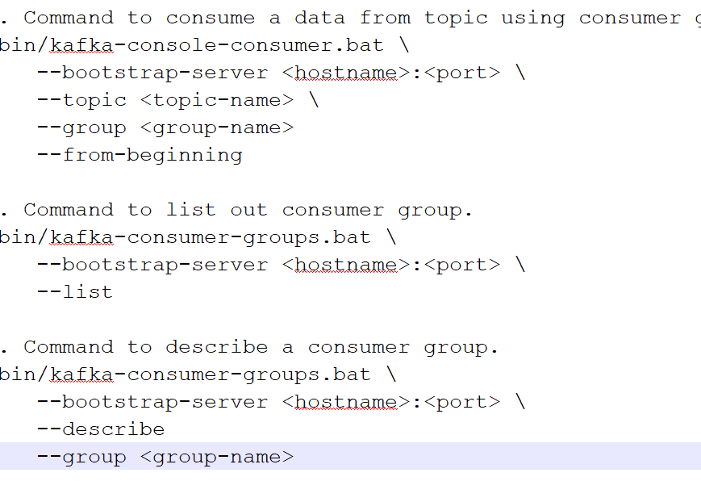
Consumer group
Command line
Java Code

Slide 28
Kafka in spring boot example demo
Dependencies
Configuration
Java Code

Slide 29
Thank You!

