Slide 1
Facade Design Pattern
Mayur sunil honmane (2020510029)
Bhumesh bodalia(2020510009)
Srushti panchbhai (2020510049)

Slide 2
Facade Design Pattern
Facade discusses encapsulating a complex subsystem within a single interface object. This reduces the learning curve necessary to successfully leverage the subsystem. It also promotes decoupling the subsystem from its potentially many clients. On the other hand, if the Facade is the only access point for the subsystem, it will limit the features and flexibility that "power users" may need.
The Facade object should be a fairly simple advocate or facilitator. It should not become an all-knowing oracle or "god" object.

Slide 3
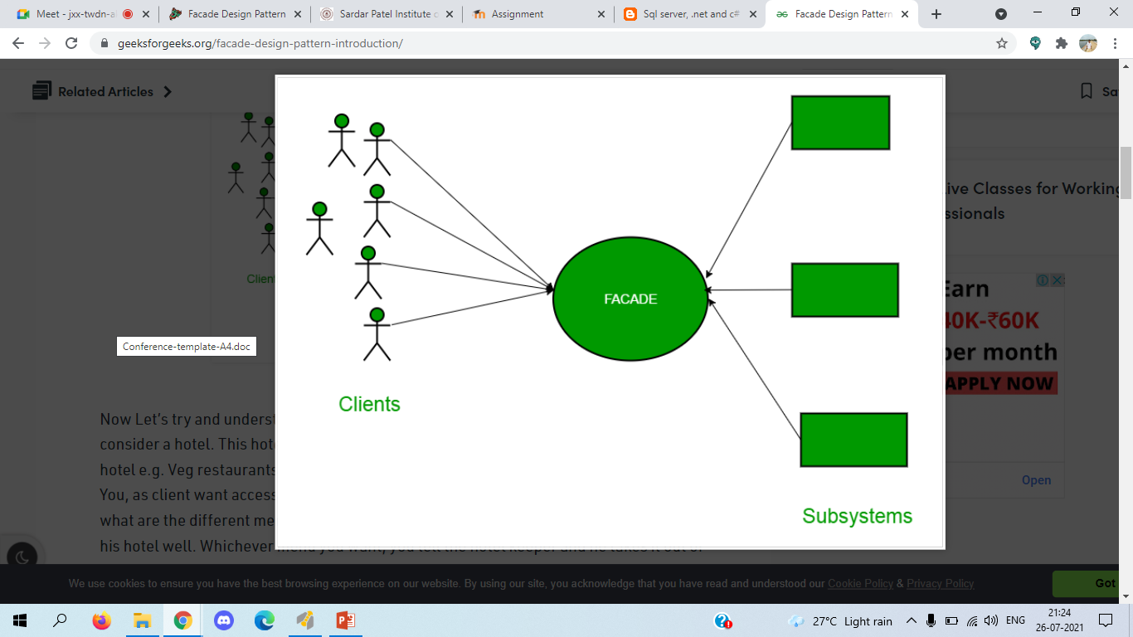
Structure
The Facade provides convenient access to a particular part of the subsystem’s functionality. It knows where to direct the client’s request and how to operate all the moving parts.
An Additional Facade class can be created to prevent polluting a single facade with unrelated features that might make it yet another complex structure. Additional facades can be used by both clients and other facades.

Slide 4
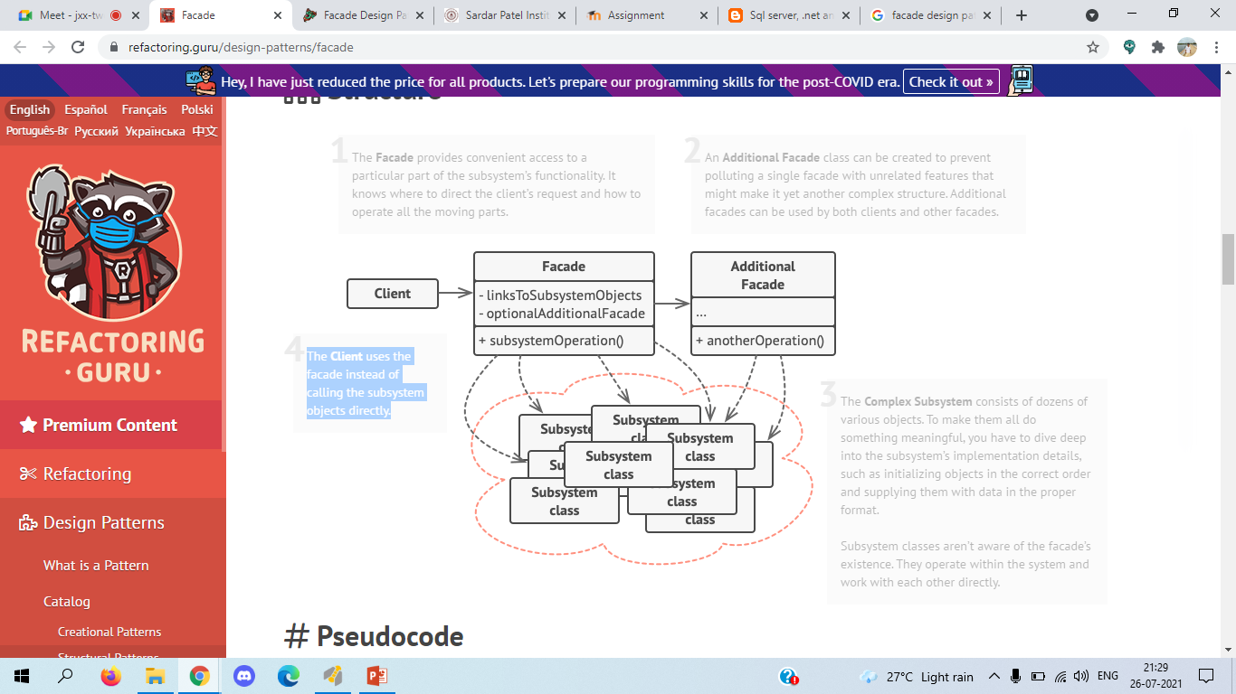
Structure
3.The Complex Subsystem consists of dozens of various objects. To make them all do something meaningful, you have to dive deep into the subsystem’s implementation details, such as initializing objects in the correct order and supplying them with data in the proper format. Subsystem classes aren’t aware of the facade’s existence. They operate within the system and work with each other directly.
4. The Client uses the facade instead of calling the subsystem objects directly.

Slide 5
Applicability
Use the Facade pattern when you need to have a limited but straightforward interface to a complex subsystem.
Often, subsystems get more complex over time. Even applying design patterns typically leads to creating more classes. A subsystem may become more flexible and easier to reuse in various contexts, but the amount of configuration and boilerplate code it demands from a client grows ever larger. The Facade attempts to fix this problem by providing a shortcut to the most-used features of the subsystem which fit most client requirements.
Use the Facade when you want to structure a subsystem into layers.
Create facades to define entry points to each level of a subsystem. You can reduce coupling between multiple subsystems by requiring them to communicate only through facades.

Slide 6
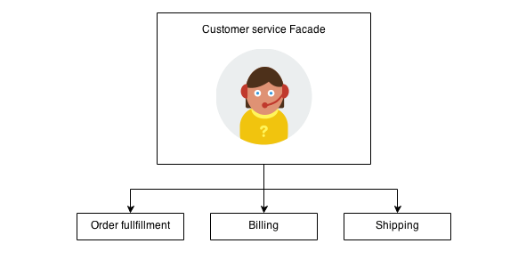
Example
The Facade defines a unified, higher level interface to a subsystem that makes it easier to use. Consumers encounter a Facade when ordering from a catalog. The consumer calls one number and speaks with a customer service representative. The customer service representative acts as a Facade, providing an interface to the order fulfillment department, the billing department, and the shipping department.

Slide 7
Thankyou!

Slide 8
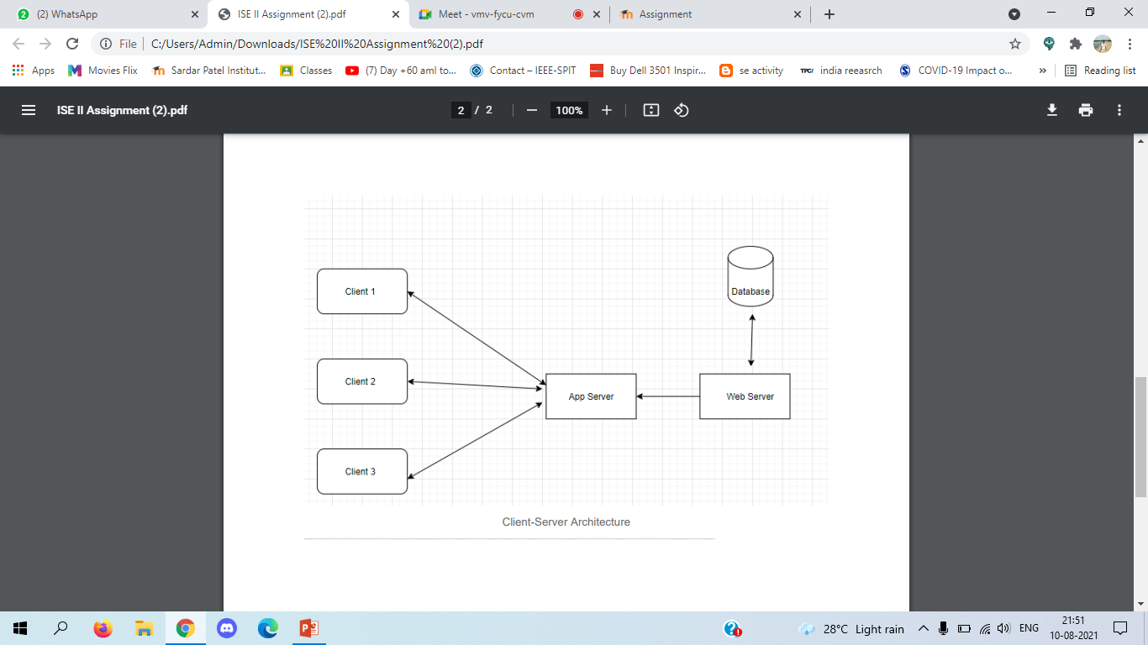
Mayur Sunil Honmane
UCID-2020510029
I would follow the Client server architecture. It will allow me to have a systematic flow , as my Website has client and web server interaction this will be the best architecture to implement. When client(student/company) submits the details the details are send to the server. Admin and super-admin get this details they process the details and assign the project to student. The assigned projects are available for clients(student/company). Client server architecture where the server contains the documents files and the related to the project and you can request any files and even upload the documents, all you need is a browser.

Slide 9
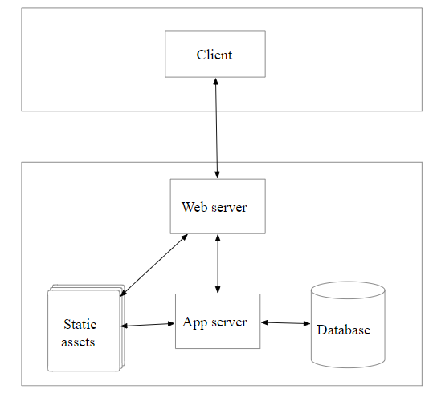
Bhumesh Bodalia 2020510009
Client Server Architecture diagram
I would follow the Client server architecture. It will allow me to have a systematic flow , as my Website has client and web server interaction this will be the best architecture to implement. When client submits the details the details are send to the server. Students, Admin and judge get the data they process the data and according to the evaluation parameters the judge give the Marks and the marks are then stored in the database with the help of App server then the results are been generated and the details are available for clients.

Slide 10
Name : Srushti Panchbhai
UCID:2020510049
Our Project, Project Development Center, in this project students, industry and alumni can register their details for the project. They can able to submit their project document and video of their project outcome. Then this submitted data comes under the admin, admin allocates the project to the students on the basis of their specialization. There is another super-admin panel, where the admin sends of the details of project and superadmin approval it. On that all the data is generated in the pdf and excel sheet format. Architecture applied: - I would follow the Client server architecture. It will allow me to have a systematic flow , as my Website has client and web server interaction this will be the best architecture to implement. When client(student/company) submits the details the details are send to the server. Admin and super-admin get this details they process the details and assign the project to student. The assigned projects are available for clients(student/company). Client server architecture where the server contains the documents files and the related to the project and you can request any files and even upload the documents, all you need is a browser.

