Slide 1
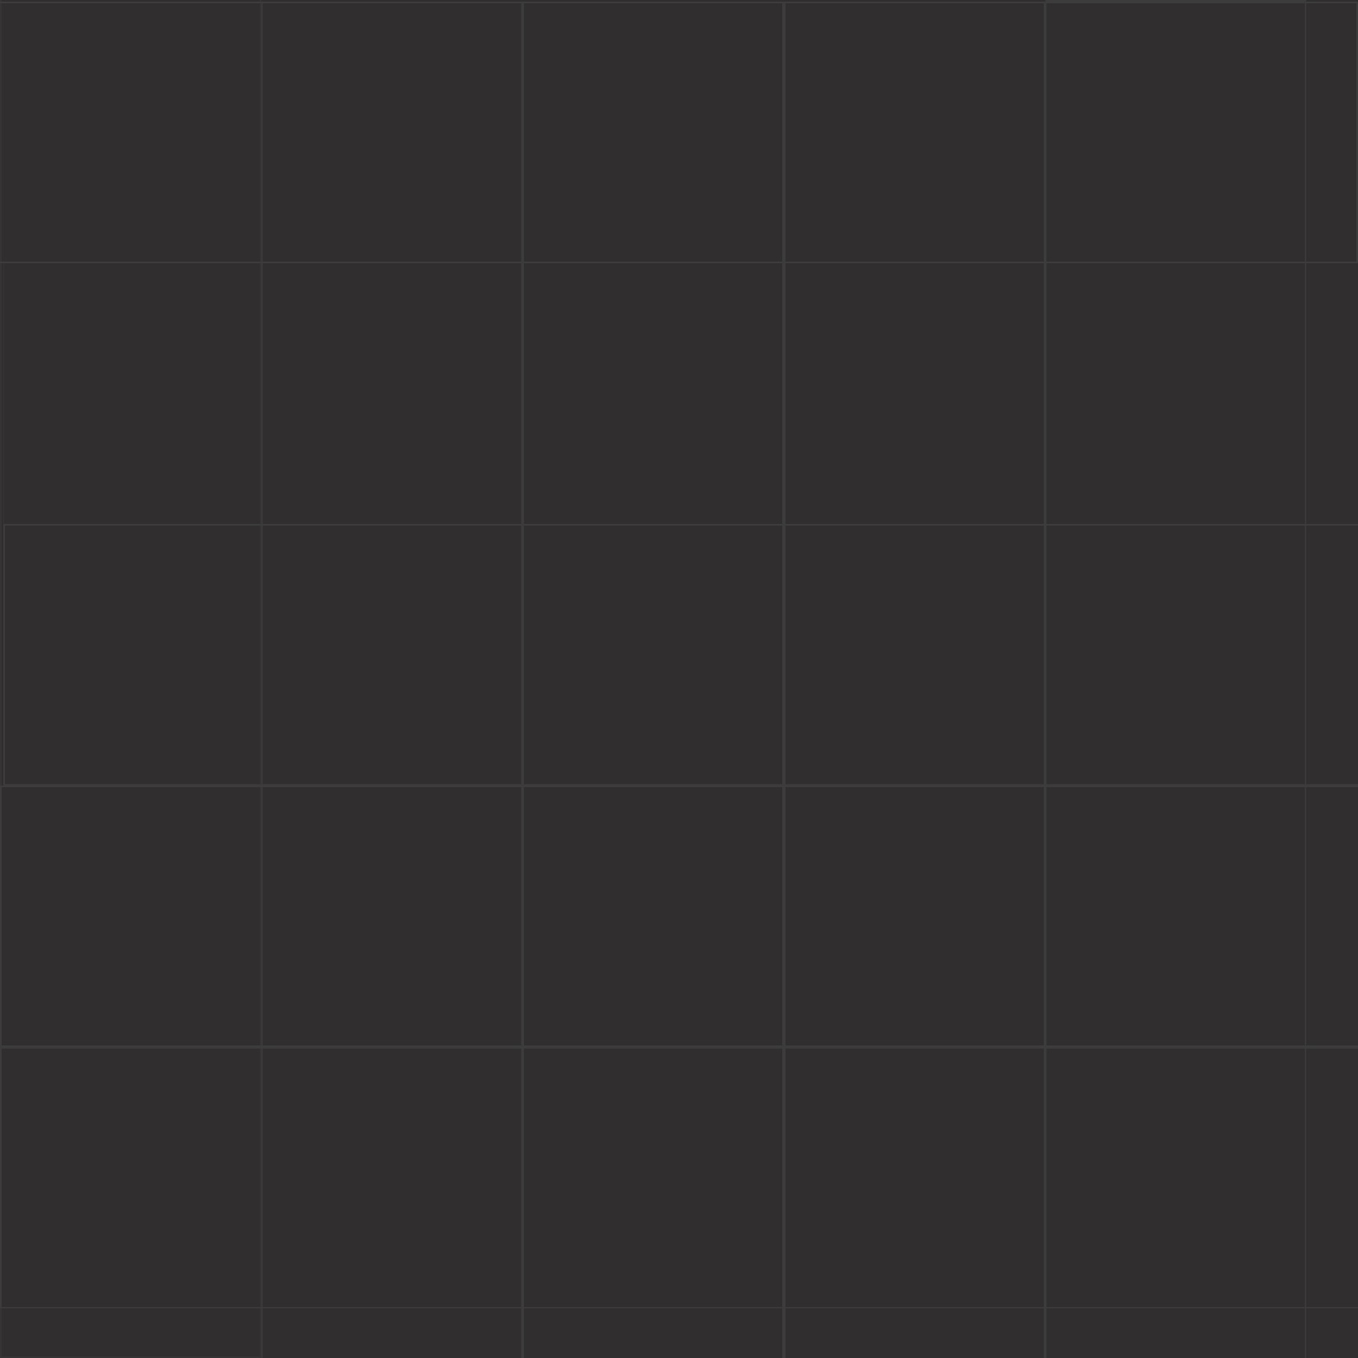
Start point
Target
Obstacle
How to use
Obstacles:
Each space in the grid is 25cm. therefore, when placing the obstacles, make sure you leave at least 30cm free so the rover can go through.
The program will display a “X” in the position where certain obstacle must be places. Make sure that the “X” matches the middle of the obstacle and that it is properly aligned according to the scenario.
If you place two obstacles together, make sure to leave some space between them (couple of cm). Otherwise, the system will recognize it as one single obstacle

Slide 2
Start point
Target
Obstacle
How to use
Targets:
You can place as many targets as you want. However, make sure they are in a reachable position. Targets located too close to the borders might not work, since the marker located on the top of the crawler might not be recognized in that point.
When running the app, you need to set the game mode as an argument (-m / --mode). This will define the manner how the targets will be shown. There are 3 available modes:
  Bottom (default): targets are shown from the bottom-right to the top-left of the scenario.
  Top: targets are displayed from the top-left to the bottom-right of the scenario.
  Mixed: targets are randomly displayed.

Slide 3
Start point
Target
Obstacle
How to use
Start point:
The crawler must start from the designed start point.
The orientation will be selected by the lecturer. Therefore, be prepared! Your crawler could begin pointing to the border or an obstacle.
Make sure you place the starting point in a position where the camera can detect the marker (not too close to the borders). The application will draw a rectangle in the starting point. Your rover must be placed within the rectangle and oriented according to the requirement before starting.

Slide 4
Start point
Target
Obstacle
How to use
Saving my scenario:
Once you have designed the scenario (using the provided template), just save the image in the same directory of the application.
The application will require the scenario image as an argument (- i/ --image)

Slide 5
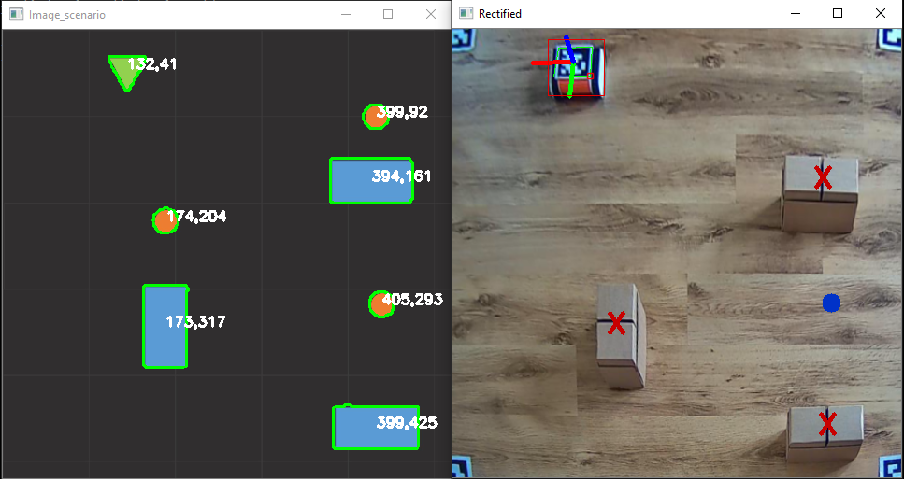
Example:
Note: In my PC I run python with the command “py”, but in your case it will be python3

Slide 6
Template:
Feel free to use this template to create your own scenarios and test the behaviour of your crawler
Good luck!

