Slide 1
Javascript
Dynamic, weakly typed, prototype-based and multi-paradigm

Slide 2
Topics to cover -
JavaScript Fundamentals
DOM and it’s Events
Object Oriented JavaScript concepts
Asynchronous JavaScript
JavaScript weird parts
JavaScript Patterns – Singleton, Factory ,Module
ES6 New Features, Webpack, Babel
jQuery

Slide 3
Why Learn JavaScript?
JavaScript is In The Browser
Most Popular Programming Language In The World
It’s Everywhere – used in both client and server.
JavaScript is extremely fast.

Slide 4
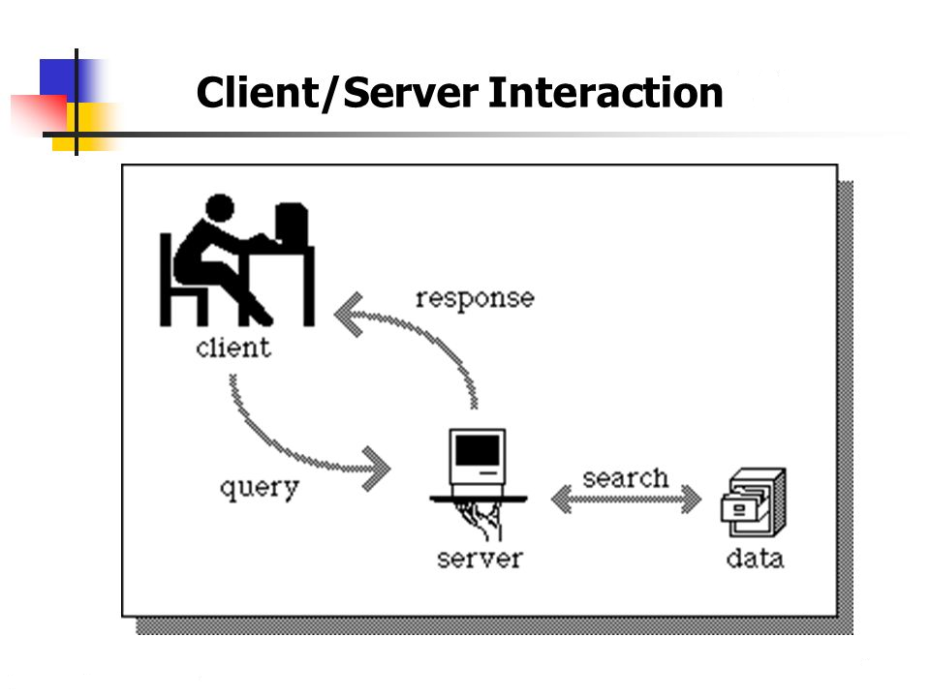
Client Server Architecture
Many clients (remote processors) request and receive service from a centralized server (host computer).
Clients are often situated at personal computers, while servers are located elsewhere on the network, usually on more powerful machines.
eg: In hospital data processing, a client computer can be running an application for entering patient info while the server computer is running another program that manages the database in which the information is permanently stored.

Slide 5
Visual Studio Code Setup –
Download and install code from https://code.visualstudio.com/
Add basic extensions like live server, JavaScript code snippets
Basics of emmet abbreviations
Serve index.html in browser with live reloading.

Slide 6
Basic Project Setup
Running JavaScript inline and from external file.
Using console in browser.
Declaring variable using var, let and const and difference between them.
var - scope of a var variable is the entire enclosing function
let - scope of a let variable is the block in which it is used.
const – have block scope and cannot be reassigned.

Slide 7
Data Types
Boolean- true and false.
Null - variable is defined to have a null or empty value.
Undefined – no value assigned to variable.
Number - covers integers and floats.
String - groupings of characters
Symbol - allow for private properties on objects (cannot be used in for in loop)
Object – Everything else in JavaScript is an Object like Array, date and even function.

Slide 8
Difference - Null, Undefined, or Undeclared
undeclared variables – variables declared without var keyword. It gets created on the global object. It will throw error in strict mode.
undefined variables exist, but don’t have anything assigned to them
null variables exist and have null assigned to them
typeof "John" // Returns "string" typeof 3.14 // Returns "number" typeof NaN // Returns "number" typeof false // Returns "boolean" typeof [1,2,3,4]
// Returns "object" typeof {name:'John', age:34}
// Returns "object" typeof new Date()
// Returns "object" typeof function () {}
// Returns "function" typeof myCar
// Returns "undefined" * typeof null
// Returns "object"

Slide 9
Type Conversion
Converting Numbers,Date to Strings –
String(123)
(123).toString( )
String(Date( ))
Date( ).toString( )
Converting Strings to Numbers -
Number("3.14") // returns 3.14
Number(“Anil ") // returns NaN
Number(false) // returns 0
Number(new Date()) // returns 1404568027739
var y = +"5"; // y is a number (using Unary operator)

Slide 10
Automatic Type Conversion
When JavaScript tries to operate on a "wrong" data type, it will try to convert the value to a "right" type
5 + null // returns 5 because null is converted to 0
"5" + null // returns "5null" because null is converted to "null“
"5" + 2 // returns "52" because 2 is converted to "2“
"5" - 2 // returns 3 because "5" is converted to 5
"5" * "2" // returns 10 because "5" and "2" are converted to 5 and 2
Go Through - https://www.w3schools.com/js/js_type_conversion.asp

Slide 11
JavaScript String Methods
length
indexOf() and lastIndexOf()
search() -searches a string for a specified value and returns the position of the match.
slice(start, end) - returns the selected elements in an array, as a new array object.
substring(start, end) – the second argument in substring is the index to stop at (but not include),
substr(start, length) - the second argument to substr is the maximum length to return
replace() - replaces a specified value with another value in a string.
toUpperCase() and toLowerCase()
concat() - to join two or more strings
charAt(position)
split()

Slide 12
JavaScript Array Methods
toString()
join()
pop() and push()
shift() and unshift()
edit and delete elements in array
splice(index, howmany, item1, ....., itemX) - adds/removes items to/from an array, and returns the removed item(s)
concat()
slice(start, end) - returns the selected elements in an array, as a new array object.
sort()
reverse()
max() and min()
Filter()

Slide 13
JavaScript Date Objects
var d = new Date(); // current date time (Mon Jun 11 2018 18:26:44 GMT+0530 (India Standard Time))
getTime() and setTime()
getFullYear() and setFullYear()
getMonth() and setMonth()
getDate() and setDate()
getHours() and setHours()
getMinutes() and setMinutes()
getSeconds() and setSeconds()

Slide 14
Javascript COnditions
Using If else
if (condition1) { } else if (condition2) { } else { }
Using switch
switch(expression) { case n: code block break; case n: code block break; default: code block }

Slide 15
Javascript Loops
for - loops through a block of code a number of times
for/in - loops through the properties of an object
while - loops through a block of code while a specified condition is true
do/while - also loops through a block of code while a specified condition is true

Slide 16
Object Literals
A JavaScript object literal is a comma-separated list of name-value pairs wrapped in curly braces.
Object literal property values can be of any data type, including array literals, functions, and nested object literals.
Example –
var Swapper = {
// an array literal
images: ["smile.gif", "grim.gif", "frown.gif", "bomb.gif"],
pos: { // nested object literal
x: 40,
y: 300
},
onSwap: function() { // function
// code here
}
}
Accessing Object Properties -
objectName.propertyName or objectName["propertyName"]

Slide 17
Function Declarations/Expressions
Function Declaration:
function sayHi() {
alert( "Hello" );
}
Function Expression:
let sayHi = function() {
alert( "Hello" );
}
sayHi() // runs the function code
Arrow functions:
let func = (arg1, arg2, ...argN) => expression
IIFE (Immediately Invoked Function Expression) :
var result = (function () {
var name = "Barry";
return name;
})();

Slide 18
Workshop -1.0
Write a JavaScript function to filter false, null, 0 and blank values from an array.
Input – [58, '', 'abcd', true, null, false, 0]
Output - [58, "abcd", true]
Write a JavaScript function to get nth largest element from an unsorted array.
Method - nthlargest([ 43, 56, 23, 89, 88, 90, 99, 652], 4)
Output – 89
Write a JavaScript function to parameterize a string
Input - Robin Singh from USA.
Output - robin-singh-from-usa
Write a JavaScript function that takes a string which has lower and upper case letters as a parameter and converts upper case letters to lower case, and lower case letters to upper case.
Input – AaBbc
Output - aAbBC

Slide 19
Workshop -1.1
Write a JavaScript function to count the number of days passed since beginning of the year.
Input - new Date(2015, 11, 14)
Output – 348
Write a JavaScript function to get a full textual representation of the day of the week (Sunday through Saturday).
Input - new Date(2015, 10, 1) Output - "Sunday"

Slide 20
Window Object
It is the root level element in any web page.
All the global variables are defined on the window object.
For example, alert(), confirm() are methods defined on the window object.
Also, properties like document, location are properties of the window object.

Slide 21
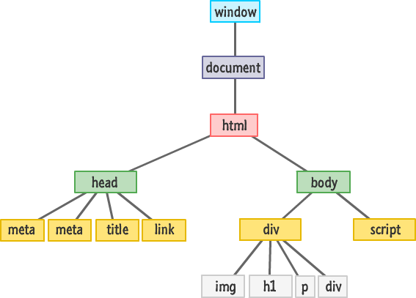
DOCUMENT OBJECT
It is the direct child of the window object. It is aka Document Object Model (DOM).
DOM is the object oriented representation of the html markup you have written. All the nodes are part of document.document object has many useful methods defined on it.
For example, document.getElementById(), document.getElementByTagName(), document.createElement(), document.querySelector() and many more

Slide 22
DOM Queries
getElementById to get a element that has the provided Id.
const taskTitle = document.getElementById('task-title’)
taskTitle.style.background = '#333';
taskTitle.style.color = '#fff';
querySelector : returns the first element that matches a specified CSS selector(s) in the document
document.querySelector('#task-title’)
document.querySelector('li').style.color = 'red’;
getElementsByClassName: returns a collection of all elements in the document with the specified class name, as a NodeList object.
const items = document.getElementsByClassName('collection-item’);
items[0].style.color = 'red';
getElementsByTagName returns a collection of all elements in the document with the specified tag name, as a NodeList object.
let lis = document.getElementsByTagName('li’);
lis[3].textContent = 'Hello'

Slide 23
DOM Queries(continued..)
querySelectorAll() - returns all elements in the document that matches a specified CSS selector(s)
const items = document.querySelectorAll('ul.collection li.collection-item')
items.forEach(function(item, index){
item.textContent = `${index}: Hello`;
});

Slide 24
DOM TRAVERSING
childNodes - returns a collection of a node's child nodes, as a NodeList object
children
firstChild
lastChild
lastElementChild
childElementCount
parentNode
nextSibling

Slide 25
Creating Elements
createElement - creates an Element Node with the specified name.
createTextNode -creates a text node
appendChild - appends a node as the last child of a node.
insertBefore(newnode, existingnode) -inserts a node as a child, right before an existing child

Slide 26
Replacing / Removing Elements
replaceWith() - replaces selected elements with new content.
replaceChild() - replaces a child node with a new node.
setAttribute()
removeAttribute()
remove() – removes an element

Slide 27
Mouse Events
onmouseover/onmouseout - When the mouse passes over an element
onmousedown/onmouseup - When pressing/releasing a mouse button
onclick - When button is clicked
ondblclick - When a text is double-clicked

Slide 28
Keyboard Events
onblur - When a user leaves an input field
onchange - When a user changes the content of an input field
onfocus - When an input field gets focus
onselect - When input text is selected
onsubmit - When a user clicks the submit button
onreset - When a user clicks the reset button
onkeydown - When a user is pressing/holding down a key
onkeypress - When a user is pressing/holding down a key
onkeyup - When the user releases a keyonkeydown vs onkeyup - Both

Slide 29
Adding and removing events
addEventListener() Method - method to attach an event handler to a specified element.
removeEventListener() Method - removes an event handler that has been attached with the addEventListener() method.
// Attach an event handler to <div> document.getElementById("myDIV").addEventListener("mousemove", myFunction); // Remove the event handler from <div> document.getElementById("myDIV").removeEventListener("mousemove", myFunction);

Slide 30
Event Bubbling
Bubbling - When an event happens on an element, it first runs the handlers on it, then on its parent, then all the way up on other ancestors.
event.target- The most deeply nested element that caused the event is called a target element, accessible as event.target.
Stopping bubbling - event.stopPropagation()

Slide 31
WORKSHOP – 2.0
Build a Calculator UI with basic arithmetic operations.
Create a web page which has six different buttons having Different Color Names as Button Text e.g. Red, Green, Blue, White, Purple & Yellow. OnClick of each button, background color of the page should be changed to that specific color.
Create a web page with three different DIVs and 3 different buttons. On click of each button the visible div should become hidden and other one should become visible. only one DIV will be visible at one time.
Write a JavaScript program to get the width and height of the window (any time the window is resized.)
Write a JavaScript program to highlight the bold words of the a paragraph, on mouse over a certain link.

Slide 32
WORKSHOP 2.1
<!DOCTYPE html>
<html>
<head>
<meta charset="utf-8"/>
<title>About Me</title>
</head>
<body>
<h1>About Me</h1>
<ul>
<li>Nickname: <span id="nickname"></span>
<li>Favorites: <span id="favorites"></span>
<li>Hometown: <span id="hometown"></span>
</ul>
</body>
</html>
Add a script tag to the bottom of the HTML body.
(In the JavaScript) Change the body tag's style so it has a font-family of "Arial, sans-serif".
(In the JavaScript) Replace each of the spans (nickname, favorites, hometown) with your own information.
Iterate through each li and change the class to "list-item".
(In the HTML head) Add a style tag that sets a rule for .list-item to make the color red.
Create a new img element and set its src attribute to a picture of you. Append that element to the page.

