Slide 1
Methodology
Preprocessing data
PCA
Classification model to predict binary response class
Regression model to predict profit on instances where response is true
Market only to those whose profit >70

Slide 2
Steps followed
Preprocessing the input data
Object to Categorical
Codes for Categorical variables
Impute missing values (Using mean)
Dummy variables for categorical variables
Standardization of variables
PCA to to get variables with high variance

Slide 3
Final models
Models tried for classification
Logistic regression
Naive Bayes
Random Forest
SVM
Gradient Boosting
Gradient Boosting used for classification task
Cross Validation Accuracy: 0.901 , CV Variance: 0.0000143
Logistic regression used for predicting profit
CV Accuracy: 0.751

Slide 4
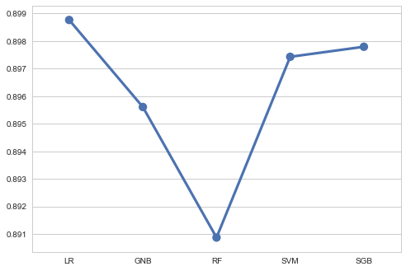
mean_acc plot with pc=12

Slide 5
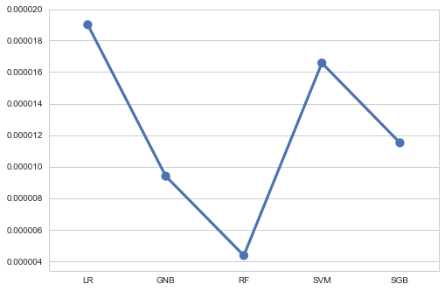
Variance plot with pc=12

Slide 6
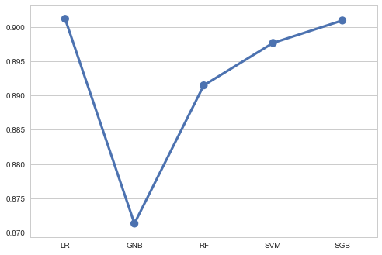
mean_acc plot with pc=18

Slide 7
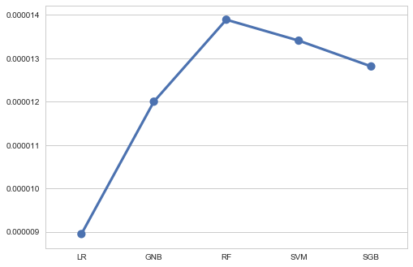
Variance plot with pc=18

Slide 8
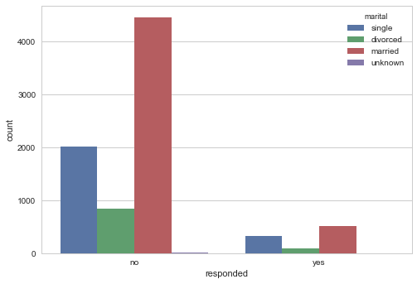

Slide 9
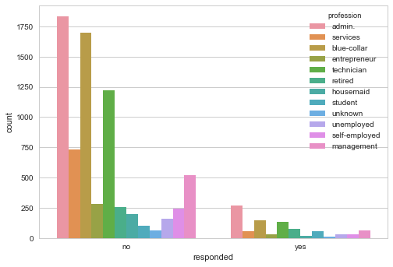

Slide 10
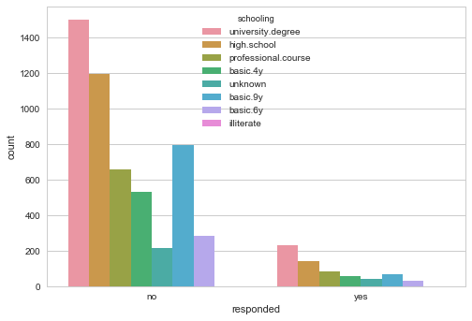

Slide 11
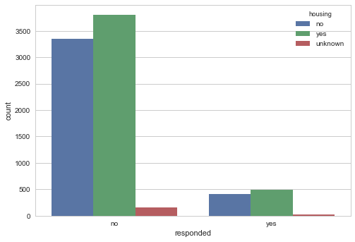

Slide 12
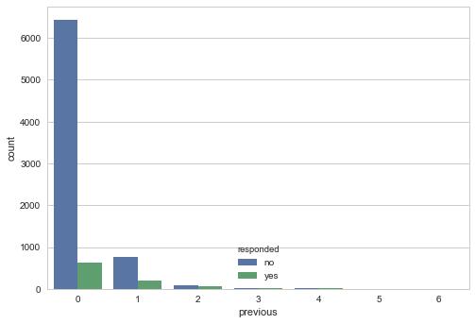

Slide 13
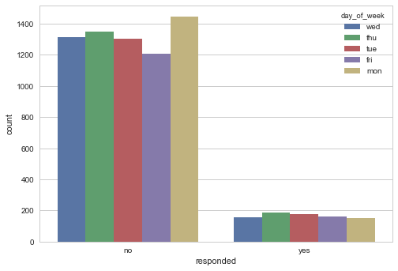

Slide 14
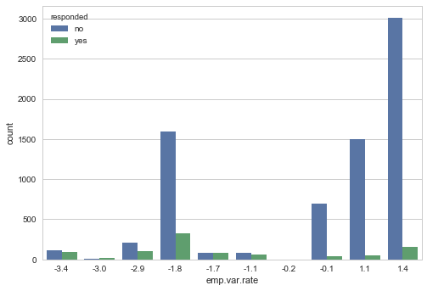

Slide 15
