Slide 1
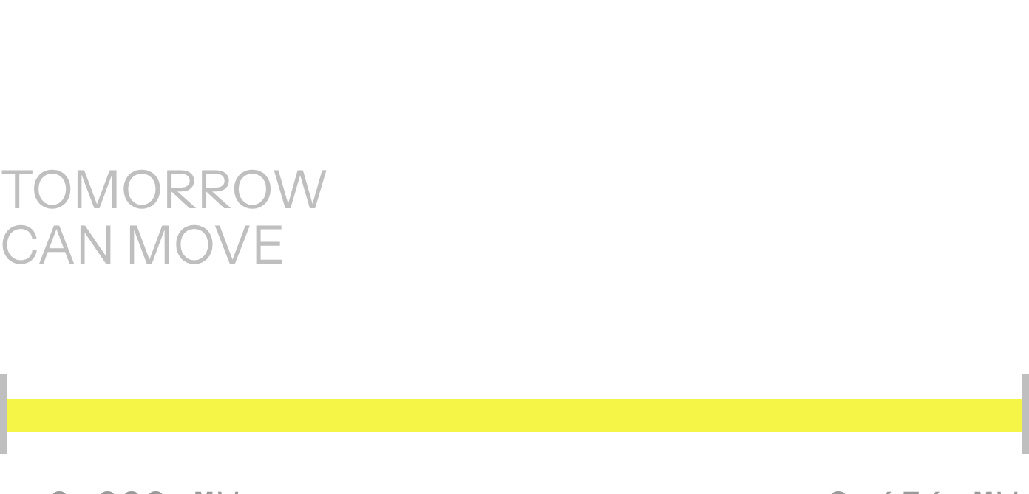
DEMAND RANGE
LOADIQ · DELHI DISCOM PLANNING
LOADIQ
Helping Delhi DISCOM planners see peak risk earlier and compare schedule choices.
Illustrative prototype · Hackathon submission
A decision-support view for earlier peak-risk visibility.
Notes:
LoadIQ helps Delhi DISCOM planners see the range of possible demand earlier and compare schedule choices before the day unfolds.

Slide 2
THE PLANNING PROBLEM
Tomorrow’s demand can move from 2,000 MW to 8,656 MW
2,000
→ 8,656
Delhi demand varies substantially across seasons and can rise sharply during peak periods.
Schedules are made before actual demand is known, so mismatches can create balancing and settlement costs.
MW · approximately
PROJECT GUIDE RANGE
Range attributed to the project guide.
02
Notes:
The planning challenge is the width of the possible day. Schedules are committed before actual demand is known, so the mismatch itself can carry balancing and settlement consequences.

Slide 3
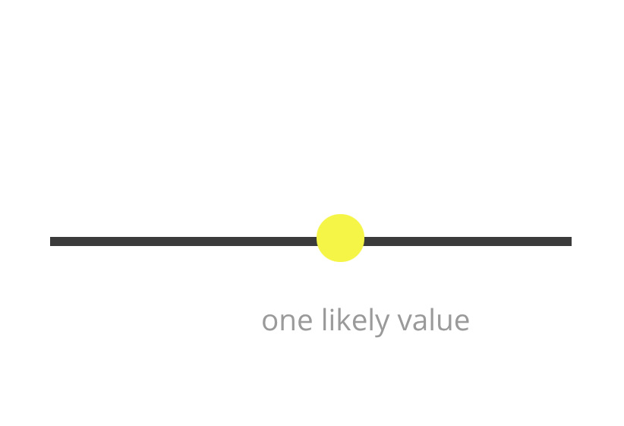
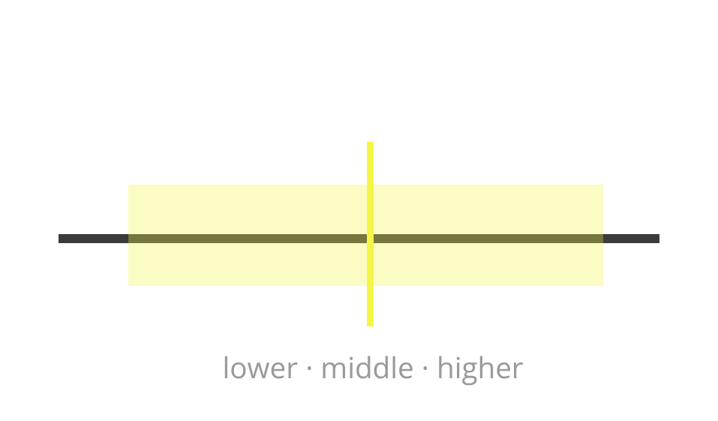
WHY RANGE MATTERS
One forecast number hides the risk planners need to see
SINGLE POINT FORECAST
P10 · P50 · P90 BAND
ONE NUMBER
IS A NARROW VIEW.
Useful for a headline estimate, but silent about the downside.
P50 shows the middle estimate; P10 and P90 frame lower and higher outcomes.
RISK VISIBILITY
The planning question is not only “what is most likely?” but also “how bad could the peak be?”
03
Notes:
Move from a single point to a band. P50 remains the middle estimate, while P10 and P90 make the lower and higher outcomes visible for planning.

Slide 4
DECISION SUPPORT
LoadIQ keeps the staff member in control
01
Bring signals together
02
03
Flag peak risk
Generate the range
Historical load, weather, and calendar signals.
A 24-hour demand range.
Likely peak periods and estimated risk.
04
Compare scenarios
05
Learn from the miss
Schedule choices using visible cost assumptions.
Review actual demand afterward.
LoadIQ supports the decision; it does not control the grid, guarantee supply, or automatically purchase electricity.
04
Notes:
LoadIQ is designed as a human-in-the-loop workflow. It assembles the evidence, surfaces the peak risk, and makes scenario assumptions visible. The staff member remains the decision-maker.

Slide 5
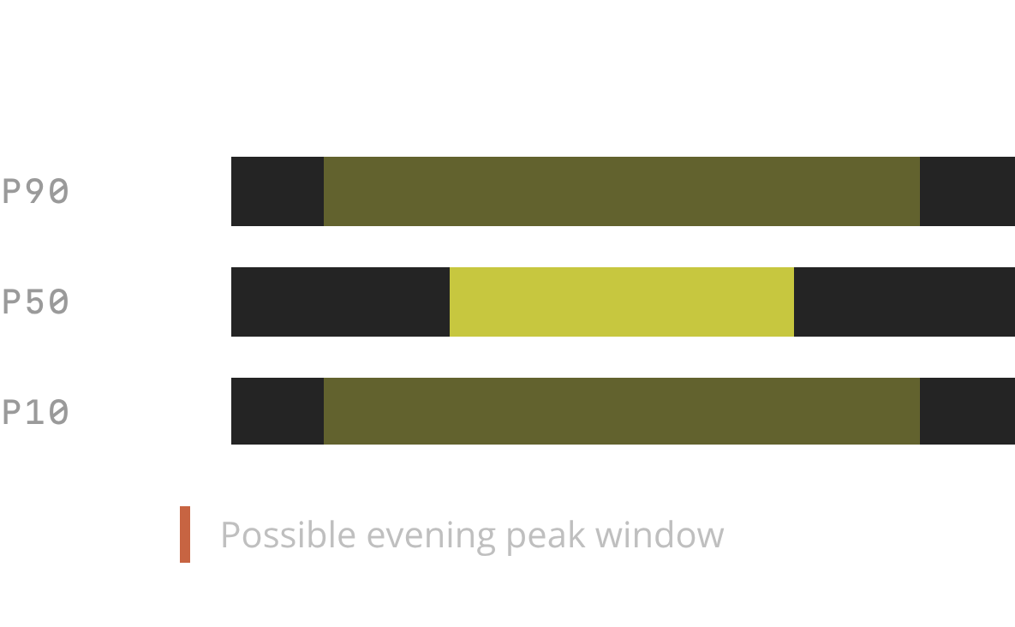
LOOKAHEAD
ILLUSTRATIVE FAN VIEW
See the peak window, not just the average day
Show an illustrative 24-hour fan chart with P10, P50, and P90.
Mark one possible evening peak window as illustrative, not observed data.
Forecast horizons: next 24 hours for daily planning; up to 168 hours for a wider lookahead.
24 H · 168 H
05
Notes:
The value of the range is temporal. Planners need to see when the peak may arrive, not only the average day. The 24-hour view supports daily planning, while the wider lookahead extends to 168 hours.

Slide 6
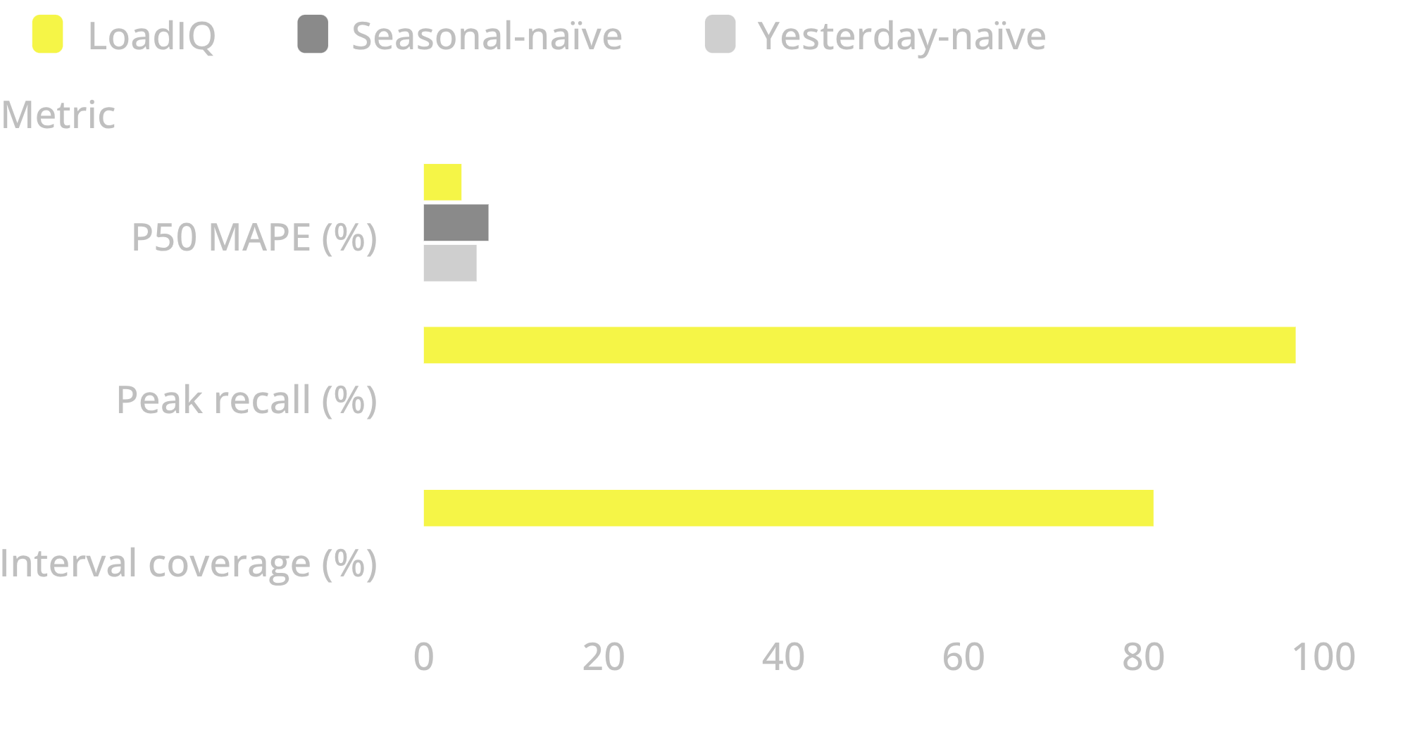
READ THE RESULT
MVP EVALUATION
4.18%
The MVP is evaluated against realistic baselines
P50 MAPE · LoadIQ
Chronological rolling-origin backtest across 52 windows.
Figures reported in the project guide; reconciliation pending.
06
Notes:
The reported MVP results outperform both naïve baselines on P50 MAPE. Peak recall and interval coverage show the additional behavior the probabilistic view is intended to surface. All figures remain pending reconciliation.

Slide 7
SCENARIO PLANNING
Scenario economics make the trade-off visible
POLICY | PLANNING POSTURE | TRADE-OFF | OUTPUT
P50 scheduling | Schedule around the middle estimate. | Balanced view of likely demand. | Compare as baseline.
Continuous P90 | Schedule for higher demand throughout. | Total cost increases. | 3.5× cost ratio is a project assumption.
Dynamic cost-threshold | Adjust the choice as risk and cost move. | Trade-off stays visible. | ₹206.66 crore
Financial outputs: project-guide simulation estimates.
07
Notes:
The point is not to declare one universal policy. It is to make the trade-off explicit: P50, continuous P90, and a dynamic cost-threshold policy expose different planning postures. The reported savings figure is a project-guide simulation estimate.

Slide 8
LOADIQ
See the range. Spot the peak. Compare the plan.
See the range.
Spot the peak.
Compare the plan.
PROTOTYPE DEMONSTRATES
LIVE PILOT NEEDS
Verified inputs and assumptions
From illustrative prototype to validated pilot.
Probabilistic forecasting
Verified load and weather data, reconciled model results, and validated cost assumptions.
Scenario-planning experience for human review.
The illustrative prototype and a future operational deployment remain distinct.
Notes:
Close with the distinction that matters for a judge: the prototype demonstrates the forecasting and scenario-planning experience, while a live pilot needs verified data, reconciled results, and validated cost assumptions.

