Slide 1
Alcohol/Weapon Venues and Crime in Atlanta
Jonathan Guy

Slide 2
It is important to know crime influencers
Past research has shown for other US cities a correlation between alcohol-selling venues and crime. Is this true for Atlanta?
http://resources.prev.org/documents/alcoholviolencegruenewald.pdf
If we are able to determine that certain venues are correlated with more crime, then better policing methods could be formed, citizens could be more aware, and more.

Slide 3
Data Acquisition and Cleaning
Atlanta Neighborhood Data
242 neighborhoods in Atlanta
https://en.wikipedia.org/wiki/Neighborhood_planning_unit
Atlanta Crime Data
Over 30,000 crimes committed in Atlanta, just in the year 2018
http://opendata.atlantapd.org/Crimedata/Default.aspx
Duplicate data, NaN entries, and irrelevant information were accounted for and dropped from data frames accordingly.

Slide 4
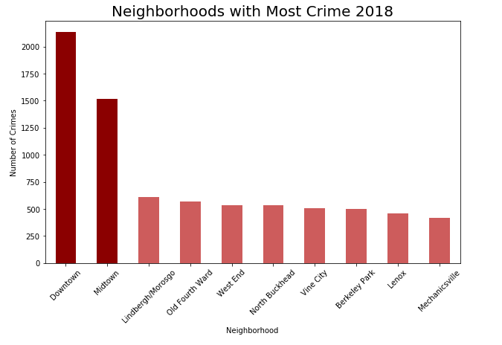
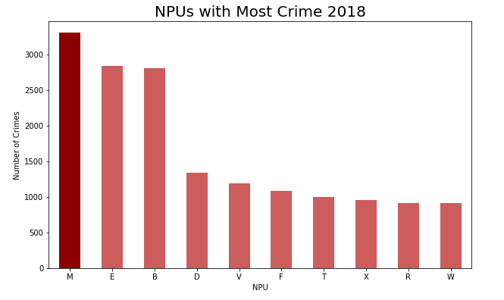
Data exploration

Slide 5
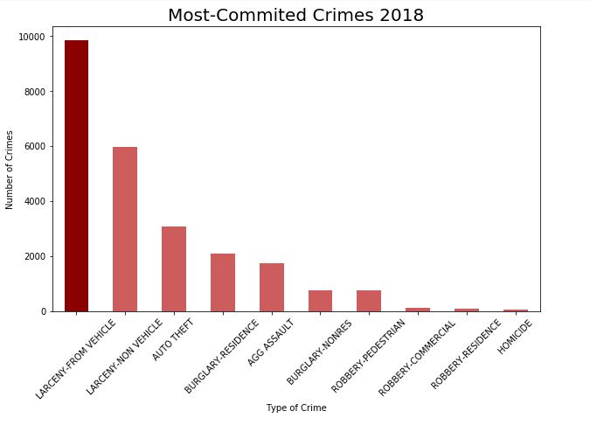
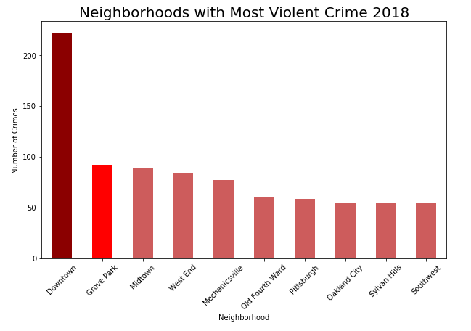
Data Exploration

Slide 6
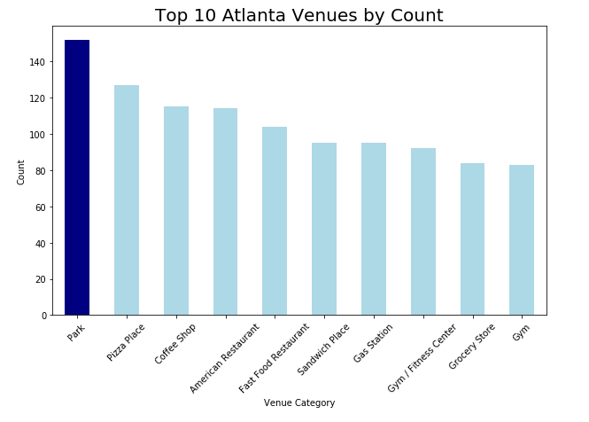
Data Exploration

Slide 7
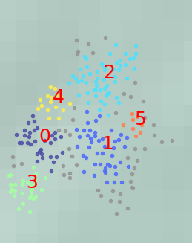
DBSCAN Clustering by Location
Cluster 0, Avg Number of Crimes per Neighborhood: 31.75
Cluster 1, Avg Number of Crimes per Neighborhood: 181.52173913043478
Cluster 2, Avg Number of Crimes per Neighborhood: 100.41818181818182
Cluster 3, Avg Number of Crimes per Neighborhood: 41.48275862068966
Cluster 4, Avg Number of Crimes per Neighborhood: 52.375
Cluster 5, Avg Number of Crimes per Neighborhood: 244.5

Slide 8
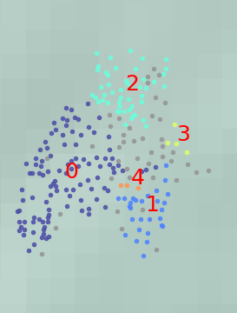
DBSCAN Clustering by Larceny Crimes
Cluster 0, Avg Number of Larceny Crimes per Neighborhood: 40.83177570093458
Cluster 1, Avg Number of Larceny Crimes per Neighborhood: 65.46428571428571
Cluster 2, Avg Number of Larceny Crimes per Neighborhood: 34.833333333333336
Cluster 3, Avg Number of Larceny Crimes per Neighborhood: 25.0
Cluster 4, Avg Number of Larceny Crimes per Neighborhood: 185.5

Slide 9
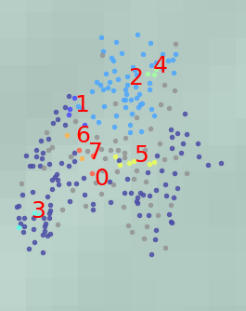
DBSCAN Clustering by violent Crimes
Cluster 0, Avg Number of Homicide/Agg Assault Crimes per Neighborhood: 48.74
Cluster 1, Avg Number of Homicide/Agg Assault Crimes per Neighborhood: 48.5
Cluster 2, Avg Number of Homicide/Agg Assault Crimes per Neighborhood: 73.0
Cluster 3, Avg Number of Homicide/Agg Assault Crimes per Neighborhood: 27.66
Cluster 4, Avg Number of Homicide/Agg Assault Crimes per Neighborhood: 168.66
Cluster 5, Avg Number of Homicide/Agg Assault Crimes per Neighborhood: 83.66
Cluster 6, Avg Number of Homicide/Agg Assault Crimes per Neighborhood: 149.33
Cluster 7, Avg Number of Homicide/Agg Assault Crimes per Neighborhood: 15.0

Slide 10
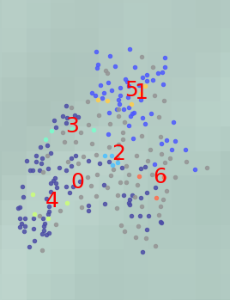
DBSCAN Clustering by Robbery Crimes
Cluster 0, Avg Number of Robbery Crimes per Neighborhood: 19.564705882352943
Cluster 1, Avg Number of Robbery Crimes per Neighborhood: 59.98148148148148
Cluster 2, Avg Number of Robbery Crimes per Neighborhood: 104.25
Cluster 3, Avg Number of Robbery Crimes per Neighborhood: 37.0
Cluster 4, Avg Number of Robbery Crimes per Neighborhood: 20.5
Cluster 5, Avg Number of Robbery Crimes per Neighborhood: 42.0
Cluster 6, Avg Number of Robbery Crimes per Neighborhood: 93.66666666666667

Slide 11
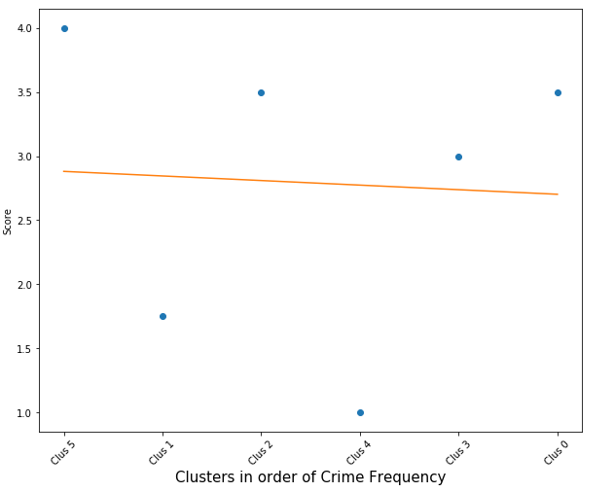
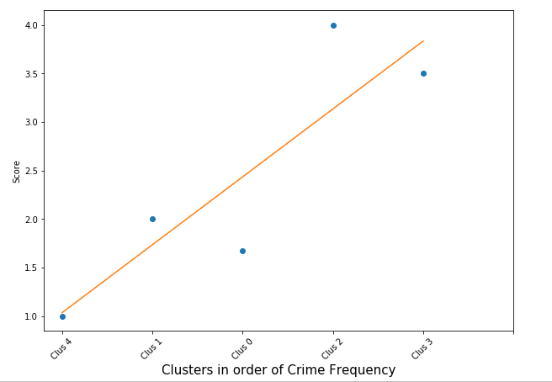
Results (for methodology see Report and code)
Overall Crime(Location) Appears to be a negative correlation surprisingly. We would expect the score average to increase(meaning lower frequency of the targeted venues) by my hypothesis.
Larceny Crimes The most common crime committed in Atlanta in 2018, there was a clear positive correlation between the frequency of the targeted venues and the average crime per neighborhood in the respective cluster.

Slide 12
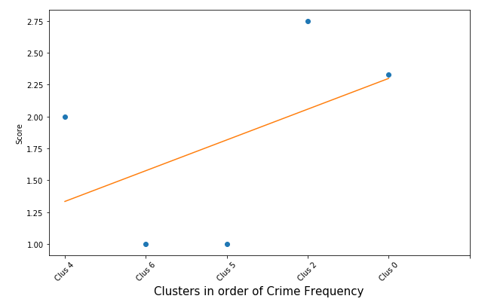
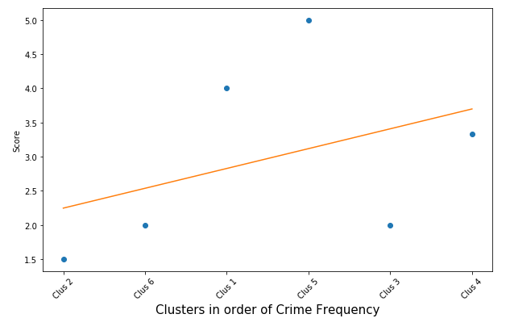
Results (for methodology see Report and code)
Agg Assualt/Homicide Crimes Although to a lesser extent than larceny crimes, there is still a clear positive relationship between the frequency of the targeted venues and the average crime per neighborhood in the clusters.
Robbery Crimes Yet again, there is a positive correlation between the frequency of the targeted venues and the average number of robbery crimes per neighborhood committed in 2018.

Slide 13
Conclusion
Based on these findings, I can conclude that there appears to be a positive correlation between the frequency of alcohol-selling venues and crime(gun shops and pawn shops were included in finding the results but their mean frequency was usually 0 among clusters). There may be other variables at play that also contribute to crime, so it is not definitive that reducing alcohol-selling venues would guarantee a decrease in crime. However, it is something to keep in mind for various groups of people such as police officers, venue owners, citizens, and more.

