Slide 1
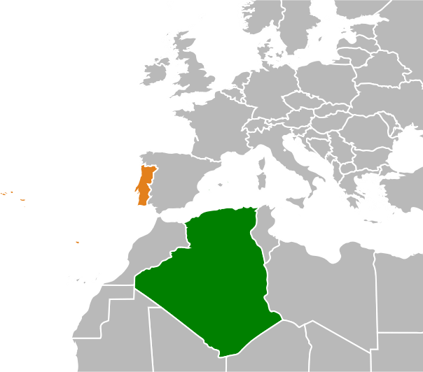
North Atlantic Ocean
Portugal
Algeria

