Slide 1


Rhyme-Jhim Connecting Moods to Music
Problem Statement :Web application for a music company to segregate playlists based on
different moods (ex. Happy, sad, calm, energetic, etc). Two types of users:
Company Representative(Admin) and Business User (End user). Company
user can add, modify, classify and delete songs from the system. Business
user can search and listen to songs according the mood specified.
• Business user can give feedback on the mood based autogenerated playlist.
The system should automatically change/add new mood type of that song(s)
based on feedback.
Problem Statement Number: PS14 Team Name : Team Creatives Team Leader Name : Sachin Motwani
College Name: S.R.M Instituite of Science and Technology

Slide 2

Idea / Approach details
To build a web application which is capable of understanding and segregating between different moods and likewise allocate the songs which suit that mood after taking feedback from the user.
We used the basics of html,css and javascript to code the project along with the backend as Google Firebase

Slide 3

Application
Our application has a collection of songs categorized by different moods. Whenever the user selects any particular mood the playlist of that particular mood opens up and the user can further provide feedback on the categorization of the songs.

Slide 4
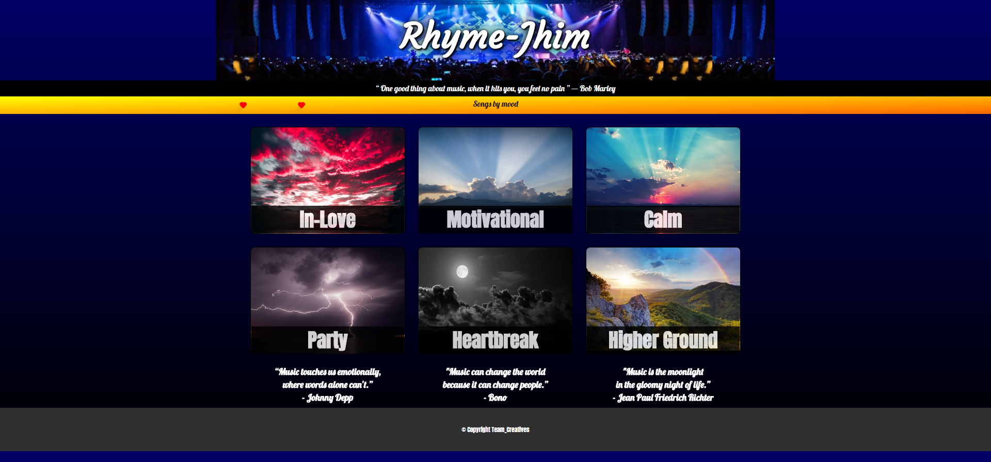
The home page

Slide 5
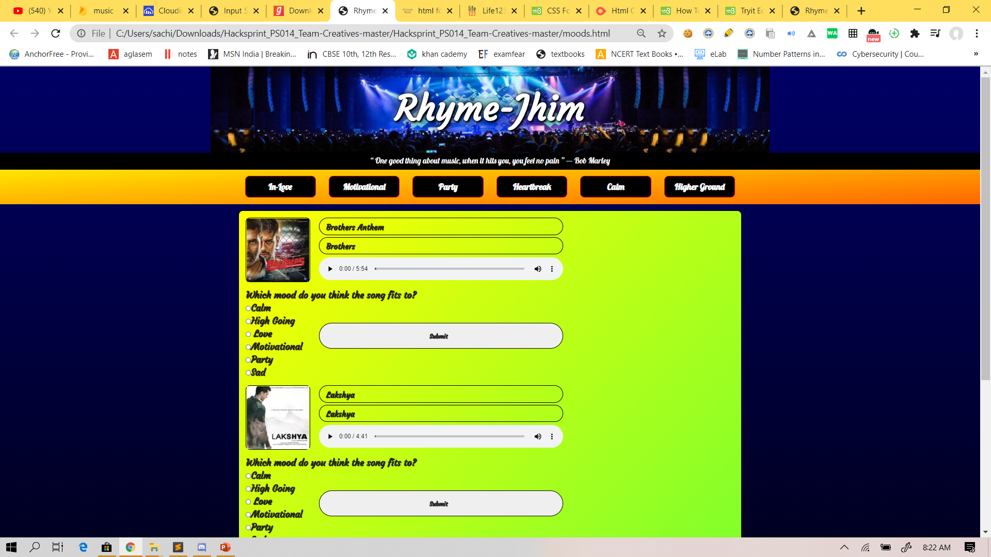
The main page

Slide 6

Day 2 additions
One of the major suggestion was to use an emoji scale instead of star scale of rating which we needed to implement.
One other change suggested was to switch from the average computational method for categorizing songs to the mode computational method.

Slide 7
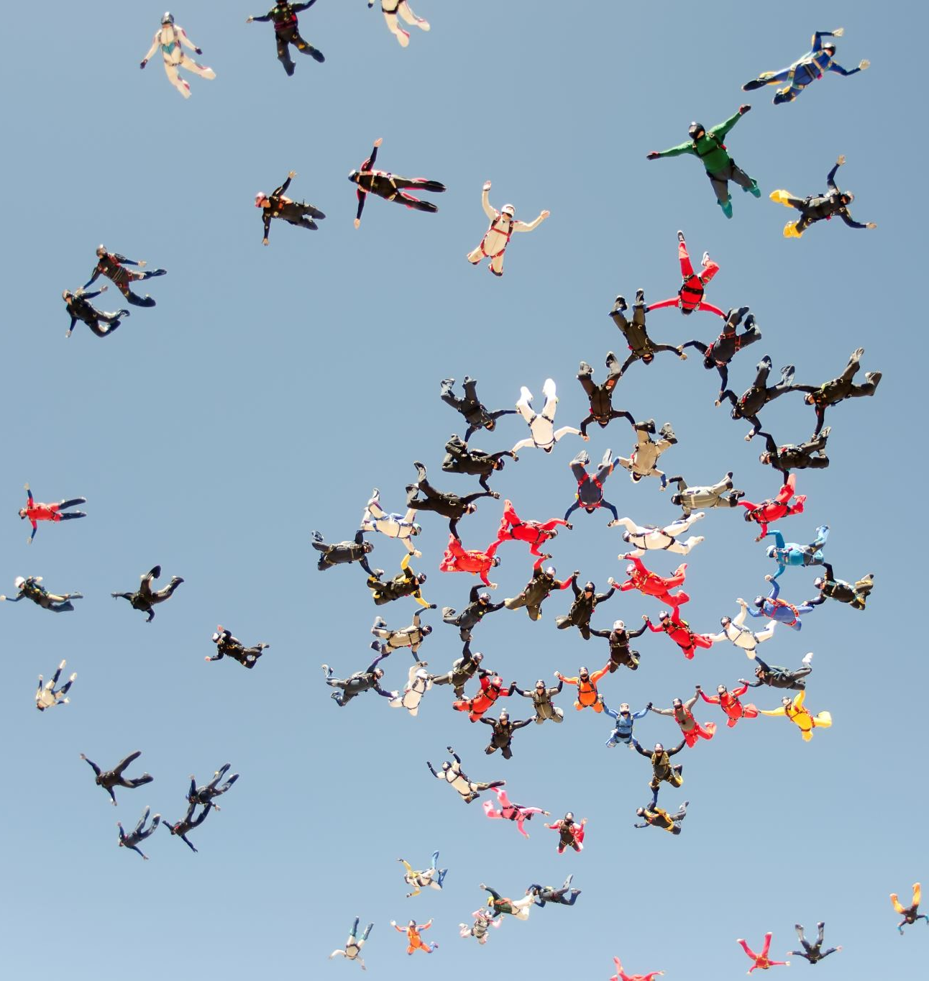
Overall journey
The overall journey on the 3 days of hackathon was quite interesting with a lot of ups and downs. A lot much to experience and add to our store of experience. At certain points it was frustrating too but nevertheless ever experience counts for itself.

