Slide 1
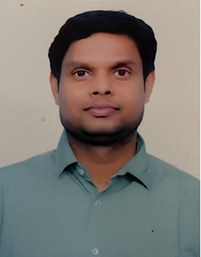
Profile: Sachidanand Gupta (Developer)
Education & Training
Employment History
Key Profile
MCA.(Master of Computer Application)
Critical Manufacturing Certified Professional-Developer
Microsoft Certified Professional
With around 11 years of IT experience in Manufacturing and various domains
Worked with various automotive and manufacturing and Healthcare clients,
Overall Expertise:
Worked with various client on Corteva Application
Used Agile mythology
Involved in sprint preparation and demo with client
Technology Stack
C# ,SQL Server ,SSRS ,Crystal Reports, WCF, WPF,
WebServices,WebApi,PostgreSQl,Typescript,HTML5,Blazor Web assembly, Entity Framework
Industry/Domain
Manufacturing ,Healthcare, Insurance, Sustainability
Key Responsibilities and Expertise
Key Achievements
Worked in all phases of development cycle , from requirement gathering to deployment.
Have worked on various modules of Corteva application
Did developments across modules and technologies.
Involved in sprint preparation, sprint release , demo to client and release to test and prod environment by pipeline.
Extensive experience in multiple MS technologies.
Have excellent and hands on experience on complete software lifecycle..
Worked as Lead/ Sr. Developer role in multiple projects for multiple clients ,
Participated in multiple sprints for Corteva and successfully delivered multiple user stories.
Got successfully production release for Corteva Application.
Notes:
1

