Slide 1
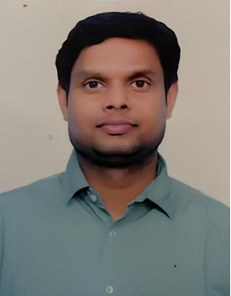
SACHIDANAND GUPTA
Background
Work Experience
    SACHIDANAND GUPTA
    Emp ID : 2347264, Role : Assistant Consultant
    Contact : (+91) 9555710512
    Qualification : MCA(Master in Computer Application), Critical Manufacturing Certified as backend developer
Key Work areas
Design to Deliver : Work on ground, with project teams (lowest to top level) to understand, establish, define a right processes. Talk to SME, Design various templates, educate team to adapt Process. Work with team to prepare, organize ways of working to define, track, monitor and report each pillar work.
The Red Tag Management System (RTMS) aligns the Isolation of Energy Sources standard to ensure the safe execution of equipment maintenance. The RTMS system enables users to inventory equipment that requires Red Tags (isolation tags) used for repairs, equipment shutdown, startup, maintenance, etc.
Worked with FigBytes Sustainability Platform captures operational and supplier data in one central, secure, cloud-based platform that connects strategy, automates reporting, and simplifies stakeholder engagement.
Worked with Vodafone Lite in automation process for sales and logistics
Worked with iclinic Healthcare for online video consultation and automate the billing process for the same.
Worked in Travel domain where we have automated the booking billing process for agents and as well as integrated the different APIs for searching flight process.
Technology and Tools
Critical Manufacturing MES - Implementation Experience, Back-end development experience , design development , data modelling activities in CM .
Certification – CM Developer Professional Certification
C# , DotNet - [Experience: 12 Years]
MS SQL Server- [Experience: 7 yrs]
Domain - [CM MES, Semiconductor, HealthCare,Telecom , Manufacturing]
Functional, Domain work areas
Overview : Sachidanand brings in 13 years experience & learnings in the areas of
Software Development with Sql Server , Asp.net Core, Web API, Blazor Web Assembly, MVC, C#, Web Services,, Angular, Microservices ,Azure and CI/CD.
Agile expert with very good understanding on the Software development life cycle.
Worked on 3Sigma Semiconductor with CM as backend developer. Worked With Micron and IKEA CM project for customization process.
Critical Manufacturing Certified as backend developer.
Involved in sprint preparation, sprint release , demo to client and release to test and prod environment and developed Stored Procedures to populate data.
Worked on Data Modeling transformation of Legacy system to new Critical Manufacturing System and worked on Master data management for Micron.
Industry Expertise:
Worked on 3Sigma Semiconductor with CM as backend developer and some CM Data Model. Worked on Protocol and others module with tables.
,Manufacturing : The Red Tag Management System is intended to prevent injury to workers by prohibiting operation of isolating devices that guard against the unexpected, inadvertent, or accidental release of energy.
Sustainability: FigBytes automates carbon data capture and management for Scopes 1, 2, 3, and beyond.
]

