Slide 1
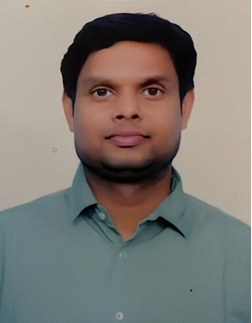



Indicative Profile: Sachidanand Gupta- Developer
Select Relevant Experience
Profile Photo
+91 9555710512
Sachidanand brings in 11 years experience & learnings in the areas of Software Development with Asp.net Core, WPF, UWP, Web API, Blazor Web Assembly, MVC, C#, Web Services, Ajax and jQuery, Angular.
Manufacturing : The Red Tag Management System is intended to prevent injury to workers by prohibiting operation of isolating devices that guard against the unexpected, inadvertent, or accidental release of energy.
Sustainability: FigBytes automates carbon data capture and management for Scopes 1, 2, 3, and beyond.
Telecom: Vodafone sales store management.
Information Technology : Core development and complete life cycle of project.
HealthCare: Online Consultation from doctors Globally.
Sachidanand.Gupta@tcs.com
Noida, India
Career Profile
Software Development with Asp.net Core, WPF, UWP, Web API, Blazor Web Assembly, MVC, C#, Web Services, Ajax and jQuery, Angular.
Completed MES Courses.
Critical Manufacturing Certified as backend developer.
Good team player with positive attitude.
Technology and Tools
Product/Tools: Critical Manufacturing , Telecom, Healthcare
Database / Data Warehouse: SQL Server, MySQL
ETL Tools: SSIS
Programming Languages: .net(c#)
Others: Microsoft Certified Developer

