Slide 1
Variables in C
A Variable is a name of the memory location. It is used to store data. Its values can be Changed, and it can be reused many times. It is way to represent memory Location through Symbol so that it Can be easily identified.
For example: int a, float B, Char A etc.

Slide 2
Rules For Defining Variables
A Variables can have alphabets, digits, and underscore.
A variables name Can start with alphabets, and underscore only. It can’t start with a digit.
No whitespace is allowed within the variables name.
A variables name must not be any reserved word or keyword, e.g. int , float, etc.

Slide 3
Data Type In C
A Data type specifies the type of data that a variable can store such as integer, floating, character, etc.
There are Some Types of Data Type that’s Shown Below:
Basic Data Type: - int, Char, Float etc.
Derived Data Type: - Array, Pointer, structure, Union.
Enumeration Data Type: - Enum
Void Data Type: - Void

Slide 4
Data Type In C
Basic Data type :
Data type | Value initialization | Range
Int | 0 ,1 2 and none point value | -32768 to 32768
Float | Only Point Value like 1.2,1.4 etc | 3.4 e-38 to 3.4e+38
Char | Only a single character like a, A, b, B etc. | -128 to 127

Slide 5
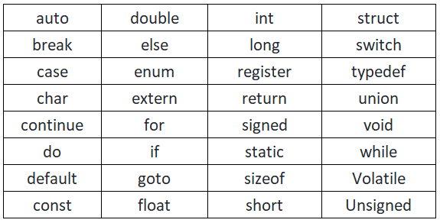
Keywords in C
A keyword is a reserved word. You cannot use it as a variable name, constant name, etc. There are only 32 reserved words (keywords) in the C language.
A list of 32 keywords in the c language is given below:

Slide 6
Comments in C
Comments in C language are used to provide information about lines of code. It is widely used for documenting code. There are 2 types of comments in the C language.
Single Line Comments
Multi-Line Comments

