Slide 1


SWIGGY CASE STUDY

Slide 2
HOW MANY RESTAURANTS HAVE A RATING GREATER THAN 4.5 ?
13
WHICH IS THE TOP ONE CITY WITH THE HIGHEST NO OF RESTAURANTS ?
BANGLORE
HOW MANY RESTAURANTS HAVE THE WORD "PIZZA" IN THEIR NAME?
4
WHAT IS THE MOST COMMON CUISINE AMONG THE RESTAURANTS IN THE DATASET
NORTH INDIAN, CHINESE
WHAT IS THE AVERAGE RATING OF RESTAURANTS IN EACH CITY?
AHEMDABAD = 4.06 & BANGLORE = 4.11
RETRIEVE THE DETAILS OF RESTAURANTS THAT HAVE THE SAME NAME BUT ARE LOCATED IN DIFFERENT CITIES?
SUBWAY , MACDONALDS , KFC , SWEET TRUTH , PIZZAHUT , MAILAND CHINA , OWEN STORY PIZZA , BURGER KING , FIRANGI BAKE , NATURRAL ICE-CREAM , CAFÉ COFFEE DAY , BEHROUZ BIRYANI , FAASOS
WHAT IS THE HIGHEST PRICE OF ITEM UNDER THE 'RECOMMENDED' MENU CATEGORY FOR EACH RESTAURANT?
SLIDE (9)
FIND THE TOP 5 MOST EXPENSIVE RESTAURANTS THAT OFFER CUISINE OTHER THAN ONLY INDIAN CUISINE?
1)CHINA PEARL – CHINESE , ASIAN
2)ANUPAMS COAST II COAST – CHINESE , NORTH INDIAN
3)CHINITA REAL MAXICAN FOOD – MAXICAN
4)ONCE UPON A FLAME – CONTINENTAL
5)PARIKA - CHINESE , NORTH INDIAN
WHICH RESTAURANT OFFERS THE MOST NUMBER OF ITEMS IN THE 'MAIN COURSE'CATEGORY?
SPICEUP
WHICH TOP 5 RESTAURANT OFFERS HIGHEST NUMBER OF CATEGORIES?
IMPERIAL REESTAURANT , ASHA SWEET CENTER , HOTEL EMPIRE , UDUPI PALACE , ANGAT 22

Slide 3
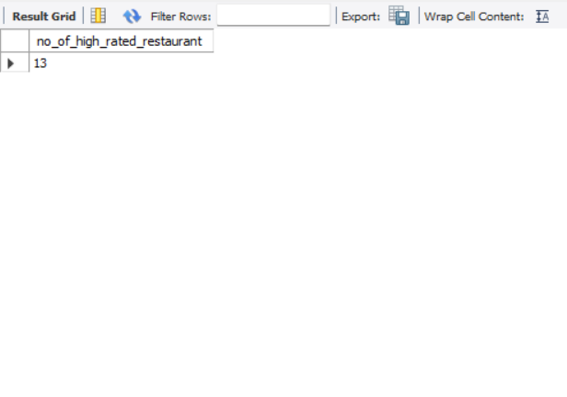
HOW MANY RESTAURANTS HAVE A RATING GREATER THAN 4.5 ?
SELECT
COUNT( DISTINCT restaurant_name ) AS no_of_high_rated_restaurant
FROM
swiggy
WHERE
rating > 4.5;

Slide 4
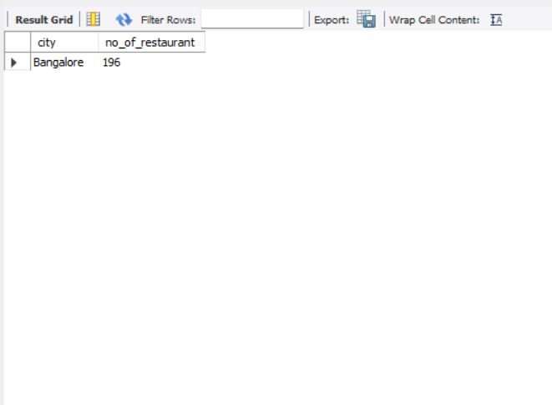
WHICH IS THE TOP ONE CITY WITH THE HIGHEST NO OF RESTAURANTS ?
SELECT
city, COUNT(DISTINCT restaurant_name) AS no_of_restaurant
FROM
swiggy
GROUP BY city
ORDER BY no_of_restaurant DESC
LIMIT 1;

Slide 5
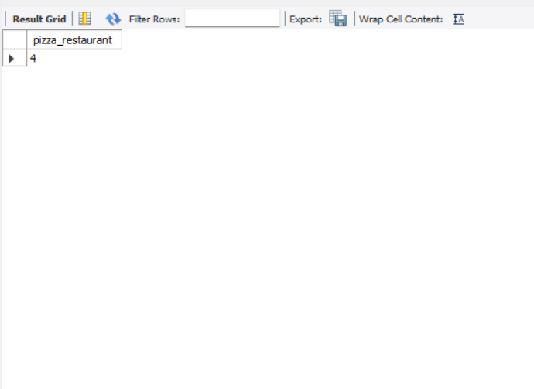
HOW MANY RESTAURANTS HAVE THE WORD "PIZZA" IN THEIR NAME?
SELECT
COUNT(DISTINCT restaurant_name) AS pizza_restaurant
FROM
swiggy
WHERE
restaurant_name LIKE '%pizza%';

Slide 6
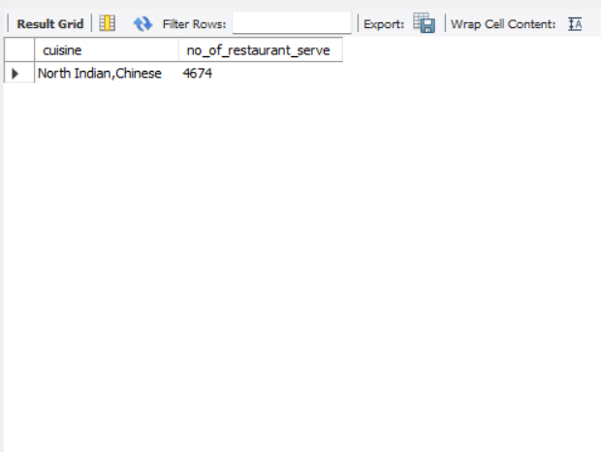
WHAT IS THE MOST COMMON CUISINE AMONG THE RESTAURANTS IN THE DATASET
SELECT
cuisine, COUNT(*) AS no_of_restaurant_serve
FROM
swiggy
GROUP BY cuisine
ORDER BY no_of_restaurant_serve DESC
LIMIT 1;

Slide 7
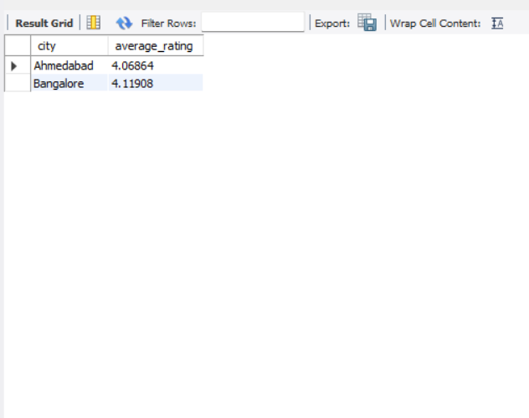
WHAT IS THE AVERAGE RATING OF RESTAURANTS IN EACH CITY?
SELECT
city, AVG(rating) AS average_rating
FROM
swiggy
GROUP BY city
ORDER BY average_rating ;

Slide 8
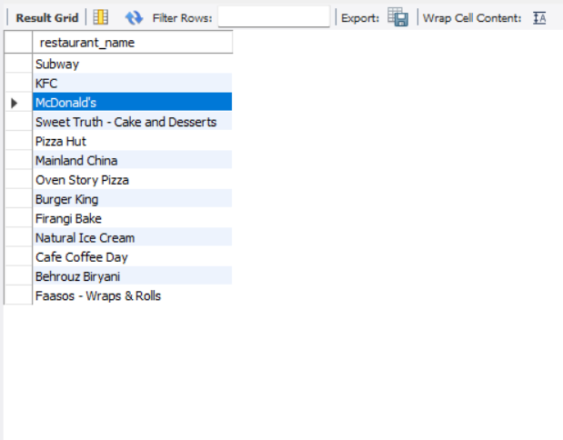
RETRIEVE THE DETAILS OF RESTAURANTS THAT HAVE THE SAME NAME BUT ARE LOCATED IN DIFFERENT CITIES?
SELECT DISTINCT
x.restaurant_name
FROM
swiggy x
JOIN
swiggy y ON x.restaurant_name = y.restaurant_name
AND x.city <> y.city ;

Slide 9
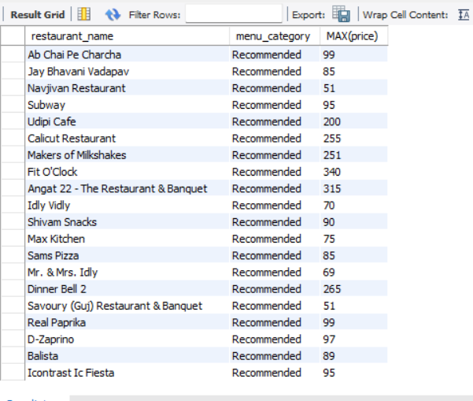
WHAT IS THE HIGHEST PRICE OF ITEM UNDER THE 'RECOMMENDED' MENU CATEGORY FOR EACH RESTAURANT?
SELECT DISTINCT
restaurant_name, menu_category, MAX(price)
FROM
swiggy
WHERE
menu_category = 'recommended'
GROUP BY restaurant_name;

Slide 10
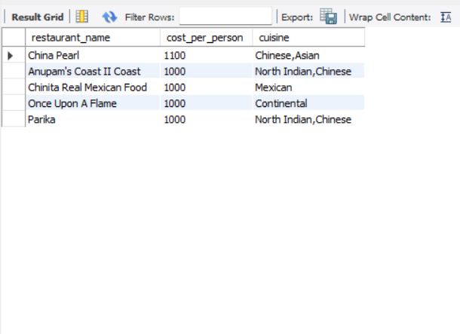
FIND THE TOP 5 MOST EXPENSIVE RESTAURANTS THAT OFFER CUISINE OTHER THAN INDIAN CUISINE?
SELECT distinct
restaurant_name, cost_per_person, cuisine
FROM
swiggy
WHERE
cuisine not like 'indian cuisine'
ORDER BY cost_per_person DESC
LIMIT 5;

Slide 11

WHICH RESTAURANT OFFERS THE MOST NUMBER OF ITEMS IN THE 'MAIN COURSE'CATEGORY?
SELECT
restaurant_name, COUNT(item) AS no_of_items
FROM
swiggy
WHERE
menu_category = 'main course'
GROUP BY restaurant_name
ORDER BY no_of_items DESC
LIMIT 1;

Slide 12
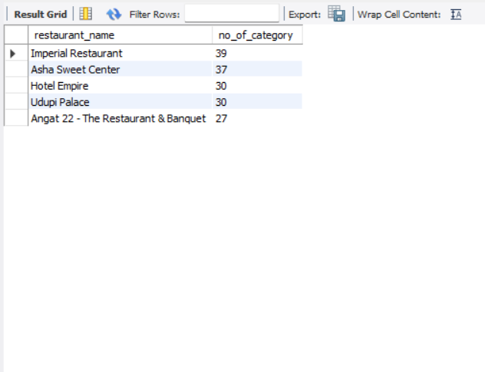
WHICH TOP 5 RESTAURANT OFFERS HIGHEST NUMBER OF CATEGORIES?
SELECT
restaurant_name,
COUNT(DISTINCT menu_category) AS no_of_category
FROM
swiggy
GROUP BY restaurant_name
ORDER BY no_of_category DESC
LIMIT 5;

