Slide 1
AEROFIND
The recovery layer
between a lost bag
and its owner.
Staff-first workflow for airports, airlines, and ground teams.
YC DEMO · SYNTHETIC DATA
One clear timeline. Fewer handoff questions. Better recovery evidence.
Demo: https://sachinpandey995633-pixel.github.io

Slide 2
PROBLEM
The bag may be found. The passenger still feels lost.
After a lost-bag report, the hardest part is often the invisible middle: updates, handoffs, verification, and pickup coordination.
THE GAP
01
No shared status
Passengers wait without knowing whether a report was matched or verified.
Report
→ ? →
Pickup
02
Manual handoffs
Ground teams coordinate across desks and tools that were not built for recovery.
03
No feedback loop
Operators cannot easily see where time and uncertainty accumulate.
AeroFind makes the middle visible.
02

Slide 3
SOLUTION
One recovery timeline for everyone involved.
AeroFind gives staff one lightweight workflow and passengers one clear source of truth—without waiting for a full airline integration.
REPORT
MATCH
VERIFY
RECOVER
Capture the case
Link the passenger
Confirm the handoff
Make pickup clear
Reference, location, description, optional photo.
A controlled reference opens the recovery record.
Staff validates the bag and collection point.
Passenger sees what to bring and where to go.
Designed for the operational reality between “found” and “collected.”
03

Slide 4
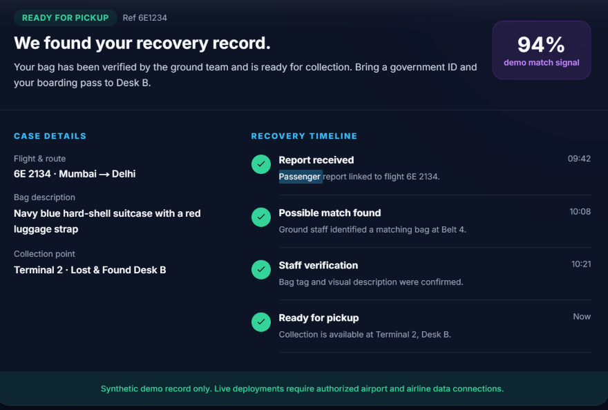
PRODUCT
A passenger sees progress—not another dead end.
LIVE DEMO FLOW
6E1234
Enter one synthetic reference to see:
verified case status
94% demo match signal
bag + route details
collection desk + timeline
Synthetic demo only—no invented production traction.
04

Slide 5
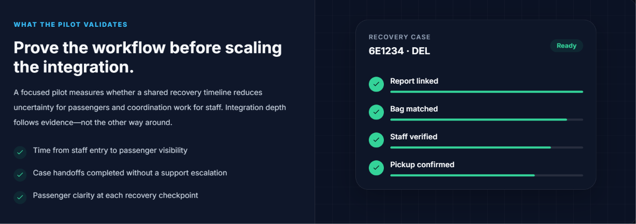
PILOT THESIS
Prove the workflow before scaling the integration.
A focused pilot should answer four questions:
01
Visibility
How quickly does a passenger see a staff-entered case?
02
Handoffs
Where does coordination still require escalation?
03
Clarity
Does each checkpoint reduce passenger uncertainty?
04
Integration
Which authorized systems are worth connecting next?
05

Slide 6
BUSINESS
A focused wedge into airport recovery operations.
Start with the lost-and-found / ground-handling workflow. Expand only after the pilot proves where software creates measurable value.
01
02
03
Pilot
Expand
Platform
One team, one workflow, real operational feedback.
More terminals, handlers, and partner stations.
Recurring software plus authorized integrations.
Initial buyer hypothesis: airport lost-and-found, airline station operations, and ground-handling leaders.
06

Slide 7
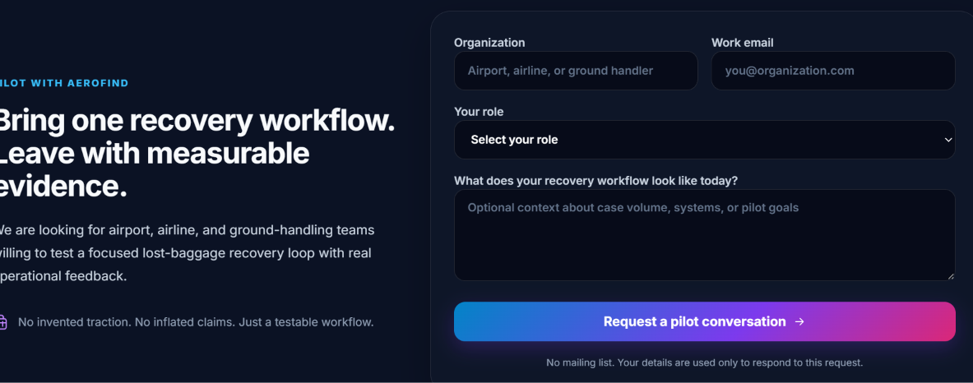
ASK
We are looking for the first operational pilot.
What we need
Access
A small airport, airline, or ground-handling team.
Feedback
Structured input on handoffs, clarity, and integration needs.
Evidence
A measurable 30-day pilot to decide what to build next.
No invented traction. Just a testable workflow and a clear next experiment.
07

Slide 8
AEROFIND
Make recovery
visible.
Questions?
A staff-first recovery layer for the moments after a bag is reported.
Pilot with us.
LIVE DEMO · 6E1234
https://sachinpandey995633-pixel.github.io

