Slide 1
Student Companion
A Complete Solution for Daily Needs of Students

Slide 2
Contents
Abstract
Problem definition
Introduction to Solution
Project Objectives
Survey Reports
Survey Analysis
Solution Proposal
Project Description
Diagrams
Expected Outcome
Technical Details
Conclusion
Limitations

Slide 3
Team Members
Rishabh Maratha (0827IT151087)
Sachin Parmar (0827IT151091)
Shahjahan Khan (0827IT151100)
Shirin Shah (0827IT151103)
Shreyansh Jain (0827IT151107)
Vaidik Khandelwal (0827IT151118)

Slide 4
Abstract
A student has to face long lines, manage his schedules, catch deadlines and the list goes on and on. There is a need of a system that can notify, remind and help one to manage all of this. Enter the concept of a companion app, an app that can solve these issues or manage them for the least.

Slide 5
Problem Definition
No application for the student to keep check on his attendance.
No current application allows real-time attendance analysis.
Task and lecture scheduling is a big mess for students.
College notifications management is a big mess again.
And to address these problems they have to install individual applications.

Slide 6
Introduction to Solution
An android application to address attendance management for the student.
An application for schedule and time table management.
Notification center for both these problems
All three functionalities in one application.
Real time sync with remote databases.

Slide 7
Project Objectives
To assist and simplify Students’ user experience and life.
Elimination of every app which works on singular problems.
Remote databases with services to sync.
Easy UX and UI.

Slide 8
Solution Proposal
An android app that can:
Assist and simplify a student’s college life.
Attendance record.
Broadcast news regarding upcoming events
Lecture Scheduling
Universal Sync with Remote databases

Slide 9
Project Description
Login / Signup / Logout for Student.
Home Screen: News Feed (Recycler View)
Slide Menu for Scheduler and Attendance Record
Maintenance of personal and academic schedule.
Real time sync and notifications.

Slide 10
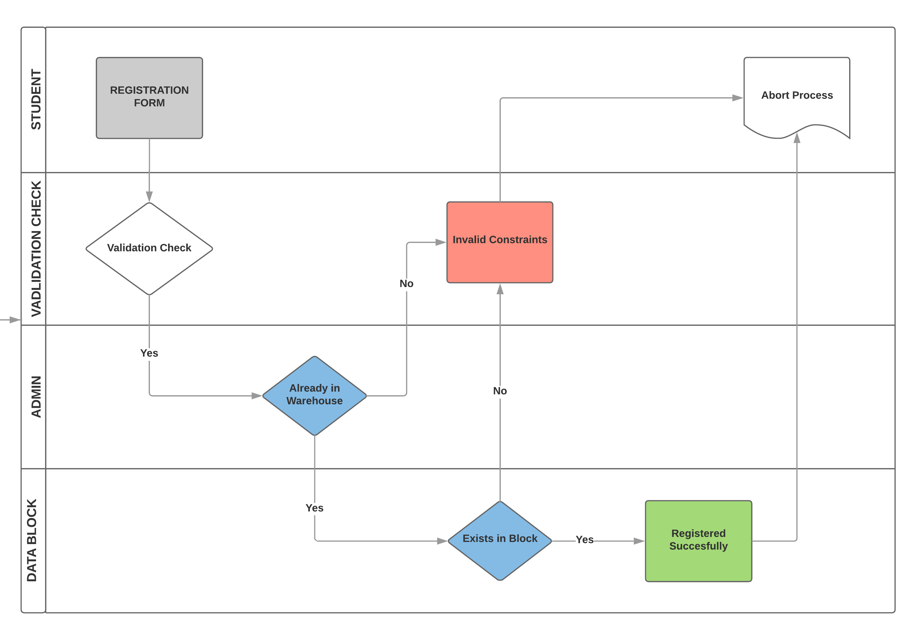
Diagrams
Registration

Slide 11
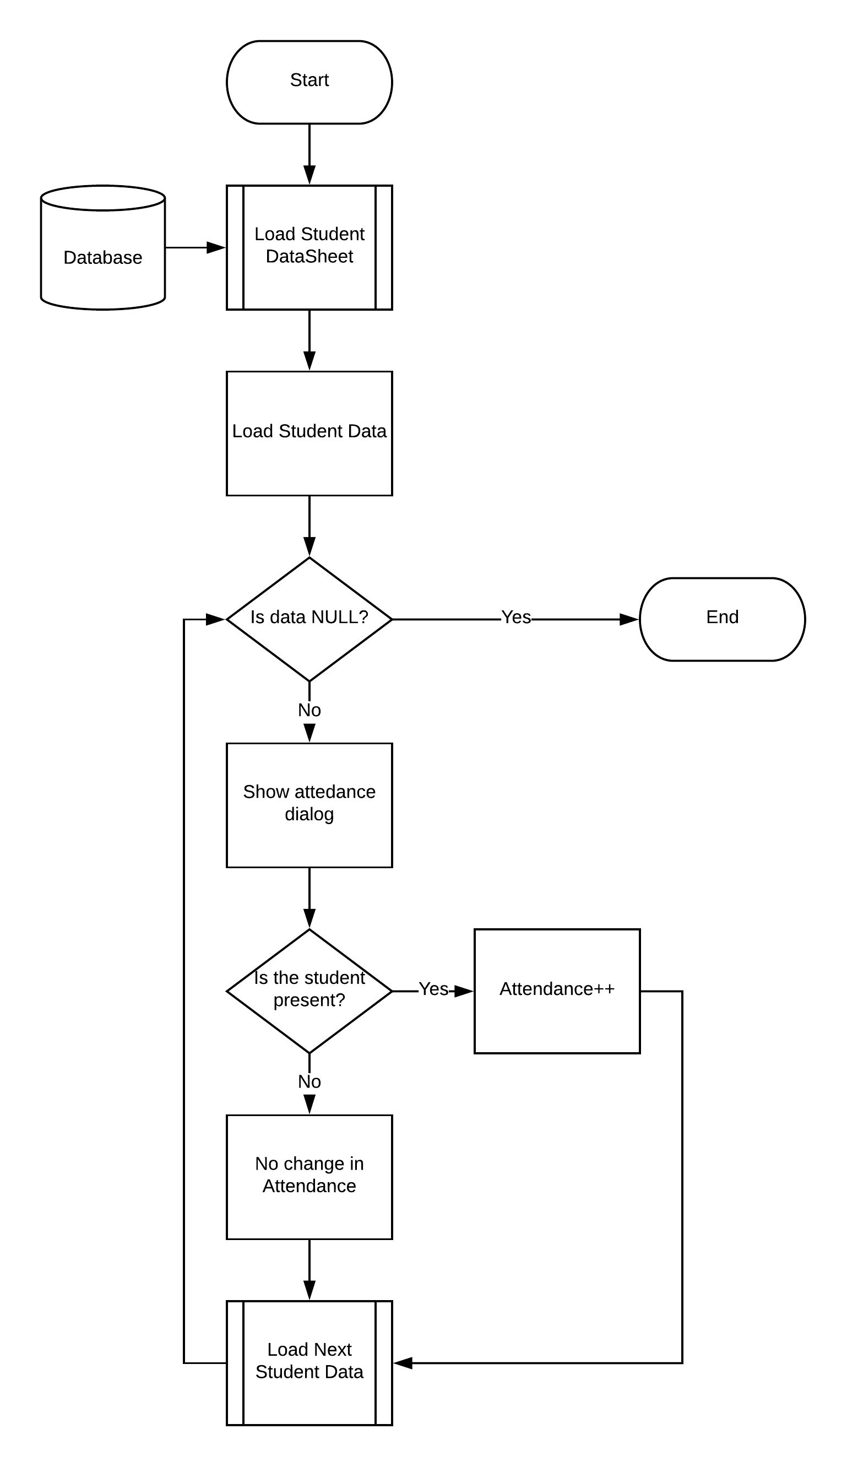
Atten4dance Flow Chart

Slide 12
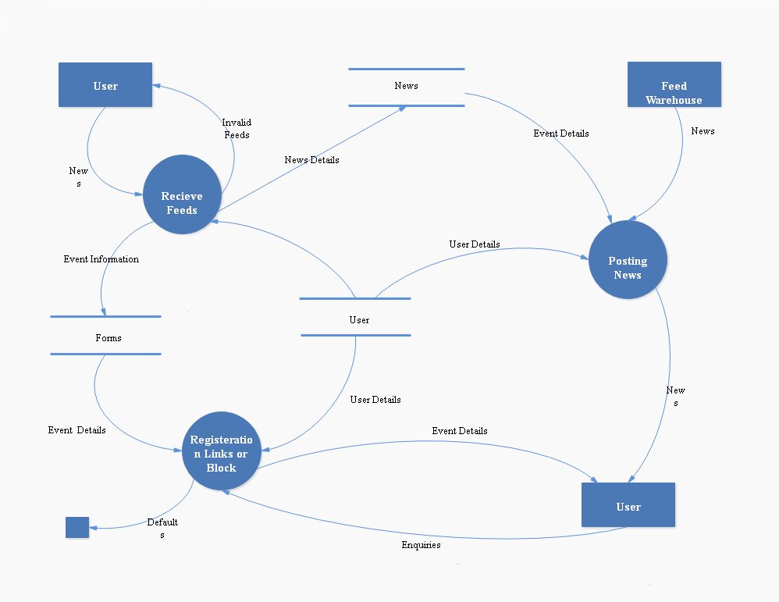
Feed Data Flow Diagram

Slide 13
Outcome
The clear target users for our app are college students who desires to stay updated with all the schedules and events. Additionally, a student will also be keep record of his/her attendance and the app will also show the student his current attendance percentage, thus preventing the last minute hassle to fix attendance shortages.

Slide 14
Technical Details
Hardware Requirements
Android Smartphone
Technologies Used
Front End
HTML
JAVA
Back End
Android Framework
JAVA
PHP Server
PHP Database
Prebuilt APIs
Software Requirements
Android 5.0 or above

Slide 15
Limitations
No progress tracking for food
Limited to android users
Lack of payment gateway

Slide 16
Conclusion
This app will make a student’s life easier. With plans of additional features in possible incremental updates.
The functions will make our solution better and modern to stage maximum problems/limitations in existing software or a lack there of.

Slide 17
Thank You!

