Slide 1






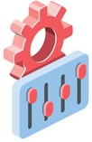

Parexel Users
Creates a New Project
Project is top most component which will have all the filters and analyses
Search is performed and Multiple Filters are applied
One or more filter combinations constitutes a Analysis

