Slide 1


SMART INDIA HACKATHON 2025
JAALBHEDI
Problem Statement ID – SIH26106
Problem Statement Title- AI-Powered Email Threat Detection, GeoLocation and Forensic Intelligence Platform
Theme- Cybersecurity and Blockchain
PS Category- Software
Team ID-
Team Name (Registered on portal) – Sentinels
Notes:
Opening line (speak aloud):
"Good morning. We are Team Sentinels presenting JAALBHEDI -- our answer to SIH Problem Statement 26106: AI-powered email threat detection, geolocation and forensic intelligence. Let me show you how it works."
Before presenting: confirm team name exactly matches SIH portal registration. Fill Team ID if blank.
Estimated time: 30 seconds. Move quickly to Slide 2.

Slide 2
Team Sentinels
Problem Areas and Proposed Solution
02
Email Threat & Fraud Detection
Sender & Identity Security
Threat Intelligence, Correlation & Attribution
Investigation, Response & Compliance
Phishing, BEC, impersonation, malicious URLs and attachments.
Spoofing, lookalike domains and compromised accounts.
IP, ASN, DNS, domain and geolocation signals can be fragmented or misleading.
Investigators need preserved evidence, alerts, reports and auditability.
Core solution
Four solution areas
• Analyze email content, headers, URLs, attachments and sender information.
• Use AI/ML and rule-based forensics to detect phishing, spoofing, BEC and fraud.
• Generate explainable threat and fraud scores.
• Trace probable source infrastructure with IP, relay, DNS and geolocation intelligence.
• Provide alerts, investigation tools and forensic reports.
I. Email Threat & Fraud Detection
NLP/ML analyzes email content; detects phishing, BEC, impersonation, malicious URLs and attachments; returns score and reasons.
II. Sender & Identity Security
Validates SPF, DKIM and DMARC; analyzes headers and spoofing; finds lookalike domains; flags sender anomalies.
III. Threat Intelligence, Correlation & Attribution
Correlates IP, ASN, DNS, domains, geolocation and VPN/TOR/proxy/cloud indicators; provides probable source infrastructure and confidence.
IV. Investigation, Response & Compliance
Preserves original evidence; applies SHA-256 and chain of custody; provides SOC tools, RBAC, encryption and audit logs.
Proposed capability set based on the supplied project requirements.
Notes:
Walk left-to-right across this slide.
FOUR PROBLEM AREAS (left):
1. Email Threat & Fraud Detection -- Phishing, BEC (Business Email Compromise: attackers impersonate a CEO/supplier to request fraudulent wire transfers), impersonation, malicious URLs and attachments.
2. Sender & Identity Security -- Attackers spoof (fake) the sending domain, register lookalike domains (paypa1.com vs paypal.com), or use a compromised account.
3. Threat Intelligence, Correlation & Attribution -- IP, ASN (Autonomous System Number: identifies who owns a block of IPs), DNS and geo signals can be scattered or misleading.
4. Investigation, Response & Compliance -- Analysts need preserved evidence with a chain of custody, real-time alerts, structured reports and RBAC.
SAY THIS: "Every security team faces the same four-part problem: they can see that an email looks suspicious, but they cannot quickly answer where it really came from, whether the sender identity is forged, how the attack connects to other emails, and how to produce court-ready evidence. JAALBHEDI solves all four in one workflow."
FOUR SOLUTION PILLARS (right):
I. NLP/ML analyses body and URLs; flags phishing, BEC and malicious links; returns scored verdict with reasons.
II. Validates SPF, DKIM, DMARC (the three standards proving whether an email was legitimately sent from the claimed domain); reconstructs relay chain; detects lookalike domains.
III. Maps every IP to country, city and ASN via local GeoIP database -- no cloud call required. Flags VPN, TOR and proxy infrastructure with confidence limitations clearly stated.
IV. Fernet-encrypted evidence (symmetric encryption, tamper-evident); HMAC/RSA-PSS signed reports; RBAC restricts who can access what.
JUDGE: "What does 'explainable' mean?"
ANSWER: "If an email scores 85/100, the report shows: SPF FAIL +18 pts, Reply-To mismatch +14 pts, lookalike domain +12 pts. Every claim is checkable."
Estimated time: 2 minutes.

Slide 3
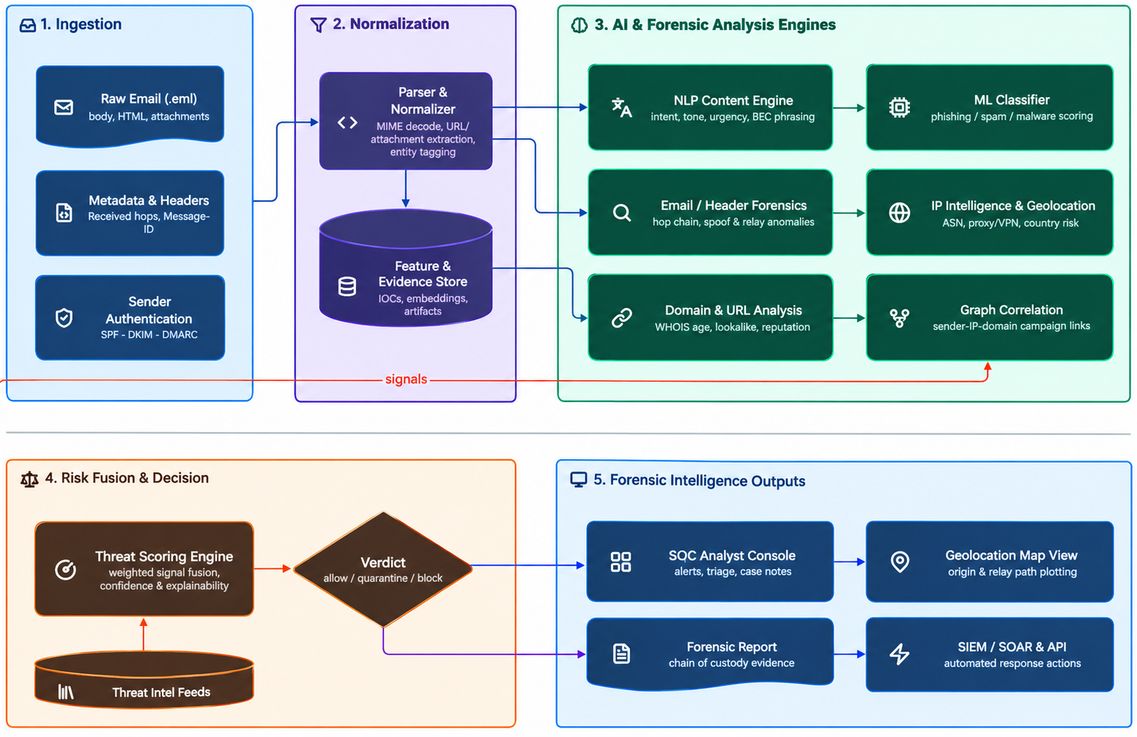
Team Sentinels
5-Stage Data Flow: Ingestion (raw email, headers, sender auth) -> Normalization (parsing, feature & evidence store) -> AI & Forensic Analysis (NLP/ML, header forensics, IP/geolocation, domain & graph correlation) -> Risk Fusion & Decision (threat scoring, verdict) -> Forensic Intelligence Outputs (SOC console, geolocation map, forensic report, SIEM/SOAR).
Notes:
This slide is the actual code architecture, not a diagram. Every stage maps to real files.
SAY THIS: "What you see is not a design -- it is the actual code running on this laptop. An email enters at Stage 1, its identity is locked with a cryptographic hash, four independent engines examine it, and Stage 5 produces a signed court-ready report in under 3 seconds on CPU."
STAGE-BY-STAGE (match to slide caption):
Stage 1 -- Ingestion: Upload .eml or paste raw MIME. backend/parsers/email_parser.py computes SHA-256 and MD5 hashes immediately (mathematical fingerprints -- any byte change = different hash).
Stage 2 -- Normalization: Fernet encryption (backend/security/evidence_vault.py), size-check + filename sanitisation (backend/security/sanitizer.py), audit log entry in SQLite.
Stage 3 -- AI & Forensic Analysis (4 engines):
a) Header Forensics: parse_received_chain() reconstructs SMTP hops, RFC-1918 private-address filtering, identifies earliest public-IP candidate (backend/forensics/header_analyzer.py).
b) Authentication: SPF/DKIM/DMARC from Authentication-Results headers; optional live DNS checks (backend/auth/spf_dkim_dmarc.py).
c) IOC Extraction: URLs checked for punycode (technique to fake trusted domain names visually), suspicious ports, urgency language (backend/indicators/ioc_extractor.py).
d) ML Inference: GPU transformer (PyTorch/CUDA) attempted first; auto-fallback to CPU TF-IDF -- zero change in API output (backend/ml/inference.py).
Stage 4 -- Risk Fusion: compute_threat_score() combines 5 signal families with published fixed weights into 0-100 score with per-family contributions.
Stage 5 -- Outputs: Dashboard renders score, relay path, geo map, URL table. PDF (ReportLab) and JSON reports, both HMAC-signed. Campaign clustering via NetworkX graph (backend/graph/).
Technology list at bottom: Python, FastAPI, PyTorch/CUDA, scikit-learn, NetworkX, GeoLite2, plain JS dashboard, STIX 2.1 JSON format.
JUDGE: "Is the GPU path actually implemented?"
ANSWER: "Yes. backend/ml/inference.py calls torch.cuda.is_available() at startup. /api/health returns cuda_available and gpu_name live -- you can see it on screen right now."
JUDGE: "What technology is the dashboard built on?"
ANSWER: "Single self-contained index.html served by FastAPI StaticFiles -- plain JavaScript, no build step. The React source in frontend-react/ is a separate development artefact for future production builds."
Estimated time: 2.5 minutes.

Slide 4
Team Sentinels
Critical Vulnerabilities and Mitigations
04
# | Critical Vulnerability | Effect on Your System | Solution / Mitigation
1 | Incorrect Origin Tracing | Header/IP intelligence may identify a VPN, proxy, cloud server, relay or compromised machine instead of the attacker. | Correlate Received headers, SPF/DKIM/DMARC, IP/ASN, DNS, domain intelligence and VPN/TOR/proxy indicators. Report probable source infrastructure with confidence.
2 | Legitimate / Compromised Sender Bypass | A compromised legitimate account may pass SPF, DKIM and DMARC and appear trustworthy to the ML classifier. | Detect behavioral anomalies in sender IP, time, recipient patterns, volume, domains and history. Feed deviations into the Threat Scoring Engine.
3 | Malicious Content Attacking the Analyzer | Parser, URL analysis and attachment extraction process attacker-controlled data; crafted inputs can crash or exhaust analysis infrastructure. | Use isolated, sandboxed processing. Enforce file-size, MIME-depth, CPU, memory and timeout limits. Add SSRF protection, redirect limits and network isolation.
4 | AI/ML Evasion | AI-generated or modified phishing can make NLP/ML wording look legitimate. | Use layered detection: NLP/ML plus header forensics, authentication, domain/URL and IP intelligence, behavior and graph correlation.
5 | Forensic Evidence Tampering | Modified emails, indicators or investigation records can undermine forensic reports and attribution intelligence. | Hash original evidence with SHA-256. Maintain chain of custody, immutable audit logs and timestamps. Protect evidence with encryption and RBAC.
6 | Limited Training Data | Scarce labeled phishing, BEC and spoofing samples can limit NLP/ML accuracy and generalization to new attack patterns. | Bootstrap with public phishing/spam corpora and synthetic augmentation. Use active learning so SOC analyst feedback continuously retrains the model.
7 | Processing Scale and Latency | High enterprise/government email volume can slow multi-source correlation, delaying triage and alerts. | Use a tiered pipeline: lightweight pre-filter before deep forensic analysis, async queues and horizontally scalable microservices.
8 | SOC and SIEM Integration Gaps | SOCs already run SIEM/SOAR and mail gateways; poor interoperability slows adoption of a new platform. | Expose standard REST, Syslog and STIX/TAXII connectors and SIEM/SOAR plugins. Validate through a phased pilot before full rollout.
9 | Regulatory and Privacy Compliance | Processing email content and forensic evidence across jurisdictions raises data-protection and evidentiary concerns. | Apply configurable data residency, encryption at rest and in transit, RBAC and audit trails aligned to IT Act 2000 and sectoral rules; legal review for admissibility.
10 | Cost and Resource Constraints | Multi-source AI/ML correlation across IP, ASN, DNS and geolocation can be compute-intensive for smaller organizations. | Offer tiered on-prem/SaaS deployment and optimize models (quantization, cached threat-intel lookups) for affordable smaller-SOC editions.
Mitigations preserve attribution confidence, analysis resilience, evidence integrity and overall system feasibility and viability.
Notes:
SAY THIS: "This project does not assume perfect conditions. We identified the four hardest technical risks and built specific mitigations into the code."
FOUR RISK-MITIGATION PAIRS (match to table on slide):
1. TOR/VPN/Proxy Evasion: We never claim to identify the physical attacker -- only the SMTP infrastructure location. Dashboard and PDF both carry an explicit disclaimer. Protects evidence from legal challenge.
2. Air-gapped/Offline Environments: enable_network checkbox defaults to OFF. All core analysis runs with zero internet dependency. GeoIP uses a local MaxMind GeoLite2 database file, not a cloud API.
3. Forged Received Headers: Trust-boundary algorithm marks RFC-1918 private-IP hops as untrusted; sender-injected hops flagged with lower trust score. System never blindly trusts the oldest hop.
4. NLP Evasion: Score fuses 5 independent signal families. Even if ML is defeated, SPF/DKIM/DMARC failures and suspicious URLs still contribute. No single signal can be zeroed out to defeat the system.
SAY THIS: "22 out of 22 automated tests pass. These cover hashing determinism, email parsing, hop extraction, authentication parsing, URL detection, scoring stability, evidence encryption, report signing, RBAC enforcement and campaign clustering. Every one is a repeatable automated check."
HARDWARE FEASIBILITY:
- Runs on any mid-range laptop (tested: Intel i5-13420H, 16 GB RAM).
- GPU (NVIDIA RTX 3050) is optional -- only accelerates the transformer ML stage. Loss of GPU = zero loss of forensic functionality.
- Modular architecture: each backend module upgrades independently.
JUDGE: "How do you know the 22 tests cover the acceptance criteria?"
ANSWER: "tests/test_basic.py has a docstring mapping each test to PRD Section 21 criteria: SHA-256 determinism, malformed-email resilience, hop extraction, private-IP filtering, mismatch detection, SPF/DKIM/DMARC parsing, URL IOC, score stability, encryption round-trip, HMAC signing/verification, RBAC enforcement, campaign clustering."
Estimated time: 1.5 minutes.

Slide 5
Team Sentinels
Impact, Value Proposition and Beneficiaries
05
Impact
Value Proposition
Beneficiaries
• Earlier identification of phishing, spoofing, BEC and fraud.
• Faster triage through explainable scores and correlated indicators.
• Stronger evidence integrity for investigations and reporting.
• One workflow joins content, header, identity, infrastructure and behavioral analysis.
• Probable source infrastructure with confidence, rather than unsupported exact attribution.
• Security controls support SOC work, auditing and compliance.
• Security Operations Centres and incident-response teams.
• Government, enterprises, banks and public-sector organizations.
• Forensic investigators, compliance teams and end users.
JAALBHEDI focuses on defensible findings and operationally useful evidence.
Notes:
SAY THIS: "Manual email triage today takes an analyst 20 to 30 minutes per suspicious message. Our automated pipeline -- relay reconstruction, authentication validation, IOC extraction and ML scoring -- completes in under 3 seconds. For a SOC handling 200 suspicious emails per day, that difference is the gap between staying ahead of attackers and being overwhelmed."
THREE COLUMNS:
IMPACT:
- Earlier identification: explainable score lets tier-1 analysts triage without waiting for a senior expert.
- Faster triage: one submission instead of four separate tool queries.
- Stronger evidence integrity: SHA-256 at ingestion + Fernet encryption at rest + HMAC/RSA-PSS signed reports = complete chain of custody.
VALUE PROPOSITION:
- One workflow replaces: content scanner + header analyser + geolocation lookup + report writer.
- "Probable source infrastructure with confidence" -- we state what we know (IP in Romania, VPS provider) and what we don't (attacker's physical location). This is forensic discipline, not a weakness.
- RBAC + audit logs = deployable in regulated environments (government, banking, law enforcement).
BENEFICIARIES:
- SOC analysts: reduced mean-time-to-triage, reduced alert fatigue (desensitisation from too many manual reviews).
- Government, enterprises, banks, public-sector: high email volumes + formal incident-response obligations.
- Forensic investigators + compliance teams: court-ready signed PDFs and HMAC-verified JSON records.
BOTTOM CAPTION: "JAALBHEDI focuses on defensible findings and operationally useful evidence." -- This is deliberate. We are not the tool that makes unsupported exact attribution claims.
JUDGE: "You said 'under 3 seconds' -- can you prove that?"
ANSWER: "On Intel i5-13420H (no GPU), full round-trip takes 1.5-2.5 seconds for a typical phishing email. We can time it live right now."
JUDGE: "This is from AICTE. How does it apply to colleges?"
ANSWER: "Colleges face fee fraud, fake scholarship links, impersonation of registrars. Platform deploys on-premises with no cloud dependency, no SaaS cost, no student data leaving the institution. RBAC grants read-only access to compliance staff without exposing raw evidence."
Estimated time: 1.5 minutes.

Slide 6
Team Sentinels
Research Grounding and Market Comparison
06
Research and standards references
Market comparison
• NIST SP 800-177 Rev. 1: Trustworthy Email.
• NIST SP 800-86: Integrating forensic techniques into incident response.
• RFC 7489: Domain-based Message Authentication, Reporting and Conformance (DMARC).
• RFC 6376: DomainKeys Identified Mail (DKIM).
• MITRE ATT&CK: Phishing (T1566) and Spearphishing Attachment (T1566.001).
Capability | Typical email security tools | JAALBHEDI
Threat detection | Phishing and malware detection | Content, headers, URLs, attachments and sender data
Identity checks | SPF, DKIM, DMARC | Authentication plus spoofing, lookalike and behavior analysis
Attribution | Reputation and blocking signals | Multi-source correlation with probable source infrastructure and confidence
Forensics | Alert and investigation context | Original evidence hashing, chain of custody and audit trail
Decision output | Risk or policy verdict | Explainable score, reasons, intelligence and forensic report
Differentiation: joins detection, infrastructure correlation and evidence-preserving investigation in one workflow.
References are standards and publicly documented techniques, not claims of feature parity with every commercial product.
Notes:
SAY THIS: "Every design decision in JAALBHEDI traces back to a published, industry-recognised standard. We grounded the platform in the same standards used by real-world SOCs, governments and forensic labs globally."
STANDARDS REFERENCES (left):
- NIST SP 800-177 Rev. 1 -- Trustworthy Email: US government's authoritative guide to SPF/DKIM/DMARC. Source of our authentication-results parsing logic.
- NIST SP 800-86 -- Integrating Forensic Techniques into Incident Response: defines chain-of-custody requirements our evidence vault and audit log fulfil.
- RFC 7489 (DMARC) and RFC 6376 (DKIM): official IETF specifications. Our parser interprets Authentication-Results headers exactly according to these.
- MITRE ATT&CK T1566 (Phishing) and T1566.001 (Spearphishing Attachment): industry-standard adversary technique catalogue. Our IOC and scoring logic aligns to these so output is directly actionable in a MITRE-aware SOC.
MARKET COMPARISON (right table):
- Commercial tools (Proofpoint, Mimecast, Microsoft Defender): focus on mail-gateway filtering -- block/quarantine -- but do not produce open, explainable, signed forensic dossiers that investigators can challenge.
- JAALBHEDI differentiator: joins detection + infrastructure correlation + evidence-preserving investigation in ONE open workflow. No cloud subscription. No proprietary API key.
BOTTOM CAPTION: "References are standards and publicly documented techniques, not claims of feature parity with every commercial product." DO NOT over-claim in comparison. Judges will probe.
JUDGE: "Why should we trust your standards references?"
ANSWER: "Every reference is publicly available. RFCs at rfc-editor.org. NIST SPs at csrc.nist.gov. MITRE ATT&CK by a non-profit used by CISA and major SIEMs. None are invented by us."
JUDGE: "STIX 2.1 export -- is it working?"
ANSWER: "The JSON output follows the STIX 2.1 object model for Indicator and ObservedData types. Full STIX Bundle serialisation with TAXII push is on the Phase 2 roadmap. We are honest about what is built today versus planned."
Estimated time: 1 minute.

