Slide 1

Parallel Programming Architecture
Notes:
Parallel programming is a method of creating programs using languages (say c or Fortran) that can leverage the parallel execution capability supported in the CPU. Such programs can deliver a very high level of performance required by highly complex scientific applications in weather forecasting, bioinformatics, molecular dynamics, and business applications in fraud detection, business analytics etc. Parallel programming is a part of an overarching technology called High Performance Computing (HPC).
In the next 30 minutes we will introduce the key concepts in Parallel programming architecture.

Slide 2
Parallel Programming – A real World Analogy
Sequential
Avg. Time/n P = 100 min
Parallel
Avg. Time/n P = 50 min
Parallel
Avg. Time/n P = 33 min
Parallel Resources
Check-in Counter 1
Check-in Counter - 2
Check-in Counter - 3
Parallel Tasks
P1
P1
P1
P2
P3
P2
P4
P2
P3
P5
P6
P4
P7
P3
P5
P8
P9
P6
Pi
Pn
Pk
Pi
Pi
Pk

Slide 3
Parallel Programming in a Computer
In real world or in a computer, higher performance and efficiency can be achieved executing tasks in parallel.
It requires parallel set of resources for parallel execution of tasks
Parallel Programming is all about concepts, methodologies, tools and techniques to design and execute parallel programs that leverage parallel resources in a computer to achieve higher performance gains
Sequential
Avg. Exec Time = 100 min
Parallel
Avg. Exec Time = 50 min
Parallel
Avg. Exec Time= 33 min
Parallel Resources
CPU 1
CPU - 2
CPU- 3
Parallel Tasks
P1
P1
P3
P1
P2
P2
P4
P3
P6
P2
P5
P4
P7
P5
P9
P3
P8
P6
Pi
Pk
Pi
Pn
Pi
Pk

Slide 4
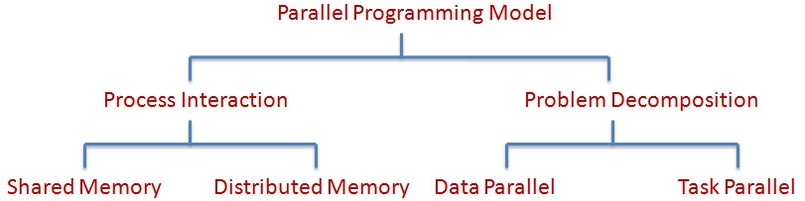
Parallel Programming Models
Parallel Programming model refers to model for writing parallel computer applications which can be compiled and run, in consideration of the underlying hardware system and inherent sequential nature of the programming language
Its focus is on achieving increased performance and productivity
They can be classified depending on the nature of process interaction or based on problem decomposition
Notes:
We are familiar with the techniques of writing sequential programs where the program statements are executed one after the other. A parallel programming model ….
The underlying hardware system here refers to the design of the CPUs in the system in a manner that support parallel applications.
Parallel programming can be classified in two ways

Slide 5


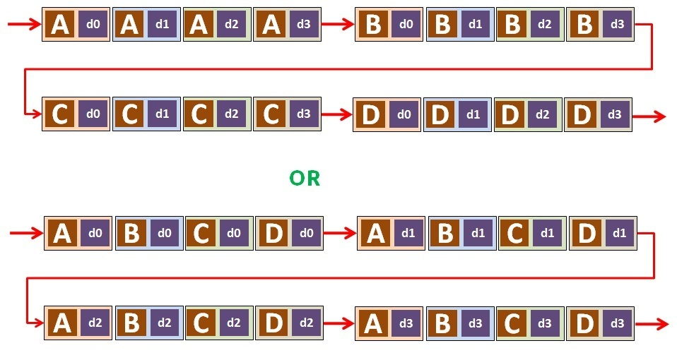
Tasks/Data Sequential Program
Tasks
Data

Slide 6
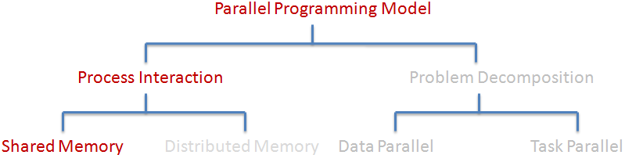
Shared Memory

Slide 7
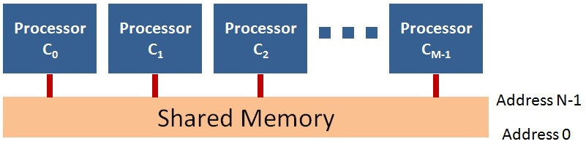
Shared Memory Model
Processors share a single memory ( Single Memory Address Space )
Also referred to as Multi-Processor system
A single copy of operating system controls all the processors
All processors have access to all parts of memory, may or may-not in parallel
2 Parallel Programming Approaches OpenMP and MPI

Slide 8
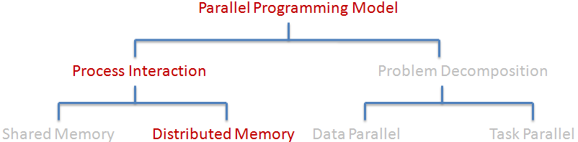
Distributed Memory

Slide 9
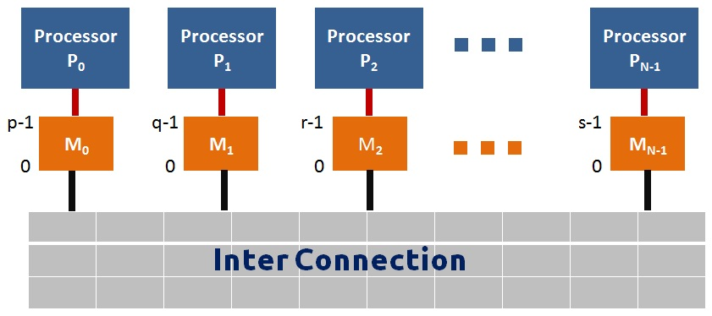
Distributed Memory Model
Processors have exclusive individual memory
Also referred to as Many-Processor system
Each processor system is controlled by its own copy of operating system
Processors with their own memory are connected together with an interconnect fabric (Ethernet, Infiniband, etc. )
1 Parallel Programming approach MPI

Slide 10
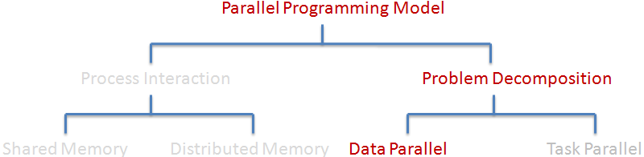
Data Parallel

Slide 11
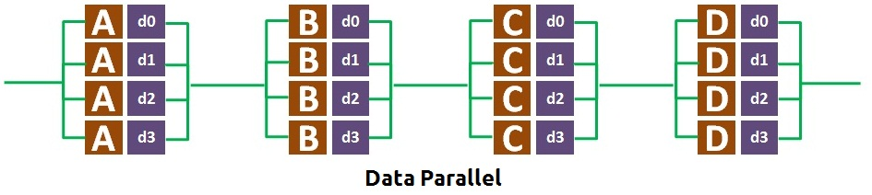
Data parallel Model
An operation or set of operations performed independently on a data-set
In Shared Memory Systems, the data-set may be accessible to all operating processors, but restricted to separate portions ( Mostly structured array )
In Distributed Memory Systems, the data-set is divided among memories and operated on locally

Slide 12
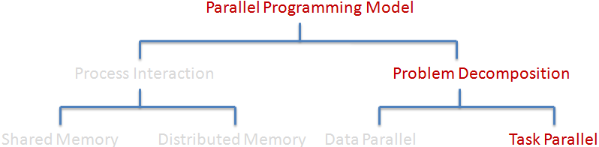
Task Parallel

Slide 13
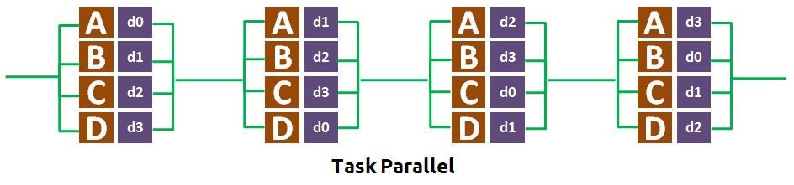
Task Parallel Model
Multiple distinct operation performed independently on data-set
Need arises to be able to communicate between different operating processes

Slide 14
Multiprocessing Context
Known as Flynn’s taxonomy
Based on Classification of Computer Architecture by Michael J Flynn in 1966
 | Single Instruction | Multiple Instruction | Single Program | Multiple Program
Single Data | SISD | MISD
Multiple Data | SIMD | MIMD | SPMD | MPMD
SPMD – Multiple autonomous processors executing same program on different data-set
MPMD – Multiple autonomous processors executing at-least 2 different sets of program on different data-set. Typical systems at-least have a master/host and worker/slave programs.
Notes:
Flynn's taxonomy is a classification of computer architectures, proposed by Michael Flynn in 1966. The four classifications defined by Flynn are based upon the number of concurrent instruction (or control) streams and data streams available in the architecture.
SISD
A sequential computer with a single instruction stream and single data stream. It exploits no parallelism in either the instruction or data streams.
Examples of SISD architecture are the traditional uniprocessor machines like a PC
SIMD
A computer that has single instruction stream and multiple data streams. It exploits multiple data streams against a single instruction stream to perform operations which may be naturally parallelized. For example, an array processor or graphics processing unit (GPU)
MISD
Multiple instructions operate on a single data stream. Uncommon architecture which is generally used for fault tolerance.
MIMD
Multiple autonomous processors simultaneously executing different instructions on different data. Distributed systems are generally recognized to be MIMD architectures
Further classification is based on program (instead of instructions)
SPMD
Multiple autonomous processors executing same program on different data-set
MPMD
Multiple autonomous processors executing at-least 2 different sets of program on different data-set. Typical systems at-least have a master/host and worker/slave programs.

Slide 15






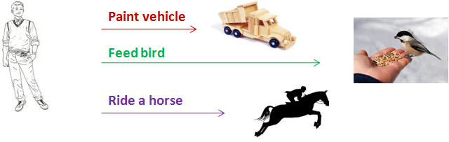
SIMD,MISD,MIMD
Single Instruction Single Data
Fill the bottle with water
Single Instruction
Multiple Data(SIMD)
Paint each ball with
Black color
Clean him
Multiple Instruction
Single Data(MISD)
Feed him
Take a ride on him
Multiple Instruction
Multiple Data(MIMD)

Slide 16
Multiprocessing Context(cont..)
Task Parallel programs are typically MIMD/MPMD or MISD
Data parallel programs are typically SIMD/SPMD
Task Parallel programs can be expressed using message passing communication
Data Parallel programs can be expressed using either message passing or multi-threading
Both Task and Data parallel models can be expressed on Shared and Distributed systems.

Slide 17
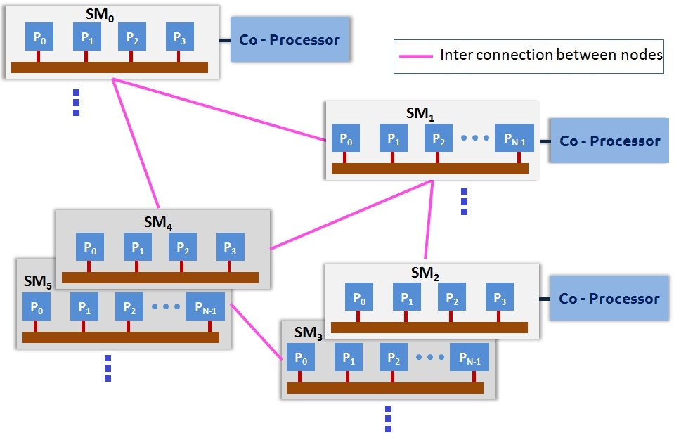
Schematic diagram of a Cluster

Slide 18
<Blank>

Slide 19
<Blank>

Slide 20
<Blank>

Slide 21
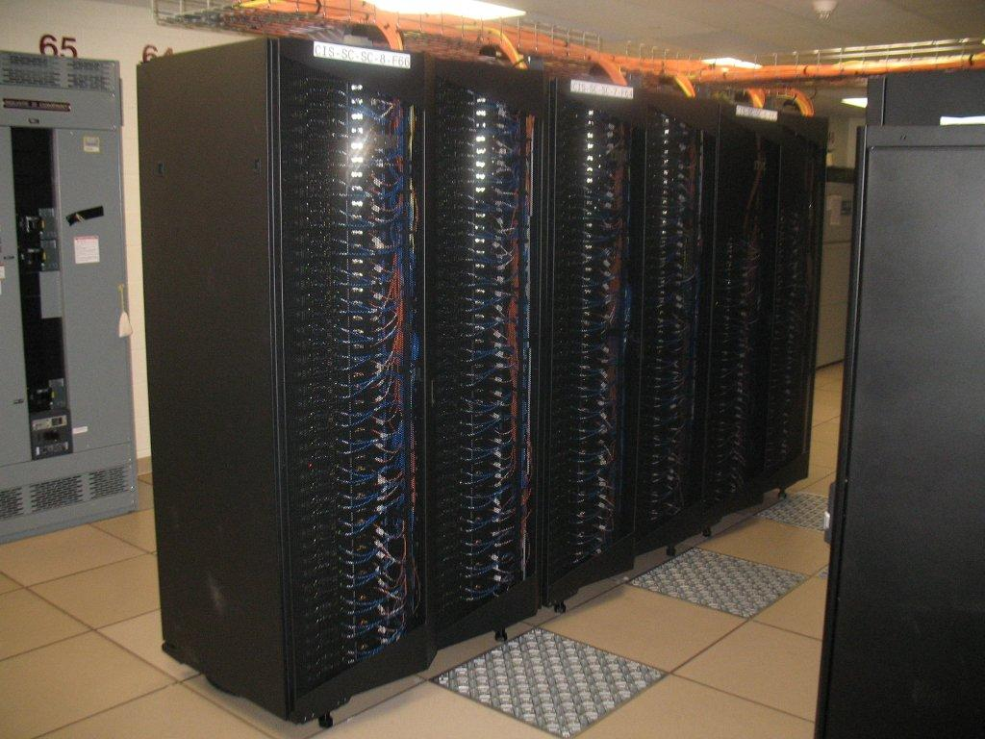
Typical HPC Cluster
Eos – an IBM iDataplex Cluster (http://sc.tamu.edu/systems/#eos)
OS: Linux (RedHat Enterprise Linux and CentOS)
No. of Nodes:372(324 8-way Nehalem- and 48 12-way Westmere-based)
Number of Processing Cores: 3168(all@2.8GHz)
Interconnect Type: 4x QDR Infiniband (Voltaire Grid Director GD4700 switch)
Peak Performance: 35.5 Tflops
Total Disk: 500 TB by a DDN S2A9900 RAID Array

Slide 22
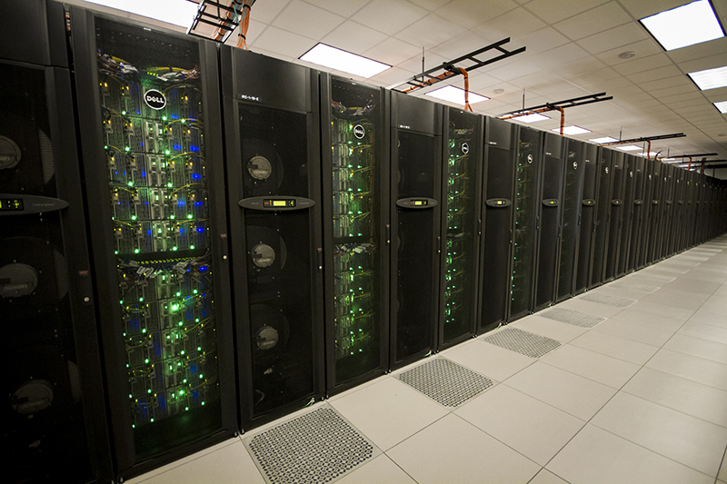
Typical HPC Cluster
STAMPEDE (Source: https://portal.tacc.utexas.edu/user-guides/stampede#overview)
Component | Technology | Performance/Size
Nodes | 2 8-core Xeon E5 processors, 1 61-core Xeon Phi coprocessor | 6400 Nodes
Memory | Distributed, 32GB/node | 205TB(Aggregate)
Shared Disk | Lustre 2.1.3, parallel File System | 14 PB
Local Disk | SATA (250GB) | 1.6PB (Aggregate)
Interconnect | InfiniBand Mellanox Switches/HCAs | FDR 56 Gb/s

