Slide 1

Hybrid Programming

Slide 2
What is Hybridization?
Combining two inherent programming models to achieve some benefit.
Using different models of parallelization in a way that takes advantage of the good points of each.
©2015 Calligo Technologies Pvt. Ltd., All rights reserved. All other trademarks or registered trademarks are the property of their respective owners

Slide 3
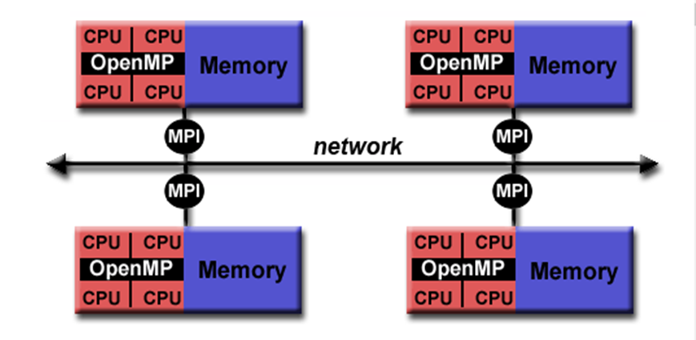
How to Approach
Use MPI to communicate (distribute work) with other nodes or processes (Outer loop).
Discover hot loops in each process and parallelize it using OpenMP(Inner loop).
©2015 Calligo Technologies Pvt. Ltd., All rights reserved. All other trademarks or registered trademarks are the property of their respective owners

Slide 4
Hybrid Programming Model
Parallel Programming models on Hybrid Platform
Pure MPI
One MPI process on each core
OpenMP only
Distributed virtual shared memory
Hybrid MPI + OpenMP MPI : inter-node communication
OMP: Inside each core
Hybrid MPI+MPI MPI for internode communication.MPI shared memory programming
Overlapping Communication
Few threads Communicate and others compute.
Non overlapping Communications
MPI parallel only outside computation
Within shared nodes:
Direct data copy
Within shared nodes: Access to neighbor data
©2015 Calligo Technologies Pvt. Ltd., All rights reserved. All other trademarks or registered trademarks are the property of their respective owners

Slide 5
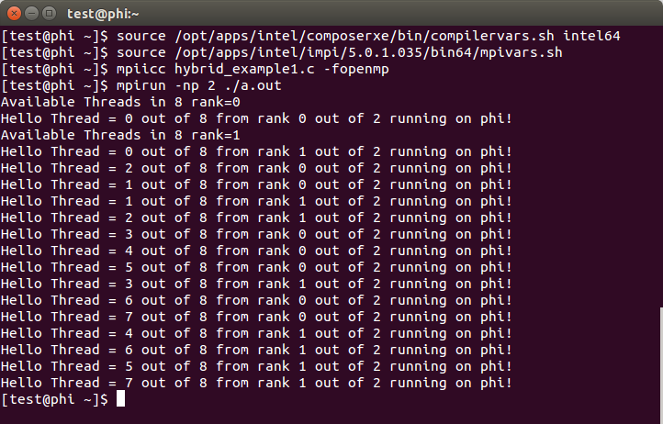
Hybrid: MPI+OpenMP Example
#include <stdio.h>
#include <mpi.h>
int main (int argc, char *argv[])
{
MPI_INT rank, size, namelen;
MPI_CHAR name[100];
MPI_Init (&argc, &argv);
MPI_Comm_size (MPI_COMM_WORLD, &size);
MPI_Comm_rank (MPI_COMM_WORLD, &rank);
MPI_Get_processor_name (name, &namelen);
int max_threads=omp_get_max_threads();
printf("Available Threads in %d rank=%d\n", max_threads, rank);
omp_set_num_threads(max_threads);
#pragma omp parallel
{
int id =omp_get_thread_num();
int tot = omp_get_num_threads();
printf("Hello Thread = %d out of %d from rank %d out of %d running on %s!\n“, id, tot, rank, size, name);
} //end of parallel region
MPI_Finalize ();
return 0;
}
©2015 Calligo Technologies Pvt. Ltd., All rights reserved. All other trademarks or registered trademarks are the property of their respective owners

Slide 6
<Blank>

Slide 7
<Blank>

Slide 8
<Blank>

