Slide 1
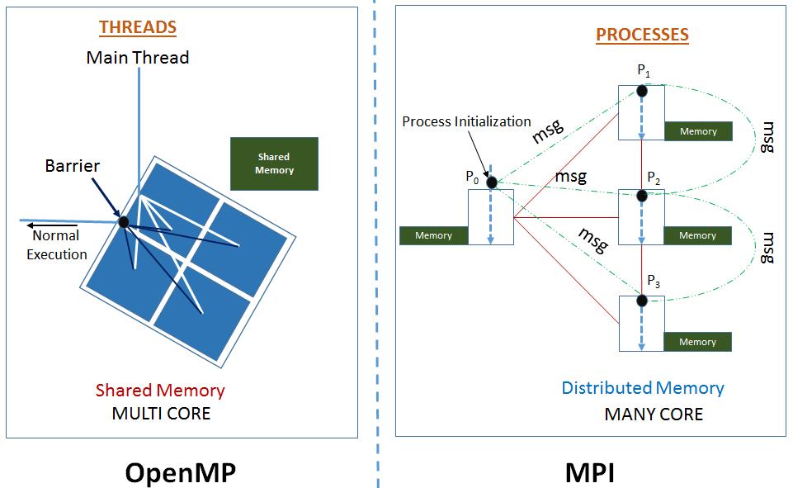
OpenMP & MPI

